Slide 1
Department of Environmental Quality
Division of Air Quality
October 31, 2019
Duplin County Air Monitoring Study (DCAMS) Overview

Slide 2
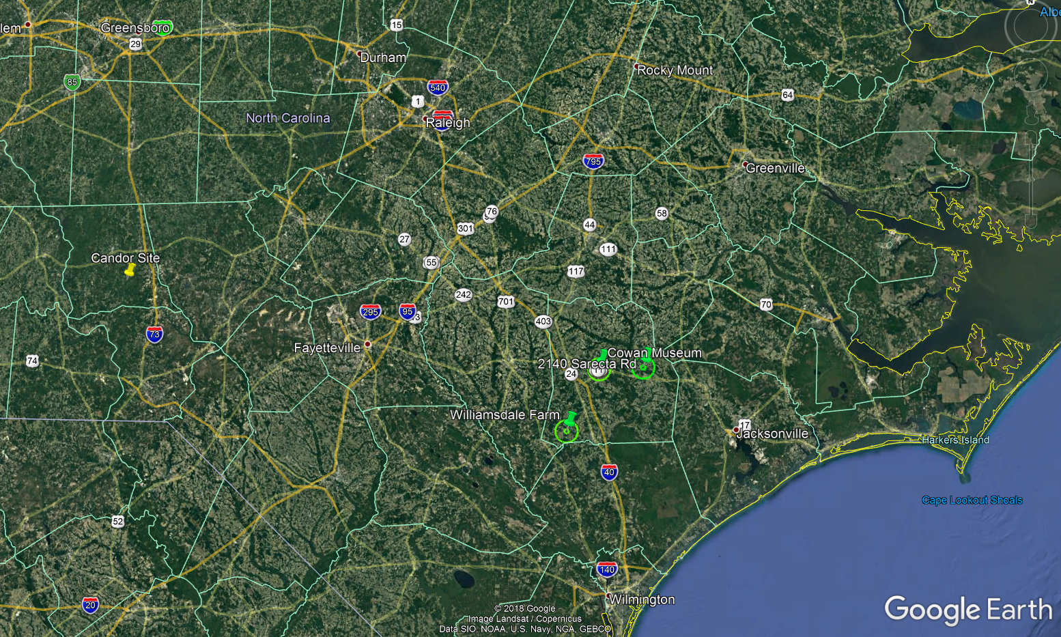
DCAMS Sites
Department of Environmental Quality

Slide 3
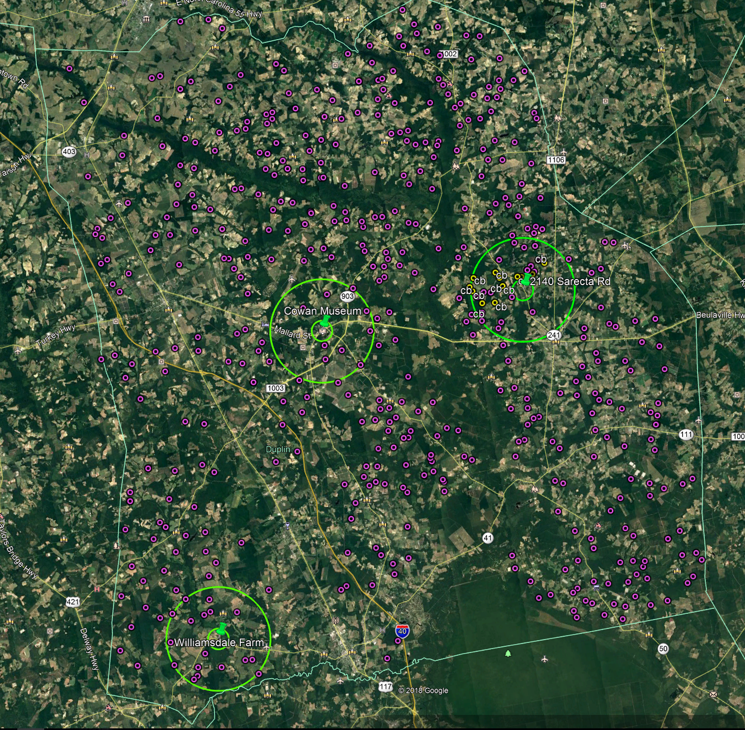
DCAMS Sites
Department of Environmental Quality

Slide 4
PM2.5 Results

Slide 5
PM2.5 Results

Slide 6
PM2.5 Results

Slide 7
PM2.5 Results Williamsdale PM, H2S, and NH3 comparison Aug 1-8, 2019

Slide 8
Hydrogen Sulfide Results

Slide 9
Hydrogen Sulfide Results
* AAL is a modeling increment and IS NOT directly comparable to the monitored concentrations but is being used as a reference point.

Slide 10
Ammonia Results

Slide 11
Ammonia Results
* AAL is a modeling increment and IS NOT directly comparable to the monitored concentrations but is being used as a reference point.

Slide 12
Timeline
October 31, 2019 End of Study
November 1, 2019 Collection of last set of data at sites
By November 15, 2019 DAQ will determine if the data warrants extension of the study
By December 1, 2019 Draft Report released on DAQ website for public comment
By March 1, 2019 Final Report posted to DAQ website

