Slide 1
NC Division of Coastal Management
NC Dept. of Environmental Quality
Division of Coastal Management
Jockey’s Ridge Area of Environmental Concern
Designation
Daniel Govoni
February 27, 2025

Slide 2
Background
During the Periodic Review Process, Jockey’s Ridge AEC was removed from the Code
Fiscal Analysis and Permanent rules were adopted on November 14, 2024, to reinstate Jockey’s Ridge as an AEC; however, on December 19, 2024, the Rules Review Commission (RRC) objected to the rule on the basis of failure to comply with the public noticing provisions of the Administrative Procedure Act and staff have taken the necessary steps to be in compliance and satisfy this objection
Staff are recommending beginning permanent rulemaking again to reinstate Jockey’s Ridge as an AEC
The Proposed Permanent Rule and Fiscal Analysis are identical to November 14, 2024, adoption
Notes:
As a reminder during the periodic review process Jockey’s Ridge designated as an AEC was removed from the code and the proposed rule redesignates Jockey’s Ridge as an AEC. You approved this permanent rule and fiscal analysis but it was object to again by the RRC……
The proposed permanent rule is identical to previously adopted

Slide 3
Summary of Proposed Permanent Rules
Permanent rules include to:
Designate Jockey’s Ridge as an Area of Environmental Concern
New Boundary map
Use Standards
Notes:
So the proposed permanent rule redesignates Jockey’s Ridge as an AEC as adopted last year
Again, During this process the State Geologist on April 24, 2024, identified Jockey's Ridge as an a unique geologic feature

Slide 4
Proposed Permanent Rule (a) Description
15A NCAC 07H .0508 Jockey’s Ridge AEC
(a) Description. Jockey's Ridge is the tallest active sand dune (medano) along the Atlantic Coast of the United States. Located within the Town of Nags Head in Dare County, between US 158 and Roanoke Sound, Jockey’s Ridge represents the southern extremity of a back barrier dune system which extends north along Currituck Spit into Virginia. Given the status of Jockey’ Ridge as a State Park, State Nature Preserve, complex natural area, and an area containing a unique geological formation as identified by the State Geologist, the Coastal Resources Commission hereby designates Jockey's Ridge as an Area of Environmental Concern pursuant to G.S. 113A-113.
Notes:
So we have broken this rule into 3 parts a b and c
A description
B boundaries
C being use standards ( what you are allowed to do)
Here is the rule language (a) describing Jockeys Ridge as tallest active dune
State Park, State Nature Preserve, complex natural area, and containing unique geological formation.

Slide 5
Proposed Permanent Rule (b) Boundaries
(b) The boundaries of the Jockey’s Ridge AEC shall be as depicted on a map approved by the Coastal Resources Commission on (adoption date), and can be found at the Division of Coastal Management, 400 Commerce Ave., Morehead City, NC 28557 or at the Division of Coastal Management’s website at https://www.deq.nc.gov/about/divisions/division-coastal-management.
The AEC includes the entire rights of way of US 158 Bypass, SR 1221 (Sound Side Road), Virginia Dare Trail, and Conch Street where these roads bound this area.
Notes:
Here is B the Boundaries which explains that it includes the entire rights of way of US 158 Bypass, SR 1221 (Sound Side Road), Virginia Dare Trail, and Conch Street where these roads bound this area.

Slide 6
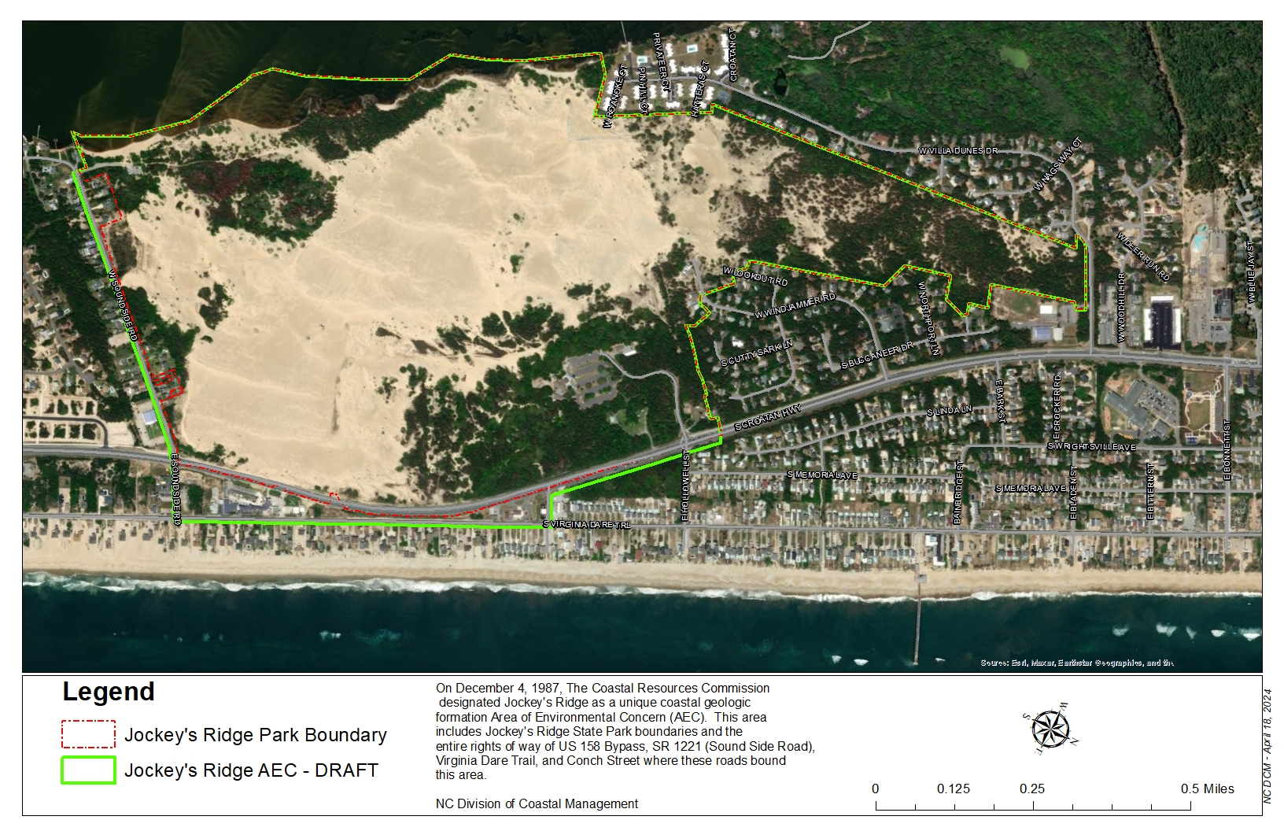
Jockey’s Ridge AEC Boundaries

Slide 7
Proposed Permanent Rule (c) Use Standards
(c) Use Standards. Development within the Jockey's Ridge AEC shall be consistent with the following use standards:
(3) Development activities within Jockey’s Ridge AEC shall not alter or retard the free movement of sand except when necessary for the purpose of maintaining or constructing a road, residential or commercial structure, accessway, lawn, garden, or parking area unless allowed by Jockey’s Ridge State Park’s Management Plan. Jockey’s Ridge State Park’s Management Plan can be found at the Division of Parks and Recreation’s website at https://www.ncparks.gov
Notes:
Removing more than 10 cubic yards of sand per year shall require a CAMA Permit
All sand that is removed per use standard 1 shall deposited at location within Jockey’s Ridge State park
And any Development with Jockey’s Ridge AEC shall not alter the movement of sand except when necessary for maintaining road, residential or commercial structures, accessways, lawn, garden or parking areas unless allowed by Jockey’s Ridge State Park Management Plan

Slide 8
Permanent Rulemaking
Fiscal Analysis has already been approved by OSBM
Proposed Permanent rule has an updated boundary map
Staff is requesting approval of the permanent rule and fiscal analysis for public hearing
Notes:
Since the Fiscal Analysis has already been approved, Staff is requesting approval of the fiscal analysis and permanent rule for public hearing

