Slide 1
Fiscal Analysis

Slide 2
7H .0308 & 7K .0103 Dune Rules – Fiscal Review
“Dune Rules”
15A NCAC 7H .0308
15A NCAC 7K .0103
Amendments will offer flexibility in the ways that oceanfront sand dunes are maintained and managed, and that structural beach accessways are constructed.

Slide 3
7H .0308 & 7K .0103 Dune Rules – Major Changes
Require sand to remain on the lot to the maximum extent practicable
Allow redistribution of sand to the crest of a frontal dune
Allow removal of sand from around structures provided it remains in the Ocean Hazard AEC
Allow accessways to cross frontal dunes and extend up to six feet past the vegetation line
Preserve the volume of dunes while allowing access, and expand materials allowed for “Hatteras ramps.”

Slide 4
7H .0308 & 7K .0103 Dune Rules – Impact Summary
Private property owners: no increased costs; potential minor benefit
Local government: no impact
State government/DCM: no impact
NCDOT: no impact
Substantial Impact: no
OSBM has reviewed the fiscal analysis and determined the proposed rule amendments have little to no impact on state or local governments, and no substantial economic impact.

Slide 5
7H .0209 Coastal Shorelines – Fiscal Review
“Coastal Stormwater”
15A NCAC 7H .0209
Corrects a conflict between the CRC’s Coastal Shorelines rule 15A NCAC 07H .0209, and the Environmental Management Commission’s Coastal Stormwater rule 15A NCAC 02H .1019.
.

Slide 6
7H .0209 Coastal Shorelines – Major Change
The EMC’s rule allows stormwater collection systems along shorelines adjacent to waters designated as Outstanding Resource Waters (ORW) by the EMC; the CRC’s rule does not.
Since the EMC has jurisdiction over stormwater management, the CRC’s rule must be amended to be consistent with the EMC’s rule.

Slide 7
7H .0209 Coastal Shorelines – Impact Summary
Private property owners: no impact
Local government: no impact
State government/DCM: no impact
NCDOT: no impact
Substantial Impact: no
OSBM has reviewed the fiscal analysis and determined the proposed rule amendments have little to no impact on state or local governments, and no substantial economic impact.

Slide 8
7K .0208 Single Family Residence Fiscal Review
“Single Family Residence Exemption”
15A NCAC 7K .0208
Corrects an inconsistency with other exemptions within 15A NCAC 07K .0100 and corrects a conflict with Environmental Management Commission’s Coastal Stormwater rule 15A NCAC 02H .1019

Slide 9
7K .0208 Single Family Residence-Major Changes
Would allow local permit officers the ability to grant this exemption which has been the current practice in the implementation of this rule
The proposed rule amendment would also delete 15A NCAC 07K .0208(c)(1) in order to address the inconsistency with the EMC’s Coastal Stormwater rules which allow the use of stormwater collection systems with an ORW Coastal Shoreline

Slide 10
7K .0208 Single Family Residence– Impact Summary
Private property owners: no impact
Local government: no impact
State government/DCM: no impact
NCDOT: no impact
Substantial Impact: no
OSBM has reviewed the fiscal analysis and determined the proposed rule amendments have little to no impact on state or local governments, and no substantial economic impact.

Slide 11
7B Land Use Planning Fiscal Review
“Public Hearing & Local Adoption”
15A NCAC 7B .0802
and
“Certification and Use of the Plan”
15A NCAC 7B .0803
Notes:
This is a Fiscal Analysis of the proposed rule change to 15A NCAC 7L .0802 & .0803, the fiscal analysis has been reviewed and approved by OSBM.

Slide 12
7B .0802 & .0803 – Major Changes
History
Past Changes to Land Use Plan Planning Program
Increased Flexibility in Content & Format
Improve Quality of Plans
Intent of Amendments
Streamline the land use plan certification and amendment process
LUP approval can be undertaken by Division Director
Notes:
BACKGROUND
In 2015, the CRC amended the 7B CAMA Land Use Planning Program to provide increased flexibility for plan content and format, to clarify that updates and amendments are voluntary, and to introduce a new process option for CAMA Major Permit Review.
The 2015 amendments also sought to facilitate a streamlined process for plan amendments and updates by delegating certification of land use plans and plan amendments to the Division. Howver, this required a legislative change to CAMA. In 2017, House Bill 56 and subsequent session law (SL 2017-209) were passed, adding a subdivision to the Coastal Area Management Act Section which gave the Commission authority “To delegate the power to approve land-use plans in accordance with to any qualified employee of the Department".
At the November 2017 meeting the CRC approved amendments to 15A NCAC 7B .0803, the intent of those amendments were to streamline the land use plan and plan amendment certification procedures by delegating the power to approve land use plans to the Division Director.

Slide 13
7B .0802 & .0803 – Impact Summary
Fiscal Analysis & Impacts
Property Owners – No Direct Impact
NCDOT – No Direct Impact
DCM
Potential Time Savings
Reduced coordination between DCM & local governments
Local Governments
Reduction in Regulatory Burden
Notes:
The Fiscal Analysis of these amendments found:
Property Owners – No direct impact as the amendments affect the procedures for the certification of land use plan and plan amendments.
No direct impact to NCDOT.
The fiscal analysis found that the amendments result in a potential time savings for the Division….however the savings will be minimal as Staff will still be reviewing plans for adherence to the 7B Land Use Planning Requirements and will still prepare documentation for final agency action associated with certifications. These benefits may have an indirect fiscal impact on the Division as less coordination will be needed with local governments.
The fiscal analysis found that the amendments reduce the regulatory burden on local governments, resulting in staff time savings and a reduction in the complexity of the certification process. These benefits may have an indirect fiscal impact on local governments in not having to work with the CRC meeting schedule.
Staff recommends approval of the fiscal analysis for public hearing.

Slide 14
Questions

Slide 15
Rule Change

Slide 16
Proposed Amendments
“Public Hearing & Local Adoption”
15A NCAC 7B .0802
Notes:
Proposed amendments to 15A NCAC 7B .0802 “Public Hearing & Local Adoption Requirements”.

Slide 17
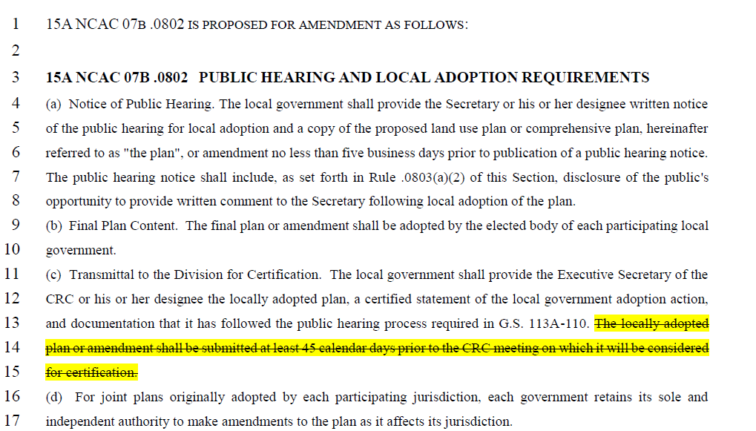
7B .0802 - Rule Change
Notes:
The proposed amendment is to strike rule language in 7B .0802 that requires that a locally adopted plan or plan amendment be sent to the Division 45 calendar days prior to the CRC meeting on which it is being considered for certification. This language is now unnecessary as the plans and plan amendments are certified by the Division Director.
Staff recommends approval of the changes to 7B .0802 rule language for public hearing.

Slide 18
Questions

