Slide 1
Department of Environmental Quality
High Rock Lake
Nutrient Management
Strategy: Agriculture
January 25, 2023

Slide 2
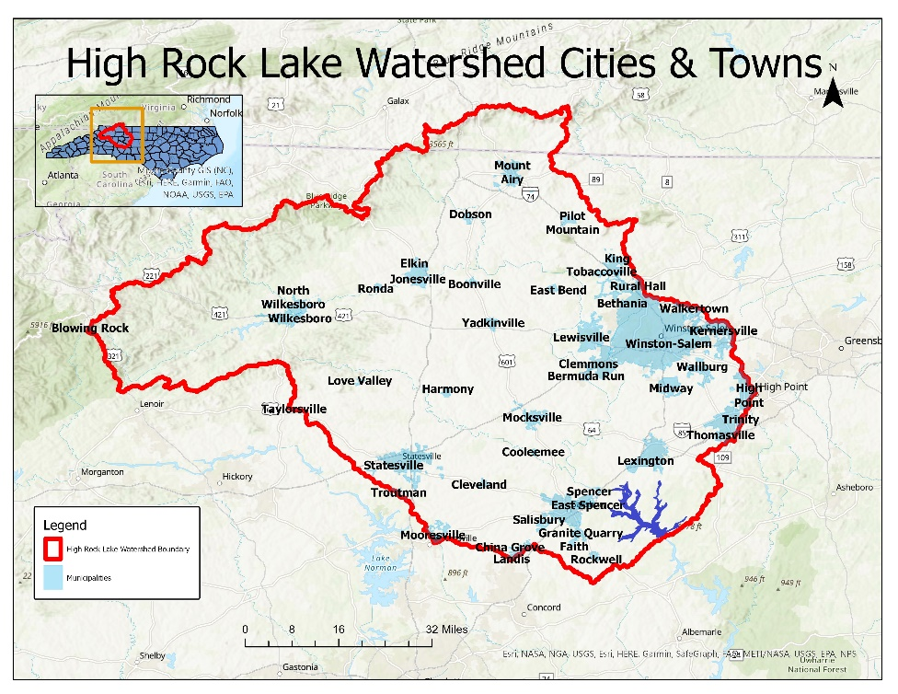
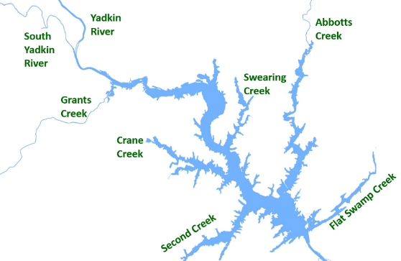
High Rock Lake NMS Rulemaking
Purpose
Engage stakeholders in watershed planning
Prioritize and enable creative and innovative solutions that meet the needs of residents
Eliminate chlorophyll-a impairment and restore full uses of the Lake (fishing, swimming, recreation)
Protect drinking water supplies along the Yadkin River and around High Rock Lake
Department of Environmental Quality

Slide 3
Meeting #1 Action Items
Julie will collect ACSP implementation data since 1/1/2007 and inquire about NRCS data
Joe will work with NCDACS to analyze litter waste analysis records
Taylor will see if NCSU has any litter waste testing records, check on fertilizer tonnage sale records
Keith and Joe will look into what information is available (if any) on overall raised chicken numbers (next slides)

Slide 4
Poultry Trends

Slide 5
Poultry Trends

Slide 6
TAG Charge
What specific management improvements has your sector already implemented for nutrient control since 2006?
Cropland
Pastureland
Animal agriculture
Waste/nutrient management
Streamside buffers/exclusions
BMPs
Conservation planning

Slide 7
TAG Charge
What further nutrient reduction management steps can you take that would make sense? Consider both examples of more easily attainable and effective opportunities, as well as more long-term or challenging opportunities for your sector.

Slide 8
High Rock Lake Nutrient Management
DWR Interests and Ideas
Identify opportunities for nutrient load reductions
Identify administrative and regulatory barriers to implementation
Monitor conservation funding and implementation
ACSP
EQIP
Grants
Other
Protect hydrologic integrity to limit downstream nutrient transport
Report progress toward goals
Load reductions
Conservation practices
Dollars spent
Other
Optimize and expand nutrient management and conservation planning
Show shared commitment to action

Slide 9
Questions?
Joey Hester
Joey.hester@ncdenr.gov
O: 919-707-3675
C: 919-418-5712
Department of Environmental Quality

