Slide 1
Sushma Masemore, P.E.
Executive Order 80: Status Update
November 20, 2019
EJ Board Meeting

Slide 2
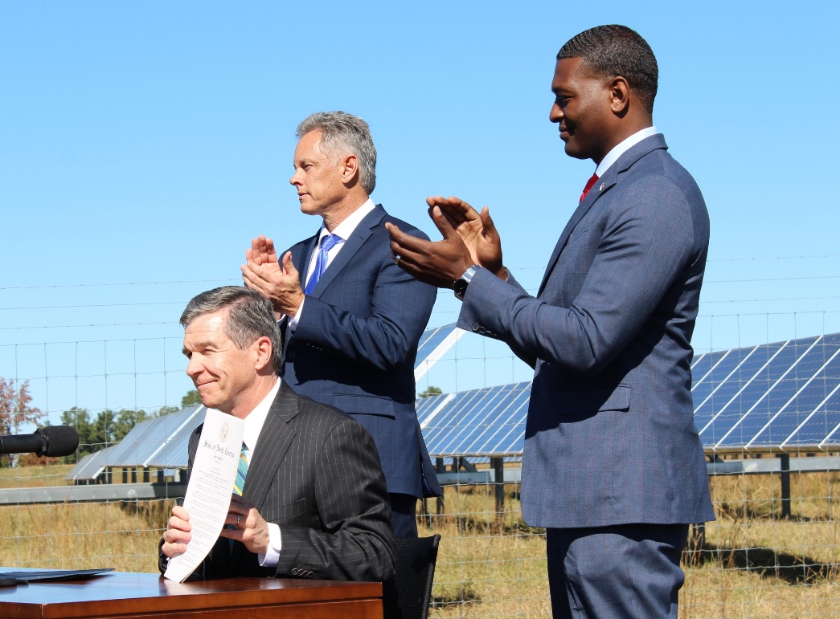
Executive Order No. 80
North Carolina’s Commitment to Address Climate Change and Transition to a Clean Energy Economy
Recognizes that climate change is affecting the health and welfare of our residents, economy, environment and our natural and built infrastructure.
Recognizes that we must take an active role in combatting climate change and make our state more resilient to its impacts.
Calls for clean energy technology innovations, workforce development, and a modern, smart electric grid to grow the state’s economy while making North Carolina a national leader in clean energy solutions.
Recognizes that we can protect our communities, grow our economy, and ensure a healthy environment at the same time.
Notes:
Governor Cooper’s Executive Order 80 supports the goals of the 2015 Paris Agreement and honors the state’s commitment to the U.S. Climate Alliance. EO80 commits NC cabinet agencies to addressing Climate Change in their programs, policies, and operations to better support the health and wellbeing of its citizens.

Slide 3
North Carolina’s Commitment to Address Climate Change and Transition to a Clean Energy Economy
Goals for NC to accomplish by 2025:
Reduce statewide greenhouse gas emissions to 40% below 2005 levels
Reduce energy consumption per square foot in state-owned buildings by at least 40% from fiscal year 2002-2003 levels
Increase the number of registered, zero-emission vehicles (ZEVs) to at least 80,000
Cabinet agencies must incorporate climate resiliency planning into policies, programs and operations

Slide 4
N.C. Climate Change Interagency Council
Composition: The secretary or designee of each cabinet agency and a representative of the Governor’s Office
Council Chair: Secretary Regan, N.C. Department of Environmental Quality
Council Duties:
    Recommend new and updated goals and actions to meaningfully address climate change
    Develop and implement programs and activities that support climate mitigation and adaptation
    Consider stakeholder input when developing recommendations, programs, and activities
    Schedule, monitor, and provide input on the preparation and development of the plans and assessments required by EO 80
    Review and submit to the Governor EO 80 plans and assessments
Status Update on Implementation: To Governor by Oct. 15, 2019.
Next Meeting: November, 2019
https://deq.nc.gov/eo80
Notes:
The Climate Change Interagency Council is comprised of the secretaries and their designees of each cabinet agency and is responsible for upholding EO80

Slide 5
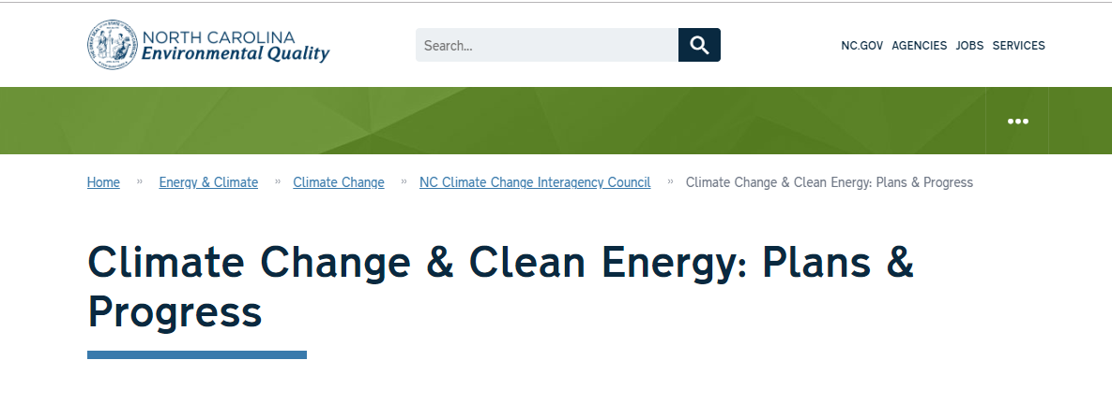
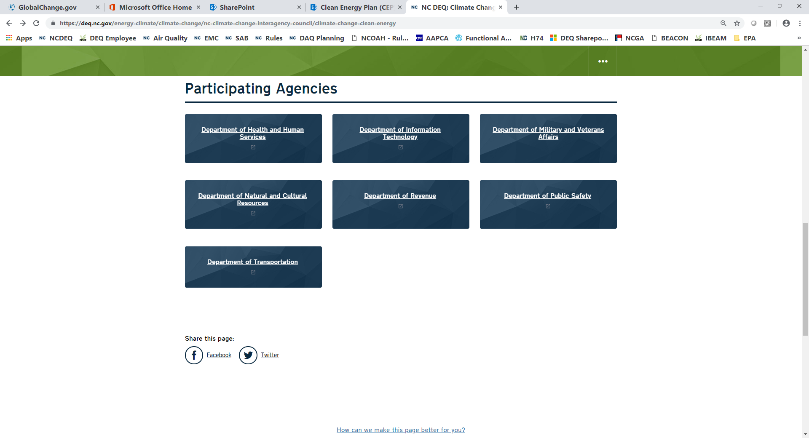
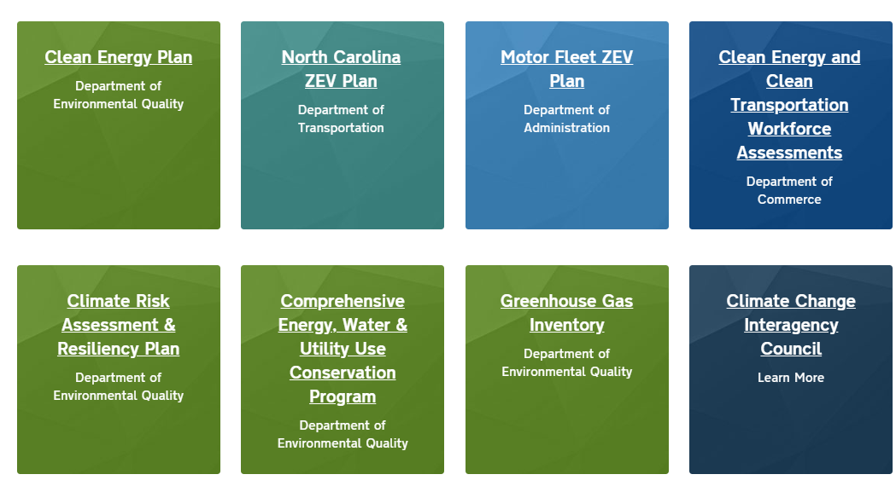

EO80 Website deq.nc.gov/climate-council
Notes:
For more information on all of EO80, please visit our website

Slide 6
EO80 Section 4-
North Carolina Clean Energy Plan
North Carolina
Climate Change Interagency Council

Slide 7
Drivers of Power Sector Transformation
Decentralization
Digitization
Decarbonization
Development

Slide 8
Electricity generation from natural gas and renewables increases, and the shares of nuclear and coal generation decrease—
AEO 2019
www.eia.gov/aeo

Slide 9
Expected new generating capacity will be met by renewables and natural gas—
AEO 2019
www.eia.gov/aeo

Slide 10
Alternative and electric vehicles gain market share—
AEO 2019
www.eia.gov/aeo

Slide 11
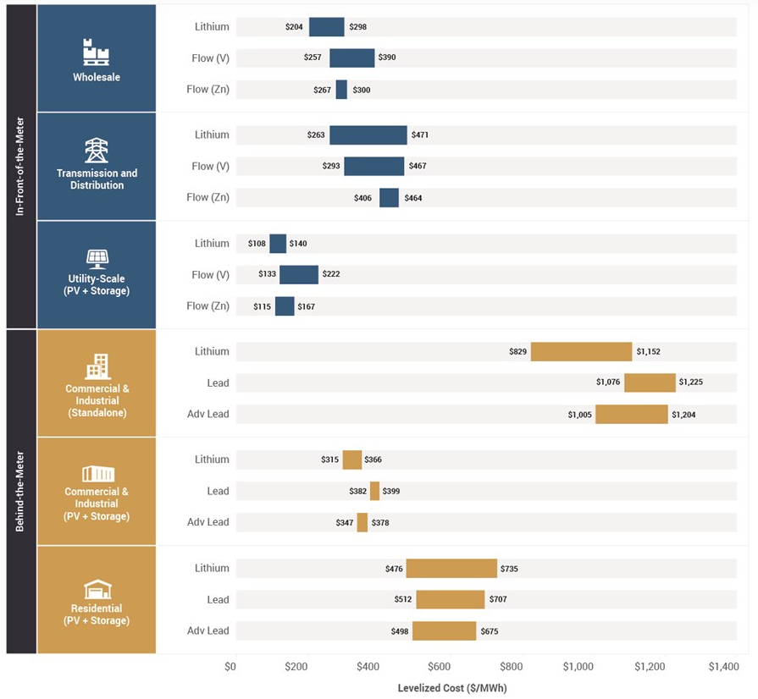
Energy and Storage Technology Cost Comparisons
Lazard’s Unsubsidized Levelized Cost of Energy for Alternative and Conventional Technologies, version 12.0
Lazard’s annual Levelized Cost of Storage Analysis (LCOS 4.0)

Slide 12
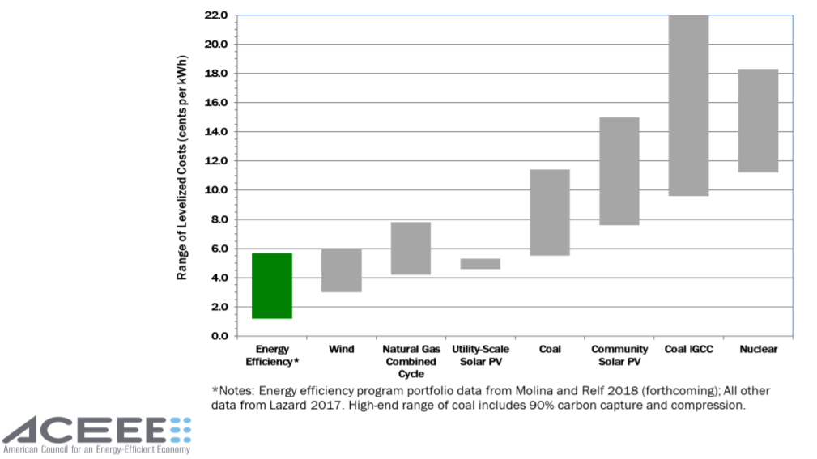
Energy Efficiency Remains a Least Cost Energy Resource

Slide 13
Executive Order 80 Directive to DEQ
Develop a North Carolina Clean Energy Plan that fosters and encourages:
  Utilization of clean energy resources such as energy efficiency, solar, wind, energy storage and other innovative technologies, and
  Integration of these resources to facilitate the development of a modern and resilient electric grid.
Collaborate with businesses, industries, power providers, technology developers, North Carolina residents, local governments, and other interested stakeholders to increase utilization of these technology solutions.
Submit the plan to the Governor by October 1, 2019.

Slide 14
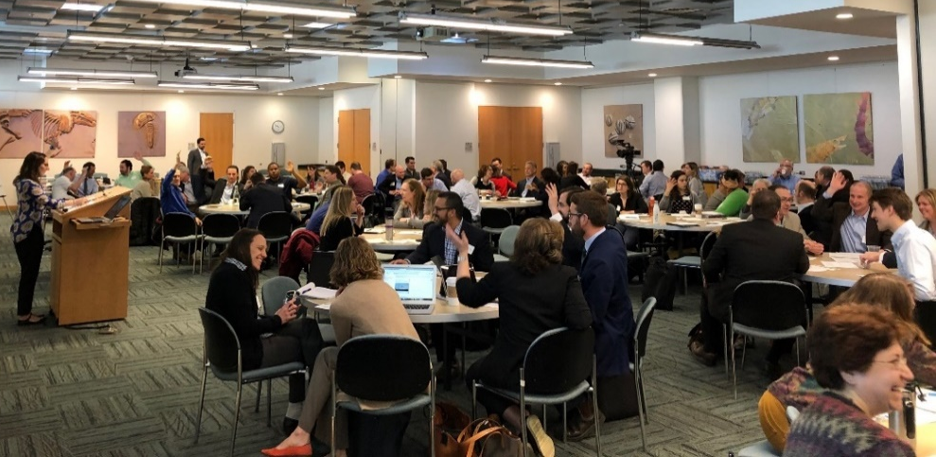
Stakeholder Process (February – July 2019)
Method 1. Six Facilitated Workshops, Raleigh
  Technical guidance and facilitation provided by Regulatory Assistance Project (RAP) and Rocky Mountain Institute (RMI)
Method 2. Regional Listening Sessions
Method 3. Combined with Other Statewide Events
Method 4. Online Input
800+ Participants and other Contributors
Charlotte | Asheville
Rocky Mount | Wilmington
Hickory | Fayetteville
Elizabeth City | Wilmington
Greensboro
Workshop Presenters

Slide 15
General Description of Approach
What is NC’s vision of a clean energy future, how different is it from the current direction, and how well do current policies, regulatory and business practices help achieve that vision?
What policy and technology trends are influencing how we foster clean energy use?
What policy or regulatory actions should be taken to achieve the clean energy vision?
Vision Building & Current Landscape
Changing Landscape
Actions to take

Slide 16
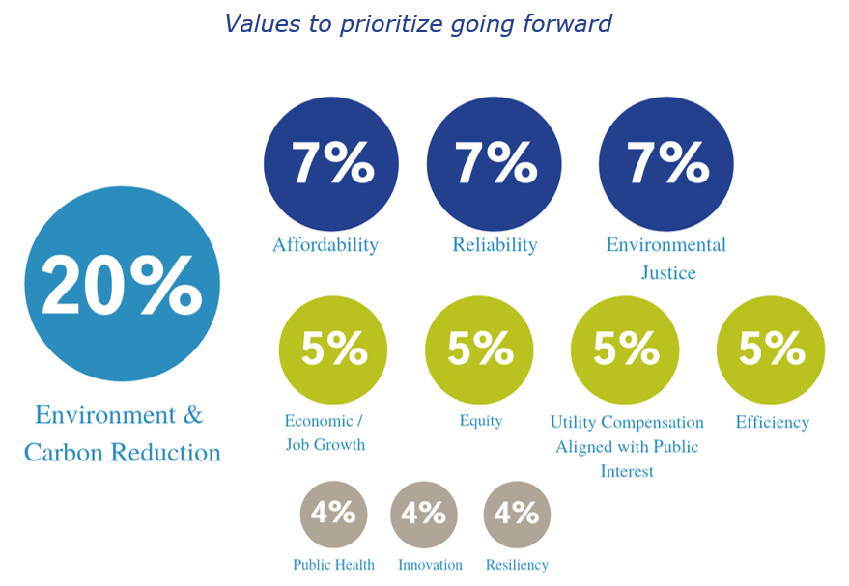
Stakeholder Values
Based on survey responses from 459 stakeholders

Slide 17
Stakeholder's Vision for NC’s Energy Future
A system that is clean, equitable, modern, resilient, and efficient, in addition to being safe, affordable, and reliable that:
Increases deployment of both grid scale and distributed energy resources such as solar, energy efficiency, battery storage, wind, electrification, and other innovative technology solutions
Gives customers more options and control over their energy use and supply
Provides equitable access to renewable energy and energy efficiency opportunities, and offers fair rates for these services.
Notes:
Vision:
Is an energy system that is clean, equitable, modern, resilient, and efficient; in addition to being safe, affordable, and reliable,
Increases deployment of both grid scale and distributed energy resources such as solar, energy efficiency, battery storage, wind, electrification, and other innovative technology solutions, and
Gives customers more options and control over their energy use and supply, provides equitable access to renewable energy and energy efficiency opportunities, and offers fair rates for these services.
To achieve this vision, NC should work toward an integrated energy system that:
recognizes the combined benefits of the central grid and DERs,
invests and retains capital in local communities,
creates jobs of the 21st century, and
serves as a catalyst for innovation, new business development and continued economic development in the state.

Slide 18
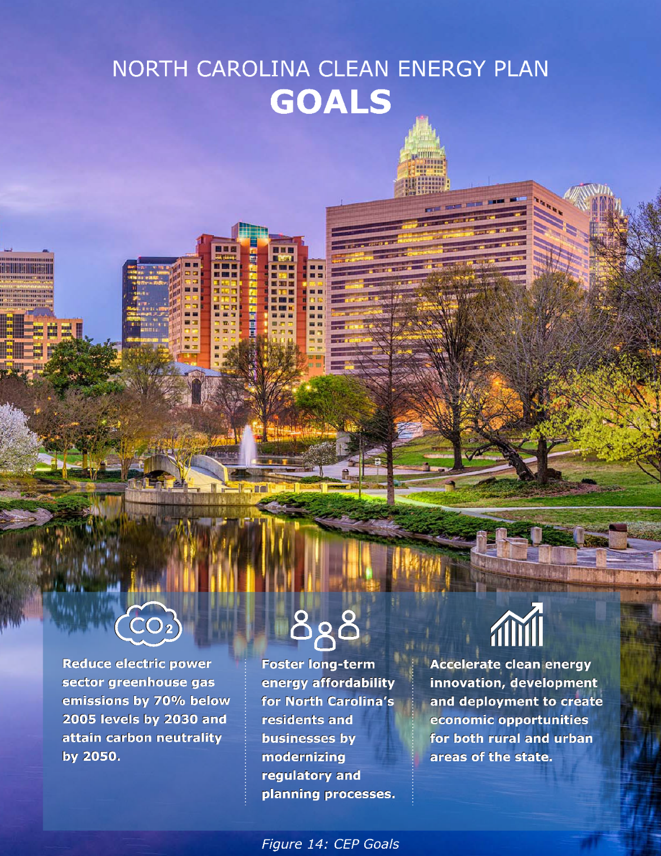
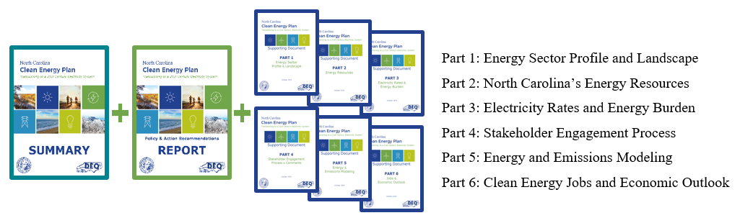
NC Clean Energy Plan
https://deq.nc.gov/energy-climate/climate-change/nc-climate-change-interagency-council/climate-change-clean-energy-16

Slide 19
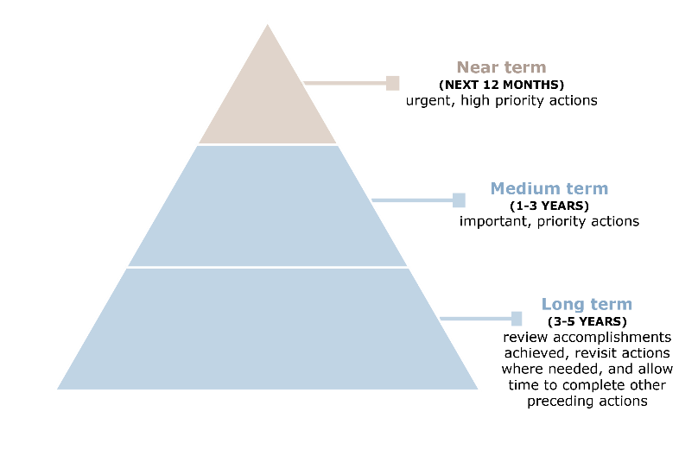
Action Takers
Action Schedule
Governor’s Office
Legislature
State Agencies
Investor-owned utilities
Co-ops and Public Utilities
Local Governments
Private business and industry
Academia and non-profits
NC Utilities Commission

Slide 20
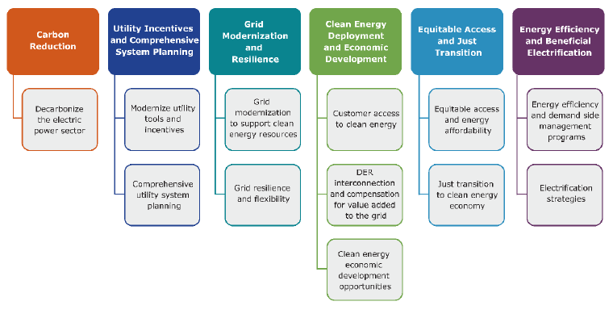
Clean Energy Plan Strategy Areas

Slide 21
Key Recommendations
To successfully transition to a clean energy future, North Carolina must establish a 21st century regulatory model that incentivizes business decisions that benefit both the utilities and the public in creating an energy system that is clean, affordable, reliable, and equitable. The following overarching recommendations are critical to the transition:
Develop carbon reduction policy designs for accelerated retirement of uneconomic coal assets and other market-based and clean energy policy options.
Develop and implement policies and tools such as performance-based mechanisms, multiyear rate planning, and revenue decoupling, that better align utility incentives with public interest, grid needs, and state policy.
Modernize the grid to support clean energy resource adoption, resilience, and other public interest outcomes.

Slide 22

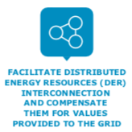




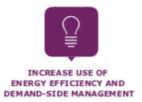
Other Recommendations

Slide 23
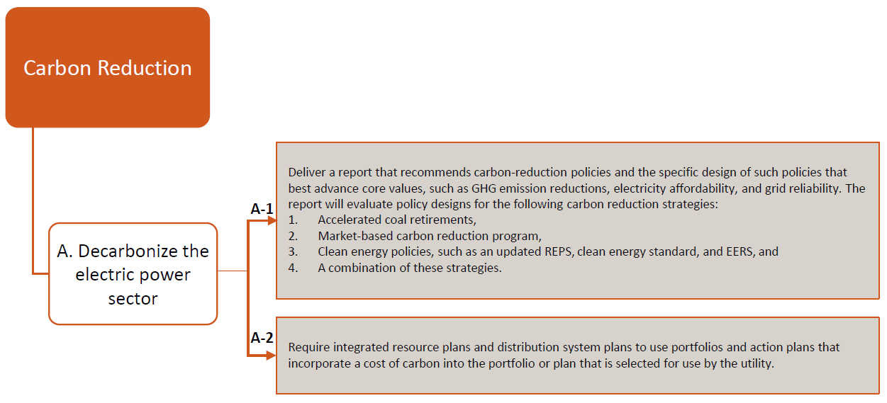
Carbon Reduction Recommendations

Slide 24
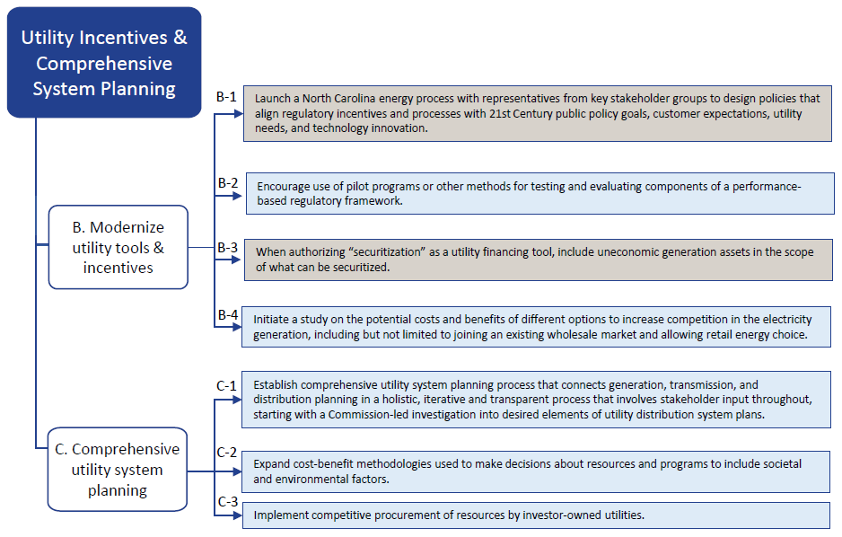
Utility Incentives & Comprehensive System Planning
Recommendations

Slide 25
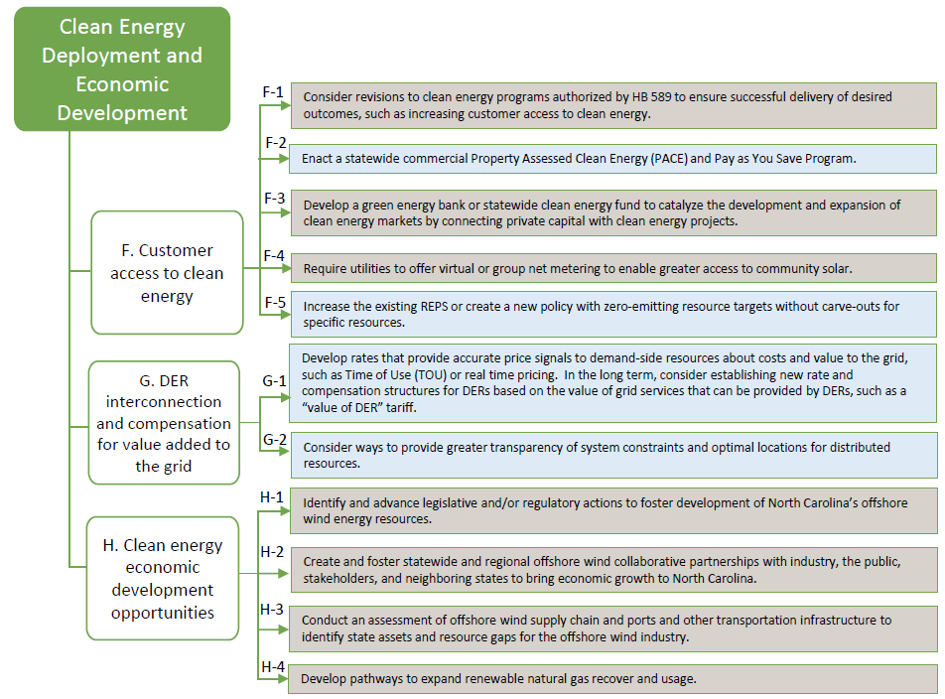
Clean Energy Deployment & Economic Development
Recommendations

Slide 26
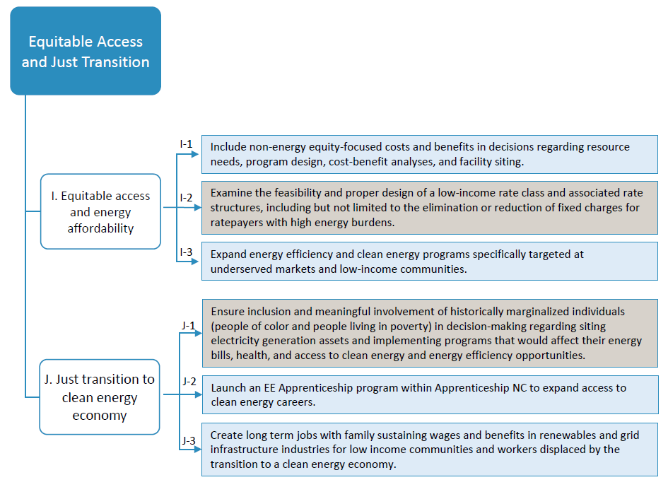
Equitable Access & Just Transition
Recommendations

Slide 27
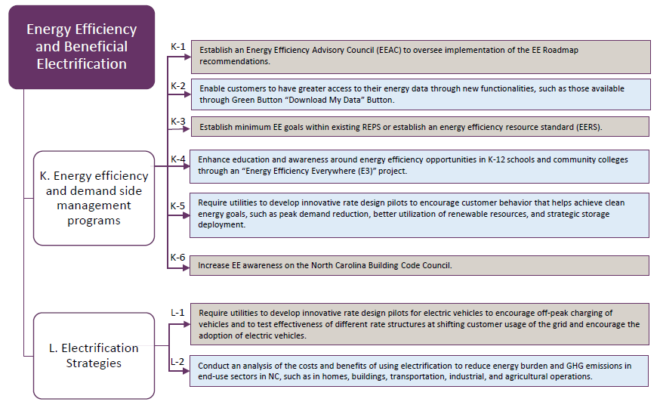
Energy Efficiency & Beneficial Electrification
Recommendations

Slide 28
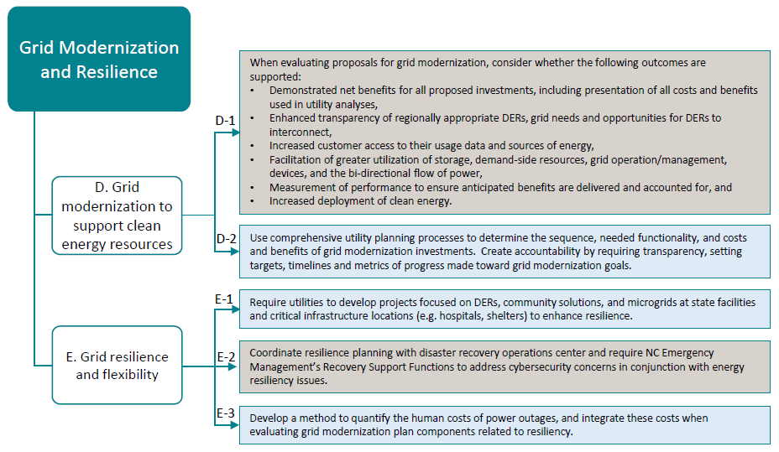
Grid Modernization and Resilience
Recommendations

Slide 29
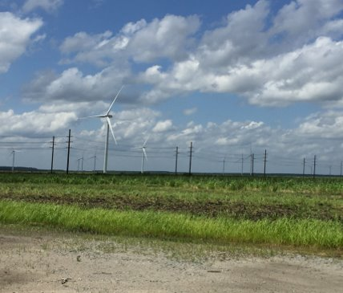
Next Steps
Call for Action
Lead by example
Integrate into operational practices
Convene experts, learn and apply
Conduct deeper dives and detailed analysis
Make adjustments where needed and take action

Slide 30
EO80 Section 9-
Climate Science, Impacts, Risks, Adaptation, and Resiliency
North Carolina
Climate Change Interagency Council

Slide 31

EO80 Section 9
Climate Change Science, Impacts, Risks and Resiliency
N.C. Climate Risk Assessment and Resiliency Plan Development
  DEQ will lead a process to provide a scientific assessment of current and projected climate impacts on North Carolina and prioritize effective resiliency strategies.
  All cabinet agencies will assess and address climate change by:
    Evaluating the impacts of climate change on agency programs and operations
    Integrating climate change mitigation and adaptation practices into agency programs and operations
    Supporting communities and sectors vulnerable to climate change impacts
  Collective efforts will be documented in the Risk and Resiliency Plan due March 1, 2020

Slide 32
N.C. Climate Risk Assessment and Resiliency Plan
Goals
Goal 1: Develop an updated Climate Science Assessment for NC
Goal 2: Assess vulnerability and risks to climate change
Goal 3: Identify strategies and actions in the NC Climate Risk Assessment and Resiliency Plan
Goal 4: Assist interested local communities develop resiliency strategies
Notes:
The specific goals of EO80 Section 9 are….

Slide 33
Risk Assessment and Resiliency Plan Strategy
Goal 1a
Dec 2019
Science Report
Lead: DEQ
NCORR/DPS, DOT, DNCR, DHHS, DHS, DOA, DMVA, DOR, DOC
NCICS, NC Climate Science Advisory Panel
Climate science assessment
NC Climate Science Report
Hazard Identification
Exposure to climate-related hazards
Goal 1b
Oct 11, 2019
Lead: DEQ
NCORR/DPS, DOT, DNCR, DHHS, DHS, DOA, DMVA, DOR, DOC
NOAA, NEMAC, NCICS
Agency Workshop 1
Hazard/Asset Matrix
Risk Assessment
Goal 2
Dec 2019
Lead: DEQ
NCORR/DPS, DOT, DNCR, DHHS, DHS, DOA, DMVA, DOR, DOC
NOAA, NEMAC, NCICS
Agency Workshop 2
NC Climate Risk Assessment
Assess Vulnerability and Risks
State Agency Strategies
Lead: DEQ / NCORR
DPS, DOT, DNCR, DHHS, DHS, DOA, DMVA, DOR, DOC
NOAA, NEMAC, NCICS
Agency Workshop 3
Regional Resiliency Workshop Reports
RSF Recommendations
NWL Recommendations Report
NC Climate Resiliency Plan
Local Government Strategies
Goal 3
March 2020
Lead: DEQ / NCORR, COGs, Cabinet agencies
NGOs, local governments, NOAA, NEMAC
Develop Actions
Recovery and Resilience Support Strategies
Lead: NCORR
State Disaster Recovery Task Force members
Nature Based Solutions
Lead: DEQ, Natural & Working Lands Stakeholders
33

Slide 34
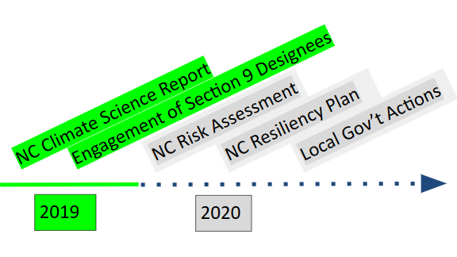
Risk Assessment and Resiliency Plan Strategy
Local and Regional Resilience Plans & Actions
Local Government and Community Assistance
Goal 4
On going
Lead: NCORR
Cabinet agencies, COGs, local governments, NGOs
Local Government Assistance: Planning, Tools, Funding, Resources, etc.
Timeline
NC Hazard Mitigation Plan
NC Hazard Mitigation & Resiliency Plan
2018
2022

Slide 35
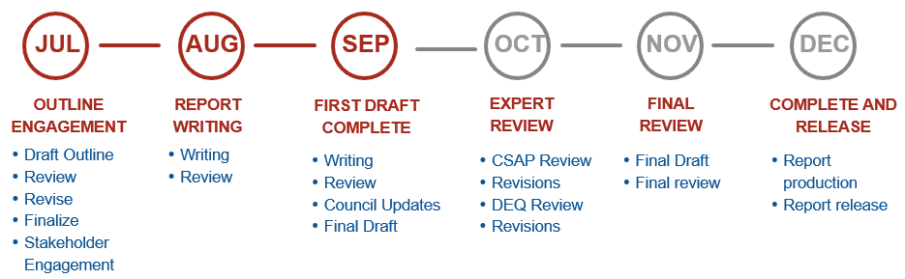

NC Climate Science Report
Goal 1a
Dec 2019
Climate Variables
Climate Science Panel
Temperature (and humidity)
Precipitation
Sea level rise
Hurricanes/tropical storms
Severe winter storms
Heat waves
Coastal erosion
Flooding (inland, coastal)
Extreme weather events
Tornadoes
Droughts
Combined sets of variables that affect the risk of landslides, wildfires, and invasive species
NAME | UNIVERSITY
Ana Barros | Duke University
Reide Corbett | Eastern Carolina University - Coastal Studies Institute
Kathie Dello | NC State University / NC State Climate Office
David Easterling | NOAA National Centers for Environmental Information
Charles Konrad | University of North Carolina-Chapel Hill
Kenneth Kunkel | North Carolina Institute for Climate Studies / NCSU
Gary Lackmann | North Carolina State University
Wenhong Li | Duke University
Rick Luettich | University of North Carolina-Chapel Hill Institute of Marine Science
Douglas Miller | University of North Carolina-Asheville
Baker Perry | Appalachian State University
Walter Robinson | NC State University (NC State Climate Office)
Adam Terando | Southeast Climate Adaptation Science Center / NCSU / USGS
Solomon Bililign | North Carolina A&T
Yuh-Lang Lin | North Carolina A&T
Science Report Timeline
2019
35
Notes:
North Carolina cabinet agencies are directed to integrate climate adaptation and resiliency planning into their policies, programs and operations.
As part of this effort, North Carolina Institute for Climate Studies (NCICS) has been collaborating and assisting the NC DEQ in the development of the NC Climate Science Report (NCCSR). This report will be a compilation of the latest and best climate science information for North Carolina and will serve not only as input in the development of the risk assessment and resiliency plan but will support cabinets, local governments and planners in understanding the climate information, risks and opportunities for North Carolina.
NCICS will be leading the development of this report, and they have enlisted the help of the top climate scientists from some of the major Universities in our state.

Slide 36
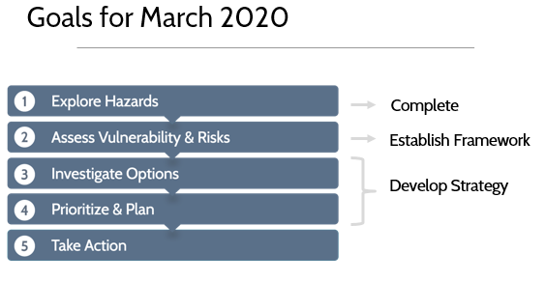
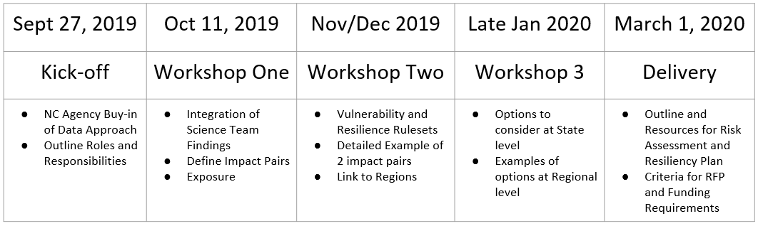


State Agency Strategies
Goal 1b
Oct 11
Goal 2
Dec 2019
Goal 3
March 2020
Resiliency Focus Sectors
Public Health
Public Safety
Commerce & Business
Agriculture & Forestry
Ecosystems
Water
Coastal Resources and Structures
Housing, Buildings, and Support Services
Transportation
Cultural Resources
Climate Justice
36
Notes:
This plan will be developed using a series of cabinet agency workshops during which the Climate Resilience Toolkit team will walk cabinet agency staff through resiliency training and will help them to explore the risks and hazards which affect each agency.
During Phase I of this process, the CRT team, with help from DEQ, will:
Employ the Steps to Resilience with Section 9 Departments.
Perform a Gap Analysis on what has already been done in the State
Establish framework that will build adaptive capability at a State and Regional level

Slide 37
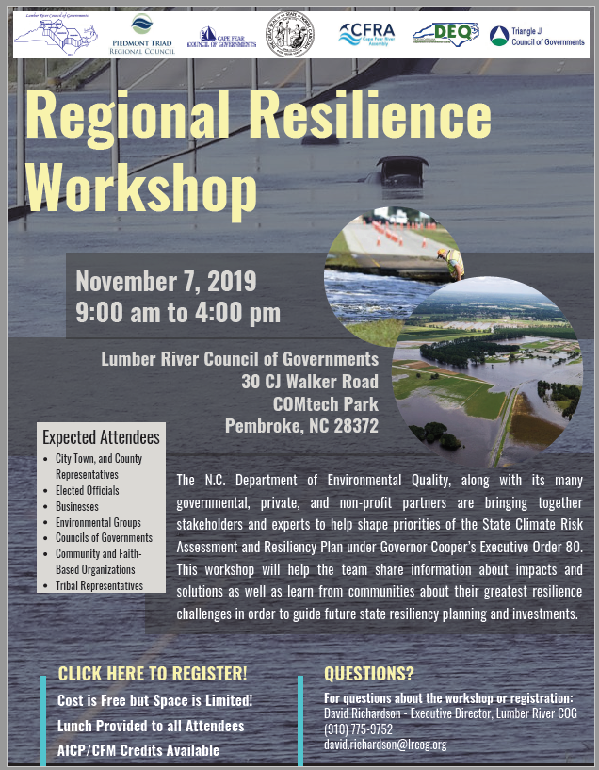
Local Government Input
Goal 3
March 2020
Participant Groups
Focus Areas
Local government officials
Local Planners
Community Organizations
Business, Commerce, and Agriculture
Supporting Organizations
State agencies
Public Health
Agriculture/Business/Commerce
People and Community
Environment and Natural Resources
Local Planning
Transportation
Workshop Date | Location | Towns
October 15th, 2019 | Southwestern Community College | Sylva
October 16th, 2019 | Western Piedmont COG | Hickory
November 4th, 2019 | Piedmont Regional COG | Kernersville
November 7th, 2019 | Lumber River COG | Pembroke
November 12th, 2019 | Upper Coastal Plain COG | Wilson

Slide 38



Goal 3
March 2020
State Disaster Recovery (And Resiliency) Task Force

Slide 39
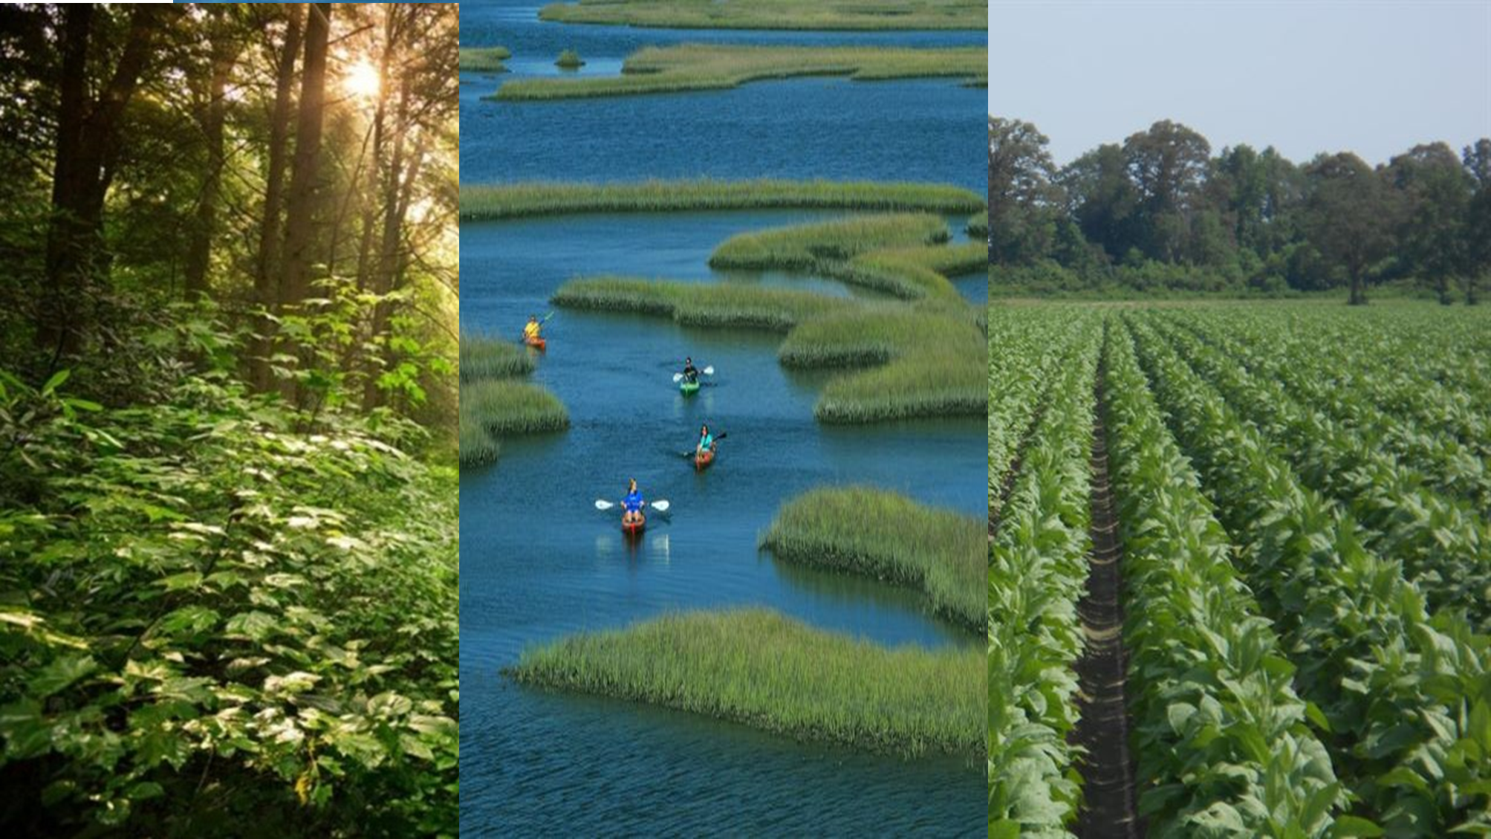

Natural and Working Lands
(NWL)Stakeholder Group
Goal 3
March 2020
Members of federal, state, and local agencies, NGOS, Universities, regional partnerships, …. have come together to develop a plan for how NC can promote carbon sequestration and storage on our NWLs.
Consider NWL carbon opportunities that will bring additional resilience benefits (reduced flooding, nutrient and pollutant loading, saltwater intrusion, wildfires, etc…)
Develop a plan – what habitats, where to target and what programs and funding can support this work.
Focus Areas
Floodplains and wetlands
Pocosin wetlands
Coastal habitats (blue carbon)
Agriculture
Forestry
Urban
Financing and programs (resilience, conservation, c market, etc…)
Notes:
Given the significant contribution of natural and working lands to potential carbon goals for the State of NC, the Governor's office and DEQ invited interested agencies and organizations to participate in a discussion about how to prioritize and engage natural and working lands in activities that reduce C loss AND enhance C sequestration and storage.
This group that now involved around 50 experts from a wide range of NGOs, academic institutions, and state and federal agencies.
Given the significant impact of last years storms, this group was interested in understanding which of these C focused opportunities on NWL would also provide resilience benefits – like reducing flooding, water quality impairments, wildfire.
So, the group is now working to
Better understand the resilience benefits of a handful of NWL activities that also can provide these along with C storage.
Develop a plan for what habitats to target and what programs and funding can support this work.

Slide 40
Thank you.
Questions?
Sushma Masemore, P.E.
DEQ Deputy Assistant Secretary for Environment
State Energy Director
919-707-8700
Sushma.Masemore@ncdenr.gov
Department of Environmental Quality

