Slide 1
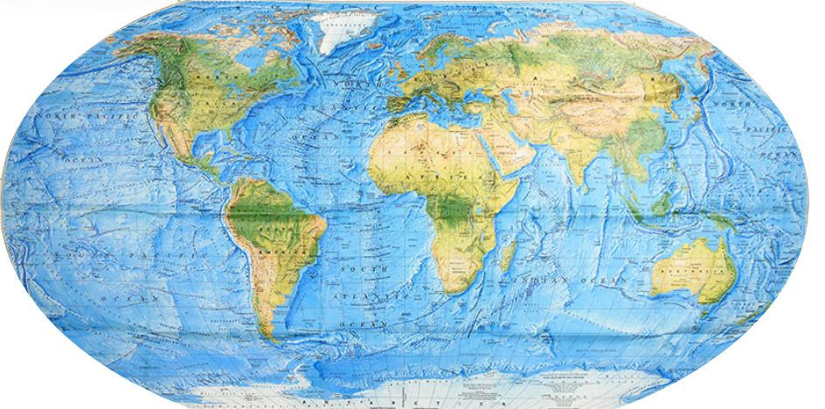
Plate Tectonic Animations
2014 Earthquakes in NC Workshop
Tim Martin Greensboro Day School

Slide 2
Earthquake Terms
Fault
Epicenter
Focus or
Hypocenter
Seismic Waves

Slide 3
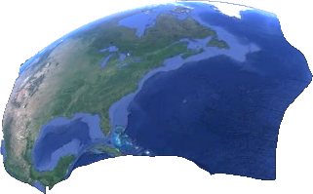
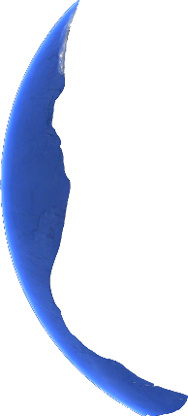
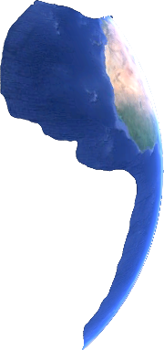
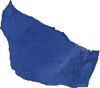
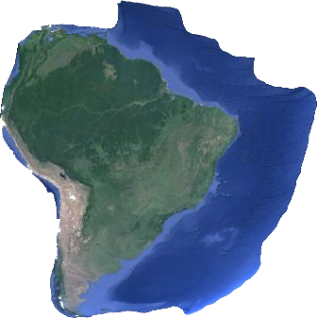
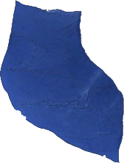
T. Martin

Slide 5
How do plates move?
Three basic plate motions.

Slide 6
Divergent Plate Motion
T. Martin
Notes:
Upwelling mantel plumes may create divergence which in tern creates stresses and earthquakes.

Slide 7
Convergent Plate Motion
T. Martin
Notes:
Animation of earthquake generation along convergent boundary

Slide 8
Transform Plate Motion
T. Martin
Notes:
Strike slip / lateral stress along a transform boundary

Slide 9
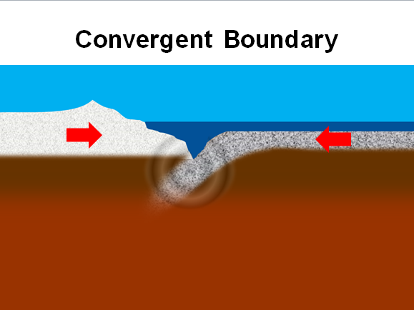
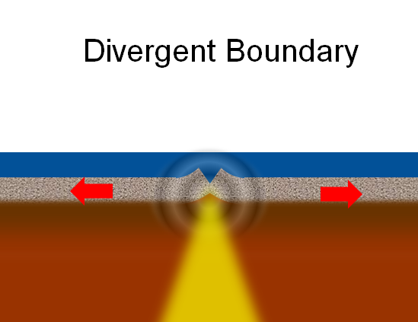
T. Martin

Slide 10
These animations were constructed by Tim Martin for the 2014 Earthquakes in NC workshop and may be freely be used by teachers for educational purposes.
tmartin@greensboroday.org www.AdventureEarthScience.org

