Slide 1
NCDEQ Stormwater Program: NPDES MS4 Permitting
February 2020

Slide 2
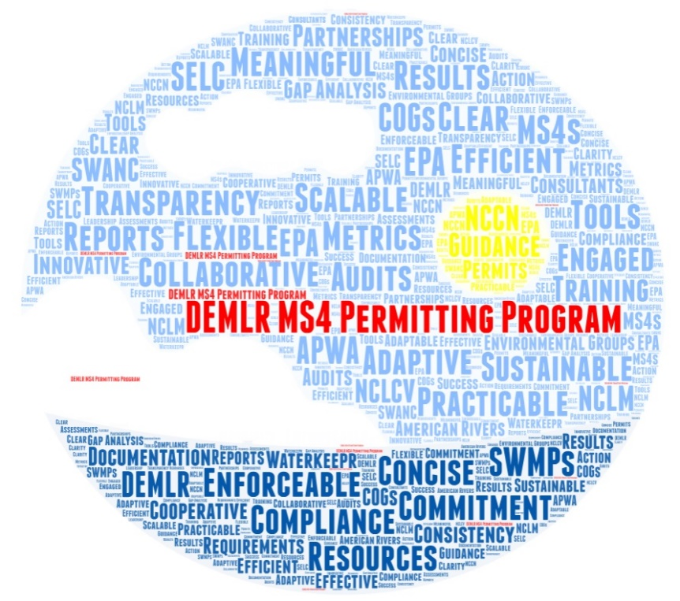
Presentation Overview
What is Stormwater?
NPDES MS4 Program
NPDES MS4 Permits
Compliance Initiative
Tools & Resources
Department of Environmental Quality

Slide 3
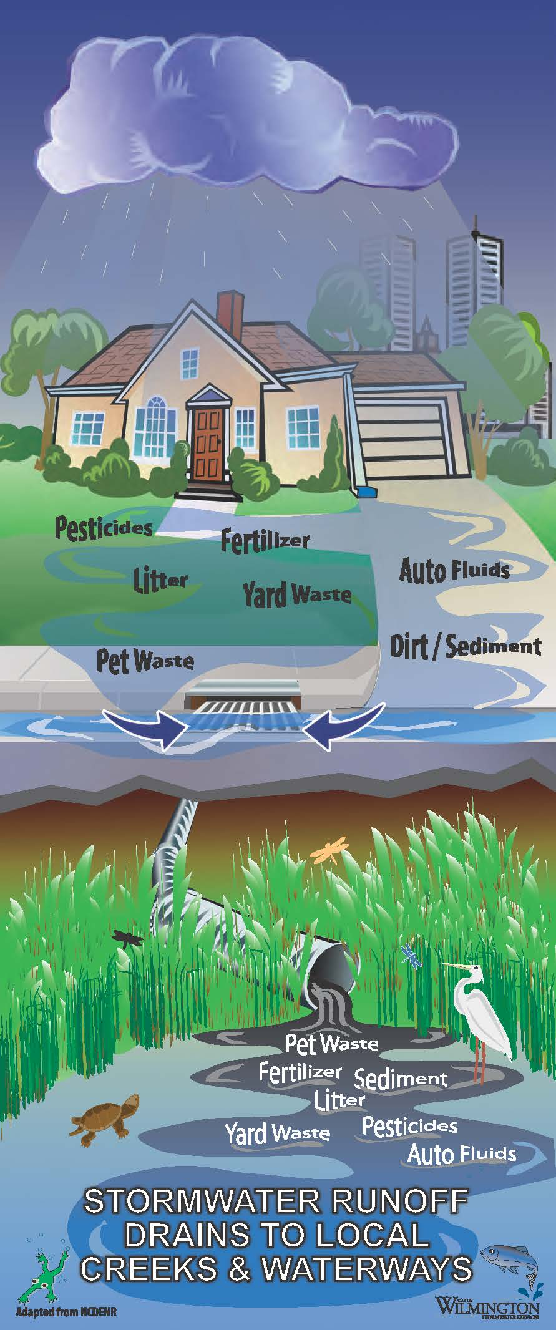
What is Stormwater & Why is it a Problem?
Storm events produce runoff (stormwater)
Runoff washes pollutants off of land surfaces
Runoff is not treated at the wastewater facility
Stormwater runoff carries harmful pollutants directly into our local creeks and waterways
Pollutants increase downstream drinking water treatment costs and impair recreational uses
Aquatic life and vegetation are sensitive to pollutants
Department of Environmental Quality

Slide 4
Federal NPDES MS4 Program
National Pollutant Discharge Elimination System (NPDES)
Federal Clean Water Act Permitting Program for:
Wastewater Permits
Stormwater Permits (40 CFR 122)
Municipal Separate Storm Sewer System (MS4)
MS4 is a system of conveyances to collect and transport stormwater runoff
NPDES MS4 Permits are for discharges of stormwater to surface waters from a publicly owned/operated stormwater collection system

Slide 5
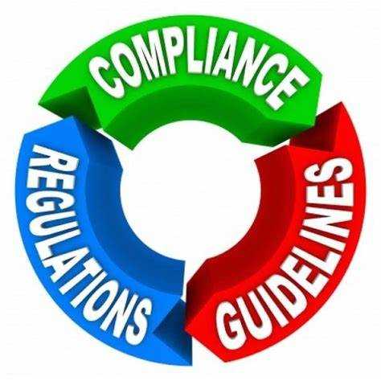
North Carolina NPDES MS4 Program
EPA Oversight & Delegation to NCDEQ
NCDEQ Program Implementation
Permitting
Customer Support
Compliance Audits
Enforcement *
Reporting to EPA
* EPA can also enforce in addition to NCDEQ
Department of Environmental Quality

Slide 6
North Carolina NPDES MS4 Program
1990’s: 6 Phase I MS4s + NCDOT
2000’s: 115 Phase II Permittees
2023ish: New Designations
2025ish: New Permittees Apply
Tentative Schedule for New MS4 Designations
Department of Environmental Quality

Slide 7
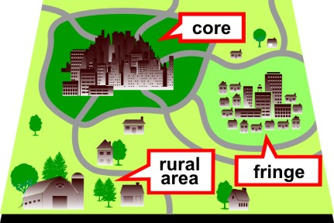
Federal Designation into the NPDES MS4 Program
US Census Urbanized Area
Population >50,000
Fringe cluster of 2,500 – 50,000
Regulated MS4s represent 4% of the US land area and >80% of the population.
Department of Environmental Quality

Slide 8
State Designation into the NPDES MS4 Program
State Designation (15A NCAC 02H.0151)
Potential for Adverse Water Quality
Population/Density/Housing Units
Petitions
Department of Environmental Quality

Slide 9
NPDES MS4 Program Waivers
Urbanized Area <1,000 people
Not contributing pollutant loadings to a regulated MS4
No WLA under a TMDL (A different Clean Water Act program, see next slide)
Small MS4 <10,000 people
DEQ has evaluated all your receiving waters (unlikely)
No WLA under a TMDL
No potential for significant water quality impacts (unlikely)
Department of Environmental Quality

Slide 10
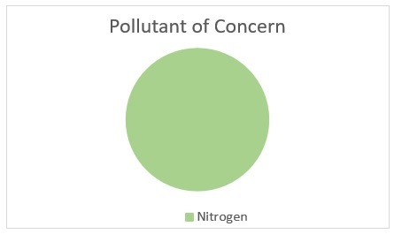
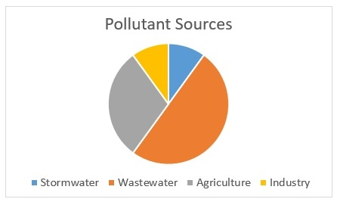
TMDLs & WLAs: The Only Time You Don’t Want Pie!
Total Maximum Daily Load (TMDL)
The total amount of a pollutant that a specific waterbody can handle.
Waste Load Allocation (WLA)
How much each primary source of the pollutant can contribute to the water body.
A TMDL is the whole pie.
A WLA is the slices of pie.

Slide 11
NPDES MS4 Permit Requirements
Fund the Stormwater Management Program
Implement a Comprehensive Stormwater Management Plan (SWMP)
Document Program Implementation
Report Annually
Obtain a New Permit Every 5 Years
Six Minimum Control Measures / Program Areas
Department of Environmental Quality

Slide 12
Six Required Minimum Control Measures
Public Education & Outreach
Public Involvement & Participation
Illicit Discharge Detection & Elimination (IDDE)
Construction Site Runoff Controls
Post-Construction Site Runoff Controls (PC)
Pollution Prevention & Good Housekeeping for Municipal Operations (PP/GH)
Image by City of South Portland

Slide 13
PP/GH: Minimum Control Measure #6
Pollution Prevention & Good Housekeeping for:
Municipal “Industrial” Facilities (and maybe a general stormwater permit too!)
Spill Response
MS4 (collection system) O&M
O&M of Municipal Stormwater Control Measures (SCMs)
Pesticide, Herbicide & Fertilizer Management
Vehicle & Equipment Maintenance
Pavement Management
Department of Environmental Quality

Slide 14
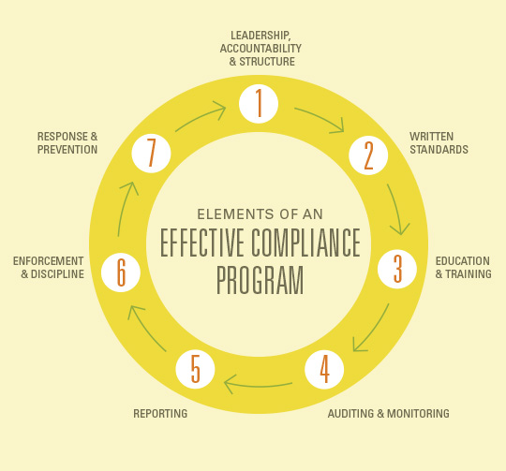
EPA / NCDEQ MS4 Compliance Initiative
Goal 1: An Efficient & Compliant MS4 Program
Restructured DEQ’s MS4 Program
Created an Informative Web Page
Standardized Tools & Processes
Provided Outreach, Training & Technical Support
Published a 5-Year Audit Schedule
Compliant MS4s
Happy EPA
2018
2020
Image by msdresponsibility.com
Department of Environmental Quality

Slide 15
EPA / NCDEQ MS4 Compliance Initiative
COMPLIANCE
GET ANOTHER 5 YEARS TO COME INTO COMPLIANCE!
DON’T WANT TO TAKE ADVANTAGE OF THIS ONE-TIME OFFER?
3rd permit term = mandatory compliance
Maximum civil penalty is $37,500 per day for each violation.
Maximum criminal penalty is $25,000 per day of violation and/or 1 year imprisonment.
Department of Environmental Quality

Slide 16
MS4 Compliance Audit Outcomes (Through Feb. 2020)
Notice of Compliance (NOC) | Notice of Deficiency (NOD) | Notice of Violation (NOV)
3 | 3 | 24
Image by Redbubble
** Plus ANOTHER 5 pending a decision **
Department of Environmental Quality

Slide 17
Top 3 Compliance Deficiencies
Lack of Documentation
If you can’t prove it, it didn’t happen!
Incomplete MS4 Mapping
All major outfalls should already be mapped!
Reactive Illicit Discharge Programs
MS4s are required to proactively find and eliminate illicit discharges!
Image by Smartsheet.com

Slide 18
Notice of Compliance (NOC)
A NOC is issued to MS4s that have nothing or just a few small things to fix
The NOC requires the permittee to do 2 things:
Submit a Draft Stormwater Management Plan (SWMP) (120 days)
Submit a permit renewal application once DEQ & MS4 concur on the Draft SWMP (30 days)
Department of Environmental Quality

Slide 19
Notice of Deficiency (NOD)
A NOD is issued to MS4s that have several little things or one big thing to fix.
The NOD is a NOC + 2 additional things:
Submit a written response to the Notice (30 days)
Conduct a self-audit of whatever DEQ didn’t audit (120 days)
Submit a Draft SWMP (120 days)
Submit a permit renewal application once DEQ & MS4 concur on the Draft SWMP(30 days)
Department of Environmental Quality

Slide 20
Notice of Violation (NOV)
A NOV is issued to MS4s that have major issues with their program.
The NOV is a NOD + 1 more thing:
Submit a written response to the Notice (30 days)
Adopt a Council Resolution demonstrating support for a compliant stormwater program (60 days)
Conduct a self-audit of whatever DEQ didn’t audit (120 days)
Submit a Draft SWMP (120 days)
Submit a permit renewal application once DEQ & MS4 concur on the Draft SWMP (30 days)
Department of Environmental Quality

Slide 21
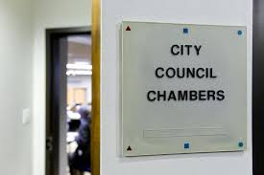
NOV: Council Resolution Requirements
Acknowledgement that the city/town:
Is in it’s 3rd permit term
Received a Notice of Violation (NOV) from NCDEQ
Must comply with the NOV & permit requirements
Is required to provide adequate program funding and staffing
Will receive enforcement penalties for not complying with the NOV
Could also be subject to enforcement by EPA
Image by timescall.com

Slide 22
Notice of Violation (NOV) Timeline
30
60
120
30
MS4
DAYS
DEQ
Receipt of NOV
Submit Written Response to NOV
Submit Council Resolution
Submit
Self-Audit & Draft SWMP
Written Concurrence on Draft SWMP
Submit Permit Application & Draft SWMP
Department of Environmental Quality

Slide 23
MS4 Permit Renewal Process

Slide 24
NCDEQ MS4 Tools & Resources
NCDEQ Stormwater Web Page:
www.deq.nc.gov/sw
DEMLR Stormwater Laserfiche Repository: https://edocs.deq.nc.gov/WaterResources/
MS4 Program Contact:
Jeanette Powell (919) 707-3620 jeanette.powell@ncdenr.gov
Department of Environmental Quality

