Slide 1
Wow Stormwater Webinar
How to Create Clear, Specific and Measurable SWMPs
02/17/2021

Slide 2
What is a Stormwater Management Plan (SWMP)?
The Stormwater Management Plan is the written plan that is used to describe and define the various best management practices and activities that the permittee will undertake to implement the permit requirements.
The SWMP must address permit requirements and audit deficiencies.
PERMIT + SWMP = ENFORCEABLE MS4 REQUIREMENTS
**DEQ requires that the standard SWMP template be utilized**
Department of Environmental Quality

Slide 3
Meeting Individual MS4 Needs With Standard Templates
Your SWMP
Address Identified Deficiencies
Commit to fix what’s broken or missing
Establish Specific Timelines
Consider what you will need for implementation
Identify Brief Reporting Metrics
DEQ tracks progress, will request more info if needed
MS4s measure of success or failure of a measure
Annual Self Assessments
Evaluate annual progress in implementing the SWMP
Revise the SWMP if needed
Department of Environmental Quality

Slide 4
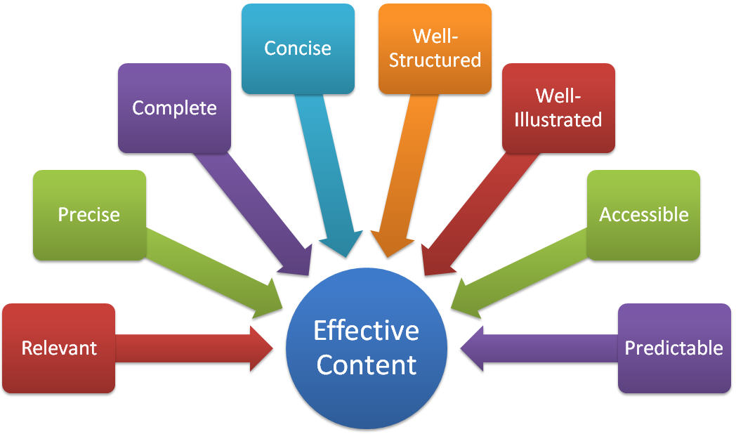
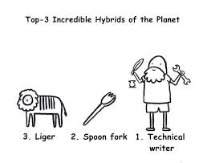
SWMPs are Technical Documents for Permit Compliance
Department of Environmental Quality

Slide 5
Visioning Your SWMP… Think of it as…
A checklist of tasks that will be systematically completed over the next five years.
The sheet music that the conductor (Stormwater Program Administrator) will use to guide the symphony (staff).
Department of Environmental Quality

Slide 6
The SWMP Audience
REGULATORS | PERMIT OWNER | PROGRAM MANAGER
Compliance & Enforcement | Requirements & Funding | Implementation & Reporting
Department of Environmental Quality

Slide 7
Start With the End in Mind
Goal is full compliance in 5 years
The approved SWMP is your “contract”
The SWMP defines the Annual Assessment
Did you do it? Yes / No / Partial & brief comment box
Permit effective date affects the SWMP
Annual reporting period is FY (July 1 – June 30)
July 1 start syncs to fiscal & reporting years
January 1 start has off-sync half year at beginning & end
Department of Environmental Quality

Slide 8
SWMPs Must Be SMART
SMART SWMPs
Specific tasks
Measurable success
Attainable commitments
Relevant to the community
Time lines established
The SWMP details the steps that the permittee will take to fully meet permit requirements over the 5-year permit term.
Department of Environmental Quality

Slide 9
The Online DEMLR MS4 Toolbox
https://deq.nc.gov/sw
A Suite of Standardized MS4 Tools
MS4 Audit Report Template
Stormwater Management Plan (SWMP) Template
SWMP Template Instructions
General SWMP Guidance
Baseline Phase II MS4 Permit Template
MS4 Toolbox
Department of Environmental Quality

Slide 10
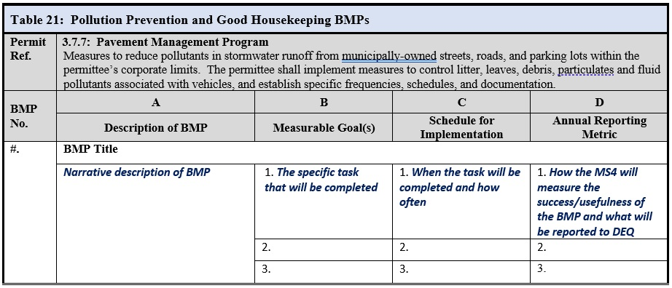
The SWMP Template
MS4 Toolbox
Each MCM has a table
Permit Conditions are listed
Consecutive BMP numbering
Group BMP tasks
Comments will be referenced as BMP#.Column.Item #:
BMP 12.B.2.
Department of Environmental Quality

Slide 11
Building the SWMP
What are we already doing?
Street sweeping on an as-needed basis, tracking sweeper hours
Where are we deficient?
Specific frequencies, schedules, and documentation
What should we do?
Let’s develop a SMART street sweeping program with a SOP.
Department of Environmental Quality

Slide 12
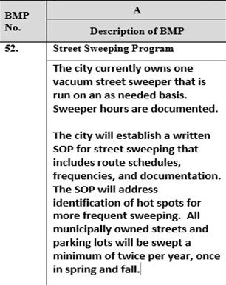
Building the SWMP
Groups tasks under a descriptive BMP title
Explain current status
Describe the overall program
Department of Environmental Quality

Slide 13
Building the SWMP
Department of Environmental Quality

Slide 14
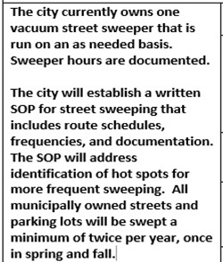
Building the SWMP
Department of Environmental Quality

Slide 15
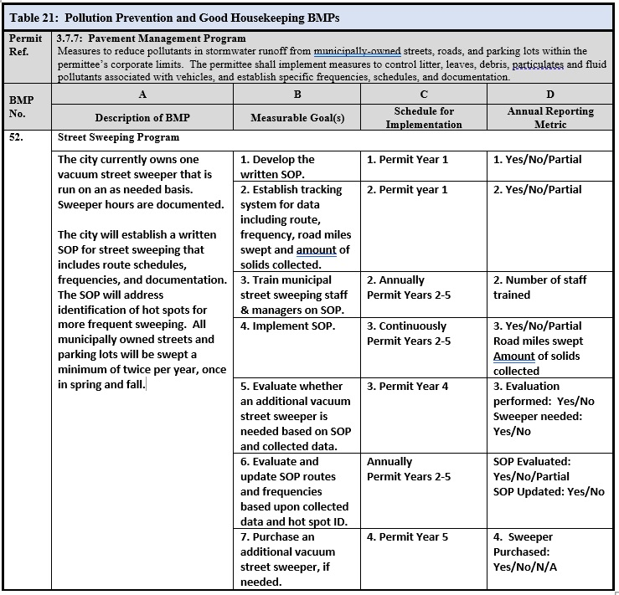
Example SWMP
SMART SWMPs
Specific tasks
Measurable success
Attainable commitments
Relevant to the community
Time lines established
Note: Street sweeping only addresses part of the permit requirement, additional BMPs will be needed for litter, leaves, debris, etc.
Department of Environmental Quality

Slide 16
Example SWMP Comments
BMP 52.C & D: Number all cells in columns consecutively.
BMP 52.B.2 and D.3: Address parking lots and include reporting of parking lot acres swept.
BMP 52.B.6: Clarify language to “…and identification of hot spots.”
BMP 52.D.6: Include number of hot spots identified.
Department of Environmental Quality

Slide 17
Approved SWMP => Annual Assessment Template
MS4 Toolbox
Department of Environmental Quality

Slide 18
SWMP to Annual Assessment Translation
Excel format for future translation to e-reporting
Master File: Each Measurable Goal as a question for each applicable year
Annual Tabs: Compiled list of questions for reporting that year
Department of Environmental Quality

Slide 19
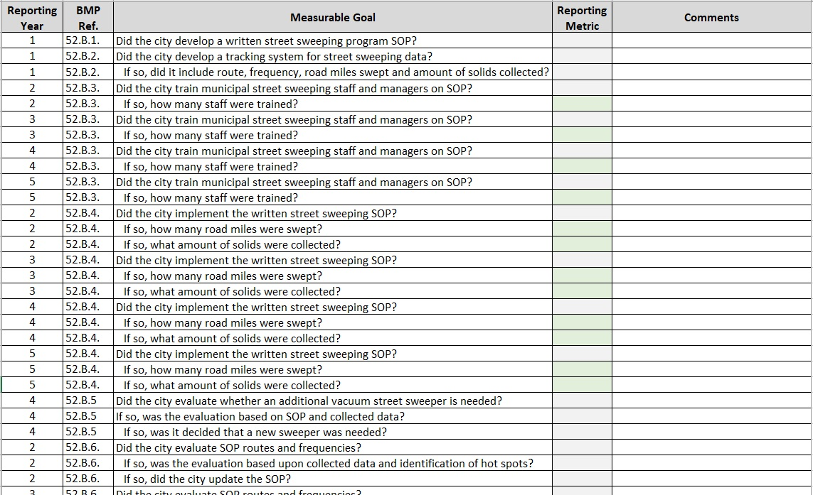
Department of Environmental Quality

Slide 20
SWMP to Annual Assessment Translation – Permit Year 1 Tab
Department of Environmental Quality

Slide 21
The End
Approved SWMP
+ Annual Assessment Template
+ New Permit
= Notice Closed
Department of Environmental Quality

Slide 22
Jeanette Powell MS4 Program Coordinator jeanette.powell@ncdenr.gov
For MS4 Program questions and permit assistance, please contact:
https://deq.nc.gov/sw

