Slide 1
ENVIRONMENTAL
SUCCESSES

Slide 2
PRODUCT SFNTC prides itself on manufacturing the best additive-free cigarette in the
world. Our high standards, as well as the quality of our tobacco and materials,
contribute to the success of our brand.
ORGANIZATION Our people and resources produce and support the production of our quality
products. The success of our products depends upon the quality of
organization.
WORK Our people processes, quality checks, equipment and innovations provide the
means by which our superior products are produced.
ENVIRONMENT The conscientiousness of our people drives our cleanliness, sustainability
and the overall quality of our environment.
RELATIONSHIPS The quality of our established internal and external relationships with our
employees, vendors and suppliers contribute to the success
of our organization and our products.

Slide 3
What Makes our Product Different
We add absolutely nothing to our tobaccos- No additives, no reconstituted sheet or puffed stems.
We purchase and blend only the best tobacco leaf available, no flavorings are needed. Menthol is in the filter, not applied to the leaf.
Our farmers produce our Organic tobacco under USDA standards and every delivery is sampled and tested at a lab to ensure no unacceptable chemicals have been applied.
Our brands have up to 25% more tobacco than other brands.
Our Menthol is certified Organic.
Our glue used in Organic production is vegetable based-not synthetic.

Slide 4
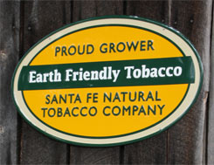
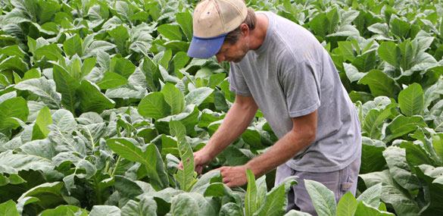
SFNTC Deliberately Different - People & Plant
SFNTC has pioneered Sustainable and Organic Tobacco Farming
Programs since 1989. Today, our dedicated farmers have over
25,000 acres under sustainable/organic practices which
promote much more environmentally friendlier practices than
conventional farming.

Slide 5
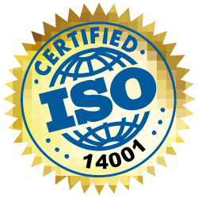
SFNTC Deliberately Different - People & Plant
Our Environmental Management System has been
ISO 14001 certified since 11/08.

Slide 6
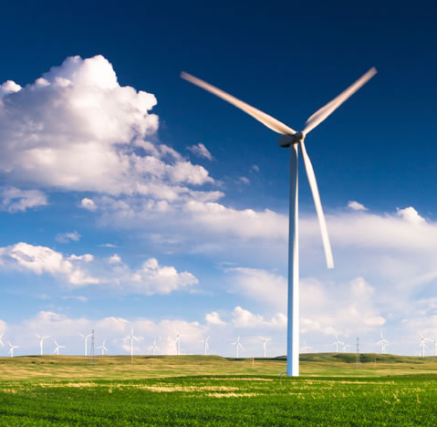
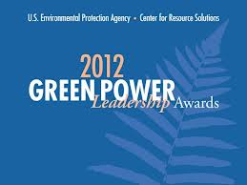
SFNTC Deliberately Different - People & Plant
We have replaced all electrical consumption used company-wide
with wind Energy Credits since 2009.
SFNTC is the only tobacco company that has earned the EPA prestigious Green Power
Leadership Award every year since 2010.

Slide 7
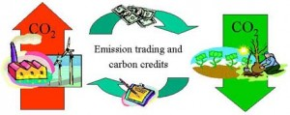
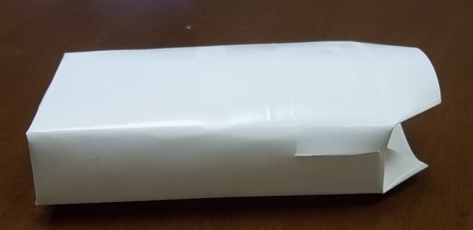
SFNTC Deliberately Different - People & Plant
We replace all fuel consumption with Verified Emission Reduction credits (VERs)
since 2011. This encompasses determining the carbon emissions from natural gas in
Manufacturing and company vehicle fuels and offsetting the amount thru
Initiatives such as reforestation.
We started replacing the foil in packs with more easily
recyclable paper liner in late 2012. SFNTC has
Changed all domestic production to paper liner.

Slide 8
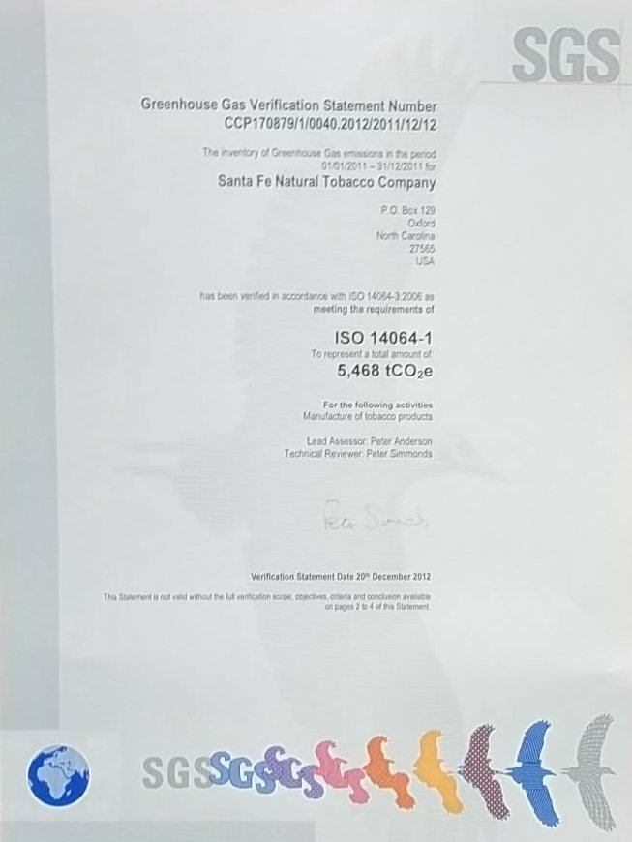
SFNTC Deliberately Different - People & Plant
Certified “Carbon Neutral” December 20, 2012 by SGS by meeting the
Requirements of ISO 14064-1. We have been certified Carbon Neutral for 2011, 2012, 2013 and 2014. We will certify our 2015 numbers this Spring.

Slide 9
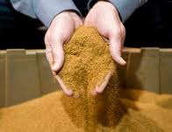
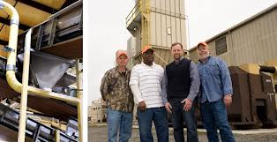
SFNTC Deliberately Different - People & Plant
All copier paper used at SFNTC is 100% recycled content since 2010.
Tobacco dust produced is shipped to a composting facility.
We have averted over 1169 tons
from landfill between April 2010 and January 2016.

Slide 10
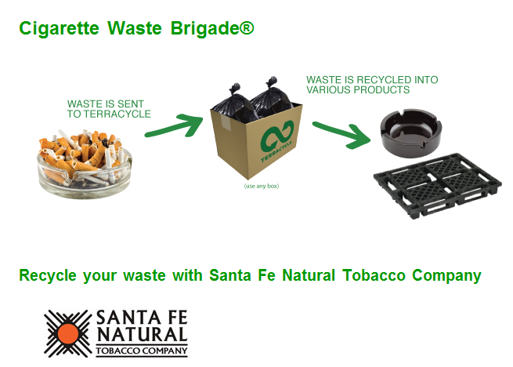
SFNTC Deliberately Different - People & Plant
We partnered with Terra Cycle in 2012 for a first of its kind in the US
cigarette butt recycling program. This program lets consumers/
recyclers collect butts and mail them in for credits they can have
donated to charities. Terra Cycle “up-cycles” the butts collected into
plastic pellets that are used to make plastic pallets and plastic
Lawn furniture.

Slide 11
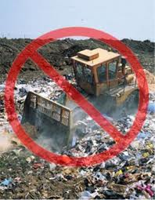
SFNTC Deliberately Different - People & Plant
Landfill Free Manufacturing Process January 2013. On Oct. 30, 2013 SFNTC Oxford went 100% Landfill free.

Slide 12
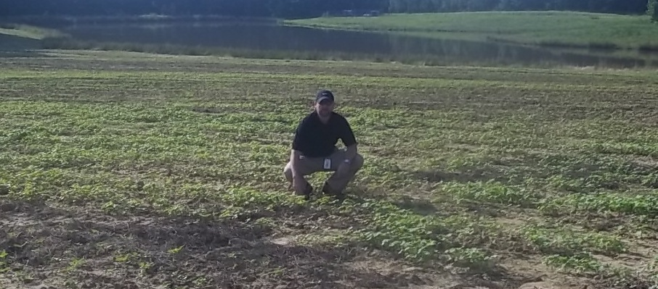
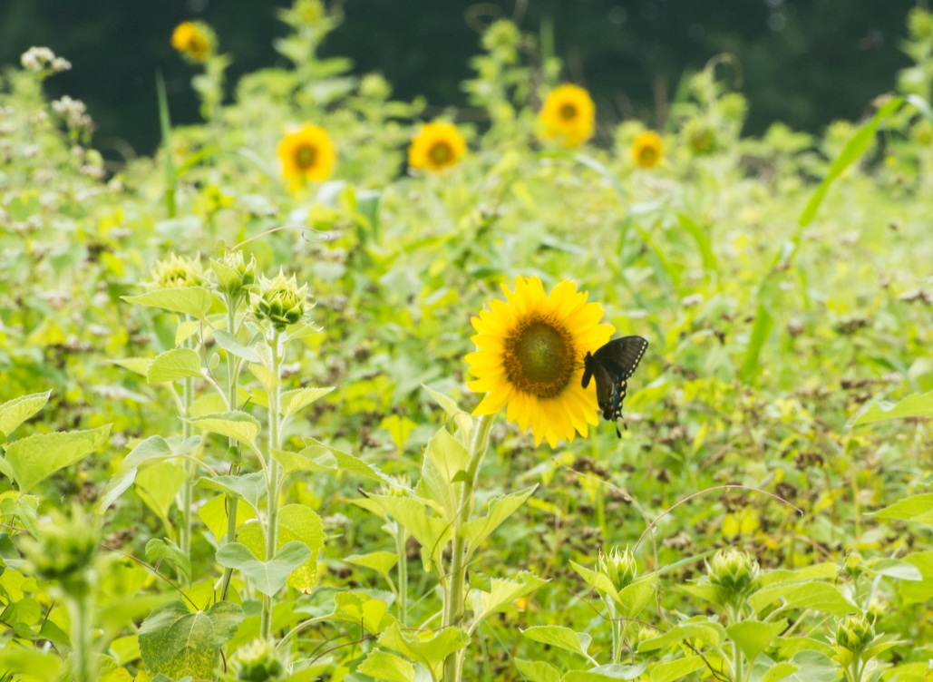
SFNTC Wildlife Habitat Project
In 2013 we planted our first Wildlife Habitat Area. We increased field boarders and planted Buckwheat and Sunflowers for seed and cover. This area has been replanted for 2015 with Sunflowers, Lespedeza and Native Grasses.

Slide 13
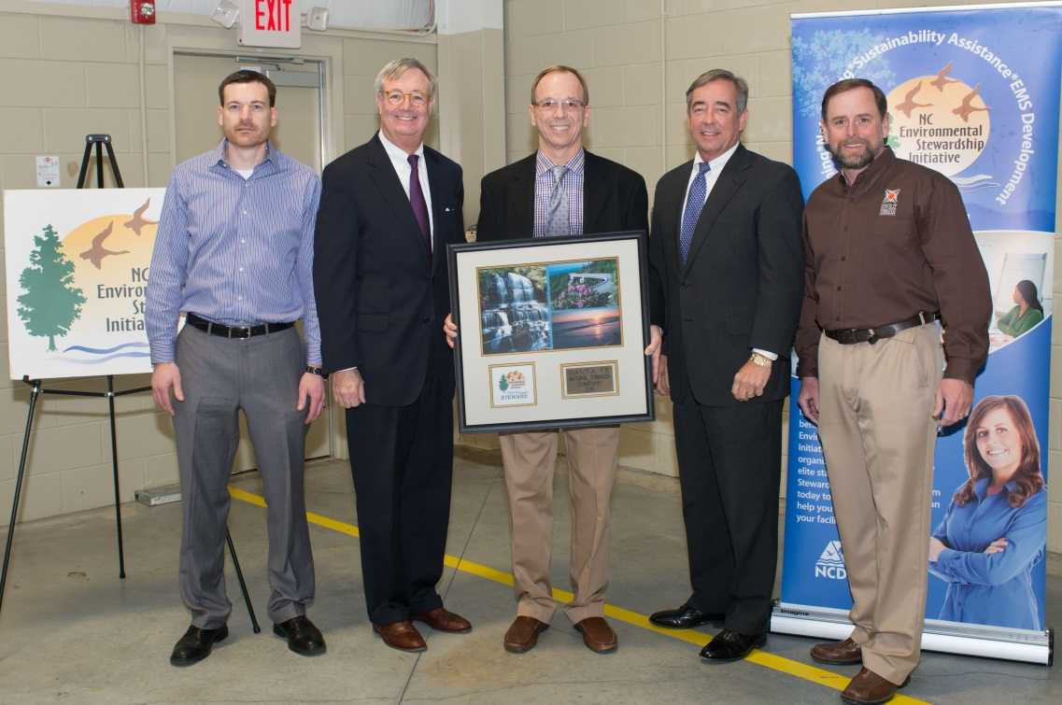
SFNTC Deliberately Different - People & Plant
On Nov. 20, 2013-Oxford was recognized as a full Steward by the N.C. Environmental Stewardship Initiative. This is Highest Environmental Award in the State of North Carolina.

Slide 14
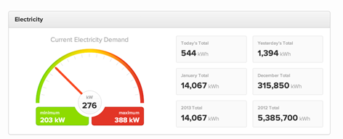
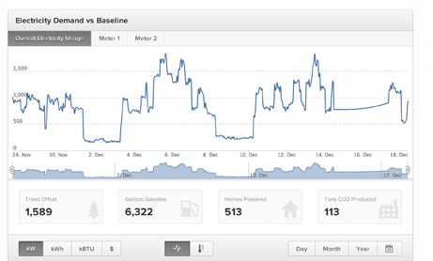
Measuring inputs to determine targeted reduction strategies...
Real Time Energy Dashboards

Slide 15
Certified ISO 50001
EnMS or Energy Management System:
Our Energy Management System was
certified October 2014

Slide 16
Sustainable- Our certified ISO 14001 Environmental Management System and the earning the Highest Environmental Recognition for the State of N.C.
Efficient- Our certified ISO 50001 Energy Management System, our Energy Monitoring Equipment and Energy Performance Indicators all show we are continually improving.
Highest Quality All Natural Tobacco Products- We only use the highest quality tobacco leaf and every delivery is sampled and tested. Our Menthol is certified Organic and our Organic products use a vegetable base glue, not synthetic.

Slide 17
Some 2015 Numbers
1. Over a million pounds recycled from SFNTC.
2. 382.69 tons of tobacco dust was composted instead of landfilled.
3. We paid to have 8.7 million kwh of wind energy produced and
put back on the grid in Mew Mexico.
4. We off set 4523 MtC02 with tree replacement initiatives in N.C.
5. 23 percent efficiency gains in BTUs needed to produce products in
2015 compared to 2013.

Slide 18
Questions?????

