Slide 1
NPDES MS4 Phase II 101
An Introduction to MS4 Permits
March 25, 2019

Slide 2
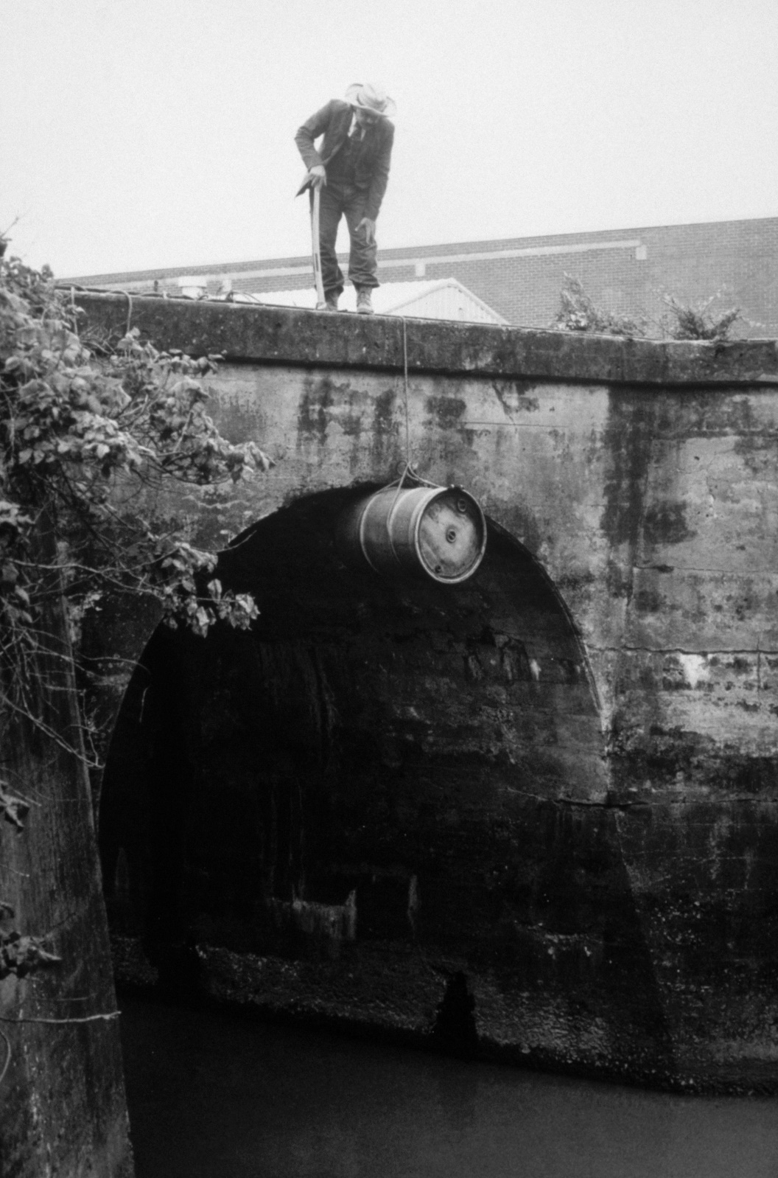
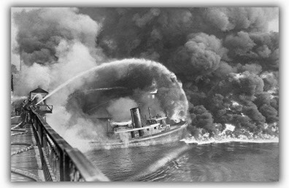
The Evolution of Water Quality Regulations
Back in the day…
Circa 1969
Notes:
82 days

Slide 3
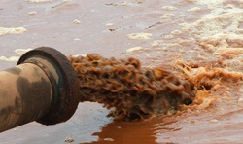
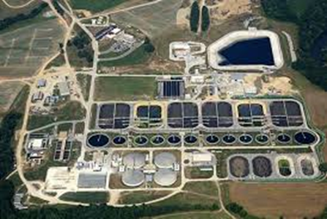
The Evolution of Water Quality Regulations
1970 EPA Established
1972 Clean Water Act – NPDES
The Low Hanging Fruit:
1973 NPDES Wastewater Permits
1974 Safe Drinking Water Act
Department of Environmental Quality
Notes:
82 days

Slide 4
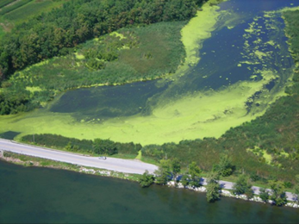
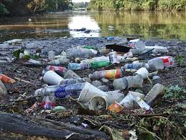
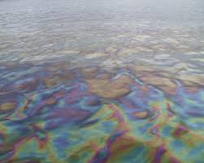
The Evolution of Water Quality Regulations
Stormwater runoff is now the #1 source of surface water pollution in the U.S.
1990 Phase I Stormwater (> 100,000 pop.)
1999 Phase II Stormwater (small MS4s)
Department of Environmental Quality
Notes:
82 days

Slide 5
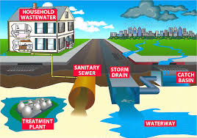
NPDES MS4
National Pollutant Discharge Elimination System (NPDES)
Municipal Separate Storm Sewer System (MS4)
A conveyance or system of conveyances (including roads with drainage systems, municipal streets, catch basins, curbs, gutters, ditches, manmade channels, or storm drains) owned or operated by the United States, a State, city, town, county, district, association, or other public body…that discharges to waters of the United States or waters of the State that is designed or used for collecting or conveying stormwater…
Department of Environmental Quality
Notes:
82 days

Slide 6
Regulated Small MS4s
Federal Designation
Urbanized Areas > 50,000 pop.
Contiguous census block groups
Core pop. > 1,000 / sq. mi.
Surrounding core > 500 / sq. mi.
State Designation
Potential for adverse impact to water quality, or
Either pop. > 10,000 or > 4,000 housing units, and
Either density > 1,000 ppsm or > 400 hupsm
Department of Environmental Quality
Notes:
82 days

Slide 7
NPDES MS4 Phase II Permit Requirements
Develop a comprehensive Stormwater Management Plan (SWMP)
to address six Minimum Control Measures (MCMs):
Public Education & Outreach
Public Participation & Involvement
Illicit Discharge Detection & Elimination (IDDE)
Construction Site Runoff Controls
Post-Construction Runoff Controls (PC)
Pollution Prevention/Good Housekeeping (PP/GH)
plus Program Administration
and sometimes TMDLs
Department of Environmental Quality
Notes:
82 days

Slide 8
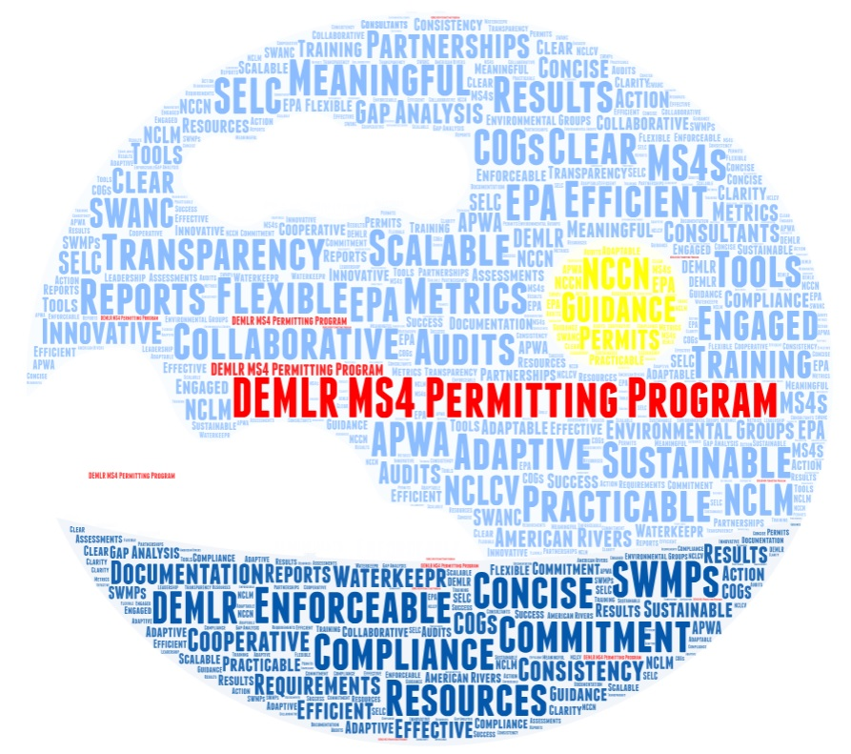
DEQ MS4 Stormwater Program
EPA has delegated the federal NPDES MS4 Program to DEQ.
DEQ is required to:
Develop & Issue NPDES MS4 Permits
Review & Approve MS4 Stormwater Management Plans (SWMPs)
Perform & Document Permit Compliance Audits
Audit 20% of Permittees Per Year
Approve Permitted Program Changes
Review Annual Reports
Department of Environmental Quality

Slide 9
Jeanette Powell MS4 Program Coordinator (919) 707-3620 jeanette.powell@ncdenr.gov

