Slide 1
Department of Environmental Quality
March 10, 2022

Slide 2
Department of Environmental Quality

Slide 3
Department of Environmental Quality

Slide 4
Department of Environmental Quality

Slide 5
Department of Environmental Quality

Slide 6
Department of Environmental Quality

Slide 7
Department of Environmental Quality

Slide 8
Department of Environmental Quality

Slide 9
Department of Environmental Quality

Slide 10
Department of Environmental Quality

Slide 11
Department of Environmental Quality

Slide 12
Small Chart
Department of Environmental Quality

Slide 13
Large Chart
Department of Environmental Quality

Slide 14

Small Image
Department of Environmental Quality

Slide 15

Medium Image

Slide 16
Large Image
Department of Environmental Quality

Slide 17
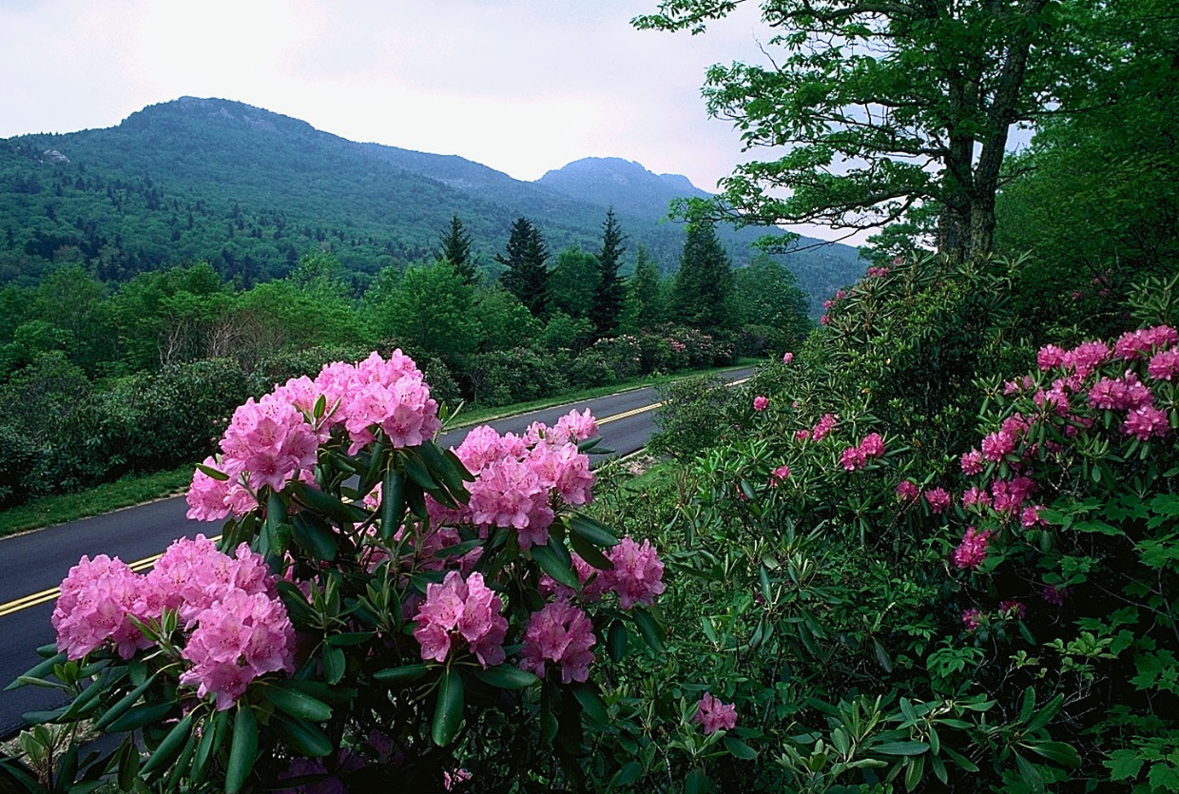
Department of Environmental Quality

Slide 18

Department of Environmental Quality

Slide 19

Department of Environmental Quality

Slide 20

Department of Environmental Quality

Slide 21
Small SmartArt Graphic
Department of Environmental Quality

Slide 22
Large SmartArt Graphic
Department of Environmental Quality

Slide 23
Department of Environmental Quality

Slide 24
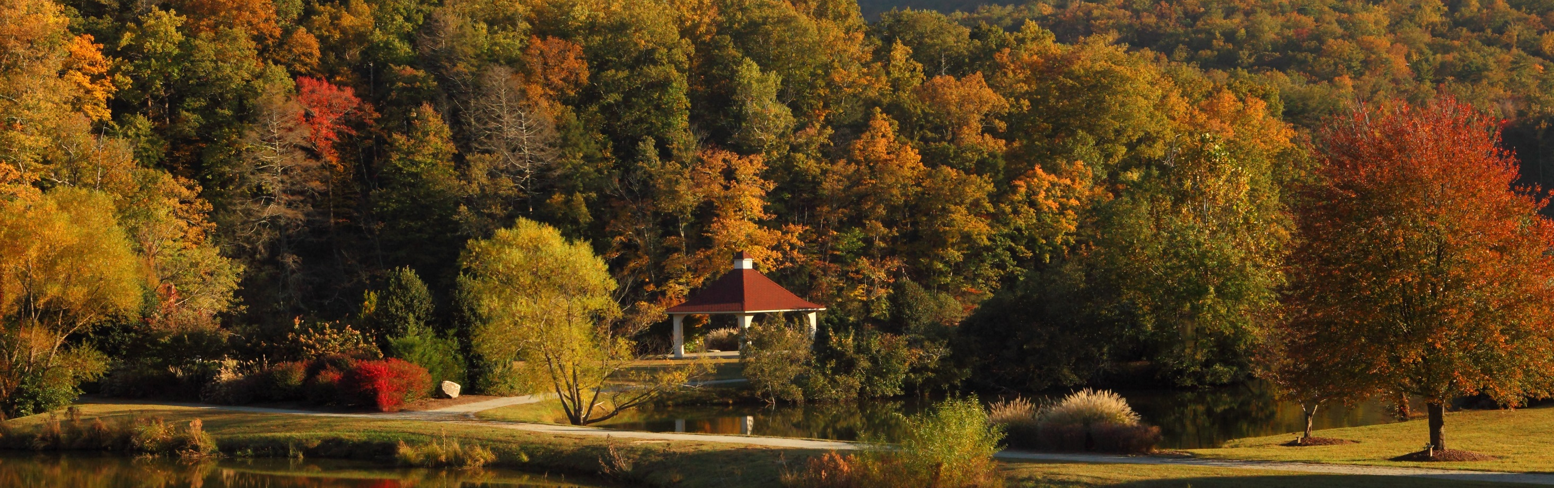
Department of Environmental Quality

