Slide 1
Department of Environmental Quality
Annette Lucas, PE
Minimum Measure 5: Post-Construction Program
April 2019

Slide 2
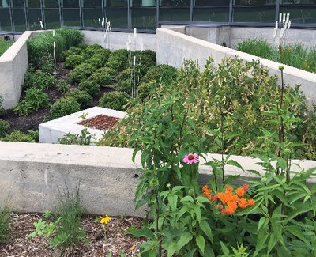
#5: Post-Construction Program: SWMP Requirements
Develop, implement, enforce, and document a Post-C program.
Projects that disturb > one acre and smaller projects that are part of a common plan of development that disturbs > one acre.
Department of Environmental Quality

Slide 3
Qualifying Alternative Post-C Programs
NC Statute and Rules state that the following programs comply with the Post-C Requirements of the permit:
Water Supply Watershed
Coastal Counties
Neuse NSW
Tar-Pamlico NSW
Randleman Lake
Universal Stormwater Management Program

Slide 4
Post-C Program Options
Qualifying alternative program (QAP) covers the whole jurisdiction.
The jurisdiction has a mix of areas covered by the MS4 program and other compliant post-construction program (or programs).
The MS4 Post-Construction Program covers the whole jurisdiction.
Department of Environmental Quality

Slide 5
Option 1: QAP everywhere
Water Supply Watershed, Coastal Counties, Neuse & Tar-Pamlico NSW, Randleman Lake, Universal Stormwater Management Program
The above program(s) meet NPDES MS4 Post-C Program requirements in the geographic areas where they are implemented.
Maintain a map indicating where the different programs apply.

Slide 7
Option 2: QAP some places, MS4 others
Water Supply Watershed, Coastal Counties, Neuse & Tar-Pamlico NSW, Randleman Lake, Universal Stormwater Management Program
The above program(s) meet NPDES MS4 Post-C Program requirements in the geographic areas where they are implemented.
Elsewhere, adhere to the Post-C permit requirements for legal authority, plan review/approval, inspection/enforcement, documentation and fecal coliform.
Maintain a map indicating where the different programs apply.

Slide 9
Option 3: MS4 everywhere
Comply with the Post-C permit requirements for legal authority, plan review/approval, inspection/enforcement, documentation and fecal coliform.

Slide 11
Legal Authority – MS4 Post-C
Review development designs to determine whether adequate SCMs will be installed, implemented, and maintained.
Request stormwater plans, inspection reports, monitoring results, etc. to evaluate compliance with the Post-C Program.
Enter private property to inspect facilities, practices, or operations to determine compliance with the Post-C Program.

Slide 12
Plan Review & Approval – MS4 Post-C
Federal, State, and local government projects shall comply with Post-C requirements unless the entity has its own NPDES MS4 permit or QAP.
Conduct site plan reviews for compliance with 15A NCAC 02H .1017.
Ensure that each project has:
an O&M Agreement and an O&M Plan.
recorded deed restrictions and protective covenants that require the project to be maintained consistent with approved plans.
permanent recorded easements for SCMs and maintenance accesses.

Slide 13
Inspection & Enforcement – MS4 Post-C
Ensure that the project has been constructed in accordance with the approved plan(s).
Inspect prior to issuing a Certificate of Occupancy (or temporary CO). Alternatively, the owner may provide a surety bond.
Annual inspection of each permitted SCM to ensure compliance with the approved Operation and Maintenance Agreement.
Inspection of low density projects at least once during the permit term.
Inspections must be conducted by a qualified professional.

Slide 14
Documentation – MS4 Post-C
Maintain an inventory of post-construction SCMs and low density projects.
Document, track and maintain records of inspections and enforcement actions. Tracking shall include the ability to identify chronic violators.
Make available to developers all relevant ordinances, post-construction requirements, design standards, checklists, and/or other materials.

Slide 15
Fecal Coliform Program – MS4 Post-C
A pet waste management component, which may be achieved by revising an existing litter ordinance.
b) An on-site domestic wastewater treatment system component (if applicable), which may be coordinated with local county health department, to ensure proper operation and maintenance of such systems.

Slide 16
Still have questions?
Feel free to reach out!
annette.lucas@ncdenr.gov
deq.nc.gov/SW
(919) 707-3639
Department of Environmental Quality

Slide 17
Department of Environmental Quality

