Slide 1
Snapshot of Some Current NC State Stormwater Engineering Group Research – with a Special Emphasis on SAND FILTERS
SAB Presentation – February 4, 2021
Bill Hunt, PE, Ph.D.
WNR Prof & Extension Specialist
Biological & Agricultural Engineering
NC State University

Slide 2
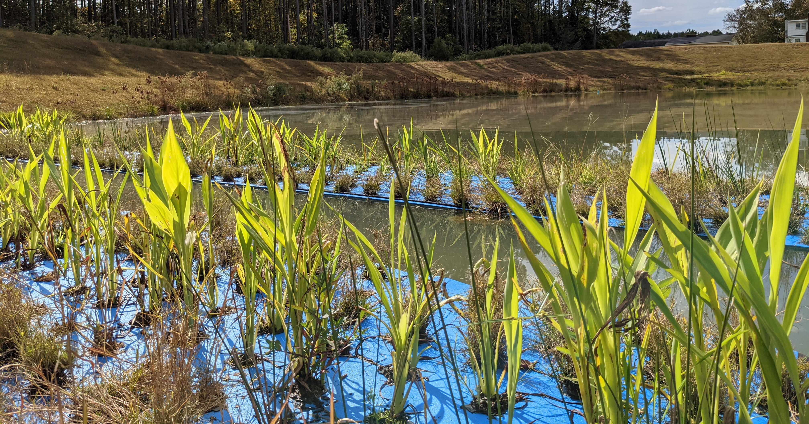
Strategic Floating Treatment Wetland Placement
Floating treatment wetlands (FTWs) are buoyant mats planted with wetland vegetation whose roots are suspended into the water column, allowing direct contact with the water to be treated.
They are commonly used as a retrofit in stormwater detention ponds (wet ponds) to increase water quality treatment.
In North Carolina, current design guidance recommends FTWs be installed at ~20% pond surface coverage in order to see significant improvement in nutrient and sediment removal.

Slide 3

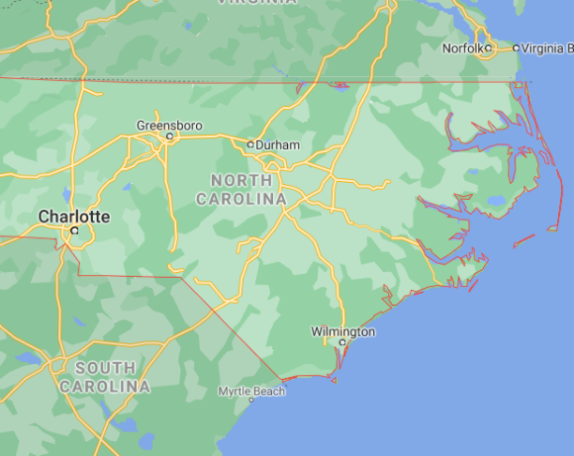
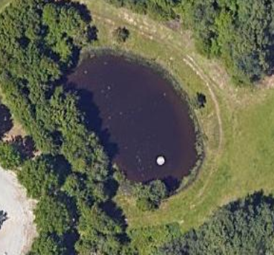
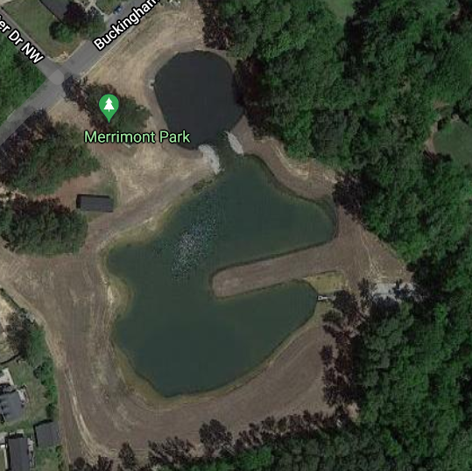

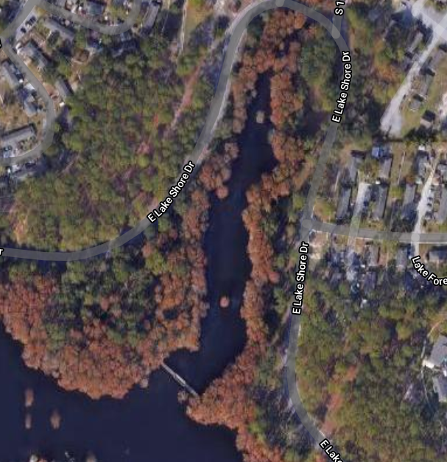
A Novel FTW Design Approach to Increase Treatment Efficiency
Project Goal
Investigate the effect of strategic FTW placement on water quality treatment at 3 field sites across North Carolina
Hypothesis
Strategic placement will provide significant improvement in nutrient & sediment removal at lower surface coverage rates
Image sources: Google Earth, Google Maps

Slide 4
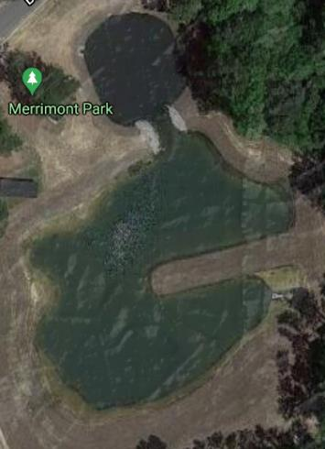
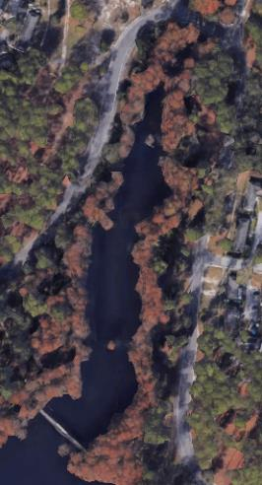
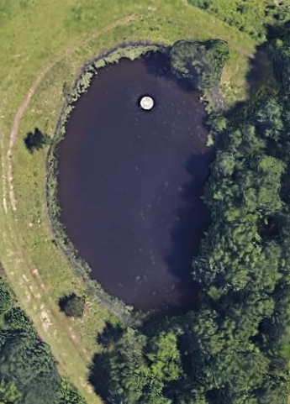
Strategic Placement Designs: Maximizing Runoff Contact w/ Root Systems
3.5% coverage
0.8% coverage
0.8% coverage

Slide 5
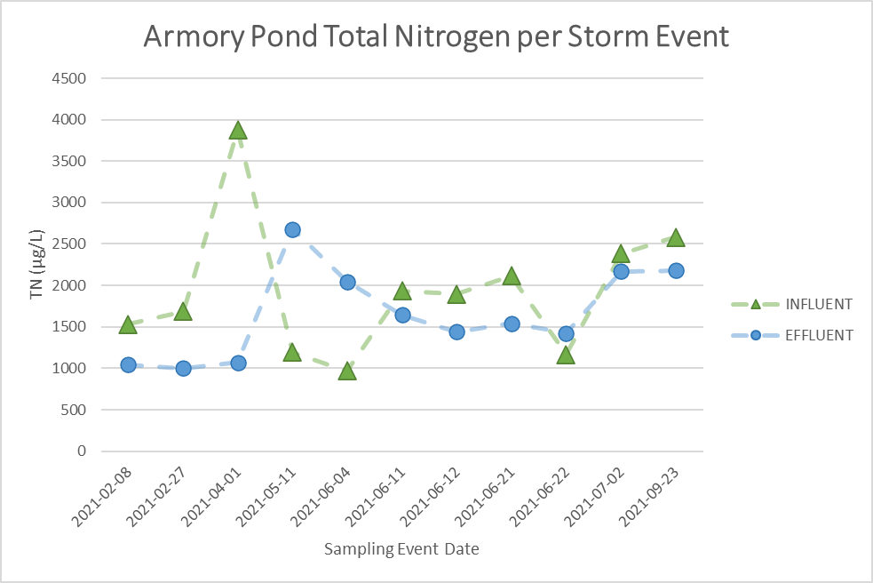
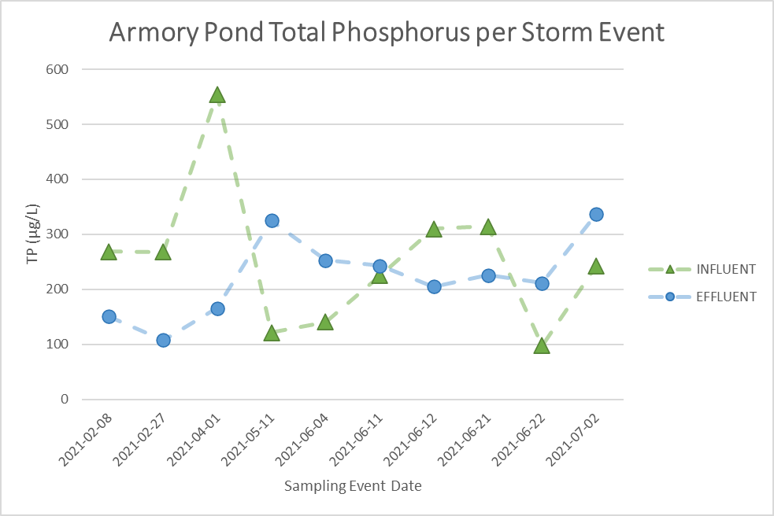
Progress: Armory Pond PRE-Retrofit Performance
10 storm events sampled between Feb-July 2021
Average total nitrogen (TN) removal efficiency of -3.75% (range -125 to 72.4%)
Average total phosphorus (TP) removal efficiency of -17.4% (range -168 to 70.1%)
Notes:
https://www.teledyneisco.com/en-us/waterandwastewater/Pages/6712-Sampler.aspx

Slide 6
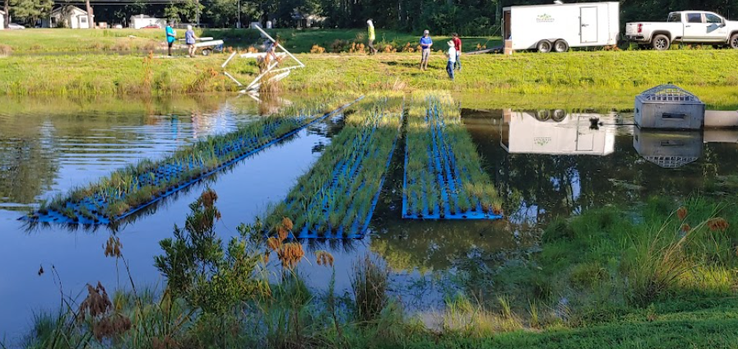
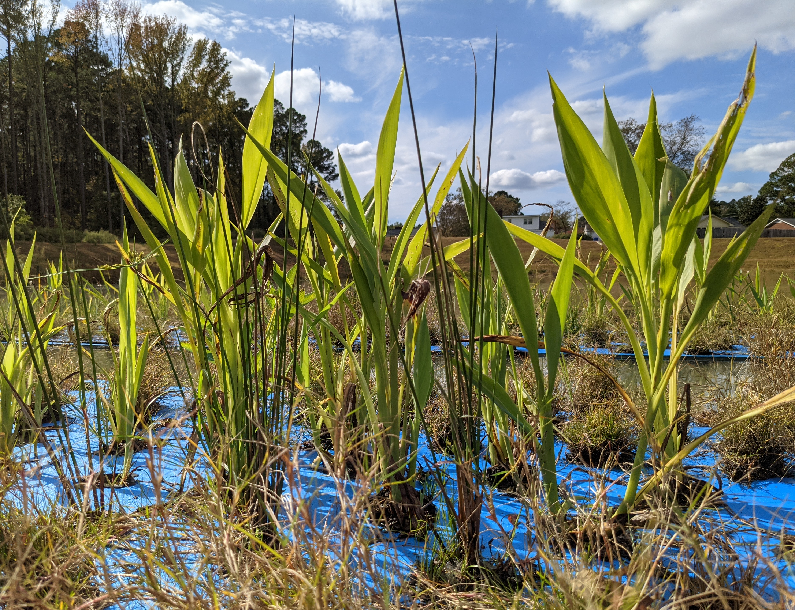
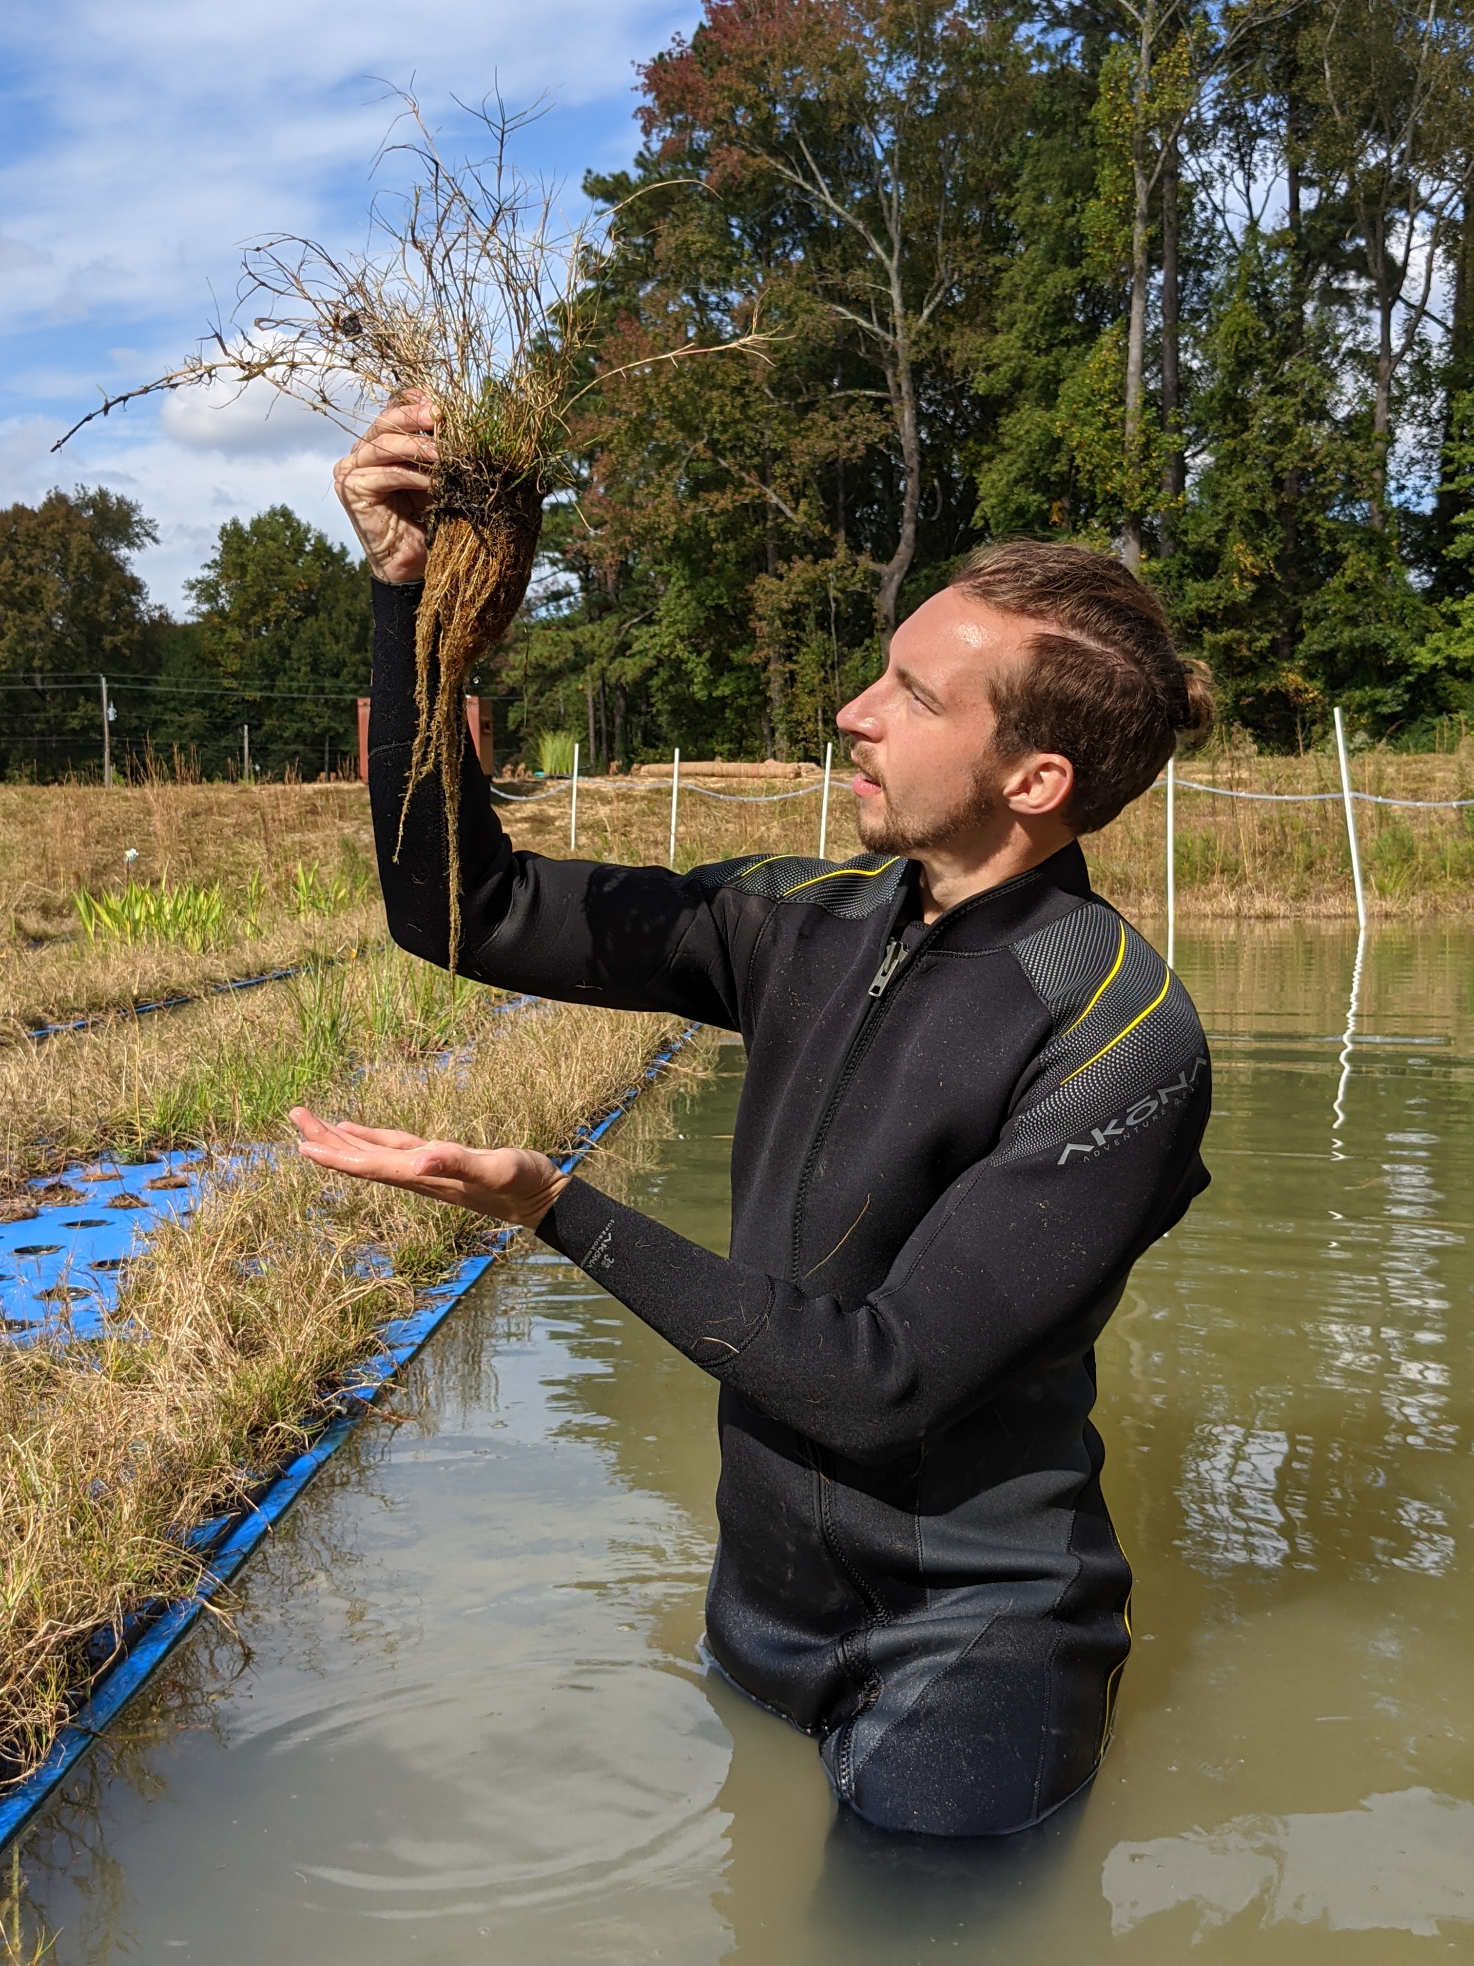
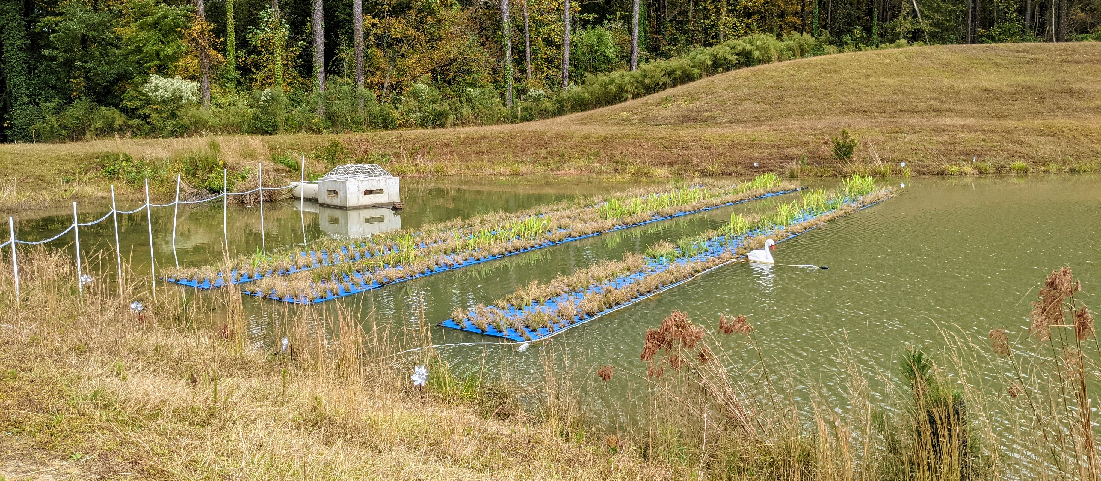
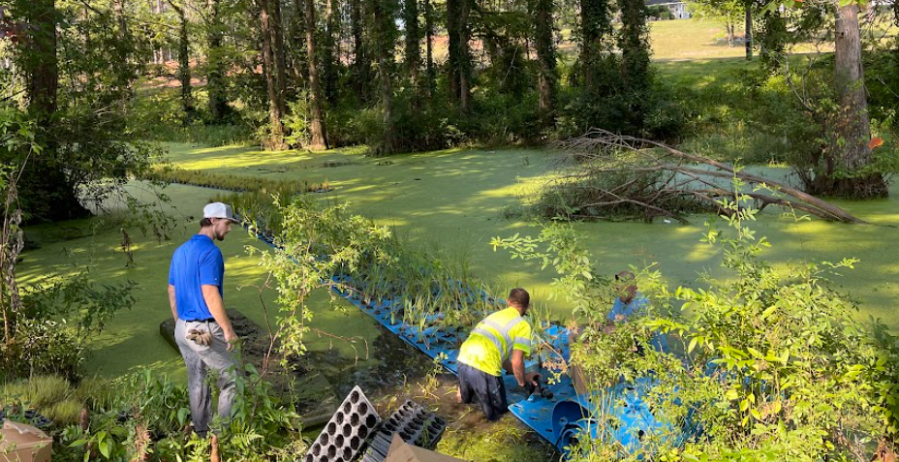
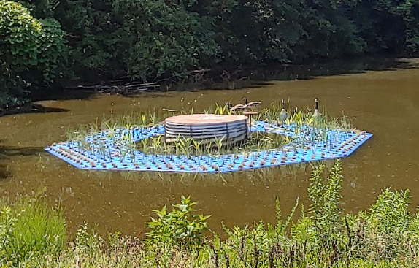
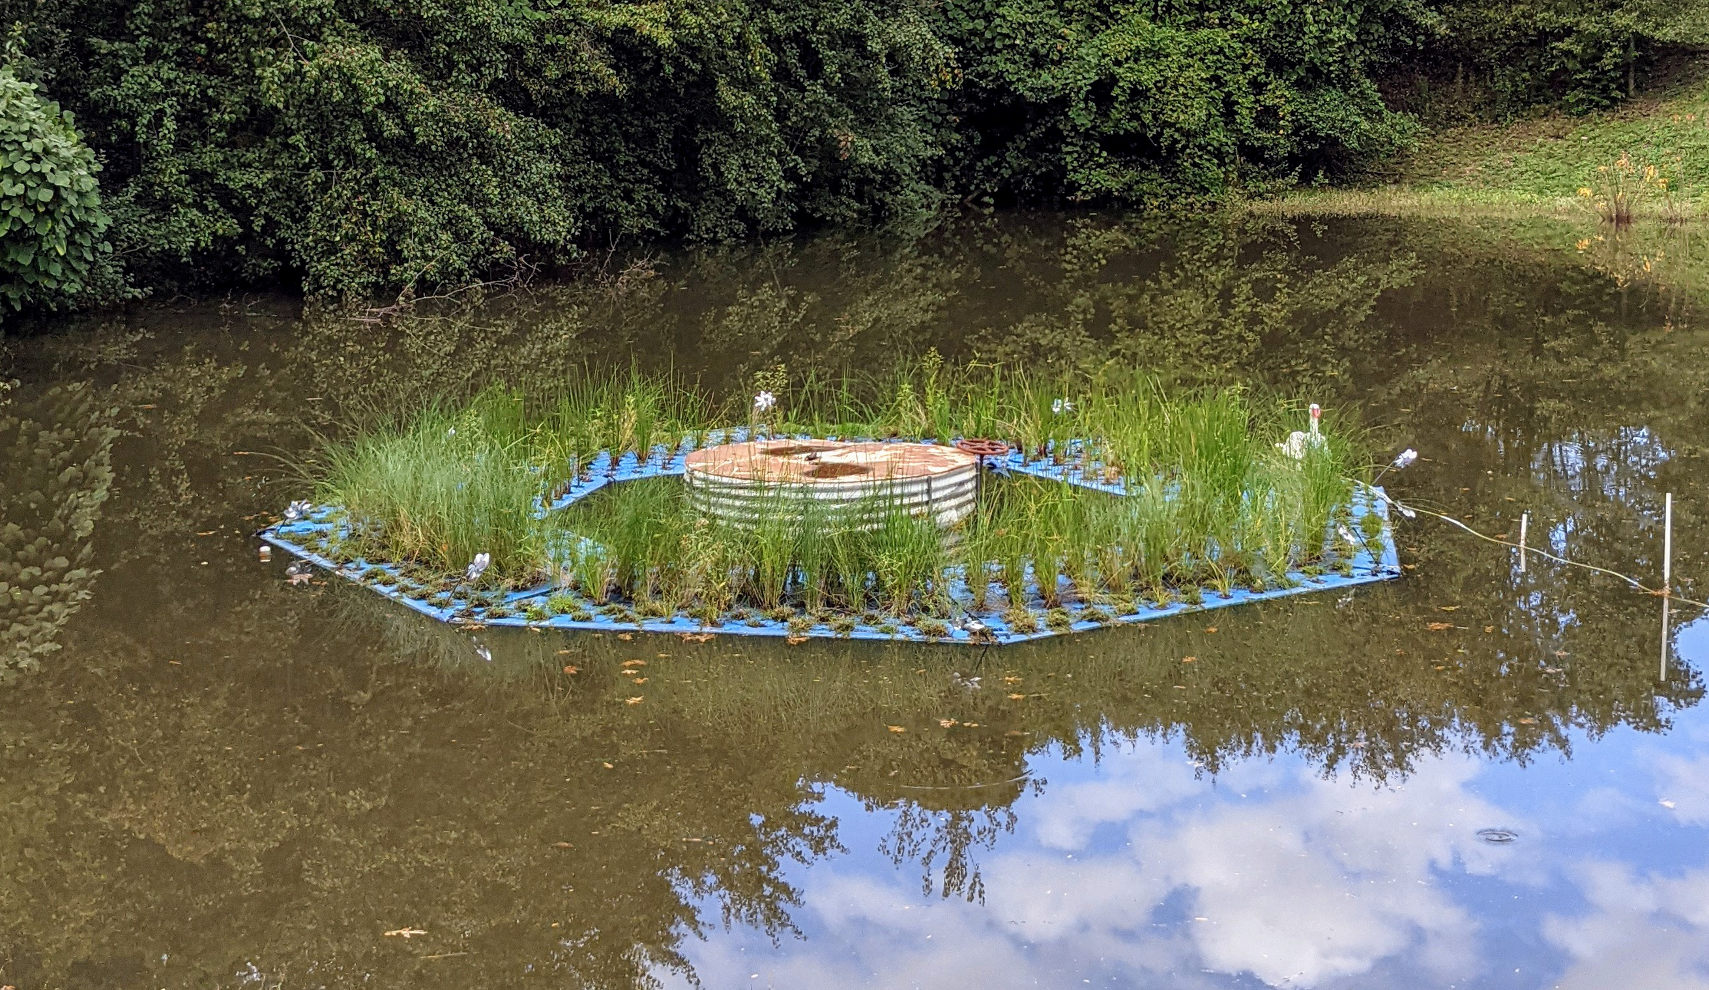
Progress: Floating Treatment Wetland Site Pictures
Notes:
https://www.teledyneisco.com/en-us/waterandwastewater/Pages/6712-Sampler.aspx

Slide 7
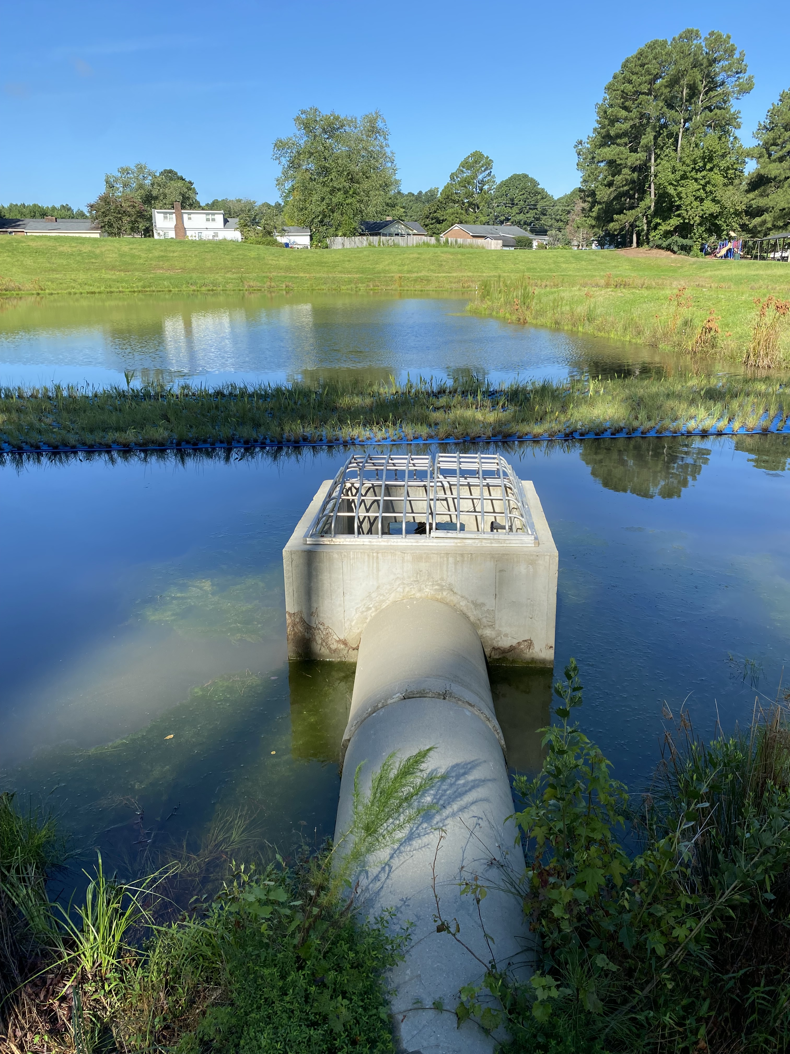
Timeframe
Projects Funded by NCDEQ, NC Policy Collaboratory, NCL&WF
  2020-2023
Raleigh pond pre-testing 2020-21
FWI Retrofit Installation: Summer 2021
FWI Monitoring Start (Raleigh: Sep 21, Wilson: Oct 21, Wilmington: Nov 21)
Project Completion: Dec 2022

Slide 8
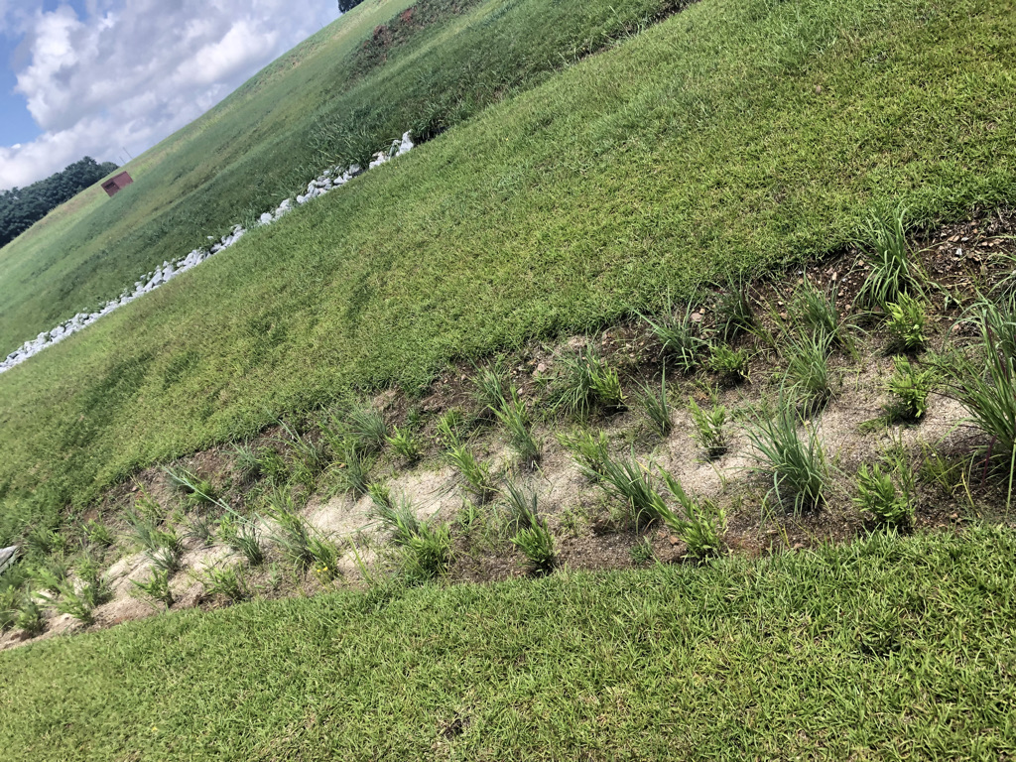
Roadside Swale Research
Emily Leupp

Slide 9
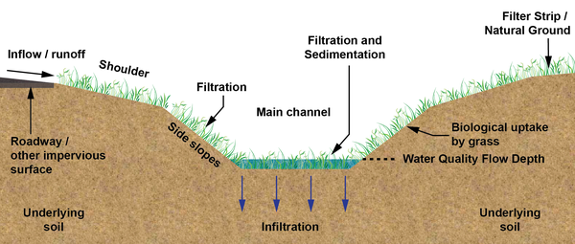
What is a swale?
Stormwater control measure designed as a shallow channel with gently sloping sides
Primary goals of pollutant removal and safe conveyance of runoff from large storm events

Slide 10
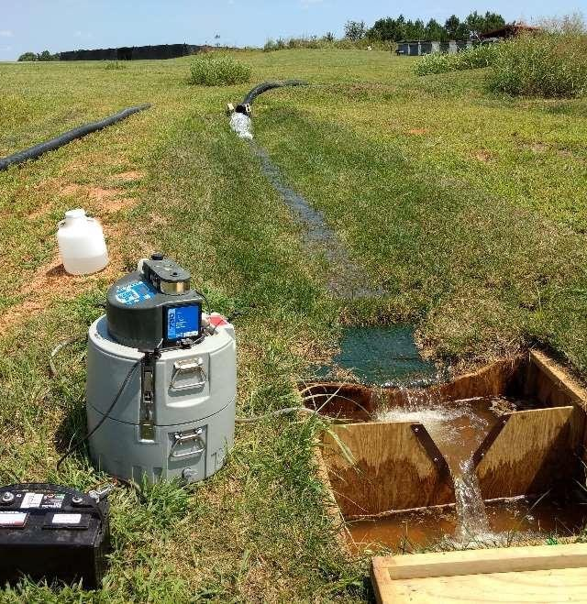
Project Details
We are always trying to improve maintenance! Partnered with NCDOT, we are exploring the benefits of alternative vegetated/non-vegetated linings to maintenance and water quality requirements of roadside swales.

Slide 11
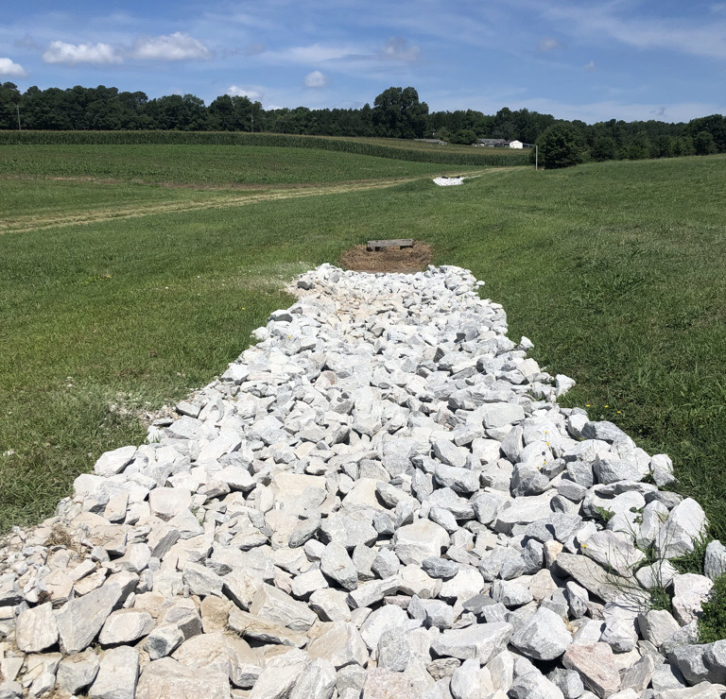
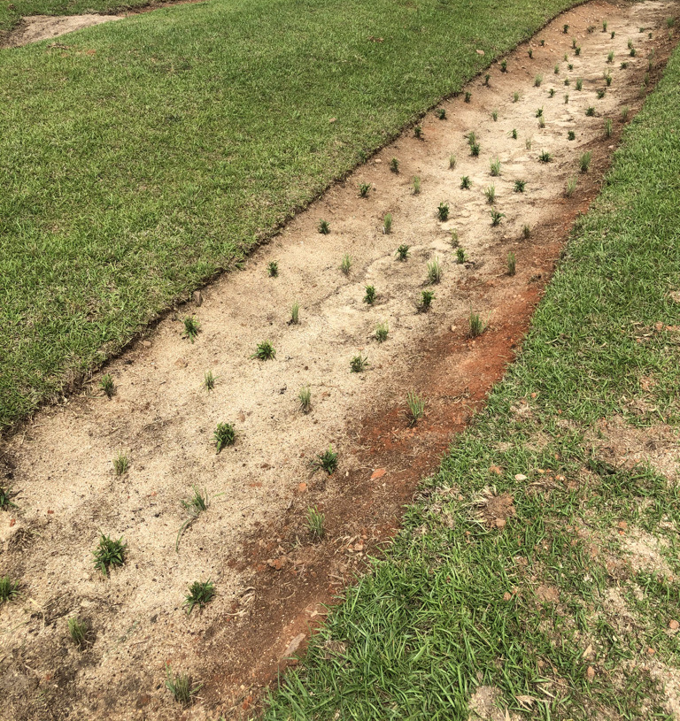
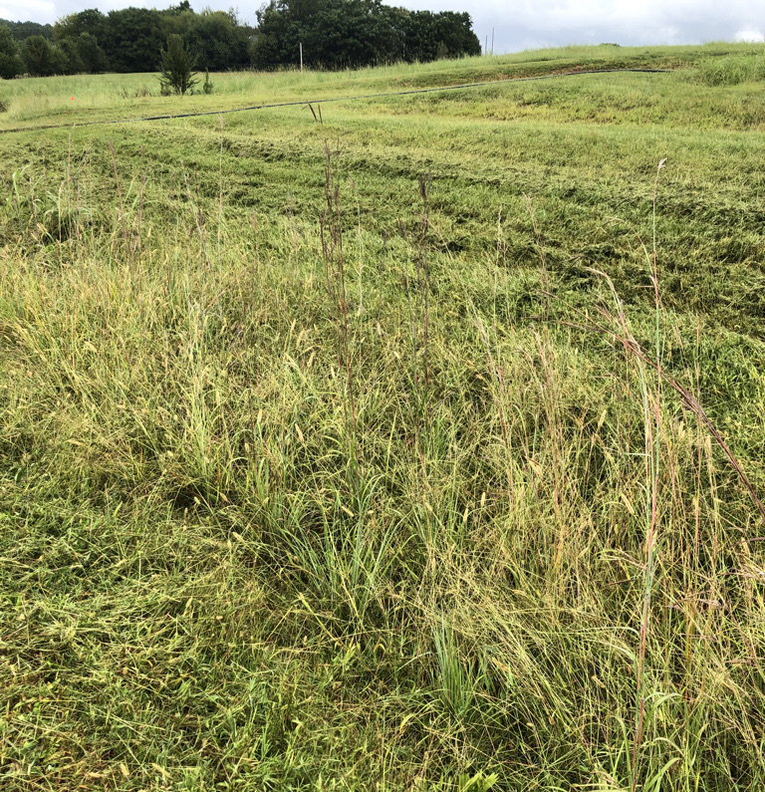
Alternative Linings
Non-Vegetated
Class B Riprap
Vegetated
50/50 combination of River Oats (RO) & Big Bluestem (BB)
Given one year to establish before data collection

Slide 12
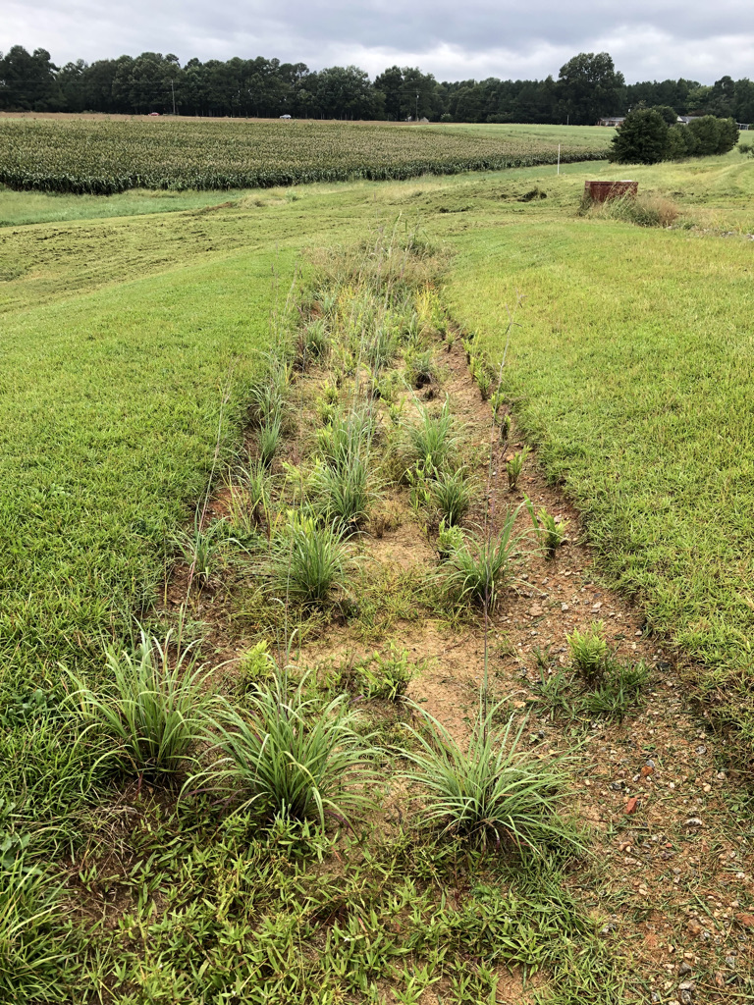
Why Native Grasses?
Current MDC states turf lining should be maintained at 6 inches
  Can be difficult to achieve
RO & BB can grow 3 ft and 6 – 8 ft, respectively
How will the native grass perform against typical turf and riprap linings?

Slide 13
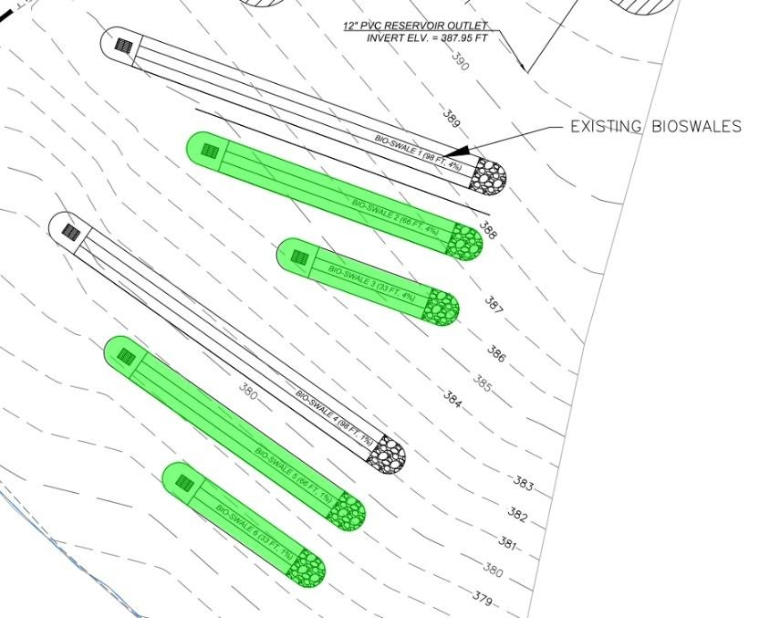
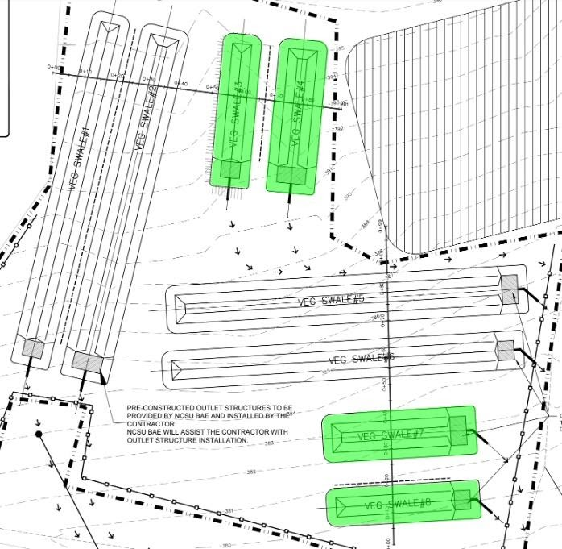
Parameters Tested
Bioswale vs. Conventional Swale
Slope
  1% vs. 4%
Alternative Linings
  Riprap
  Native Grasses to North Carolina
Multiple Storm Sizes
  0.5 in
  1.5 in
Water quality samples collected:
Total Suspended Solids (TSS)
Total Nitrogen (TN)
Total Phosphorus (TP)
Dissolved Metals
  Cadmium
  Copper
  Lead
  Zinc

Slide 14
Parameters Tested
Water quality samples collected:
Total Suspended Solids (TSS)
Total Nitrogen (TN)
Total Phosphorus (TP)
Dissolved Metals
  Cadmium
  Copper
  Lead
  Zinc

Slide 15
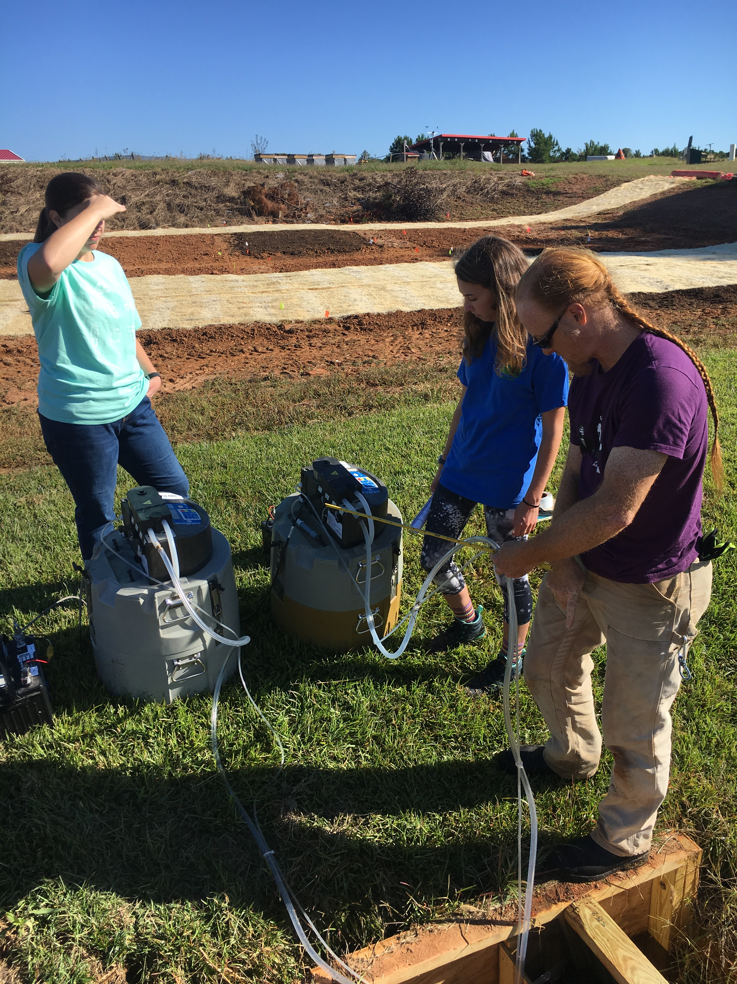
Timeframe
Project Funded by NCDOT
  2021-2023
Alternative Lining Swales installed in Summer 2021
Rip-rap swale testing began late summer
Native grass testing Summer 2022
Manning’s “n” Experimentation: Summer-Fall 2022

Slide 16
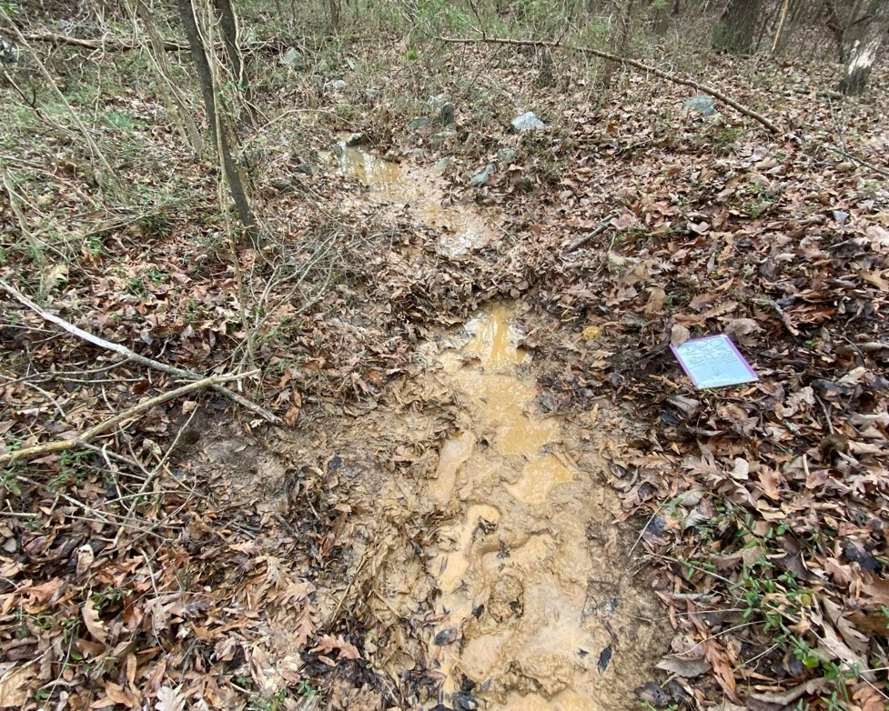
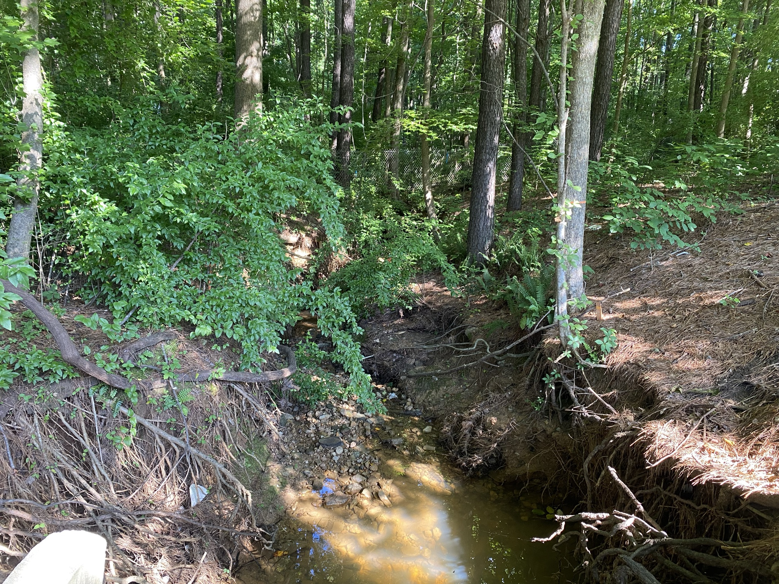
Outlet Analysis Protocol
Collaborating with NCDOT to identify characteristics causing downslope erosion from pipe outlets
  Determining length of downslope erosion
  Estimating amount of sediment lost to erosion
Developing protocol to assess future and current pipe outlets for downslope erosion
Monitoring and modeling 6 assessed sites

Slide 17
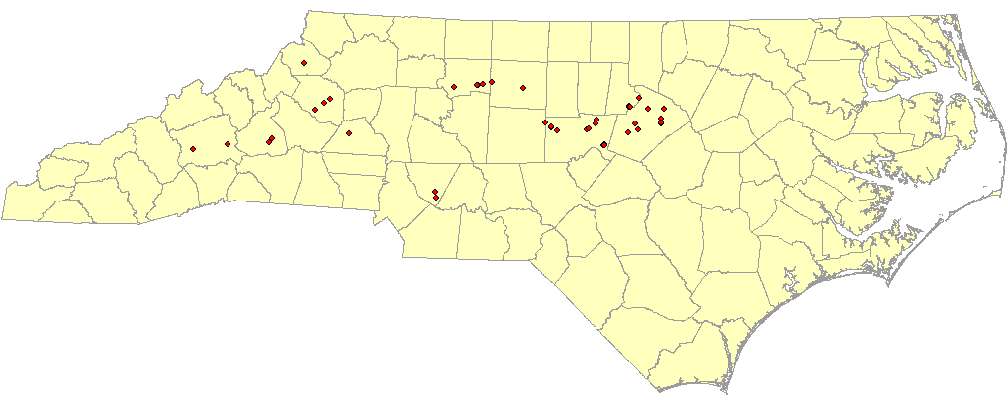
Site Assessments
60 site assessments across NC
Notes:
Total of 60 site assessments
Majority of assessments occurred in Wake and Chatham county; 10 assessments completed throughout Caldwell, Buncombe, McDowell, Watauga, and Catawba county

Slide 18
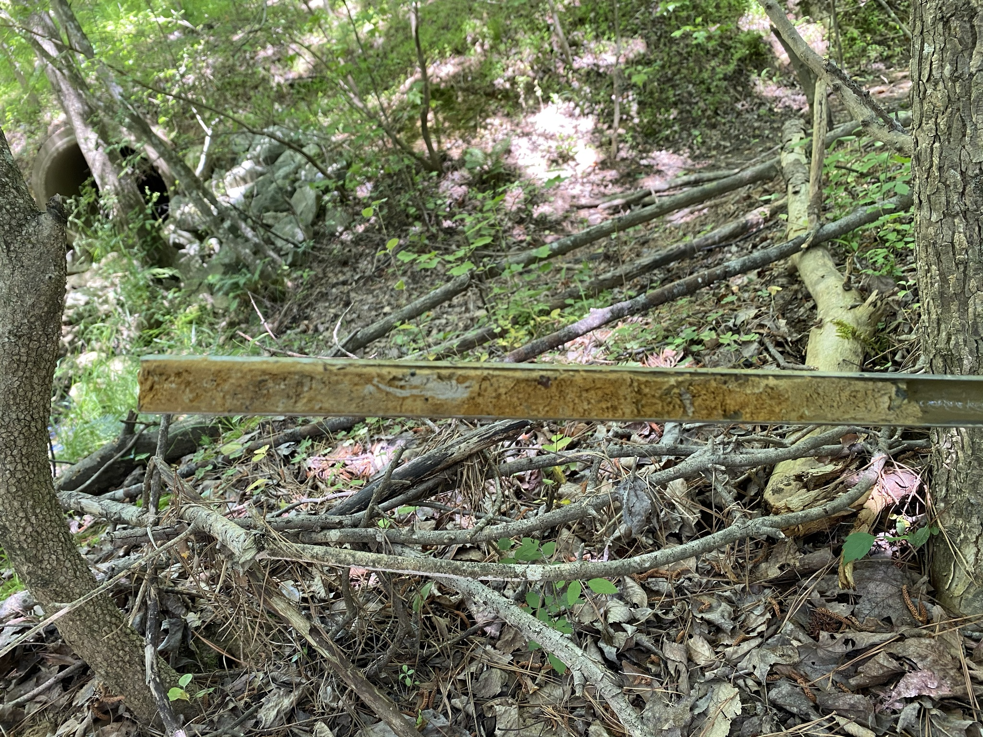
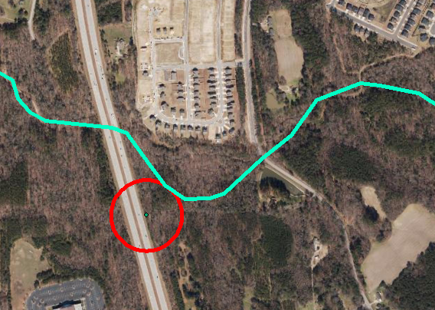
Site Assessments
Site assessed at outlet, furthermost adjacent property boundary, and outfall for:
  Cross-sectional area,
  Bulk density,
  Soil texture,
  Cohesion,
  Bank Erosion Hazard Index (BEHI)
  Manning’s n
Changes in channel between assessments points evaluated for:
  Cross-sectional area, BEHI, Manning’s n, cohesion
Notes:
Data collected included bulk density, cohesion, Manning’s n, cross-sectional area, bank erosion hazard index (BEHI), depth to confining layer, evidence of SHWT
Watershed area and buffer radius to nearest National Hydrology Dataset (NHD) stream data

Slide 19
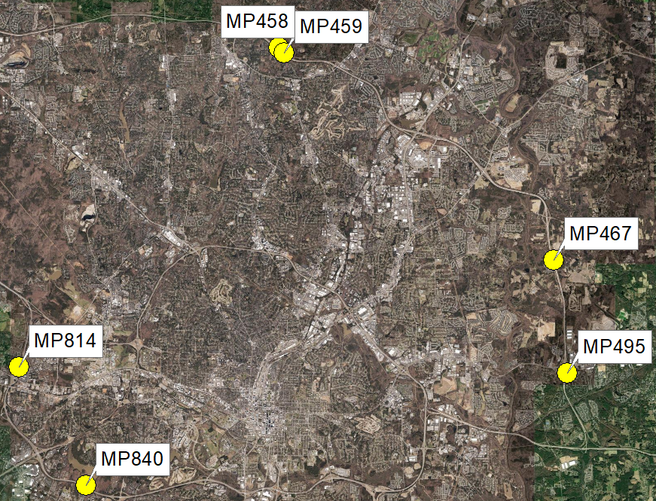
Monitoring and Modeling Sites
Survey data input to HEC-RAS to compare to monitoring results
Monitoring Site | Number of Samples
MP495 | 8
MP467 | 5
MP459 | 1
MP458 | 5
MP814 | 7
MP840 | 7
Wake Co (I-40 & I-540)
Notes:
Monitoring equipment installed in July 2021; expecting to collect samples through April 2022 (sites located along I-540 and I-40)
Will survey monitoring sites before December 2021 for HEC-RAS models
Design standards will be developed using monitoring sites and stability characteristics
Draft design standards/cost analysis/outlet analysis tool by June 2022

Slide 20
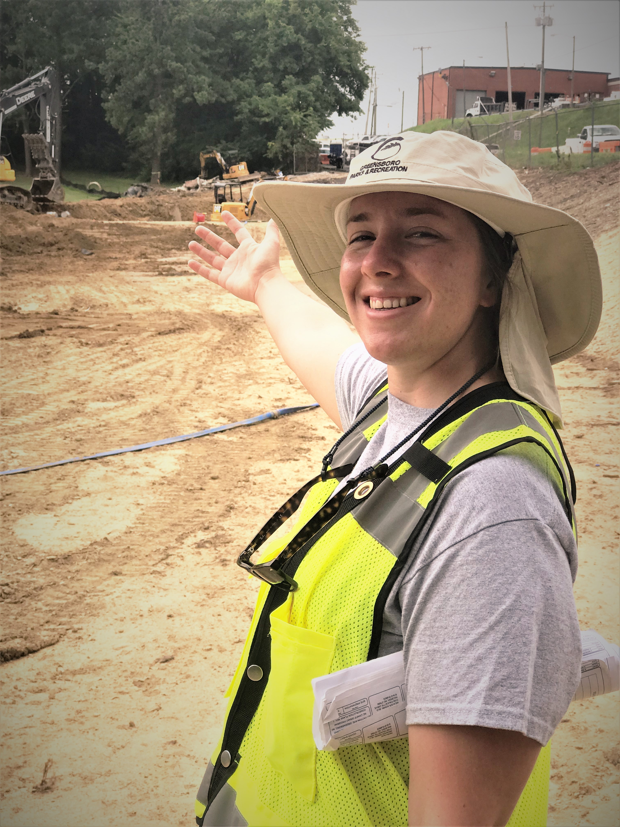
Timeframe
Project Funded by NCDOT
  2018-2022
Site Assessments: 2019-2021
Monitoring & Modelling: Jul 2021- Apr 2022
First Draft of Report: Jun 20022

Slide 21
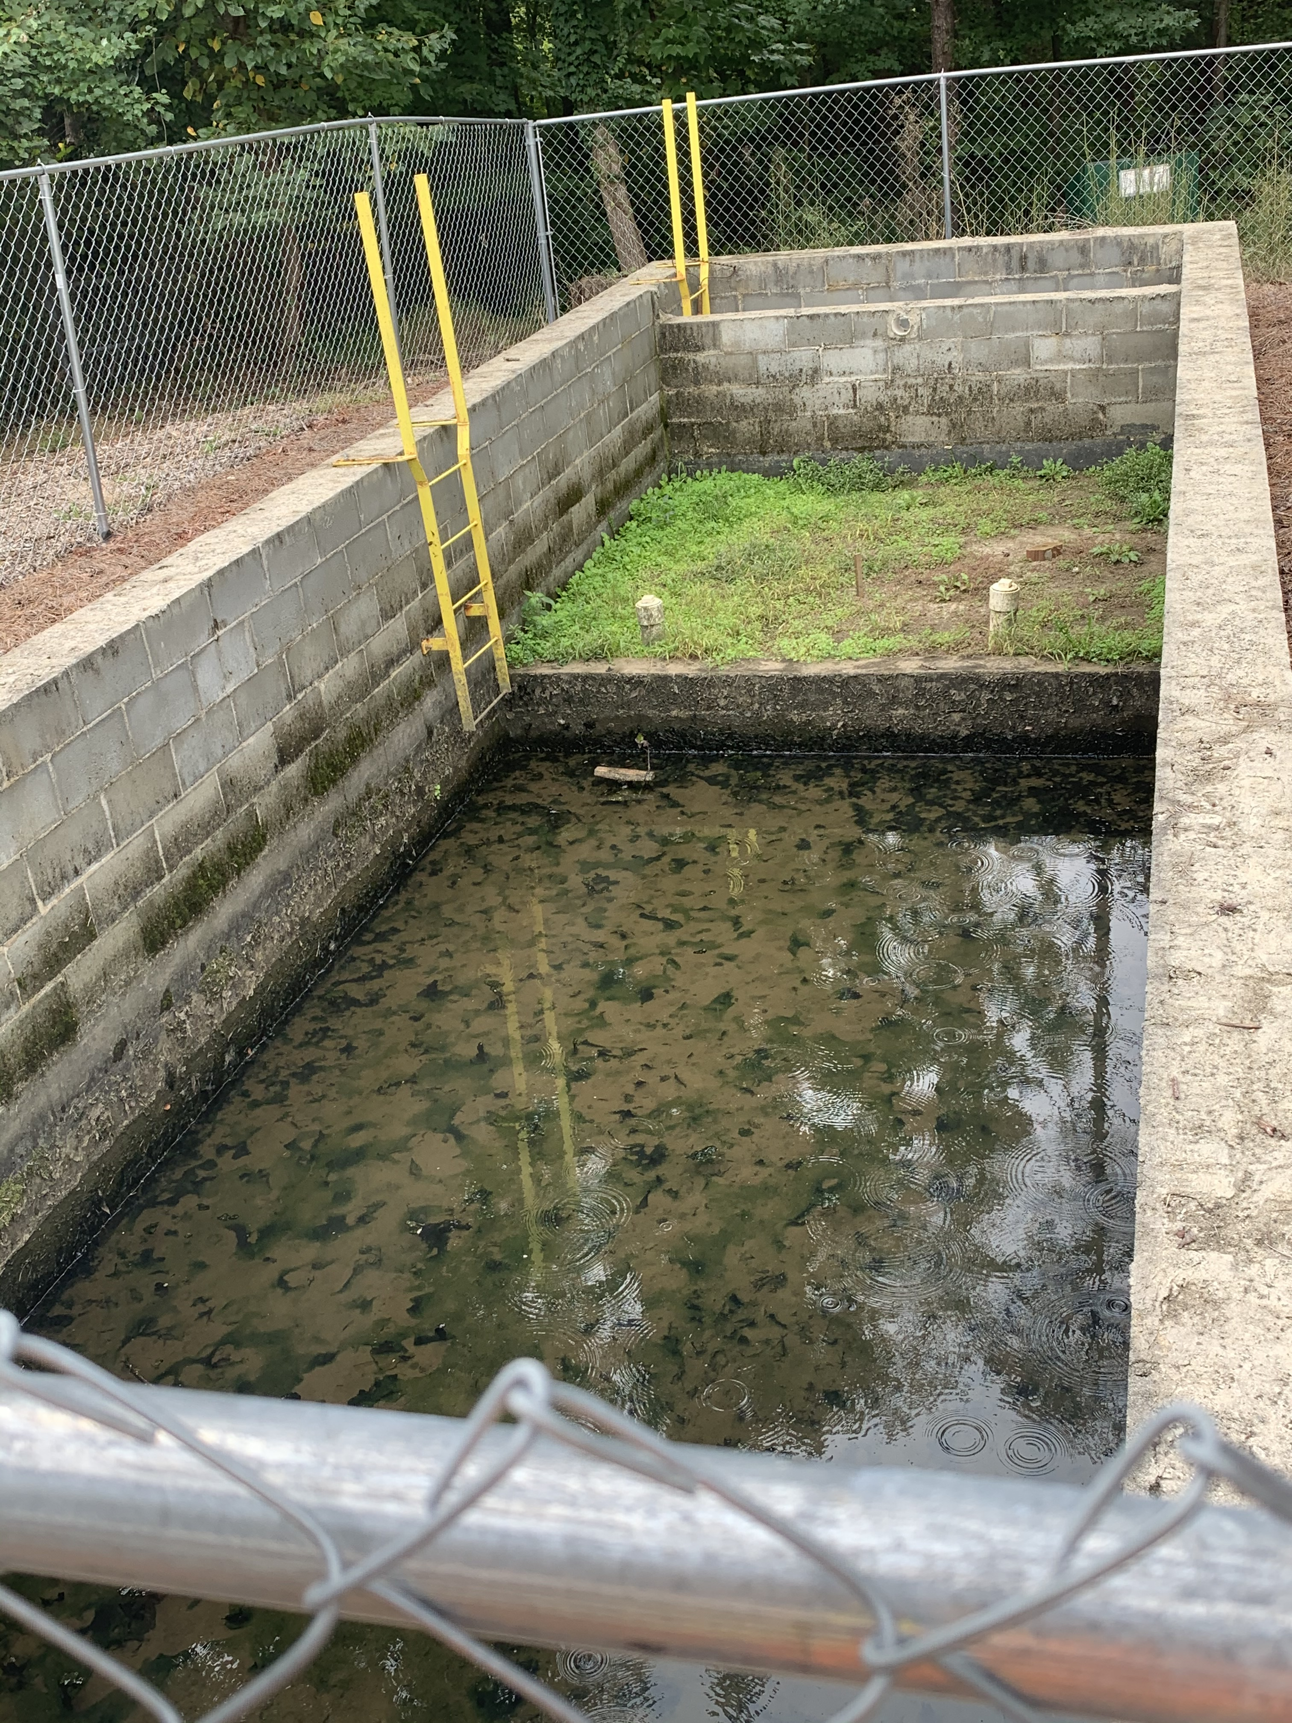
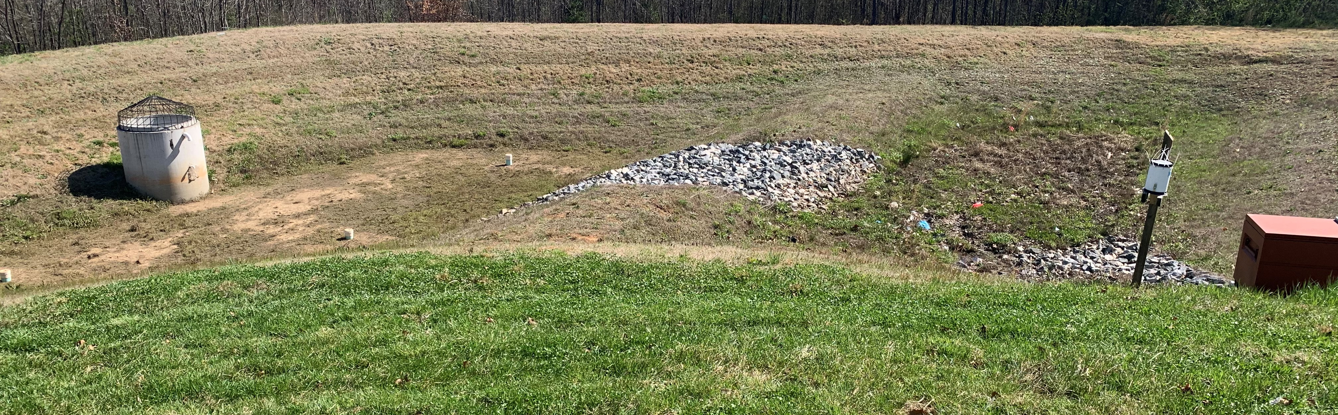
Stormwater Sand Filters
Greensboro, NC

Slide 22
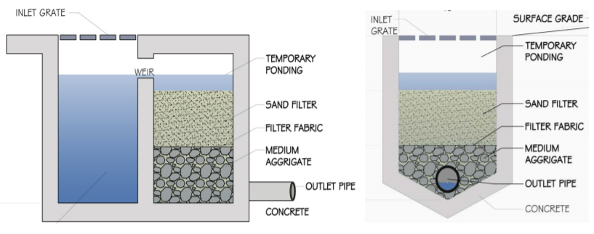
Stormwater Sand Filter
Research Questions:
Sand filter performance in NC’s humid subtropical climate?
Performance comparison to NCDEQ stormwater credits?
Internal water storage impact on treatment?

Slide 23
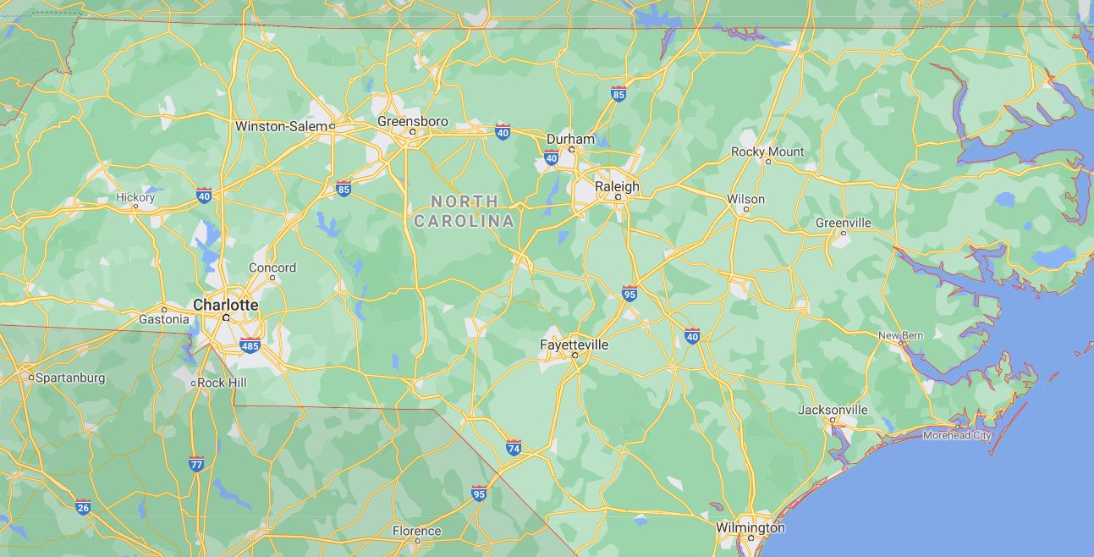
Methods
4 sand filters between Fayetteville and Greensboro
Retrofit to one filter in each city
Lab analysis for removal efficiency of TSS, TN (NO₃ + NH₃), TP (OP)
Image of North Carolina from Google Maps

Slide 24
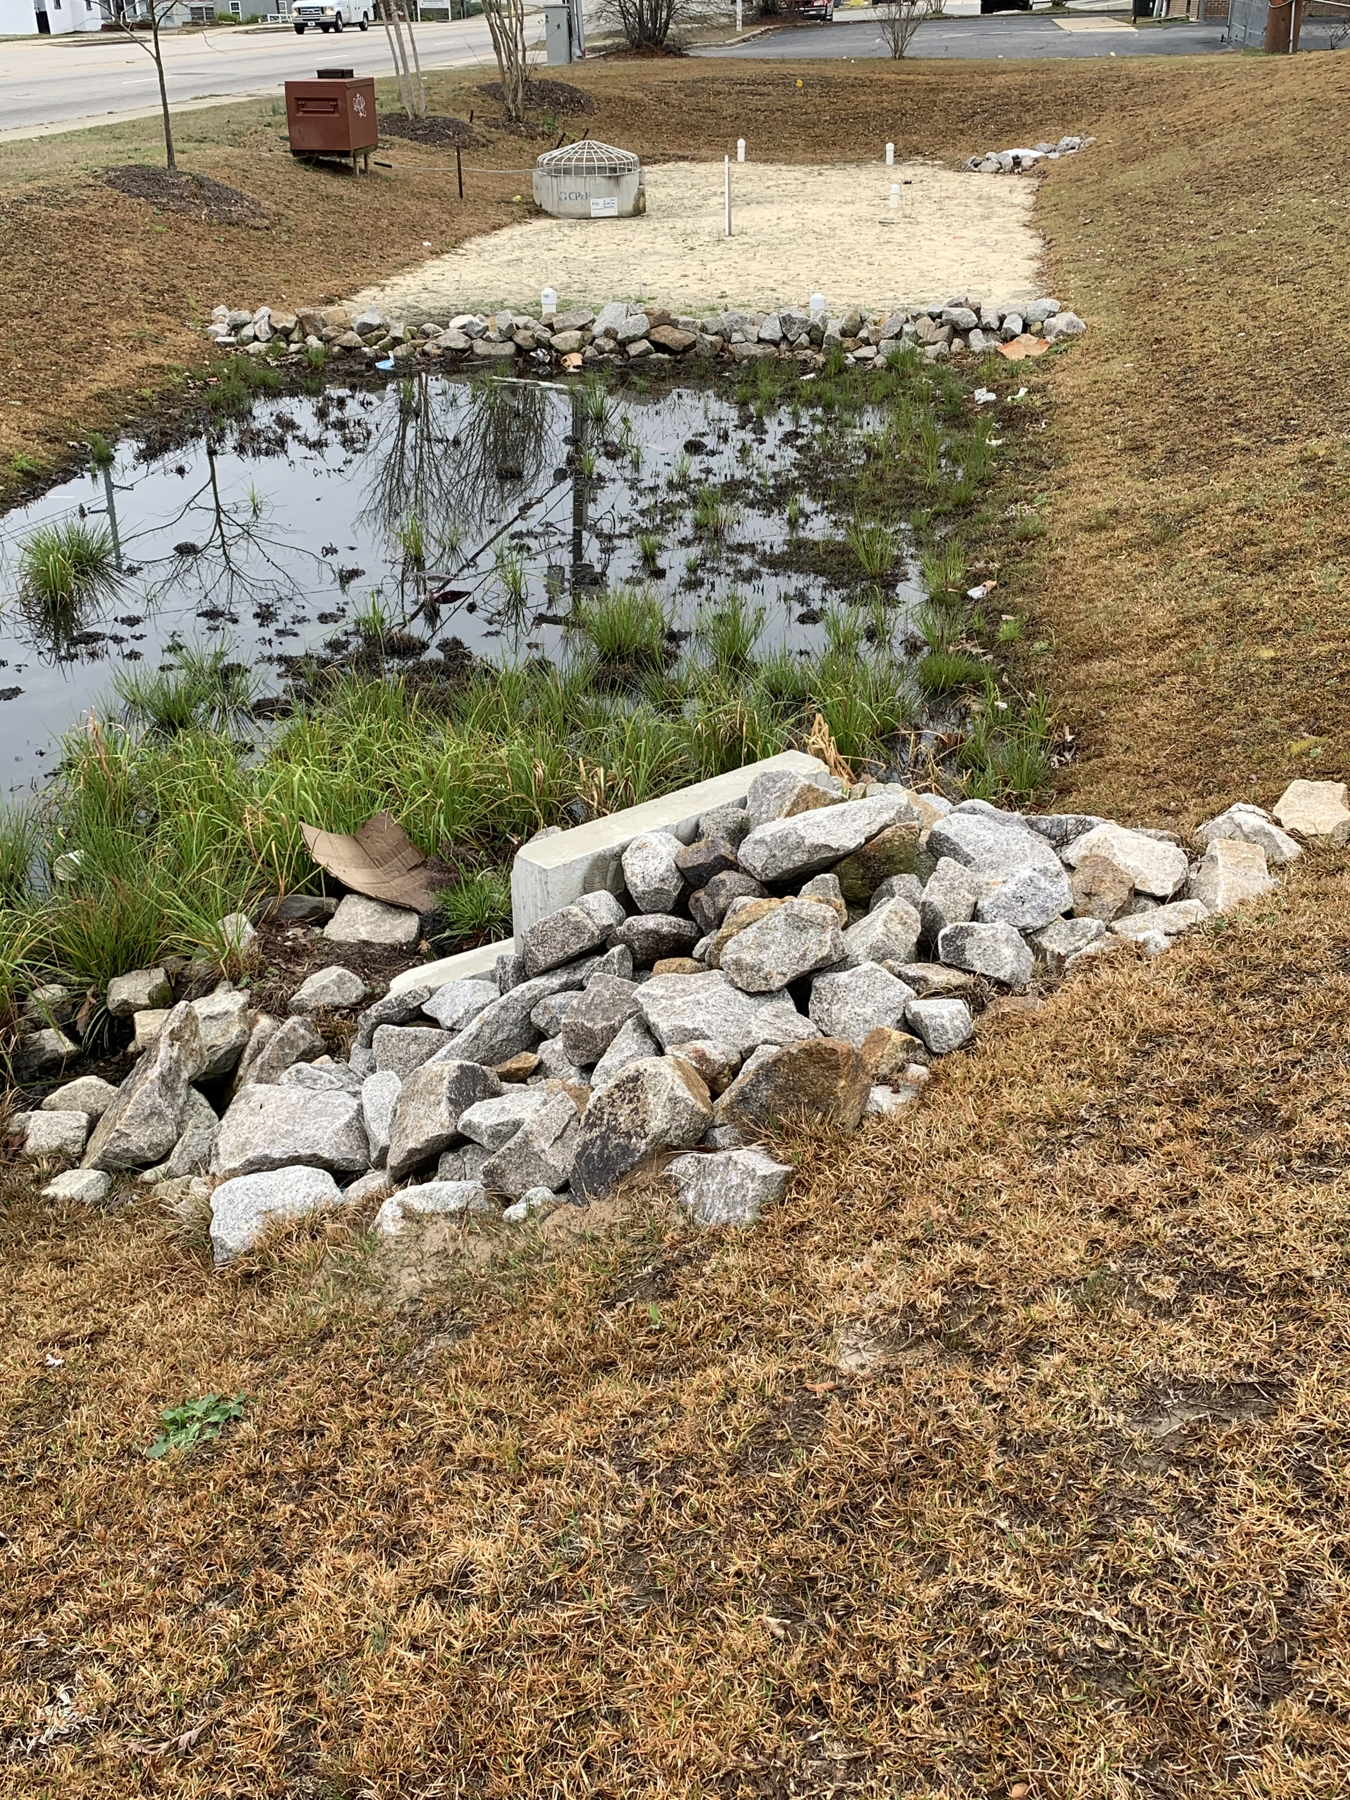
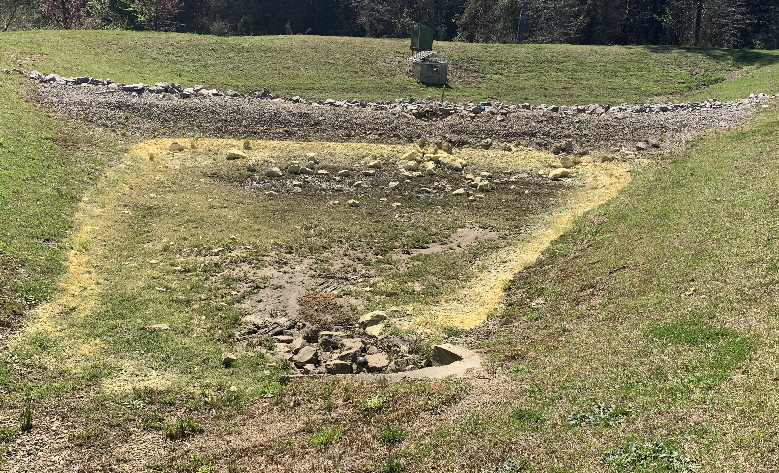
Fayetteville, NC

Slide 25
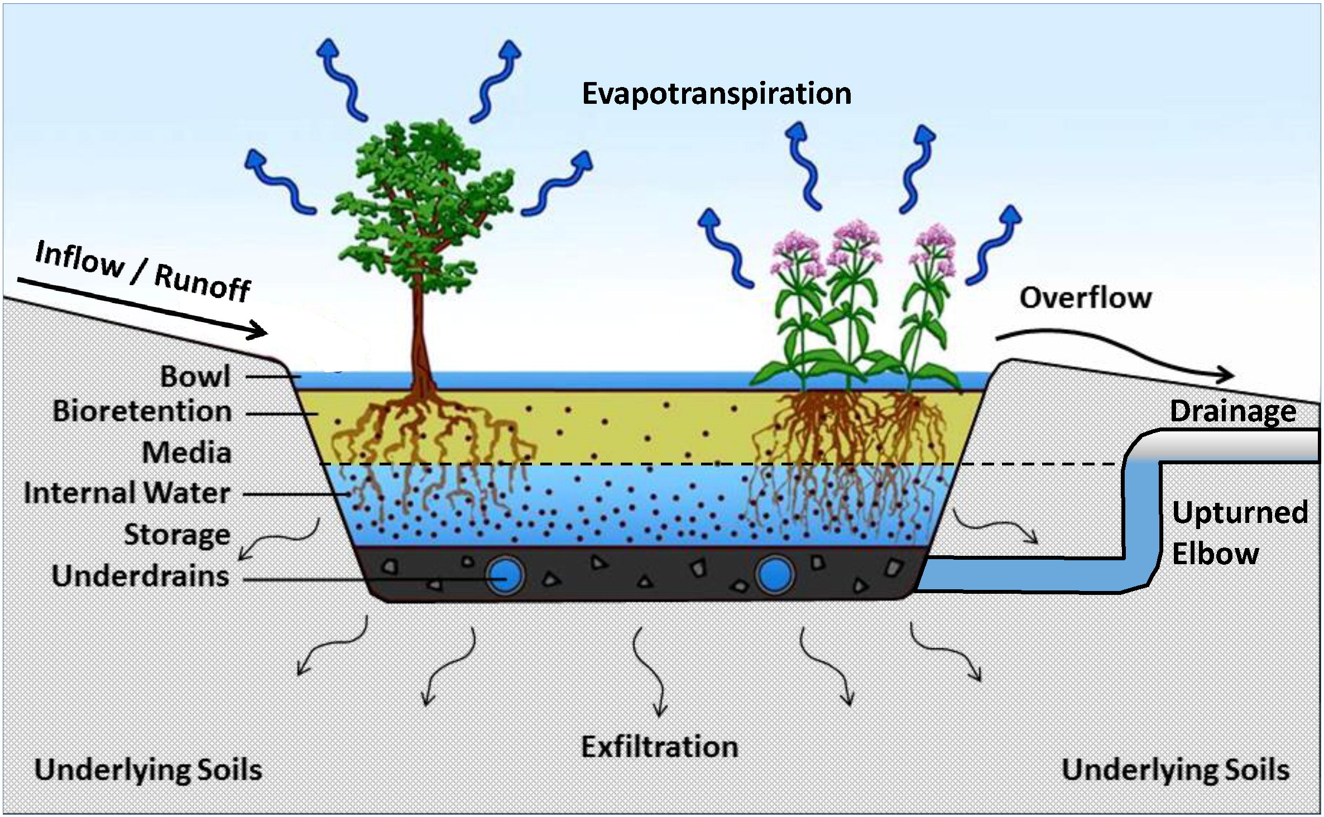
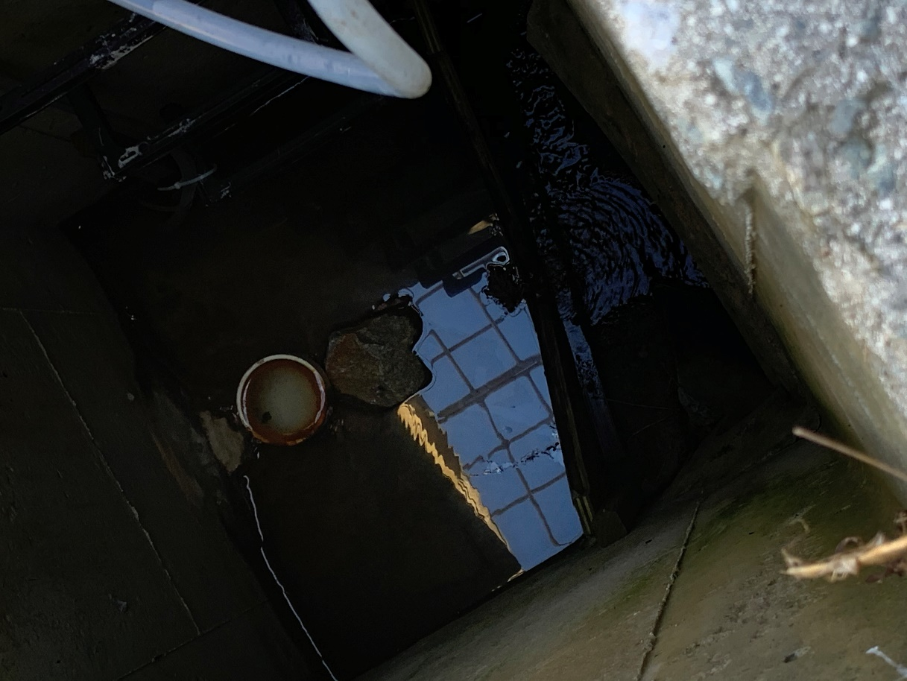
The Retrofit: Internal Water Storage
Diagram of Internal Water Storage in a Bioretention Cell

Slide 26
City | Site | Type of Business | Filter Surface Area (ft²) | Watershed Area (ac)
Greensboro | Sheetz^{IWS} | Gas Station | 4,875 | 3.26
 | Park Place | Hair Salon | << 1,000 | <1
Fayetteville | Cape Landing^{IWS} | Apartment Complex | 1,882 | 5.50
 | RNR | Tire Shop | < 1,000 | 1.12

Slide 27
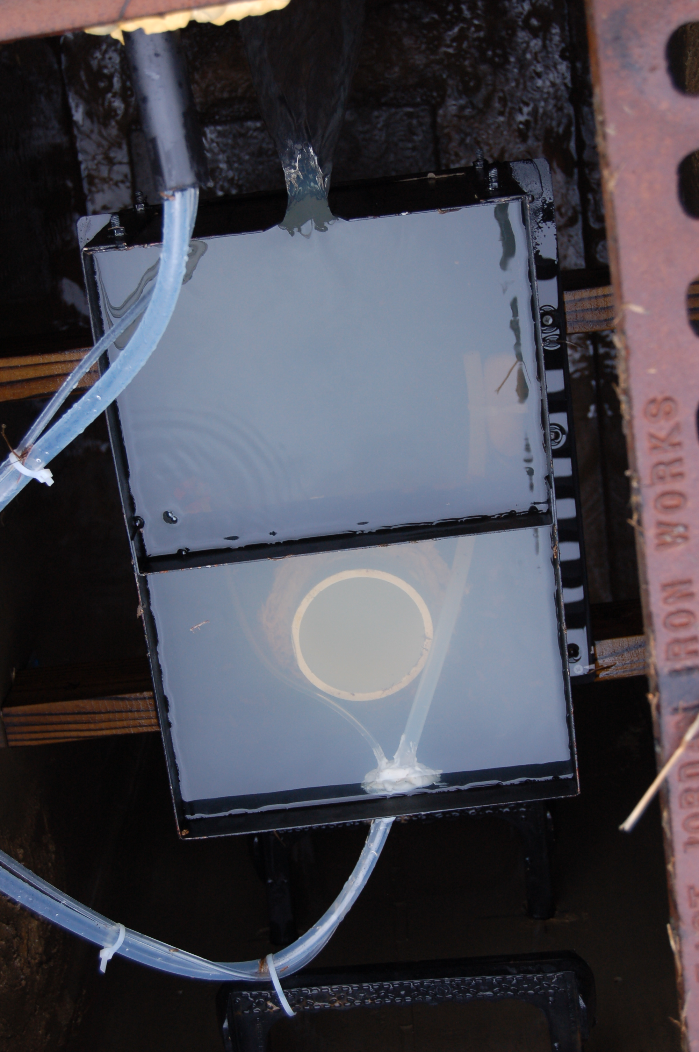
Sampling Setup
Sampling Point | Sheetz | Park Place | Cape Landing | RNR
Inlet | ISCO Model X AVM | 90° V-notch weir | Tipping Bucket | Tipping Bucket
Outlet/ Underdrain | 90° V-notch weir | 90° V-notch weir | 90° V-notch weir | 22.5° V-notch weir

Slide 28
Across the Board: Great TSS Reduction
Target Outflow Threshold

Slide 29
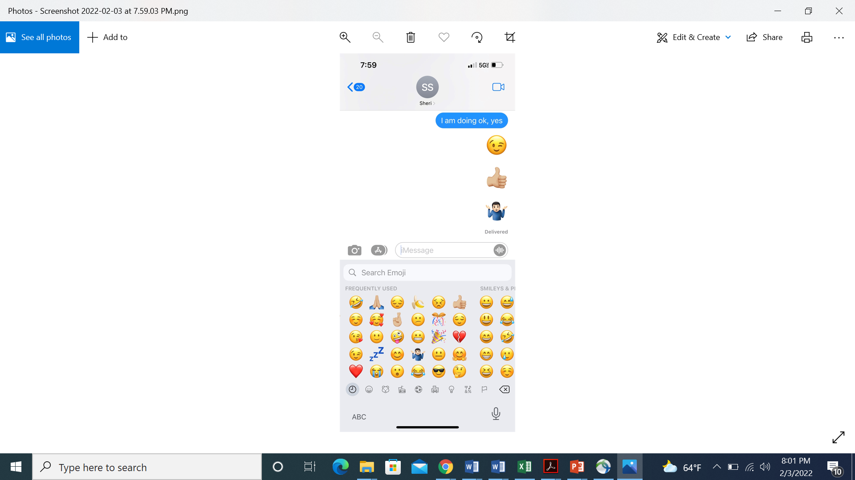
Representative Nutrient Treatment
Greensboro, Sheetz, Post-Retrofit

Slide 30
Pollutant Concentration – All 4 Sites
 | TN (mg/L) | TKN (mg/L) | NOx (mg/L) | NH3 (mg/L) | TP (mg/L) | OP (mg/L) | TSS (mg/L)
Influent | 1.25 | 0.89 | 0.23 | 0.13 | 0.159 | 0.044 | 34.2
Effluent | 0.83 | 0.39 | 0.39 | 0.049 | 0.084 | 0.030 | 5.5
% Red | 34% | 56% | -40% | 62% | 53% | 32% | 84%
Count | 95 | 95 | 95 | 95 | 95 | 93/94 | 95

Slide 31
Did IWS Retrofit Help?
Sheetz Removals (%)
 | Pre- | Post- | Δ
TKN | 63.5 | 50.1 | -13.4
NOx | -57.8 | -55.1 | +2.7
NH3 | 14.3 | -40.1 | -54.3
TP | 10.4 | 32.2 | +21.8
OP | -33.3 | -31.6 | +1.7
TSS | 63.1 | 78.6 | +15.5
Cape Landing Removals (%)
 | Pre- | Post- | Δ
TKN | 19.7 | 51.2 | +31.5
NOx | -105.5 | -196.2 | -90.7
NH3 | 75.3 | 62.0 | -13.3
TP | 31.4 | 31.8 | +0.4
OP | -2.4 | -47.5 | -45.1
TSS | 68.5 | 79.4 | +10.9

Slide 32
Did IWS Retrofit Help?
A: From a concentration perspective…
Not really/ On Margins

Slide 33
Sheetz: Pre- & Post-Retrofit Concentrations
Pre-Retrofit
Post-Retrofit

Slide 34
Hydrology
 | Volume Mitigation (%)
 | Phase 1 | Phase 2 | Total
Mean | 36.4 | 32.9 | 34.8
Median | 25.3 | 16.3 | 24.6
1st Quartile | 7.3 | 1.1 | 6.0
Minimum | -7.0 | -53.9 | -53.9
Maximum | 100 | 100 | 100
3rd Quartile | 59.1 | 74.6 | 61.8

Slide 35
Hydrology
 | Peak Flow Mitigation (%)
 | Phase 1 | Phase 2 | Total
Mean | 90.1 | 88.4 | 89.3
Median | 91.4 | 93.0 | 92.0
1st Quartile | 85.5 | 83.6 | 84.8
Minimum | 68.0 | 56.7 | 56.7
Maximum | 100 | 100 | 100
3rd Quartile | 97.3 | 98.5 | 97.7

Slide 36
So what’s the verdict?
Remember: Results are PRELIMINARY
Sand Filters are justifiably an PRIMARY SCM
  Great TSS Removal
Sand Filters release low concentrations of Nutrients
  But not always {much} lower than inflow
The IWS Retrofit does not appear to notably improve performance
Some Hydrologic Mitigation is occurring.
  Definitely Mitigates Qp

Slide 37
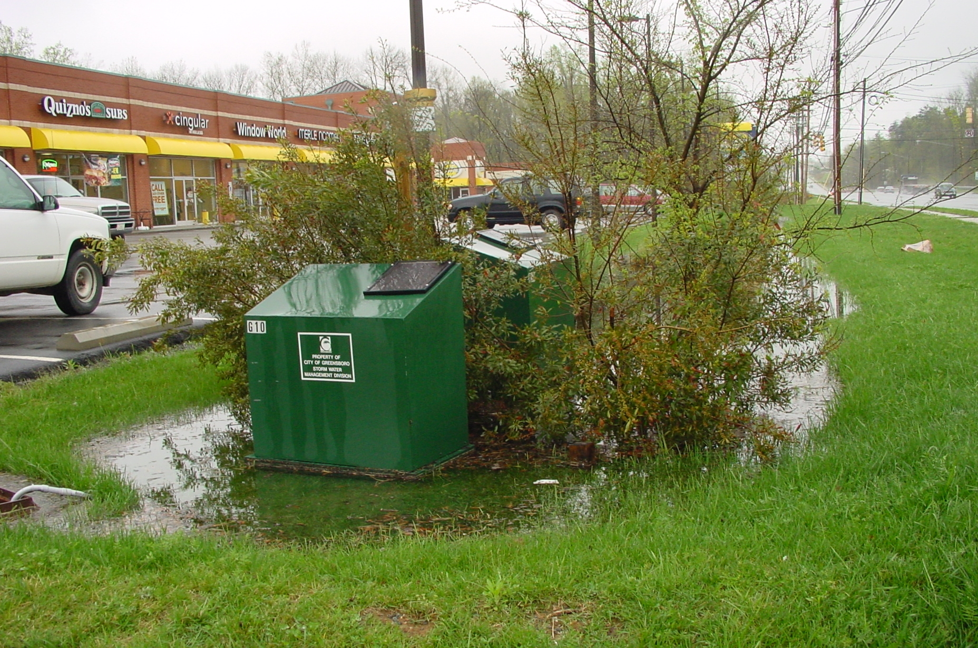
Sand Filter Relative to Bioretention (per MDC) Performance?
TSS?
TN?
TP?
Volume Reduction?
Qp?
Comparable
Not as good, but OK
Not quite as good
Not as good
Better

Slide 38
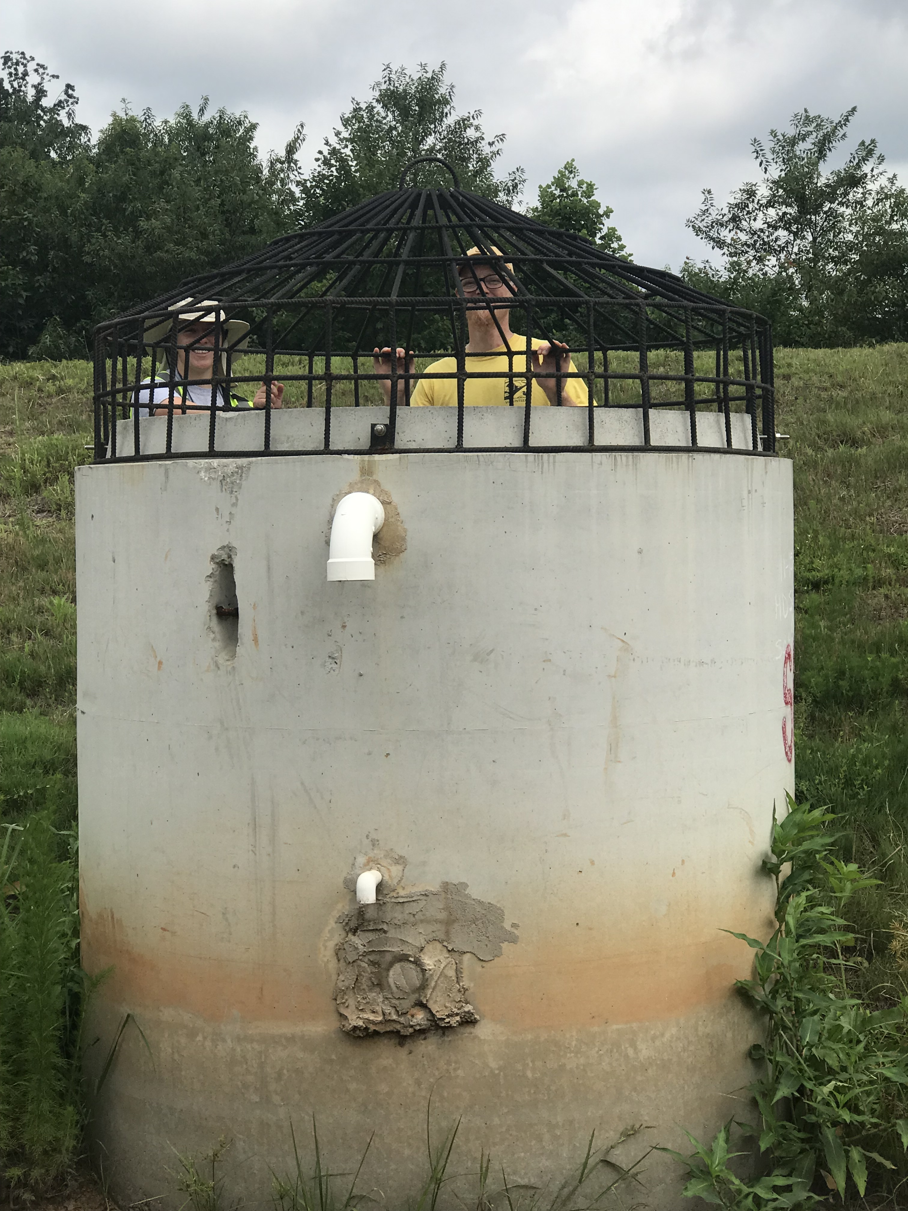
Timeframe
Project Funded by NCL&WF
  2019-2022
Phase I monitoring: 2019-2020
Phase II (retrofit) monitoring: 2021- complete
Data analysis & report: Apr/May 2022
  Load Calcs
  Data Check
  Thesis

Slide 39
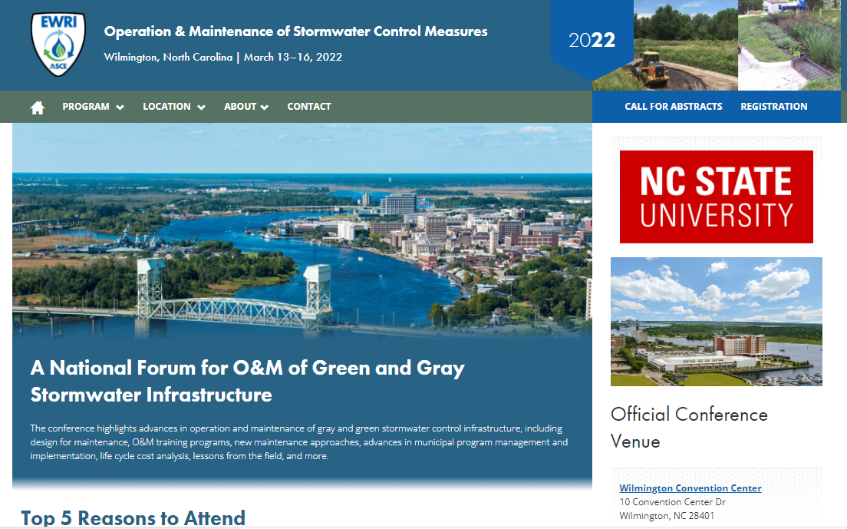
(Inter-) National Event
Negotiated rate for NC gov’t officials (you)

Slide 40
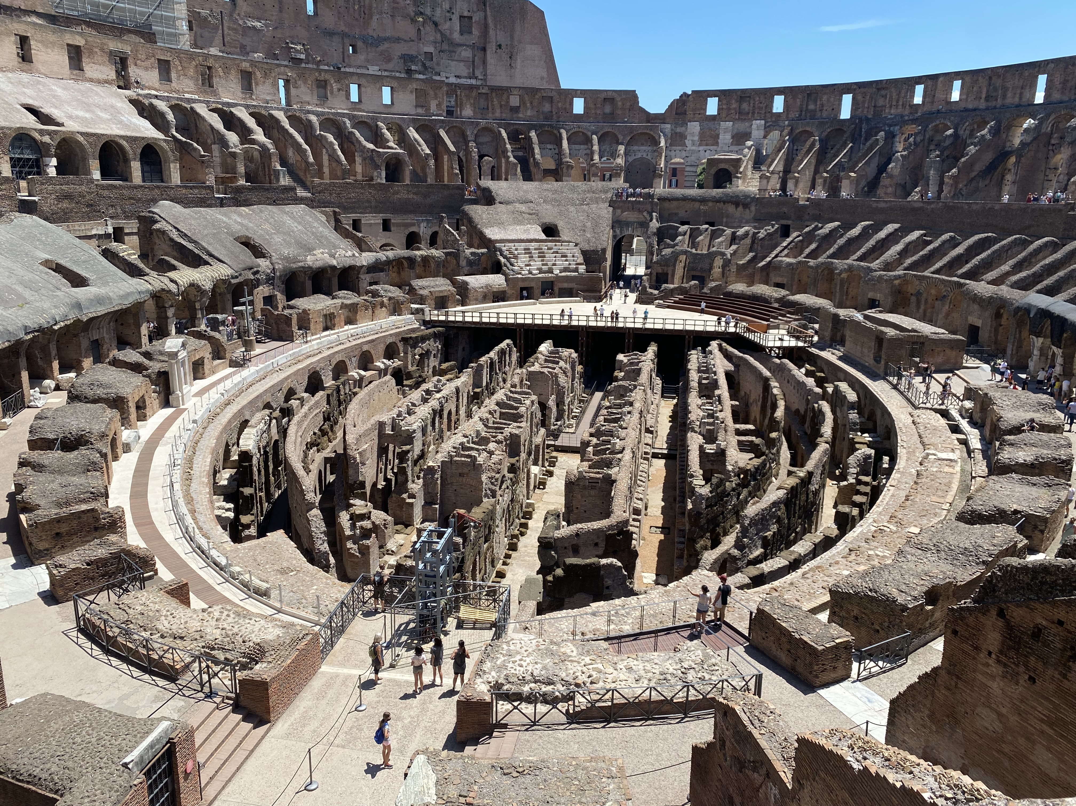
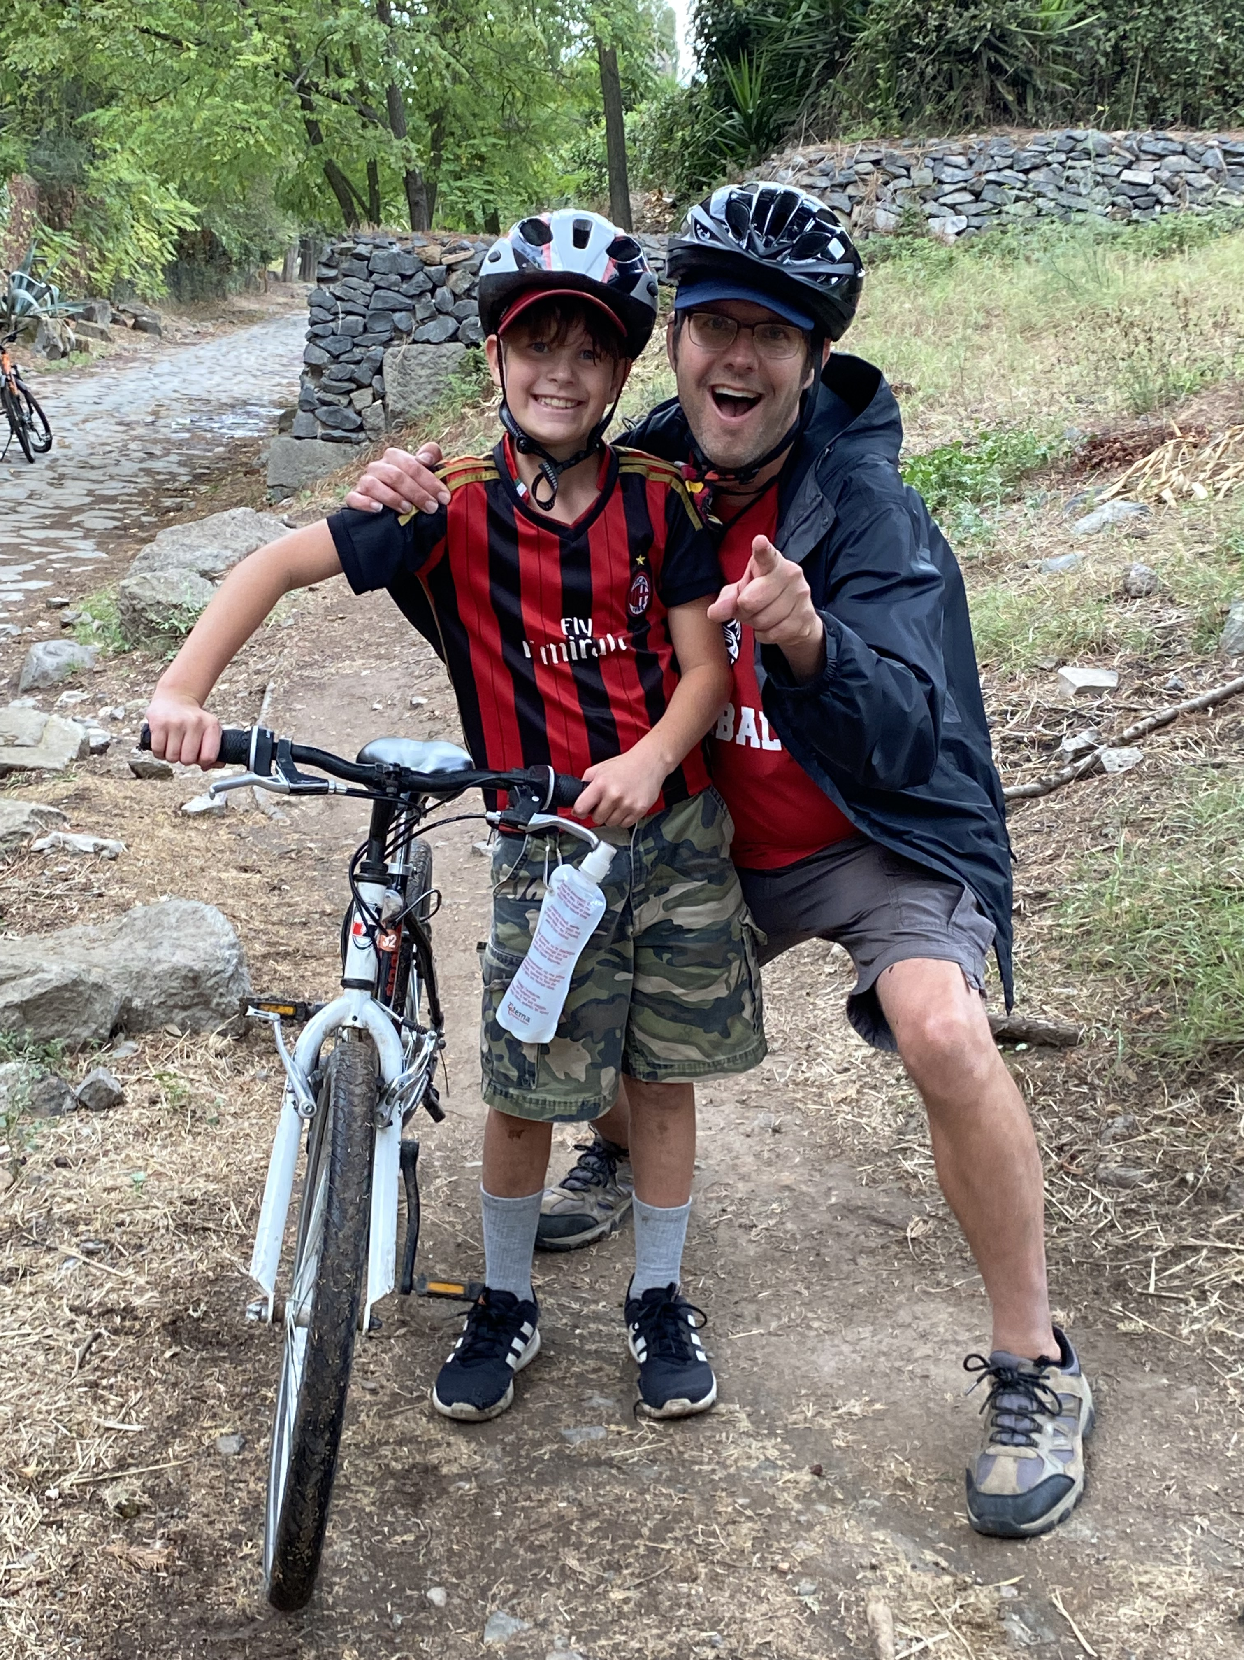

Thank you for your time! Questions?

