Slide 1
Department of Environmental Quality
Volkswagen Settlement Information Meeting
May 24, 2018
Dave Willis, Environmental Program Consultant, NC Division of Air Quality

Slide 2
What did VW do?
2015 – U.S. EPA cited VW with Clean Air Act violations.
  Manufactured and installed defeat devices
  Approximately 580,000 vehicles impacted nationally
2016 – Settlement agreements of $14.9 billion nationally were lodged by U.S. DOJ and State Attorney Generals (including NC DOJ) with court to resolve matters related to the violations.
Department of Environmental Quality

Slide 3
Volkswagen Settlement Summary
Three major components to the settlement:
  Buyback or emissions modification on at least 85 percent of the subject vehicles (Appendices A & B)
  Invest $2 billion to promote the use of zero emission vehicles and infrastructure (Appendix C)
  $2.7 billion to fully remediate the excess NOx emissions from the subject 2.0 liter vehicles (Appendix D)
    +$225 million for 3.0 liter diesel engines
Department of Environmental Quality

Slide 4
Volkswagen Settlement Summary
National Breakdown
Department of Environmental Quality

Slide 5
Volkswagen Settlement Summary Appendix D – Mitigation Trust
To administer these funds, an “environmental mitigation trust” has been established. States that wish to access their allocated portion of the funds will apply to become beneficiaries of the trust.
The Governor must indicate and certify which agency, department, office, or division will have the delegated authority to act on behalf of and legally for North Carolina. The Department of Environmental Quality was designated by Governor Cooper.
States must indicate that they want to receive funding by filling out and submitting the certification form to the trustee.
Department of Environmental Quality

Slide 6
Volkswagen Settlement Summary Appendix D – Mitigation Trust for NC
The North Carolina allocation is set at $87,177,373.87 – 3.23% of the $2.7 billion settlement. This is based on the number of registered subject vehicles in the state for the
2.0 liter subject vehicles.
Additionally, North Carolina is eligible for $4,868,284.13 – 2.16% of the $225 million settlement for the 3.0 liter subject vehicles.
At total amount of $92,045,658.00 – 3.15% is allocated for North Carolina.
Department of Environmental Quality

Slide 7
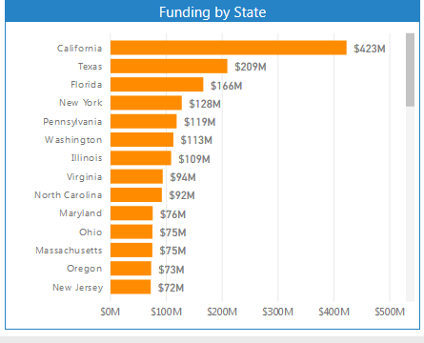
Appendix D – Mitigation Trust
Department of Environmental Quality

Slide 8
Appendix D – Settlement Parameters
Up to one-third of funds – initial request
Up to another third – one year after Trust Effective Date (TED) October 2, 2017
Remainder – two years after TED
All funds must be expended by 10 years after TED
All eligible vehicles replaced must be scrapped
Department of Environmental Quality

Slide 9
Appendix D – Settlement Parameters
Beneficiaries may spend funds from the environmental mitigation trust on projects that fall within ten eligible mitigation action categories.
According to the final consent decree, “the goal of each Eligible Mitigation Action shall be to achieve reductions of NOX emissions in the United States.”
Trustee must approve the mitigation plan and the project expenditures.
Department of Environmental Quality

Slide 10
Eligible Mitigation Projects
No. 1 - Class 8 local freight trucks and port drayage trucks
Repower or replacement of pre-2010 Class 8 (over 33,000 pounds) local freight and port drayage trucks. This includes trucks used for hauling cargo to and from ports and intermodal rail yards as well as trucks used for freight or cargo delivery including waste haulers, dump trucks, and concrete mixers.
Department of Environmental Quality
Notes:
Replace with clean diesel, propane, electric, natural gas, or hybrid

Slide 11
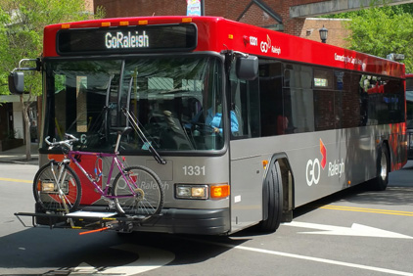
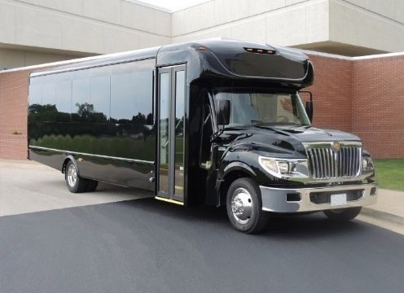
Eligible Mitigation Projects
No. 2 - Class 4-8 school bus, shuttle bus or transit bus
Repower or replacement of a Class 4-8 School Bus, Shuttle Bus, or Transit Bus (vehicles with a Gross Vehicle Weight Rating (GVWR) greater than 14,001 lbs used for transporting people). Vehicles eligible for scrappage and repower or replacement include those with engine model years prior to 2010. (For states which already require replacement of these vehicles, buses using engines from model years 2010-2012 will also be eligible.)
Department of Environmental Quality
Notes:
Replace with clean diesel, propane, electric, natural gas, or hybrid

Slide 12
Eligible Mitigation Projects
No. 3 - Freight switchers
Repower or replacement of pre-Tier 4 freight switcher locomotives that operate 1,000 or more hours per year. A freight switcher is a locomotive that moves rail cars around a rail yard as compared to a line-haul engine that moves freight long distances.
Department of Environmental Quality
Notes:
Replace with clean diesel, alt fuel, electric

Slide 13
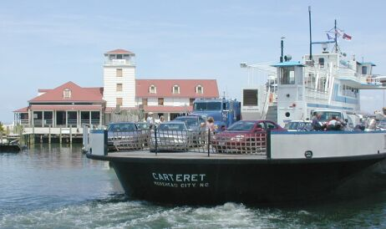
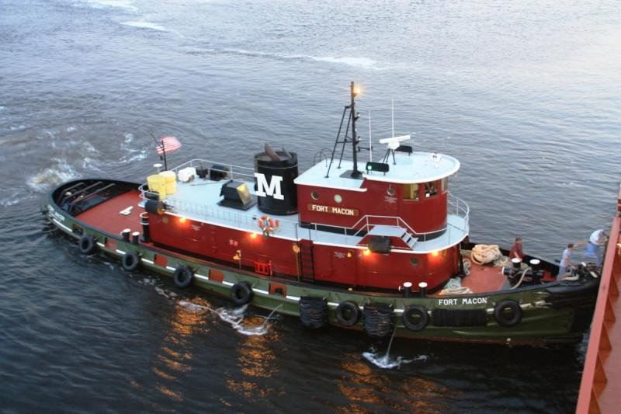
Eligible Mitigation Projects
No. 4 - Ferries and tugs
Ferries or tugs equipped with unregulated, Tier 1, or Tier 2 marine engines may be repowered.
Department of Environmental Quality
Notes:
Replace with clean diesel, alt fuel, electric

Slide 14
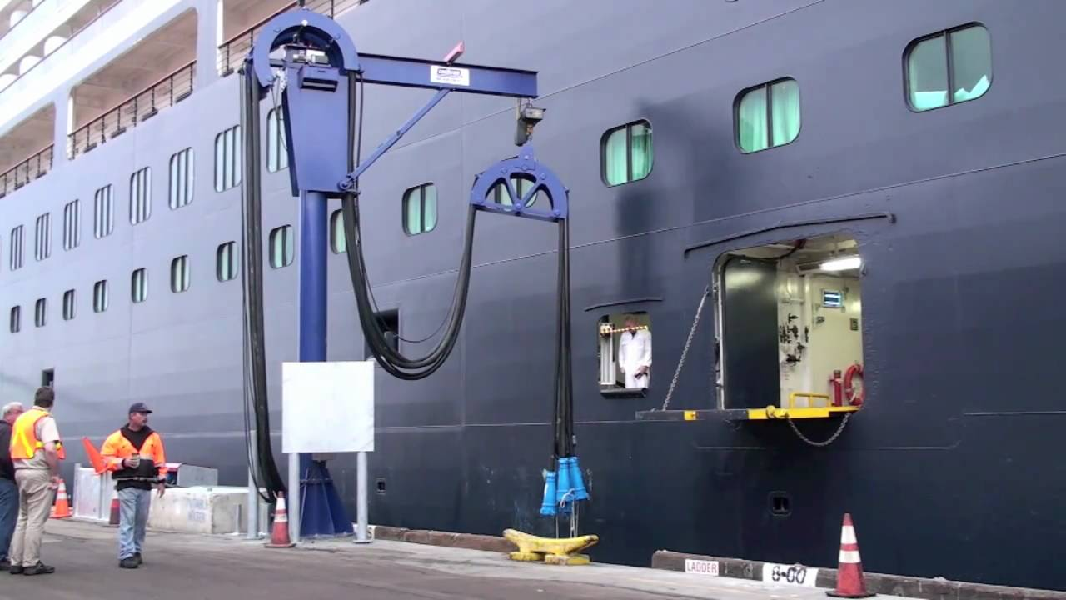
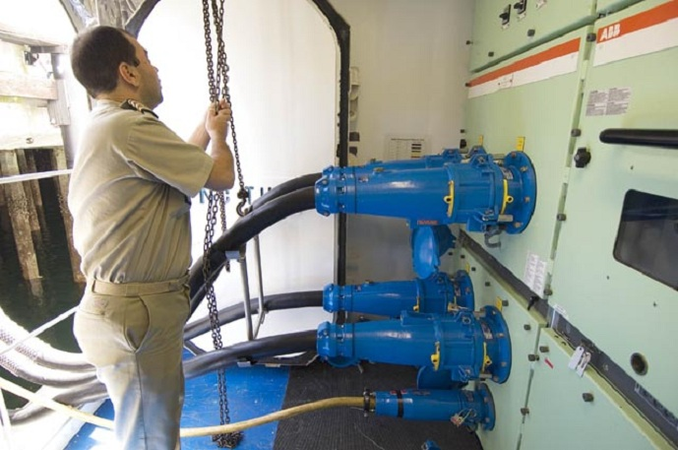
Eligible Mitigation Projects
No. 5 - Ocean going vessels shorepower
Marine shorepower. Eligible marine shorepower systems provide electric auxiliary power from shore while a boat is docked to allow a vessel’s engines to turn off and remain off while the vessel is at berth.
Department of Environmental Quality
Notes:
Electric

Slide 15
Eligible Mitigation Projects
No. 6 - Class 4-7 local freight trucks (medium trucks)
Repower or replacement of Class 4-7 local freight trucks.
Vehicles eligible for scrappage and repower or replacement include those with engine model years 1992–2009.
For states which already require replacement of these vehicles, trucks using engines from model years 2010–2012 will also be eligible.
Department of Environmental Quality
Notes:
Replace with clean diesel, propane, electric, natural gas, or hybrid

Slide 16
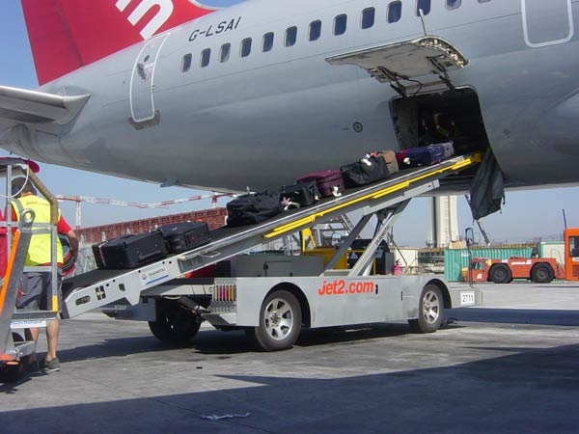
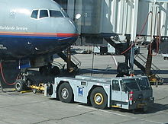
Eligible Mitigation Projects
No. 7 - Airport ground support equipment
To focus on concentrated emissions reductions at airports, the mitigation trust is authorized to support fuel switching of diesel and gasoline airport ground support equipment. This type of equipment includes all vehicles and equipment used at airports to service aircraft between flights.
Department of Environmental Quality
Notes:
All electric repower / replace

Slide 17
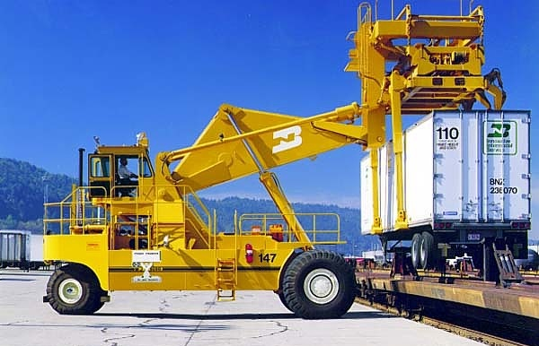
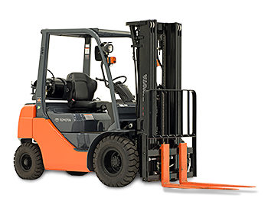
Eligible Mitigation Projects
No. 8 - Forklifts and port cargo handling equipment
Repower or replacement of forklifts and port cargo handling equipment. Eligible repower or replacement includes electric charging infrastructure.
Department of Environmental Quality
Notes:
All electric

Slide 18
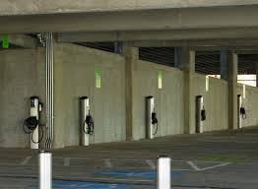
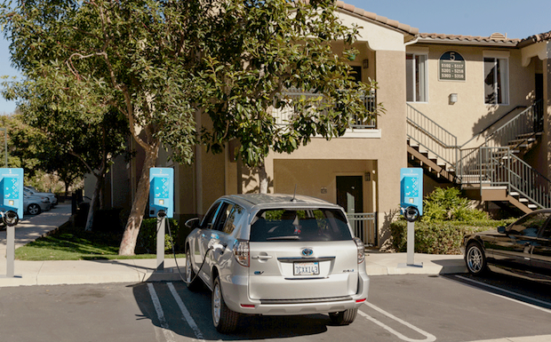
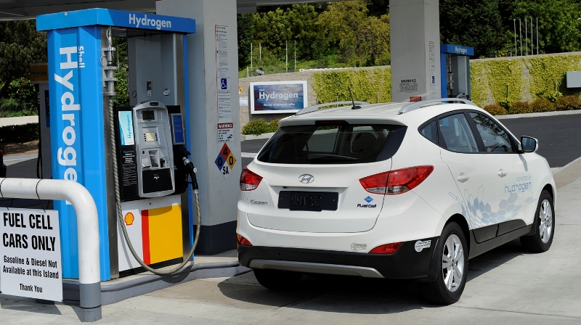
Eligible Mitigation Projects
No. 9 - Light duty zero emission vehicle supply equipment
Beneficiaries may use up to 15 percent of their allocation of trust funds for the acquisition, installation, operation and maintenance of new light duty zero emission vehicle supply equipment.
Department of Environmental Quality
Notes:
Electric and hydrogen

Slide 19
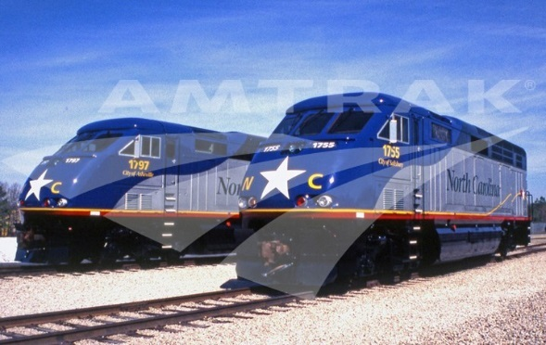

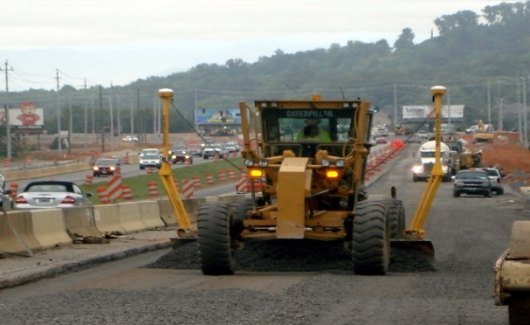
Eligible Mitigation Projects
No. 10 - Diesel Emission Reduction Act (DERA) option
DERA provides funding for projects that reduce emissions from existing diesel engines.
Authorized under the Energy Policy Act of 2005 and administered by U.S. EPA, DERA is designed to help replace or retrofit older, dirtier engines still in use with clean diesel or alternative fuel engines.
Department of Environmental Quality

