Slide 1
Department of Environmental Quality
Interbasin Transfer Program Update
Water Allocation Committee January 11, 2017

Slide 2
IBT Update
Two Requests Currently in the Process
Union County
New Certificate, following G.S. 143-215.22L(c-n)
Pender County
New Certificate, following G.S. 143-215.22L(w) (Requirements for Coastal Counties)
Department of Environmental Quality

Slide 3
Proposed Project Description
Primary Applicant: | Union County
Source Basin: | Yadkin
Receiving Basin: | Rocky
Grandfathered Allowance: | N/A
Total Requested IBT (2050 Demands): | 23 MGD (avg day/max mth)
New Certificate, following G.S. 143-215.22L(c-n)
Department of Environmental Quality

Slide 4
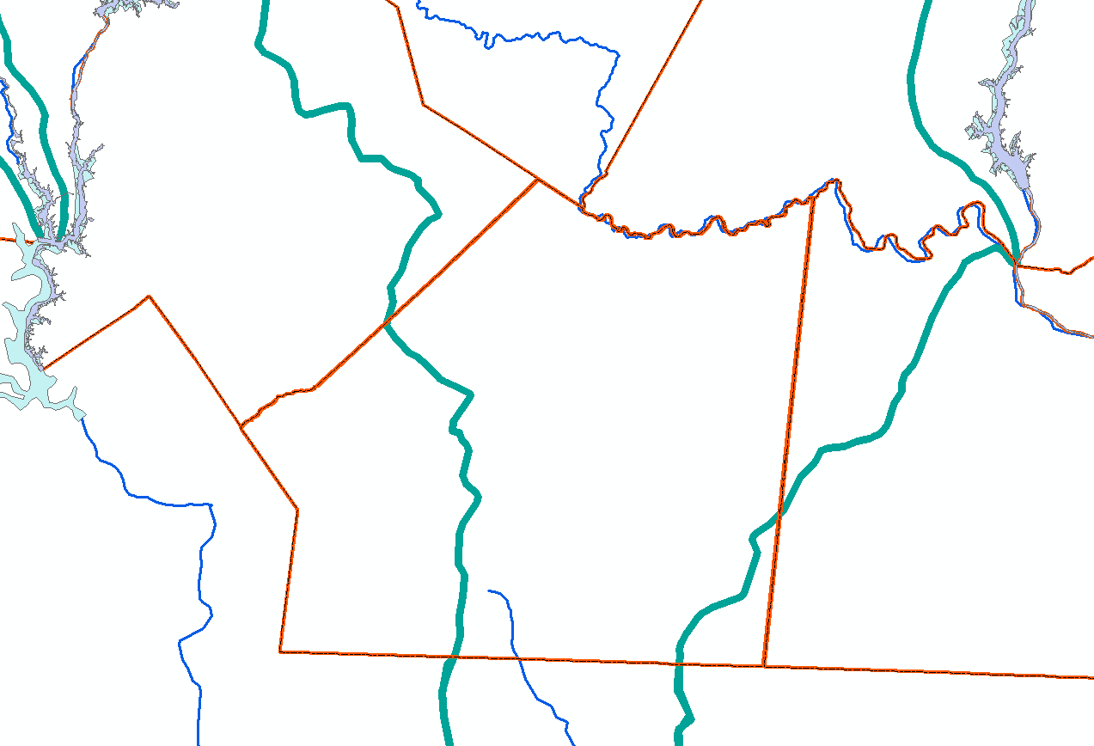
Lake Tillery
Cabarrus
Stanly
Norwood
Catawba River Basin
Mecklenburg
Proposed 23.0 mgd IBT: Yadkin to Rocky
Union
Monroe
Yadkin River Basin
Rocky River Basin
South Carolina
Existing 5.0 mgd Grandfathered IBT: Catawba to Rocky
Anson

Slide 5
IBT Process § 143-215.22L
✓ I. Applicant submits Notice of Intent to file a petition.
30 days notice of public meetings
3+ Public meetings
✓ II. Applicant submits draft environmental document (EIS or EA)
30 days notice of public hearing
Public hearing
Comments accepted for 30 days after hearing
Written response to comments prepared
Adequacy of environmental document determined (DEQ issues ROD)
Settlement discussions, if requested
➔ III. Applicant submits petition to EMC
EMC issues Draft Determination within 90 days of receiving petition and adequacy of doc determined
Public notice of draft determination and 30-day notice of hearings
2+ public hearings held within 60 days of issuing draft determination
Written response to comments prepared
Comments accepted for 30 days after last hearing
EMC issues final determination

Slide 6
Past Actions and Current Status
At the July WAC/EMC meetings: Draft Determination on petition for IBT certificate and assignment of hearing officer
3 public hearings held in Aug-Sept for draft certificate
At the November EMC meeting: EMC authorized selection of mediator and to enter into settlement discussions with Union and Montgomery Counties
Mediation is currently ongoing

Slide 7
Proposed Project Description
Primary Applicant: | Pender County
Source Basin: | Cape Fear River
Receiving Basin: | South River, Northeast Cape Fear River, & New River
Grandfathered Allowance: | N/A
Total Requested IBT (2045 Demands): | 14.5 MGD (avg day/max mth)
New Certificate, following G.S. 143-215.22L(w)
Department of Environmental Quality

Slide 8
Pender County and IBT Basins

Slide 9
Pender County Utilities Water Supply System
IBT needed due to growth
coastal access and vicinity to Wilmington
economic development along US 17 corridor
system expansion to move residents off groundwater – 70 miles of water lines being constructed this year, 200 miles planned over next 20 years
Co-applicants on IBT certificate (currently rely on groundwater):
Town of Burgaw
Town of Topsail Beach
Town of Surf City
Town of Wallace
Utilities, Inc.

Slide 10
IBT Process § 143-215.22L(w) Requirements for Coastal Counties
I. Applicant submits Notice of Intent to file a petition
II. Applicant submits draft environmental document (EA) pursuant to State Environmental Policy Act (SEPA)
Applicant submits EA to NCDEQ for review and comment
NCDEQ issues finding of no significant impact (FONSI)
EA and FONSI published for 30-day review/comment period through State Clearinghouse
III. Applicant submits petition
NCDEQ prepares written response to comments
Public notice of petition and 30-day notice of hearing
Comments accepted for 30 days after hearing
Public hearing on the petition
EMC issues final determination

Slide 11
Contact Information
Kim Nimmer
NCDEQ - Division of Water Resources
kim.nimmer@ncdenr.gov
919-707-9019
Department of Environmental Quality

