Slide 1
Case Study – Norge Laundry and Dry Cleaning
Eutaw Shopping Center, Fayetteville, NC
Developed in 1950s
Phase I and II ESAs performed by property owner in preparation for possible property transaction

Slide 2
Case Study – Norge Laundry and Dry Cleaning
Possible historical dry-cleaner
Indoor air sampling in NC Gold Buyers space during Phase II ESA indicated PCE at 460 µg/m³ and TCE at 12 µg/m³
Concentrations of PCE and TCE exceed acceptable risk thresholds for a non-residential worker
Concentration of TCE also exceeds the NC DWM Non-Residential Immediate Action Level (IAL) of 8.8 µg/m³

Slide 3
Case Study – Norge Laundry and Dry Cleaning
NC DWM supplemental vapor intrusion guidance issued in July 2019
Defines Immediate Action Levels (IALs) based on possible short-term risks associated with exposure of pregnant women to TCE
Specifies stringent reporting and response timeframes - goal is to reduce exposures within 72 hrs
Norge site response timeframes:
9/28/2021 – Property owner submitted release notification to NC IHSB
9/29/2021 – NC IHSB provided site info to DSCA Program, DSCA Program informed property owner of TCE risks and invited property owner to petition into the program
9/30/2021 – Meeting on-site with property owner and tenants, deployed air purification units (APUs) in NC Gold Buyers space for mitigation

Slide 4
Case Study – Norge Laundry and Dry Cleaning
DEQ toxicologist attended meeting with tenants to explain health risks
Tenants provided with DEQ fact sheet and Resource Contact List
RESOURCE CONTACT LIST:
HEALTH RELATED:
Francis Nilsen, Toxicologist/NCDEQ – frannie.nilsen@ncdenr.gov – (919) 707-8217
Dr. Rick Langley, Medical Doctor/NCDHHS – rick.langley@dhhs.nc.gov – (919) 707-5913
SITE WORK:
Genna Olson, Hart & Hickman Team Lead: golson@harthickman.com – (919) 723-2511
Billy Meyer, DSCA Remediation Unit Manager: billy.meyer@ncdenr.gov – (919) 796-3249

Slide 5
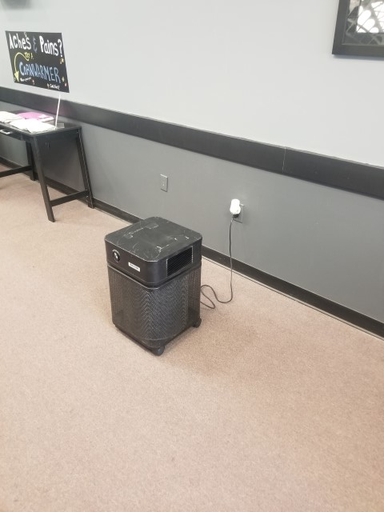
Initial Temporary Mitigation Measure - APUs
DSCA Program has a fleet of 18 Austin Air Healthmate air purification units (APUs)
Two APUs deployed in NC Gold Buyers space
Three additional APUs later deployed in adjacent Cameo’s Salon space due to concentrations close to (but not exceeding) acceptable levels
Post-mitigation indoor air sampling indicated concentrations below acceptable levels, with reductions of 72 to 93%

Slide 6
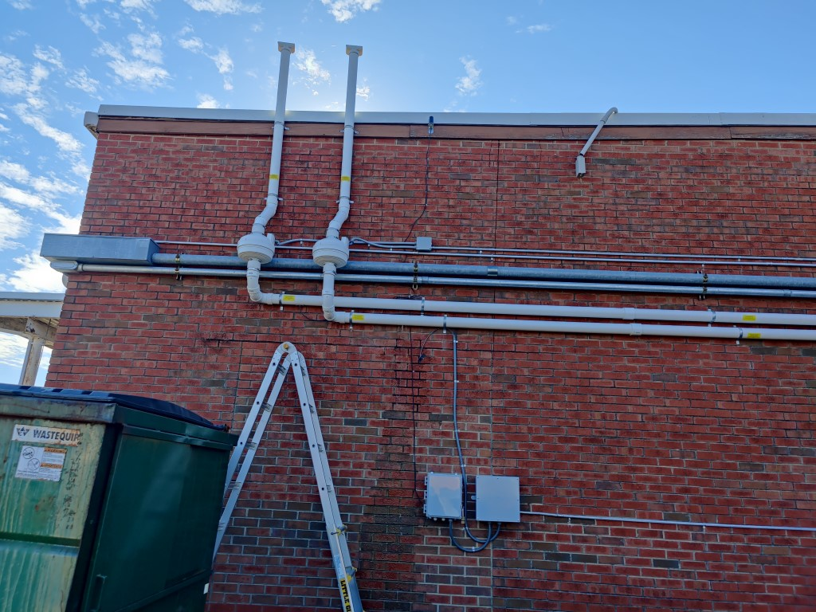
Permanent Mitigation Measure - SSDS
Sub-slab depressurization system (SSDS) installed as permanent mitigation measure
Two suction points installed below the floor slab in each space (four total), piping from suction points extending to roofline of the building, electric fan to depressurize sub-slab
Testing performed to ensure adequate vacuum throughout each space
System operational 42 days after initial notification to DSCA Program

Slide 7
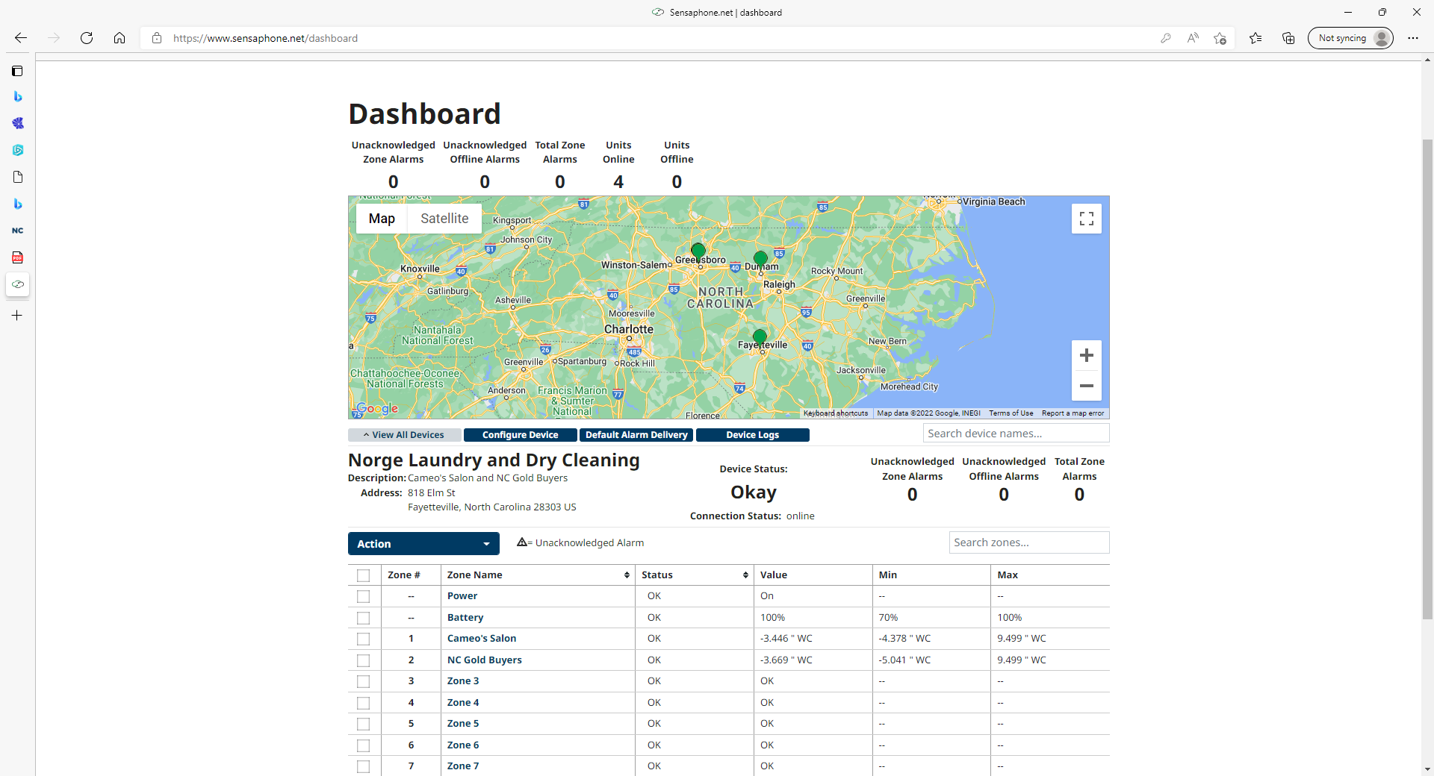
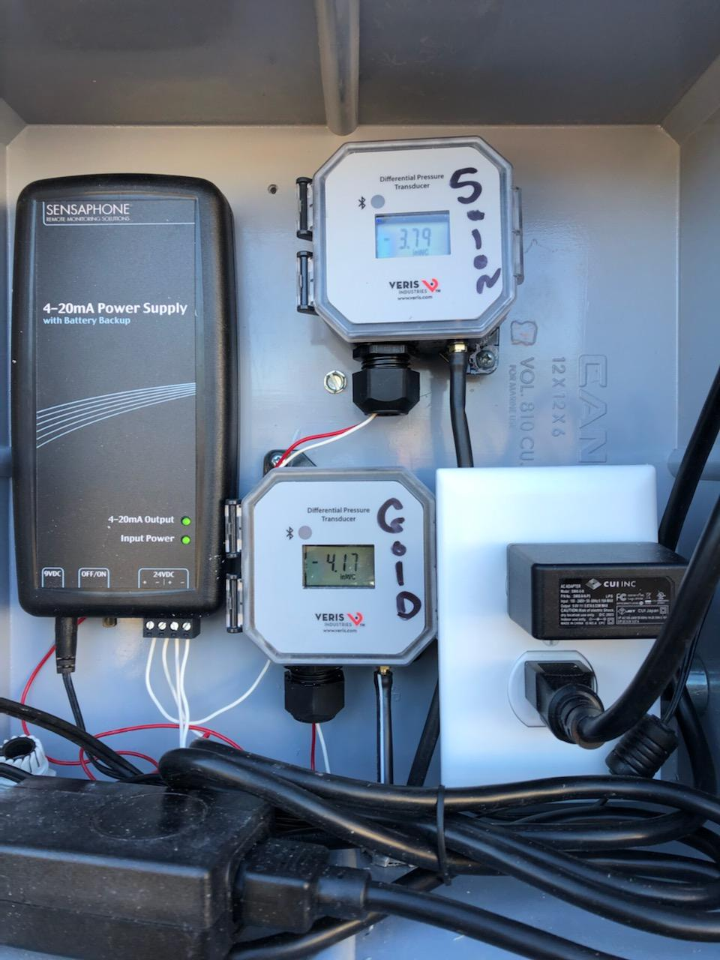
Permanent Mitigation Measure - SSDS
Telemetry system installed for remote monitoring of system operation
Post-mitigation indoor air sampling confirmed concentrations below acceptable levels
Currently planning additional phases of soil and groundwater assessment

Slide 8
Challenges
Determination of APU filter changeout schedule (APUs treat all VOCs, including VOCs associated with beauty salon operations)
Asbestos survey prior to disturbing building materials
Contractor availability for SSDS installation
SSDS initially generated excess condensation which reduced effectiveness, installed condensate drain which effectively addressed
Hit a water line during condensate drain installation activities
Availability of Summa canisters for confirmatory indoor air sampling
Challenging risk communication with beauty salon tenants

Slide 9
Questions?

