Slide 1
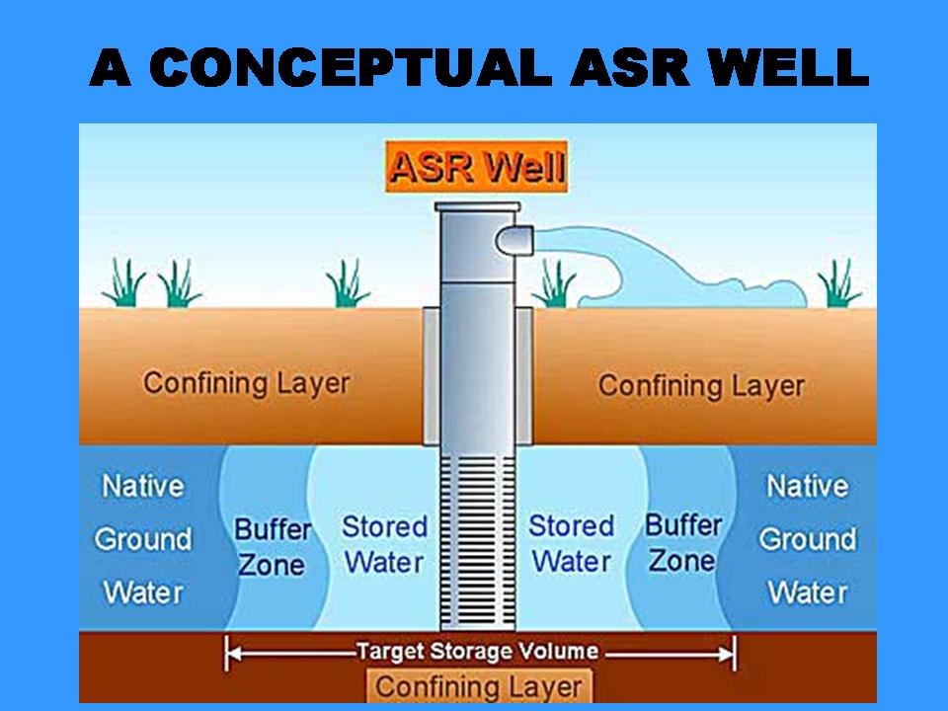
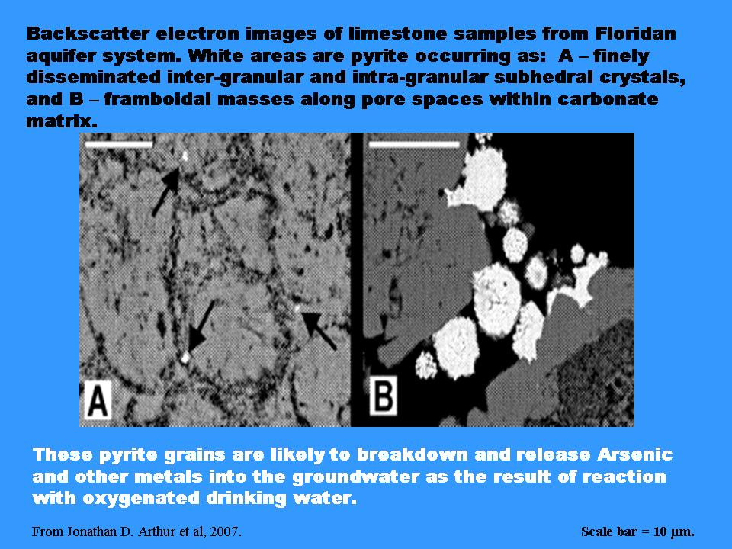
AQUIFER STORAGE AND RECOVERY (ASR)

