Slide 1
Per-and Poly-fluorinated Compounds Analysis Case Study: Cape Fear Drainage Basin
Mark Strynar¹, James McCord², Johnsie Lang², Andrew Lindstrom¹, Zack Hopkins³, Detlef Knappe³
1. National Exposure Research Laboratory, U.S. Environmental Protection Agency, Research Triangle Park, NC;
2. ORISE Fellow, Oak Ridge Associated Universities, Oak Ridge, TN;
3. Department of Civil, Construction, and Environmental Engineering, North Carolina State University, Raleigh, NC
LAB TECHNOLOGY DAY 2018
THURSDAY – MAY 3, 2018
MCKIMMON CENTER - RALEIGH

Slide 2
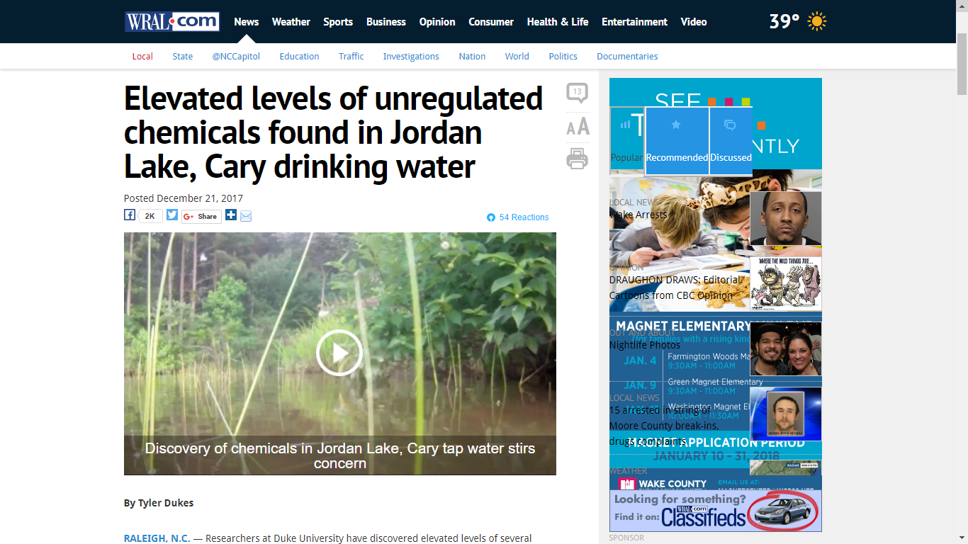

Slide 3
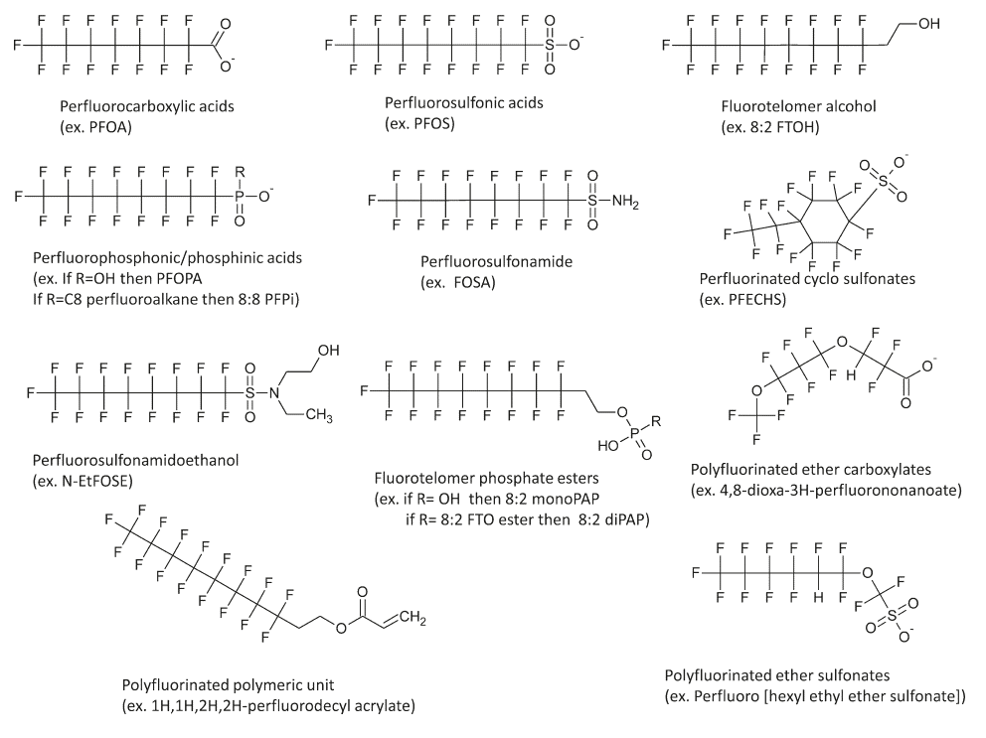
Some Typical PFAS

Slide 4
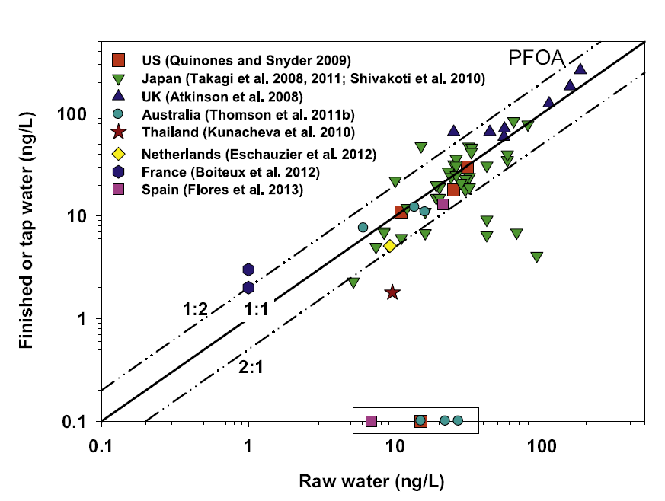
PFAS Generally Not Removed During Conventional Drinking Water Treatment
Similar for PFOS, PFHxA and PFHxS
Rahman et al., (2014) Water Research, 50:318-340
Notes:
Work approached for detection not quantification

Slide 5
Timeline: US EPA/NERL Water PFAS Efforts
2007 Nakayama et al., PFAS in Cape Fear Watershed
2007-2008 Decatur, AL discovery of PFAS in bio-solids, soil, surface water, groundwater
2009 (January) Provisional Health Advisory (PHA) for PFOA and PFOS established 400 and 200 ng/L
2011-2012 Sampling of Cape Fear River for determination of replacement chemistries
2012 (November) Presentation at SETAC Long Beach CA – Identification of novel polyfluorinated compounds in natural waters using accurate mass TOFMS (GenX)
2013-2014 Collaborative study with NCSU with sampling of Cape Fear River and three municipalities (Pittsboro, Fayetteville, Wilmington, NC) for legacy and PFECA determination
2014 (November) Presentation at SETAC Vancouver, BC - Determination of perfluoroalkyl ether carboxylic acids (PFECAs) and sulfonic acids (PFESAs) in North Carolina surface water using high resolution mass spectrometry (GenX and eleven other novel chemicals)
2015 (August) Publication of Strynar et al., “Identification of Novel Perfluoroalkyl Ether Carboxylic Acids (PFECAs) and Sulfonic Acids (PFESAs) in Natural Waters Using Accurate Mass Time-of-Flight Mass Spectrometry (TOFMS)” ES&T
2016 (May) OW Health Advisory for PFOS and PFOA set at 70 ng/L
2016 (November) Publication of Sun et al., “Legacy and Emerging Perfluoroalkyl Substances Are Important Drinking Water Contaminants in the Cape Fear River Watershed of North Carolina” ES&T Letters
2017 (June) Reporting of PFECAs in CFR and Wilmington drinking water – Star News Online

Slide 6
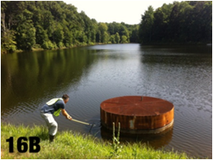
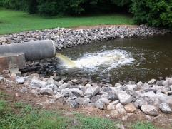
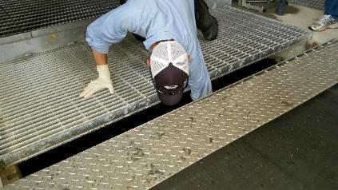
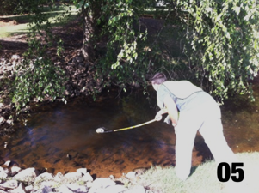
NERL/EMMD Water Analysis Method
Surface Water
Ground Water
WWTP Effluent
Drinking Water
Also methods for:
Soil
Fish tissue
Dosed rodent tissue/fluids
Human Serum/Urine
House Dust

Slide 7

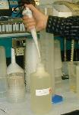
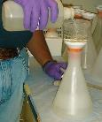


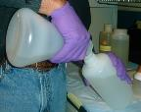
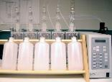
Method Summary – Sample Processing
Nakayama et al., 2009, Strynar et al., 2015; Sun et al., 2016, Newton et al., 2017
All samples Treated same way
Trip Spike
Blanks
Unknowns
Calibration
Pour water out of sample bottle for volume measurement
Filter entire contents Whatman GF/A 1.7 um
1 L HDPE bottles
5 mL 1:1 HNO₃ (35%):DI
Shipped ambient
Wash bottle with 10 mL MeOH, add water back to bottle, add IS Shake
Elute for LC/MS-MS analysis
Subsample 500 mL
Store 500 mL
Add filtered water back into original bottle
Load onto SPE tube Waters Plus style WAX

Slide 8
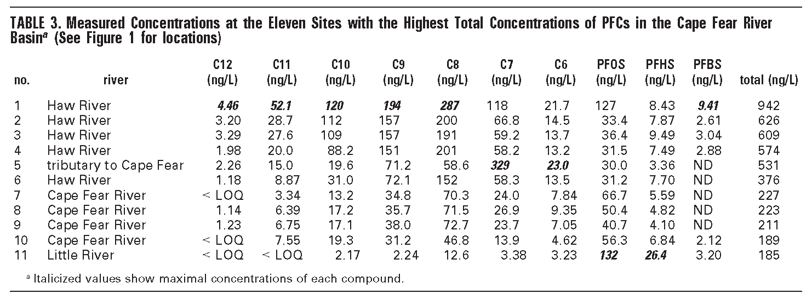
Water Sampling Cape Fear River, NC
Nakayama et al., 2007
Nakayama et al. 2007 ES&T 41:5271-5276
performance fabrics, bio-solids, AFFF, industrial waste
Notes:
Framed talk in terms of defining the problem
Why this is important at NERL

Slide 9
Fact Sheet: 2010/2015 PFOA Stewardship Program
Q1. What is the 2010/2015 PFOA Stewardship Program?
In 2006, EPA invited eight major leading companies in the per- and polyfluoroalkyl substances (PFASs) industry to join in a global stewardship program with two goals:
To commit to achieve, no later than 2010, a 95 percent reduction, measured from a year 2000 baseline, in both facility emissions to all media of perfluorooctanoic acid (PFOA), precursor chemicals that can break down to PFOA, and related higher homologue chemicals, and product content levels of these chemicals.
To commit to working toward the elimination of these chemicals from emissions and products by 2015.
Q4. What companies participated in the PFOA Stewardship Program?
Participating companies included:
  Arkema
  Asahi
  BASF Corporation
  Clariant
  Daikin
  3M/Dyneon
  DuPont
  Solvay Solexis
https://www.epa.gov/assessing-and-managing-chemicals-under-tsca/fact-sheet-20102015-pfoa-stewardship-program#what

Slide 10
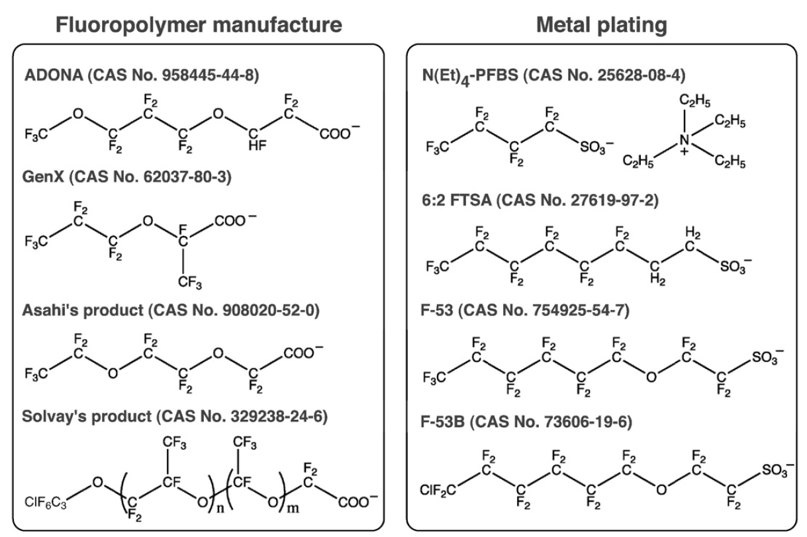
Wang et al. Environment International, 2013, 60, pp 242–248

Slide 11
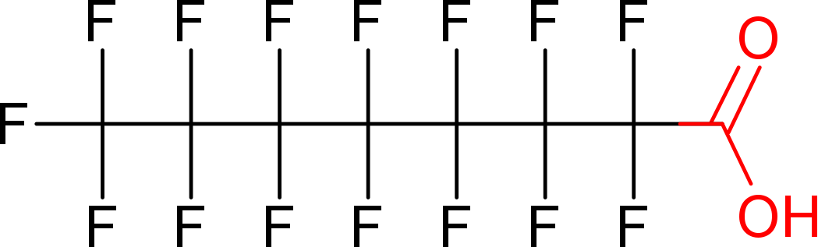
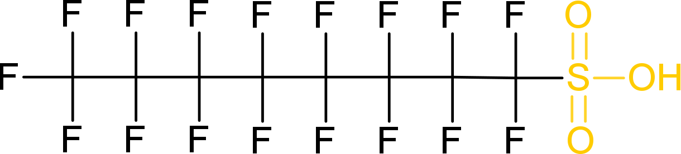
OTHER PFASs: The Era of HRMS & Non-Targeted Analysis
How do we find compounds without knowing what they are?
How do we prioritize unknowns for further analysis?
How do we identify/quantify without analytical standards?
???

Slide 12
What is Non-Targeted Analysis
Targeted Analysis
  How much PFOA is in my sample?
Suspect Screening
  Which chemicals in this database are in my sample?
  Non-Targeted Screening
  What are the chemicals in my sample?
(HRMS)
TOF
Q-TOF
Orbitrap

Slide 13
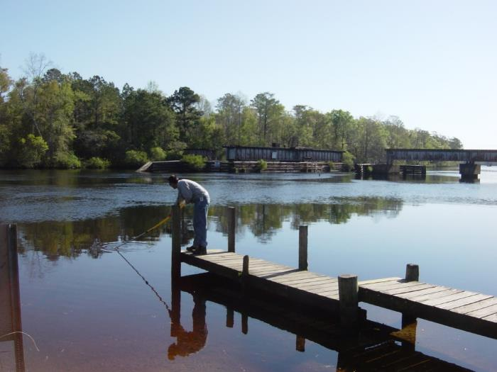
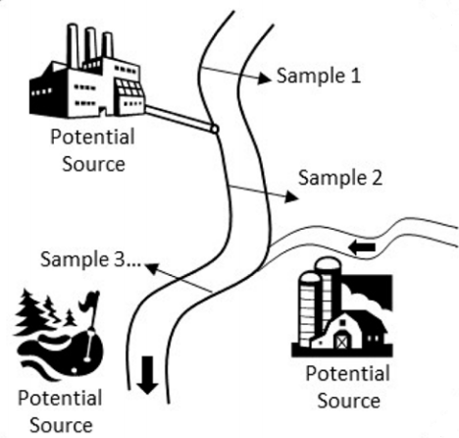
Data Generation: Source Determination by NTA
Surface Water
Ground Water
WWTP Effluent
Drinking Water
HDPE Bottles
Sampling from geographically or temporally displaced locations allows triangulation of sourcing
Strynar et al. Environ. Sci. Technol., 2015, 49 (19), pp 11622–11630

Slide 14
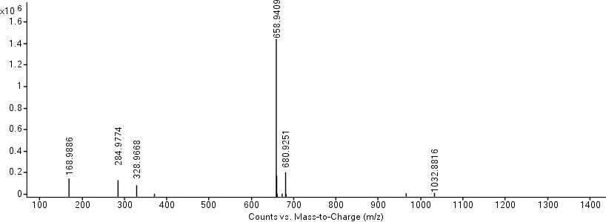
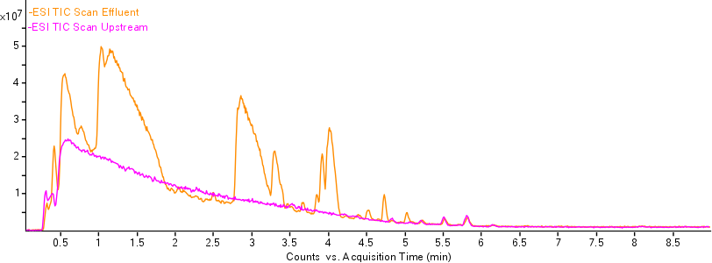
Chromatographic and MS Data

Slide 15
Feature Finding: Unique & Highly Different Features
Cmpd | m/z | RT | Effluent Peak Area | Upstream Peak Area
1 | 194.9263 | 0.31 | 1277673 | NA
2 | 174.9502 | 0.32 | 128095 | NA
3 | 272.9487 | 0.35 | 893478 | NA
4 | 290.9396 | 0.37 | 82068 | NA
5 | 119.0345 | 0.37 | 56430 | NA
6 | 179.0558 | 0.38 | 51910 | NA
7 | 340.9372 | 0.4 | 1961449 | NA
8 | 324.9428 | 0.41 | 75414 | NA
9 | 248.961 | 0.42 | 235520 | NA
10 | 112.9856 | 0.42 | 9963533 | NA
11 | 1033.987 | 0.43 | 185007 | NA
12 | 340.9376 | 0.49 | 847790 | NA
13 | 118.9927 | 0.5 | 242003 | NA
14 | 162.9821 | 0.5 | 1382091 | NA
15 | 1083.984 | 0.51 | 14125 | NA
Useful For:
Identification of increasing/decreasing chemicals
Features unique to a specific location, time, treatment, etc.
Hundreds of Features of Interest

Slide 16
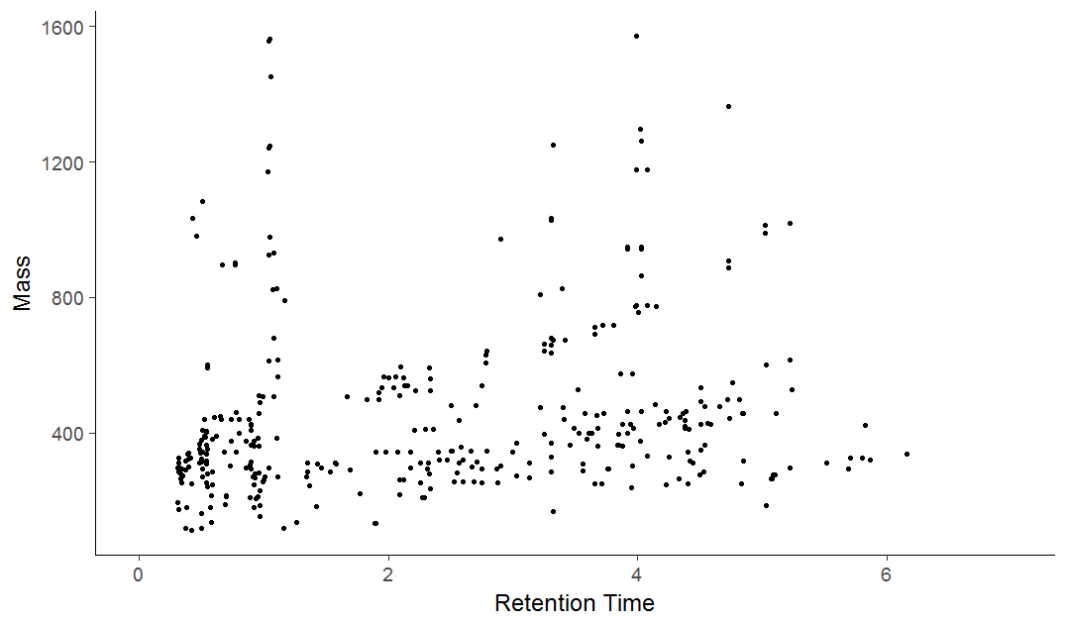
Relationships Reveal Underlying Chemistry
Adducts +
Fragments +
Dimers/Trimers
Homologous Series

Slide 17
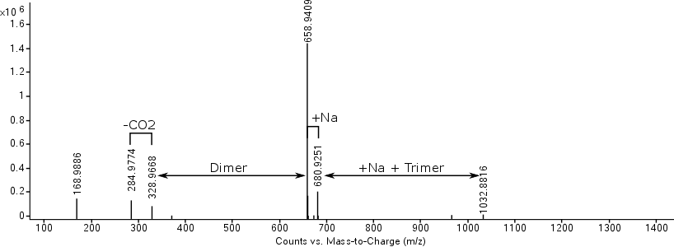
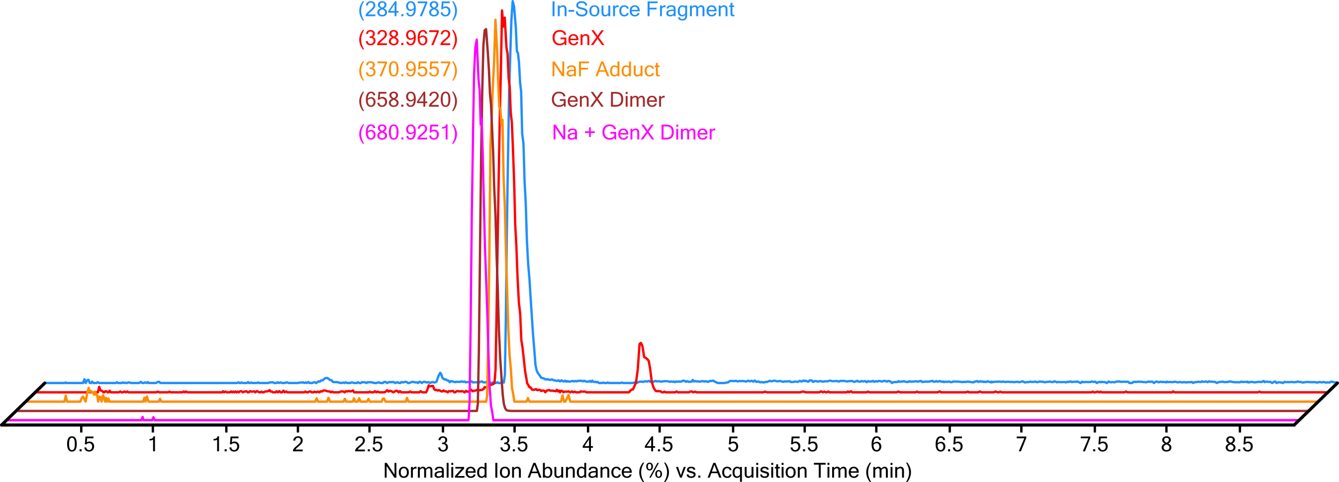
In-Source Related Species

Slide 18
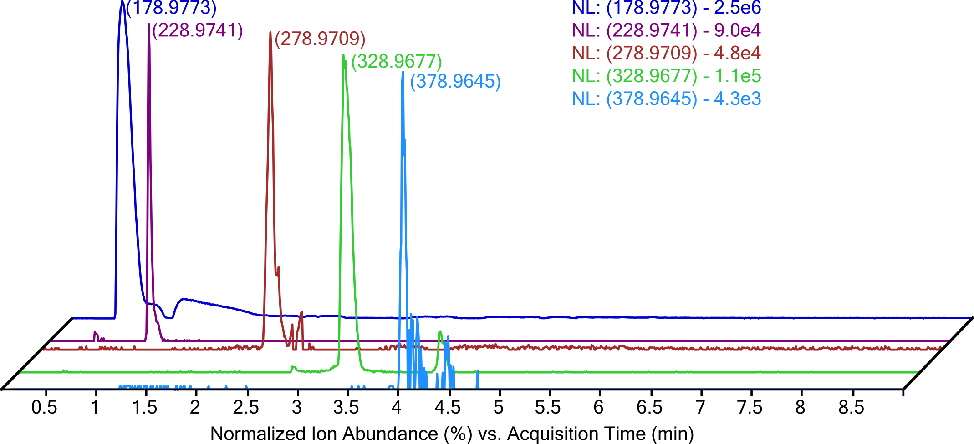
Homologous Series
+CF2
+CF2
Absolute Ion Intensity
+CF2
+CF2

Slide 19

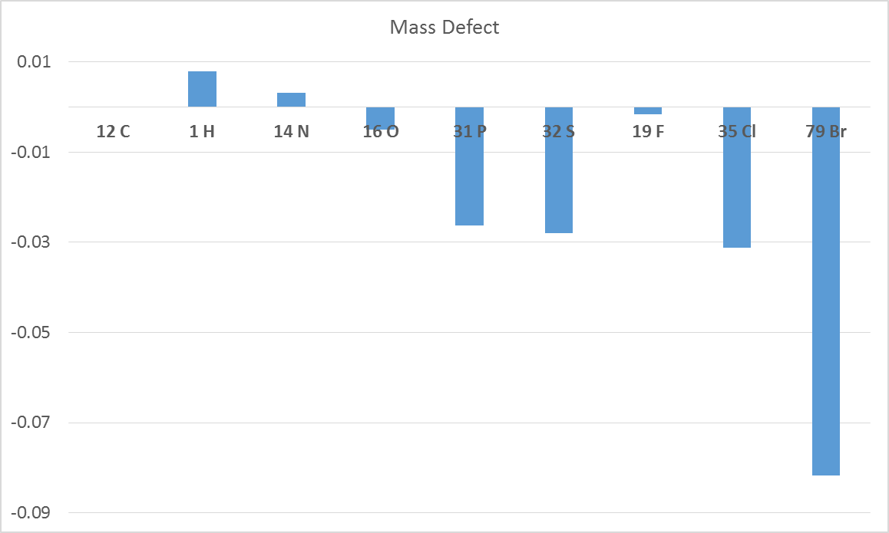
Isotope Signatures: Negative Mass Defect
Positive Mass Defect
1.00784
14.0067
12.0000
Negative Mass Defect
15.9949
18.9984
30.9738
31.9721
34.9689
F
-0.0016
H
+0.0078
4.8 F:H
78.9183

Slide 20
Example of Mass Defect
Octane
MI mass 114.1409
Octanoic Acid
MI mass 144.1150
Perfluorooctanoic Acid
MI mass 413.9737

Slide 21
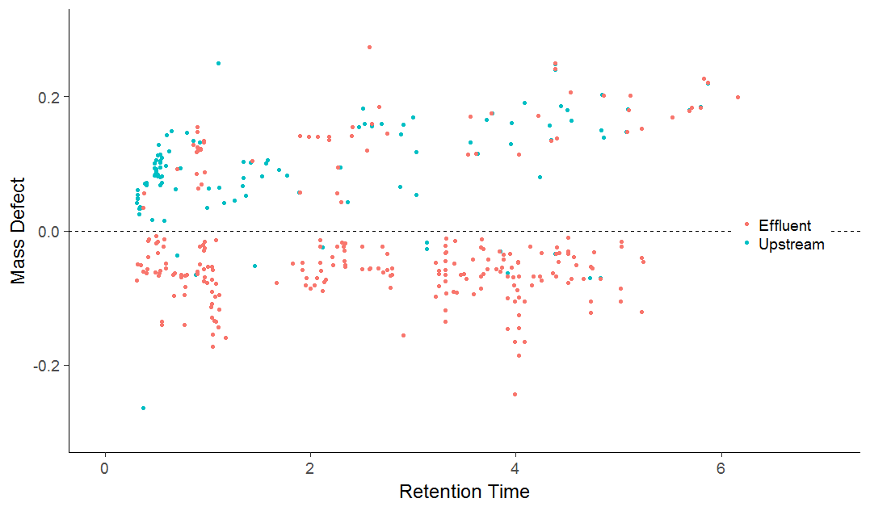
Mass Defect of Outfall and Upstream Features
High Priority Species:
Unique to Downstream, Likely Fluorinated
Notes:
MAKE ONE OF THESE FOR OUR DATA

Slide 22
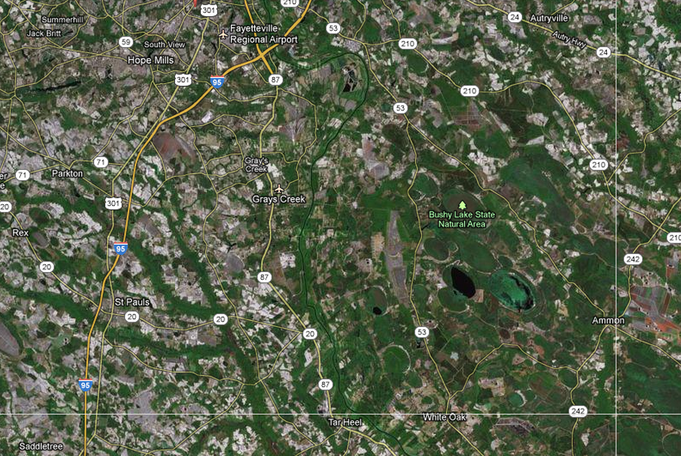
Fayetteville, NC (Cape Fear River)
CF 008,009
CF 005
CF 007
First Sampling 2011-2012
Presented at SETAC 2012
Follow-up sampling 2013-2013
Presented at SETAC 2014
RC
006
CF 004
Stream Flow
CF 003
CF 002
CF 001

Slide 23
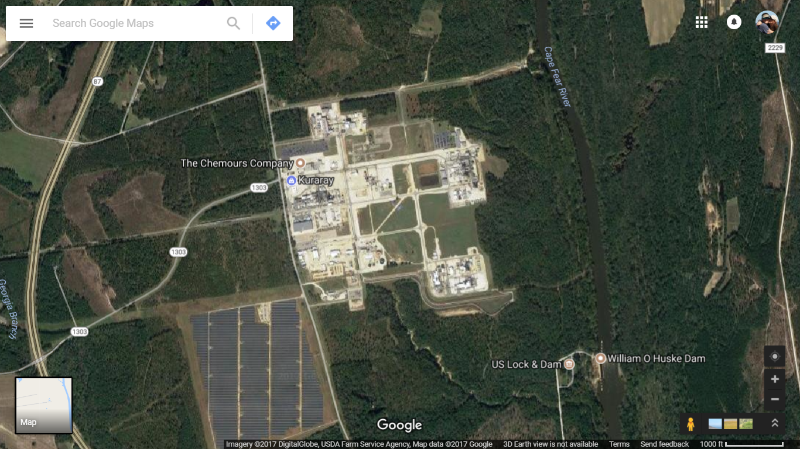
Water Intake
Current
Outfall
Former
Outfall

Slide 24
Stream Flow
Legacy PFAS found in Cape Fear Water
Analyte | 001 | 002 | 003 | 004 | 005 | 006 | 007 | 008 | 008 | 009
C4 | 23 | 502 | 3761 | 6 | 4 | 0 | 8 | 7 | 5 | 3
C5 | 441 | 5607 | 43590* | 17 | 9 | 1 | 32 | 46 | 12 | 9
PFBS | 4 | 5 | 3 | 4 | 5 | 2 | 9 | 5 | 6 | 4
C6 | 17 | 90 | 434 | 18 | 12 | 2 | 27 | 16 | 18 | 14
C7 | 37 | 599 | 3873 | 14 | 17 | 0 | 11 | 20 | 21 | 9
PFHS | 7 | 12 | 10 | 9 | 7 | 4 | 9 | 10 | 9 | 22
C8 | 32 | 39 | 71 | 33 | 25 | 2 | 38 | 36 | 41 | 18
C9 | 13 | 34 | 127 | 7 | 11 | 1 | 6 | 8 | 11 | 5
PFOS | 19 | 27 | 26 | 17 | 23 | 0 | 0 | 16 | 18 | 14
C10 | 10 | 17 | 12 | 11 | 0 | 3 | 3 | 8 | 10 | 5
items in red exceed the standard curve high end of 500 ng/L; 10x diluted and re-analyzed; * still exceed curve and are estimated

Slide 25
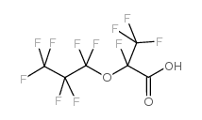
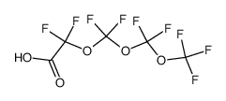
November 2015
Example Structures
Monoether (6):
GenX
polyethers (4):
Polyethers
sulfonates (2):

Slide 26
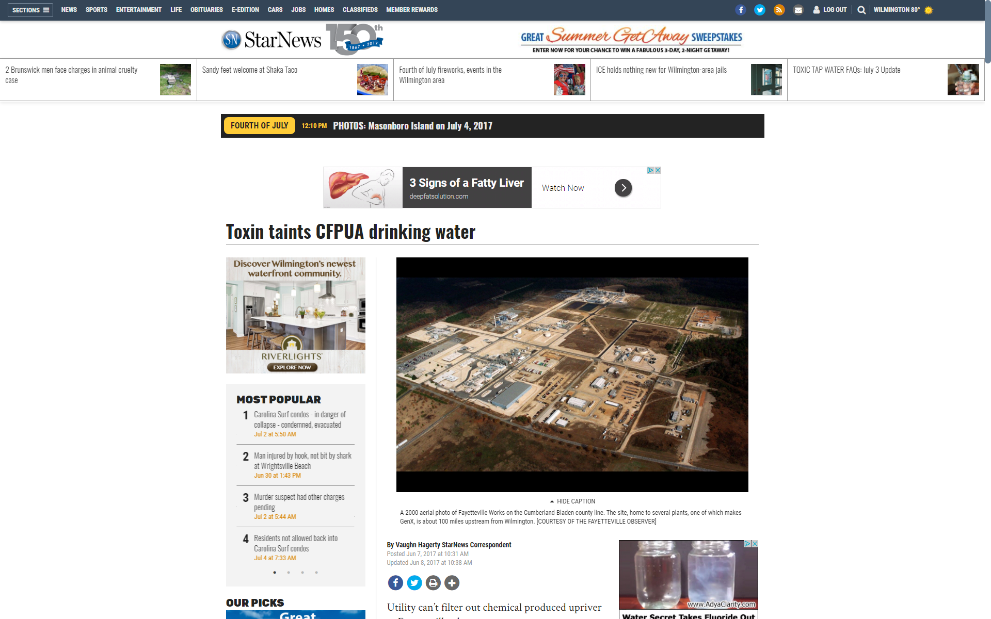
Cape Fear River
Fayetteville to Wilmington, NC

Slide 27
November 2016
Best of ES&T Letters 2016
June 7, 2017 story on in Wilmington Star Online News basis

Slide 28
Pittsboro, NC
Fayetteville, NC
Wilmington, NC
Sun et al., 2017

Slide 29
PFAS removal at Sweeney WTP
Sun et al., 2017

Slide 30
Other PFECAS Sweeney WTP
(GenX)

Slide 31
Chemours Site TSCA Inventory
Other
CAS 3330-14-1
Sulfonyl Fluorides
Vinyl Ethers
CAS 697-18-7
Legacy
CAS 335-67-1
PFOA
CAS 10493-43-3
CAS 1187-93-5
CAS 3825-26-1
APFO
CAS 428-59-1
Acid Fluorides
CAS 16090-14-5
CAS 2062-98-8
CAS 1623-05-8
CAS 677-67-8
CAS 2927-83-5
CAS 4089-58-1
CAS 2641-34-1
CAS 335-66-0
CAS 1682-78-6
DUPONT FAYETTEVILLE PLANT
22828 NC HIGHWAY 87 WEST
FAYETTEVILLE, NC 28306-7332
http://iaspub.epa.gov/enviro/tsca.get_chem_info?v_registry_id=110000559609

Slide 32
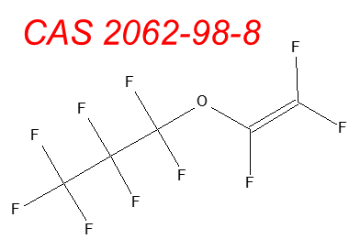
Hexafluoropropylene Oxide (HFPO) Based Chemistry
Vinyl Ether Production
HFPO
HFPO-DAF
CAS 2062-98-8
CAS 428-59-1
Dimerized to HFPO-DAF
polymers
Acid Fluorides
Polyvinyl Ether Intermediates
In Water
+Ammonium Hydroxide
Common Analyte
In Water
NH₄⁺
In water
HFPO-DA
GenX
CAS 62037-80-3
CAS 13252-13-6

Slide 33
Polyvinyl Ether Production
CAS 1682-78-6
CAS 2062-98-8
CAS 10493-43-3
CAS 2062-98-8
CAS 2927-83-5
CAS 1187-93-5
Polyvinyl Ether Intermediates
Acid Fluorides
Head-(CF₂)_{n}(CF₂O)_{m}-Head
Polyvinyl Ether

Slide 34
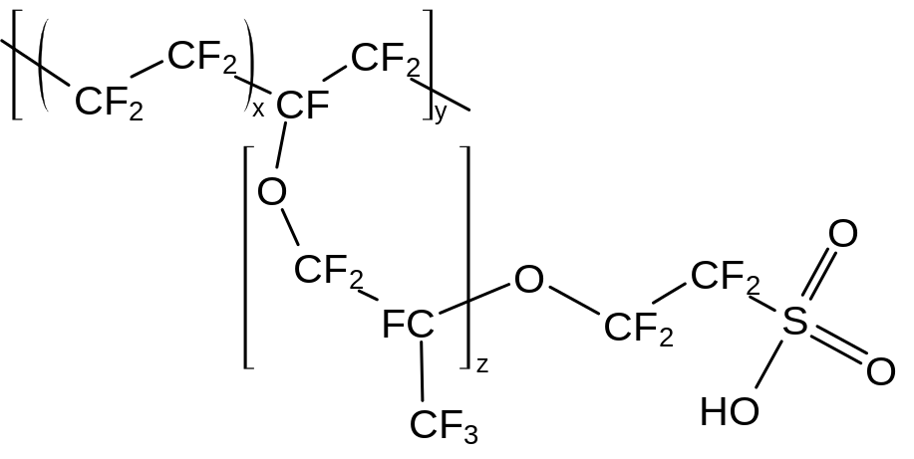
Nafion Polymer
Nafion is a sulfonated tetrafluoroethylene based fluoropolymer-copolymer.
proton conductor for proton exchange membrane (PEM) fuel cells
CAS 116-14-3
CAS 16090-14-5
CAS 66796-30-3

Slide 35
Relative Quantitation Time Trends
6 weeks mid June – early August
(HFPO-DA)

Slide 36
Relative Quantitation Time Trends
6 weeks mid June – early August
Nafion BP1
CAS 29311-67-9
Nafion BP2
CAS 749836-20-2

Slide 37
Retrospective HRMS Data Analysis
Samples analyzed via HRMS (TOF, QTOF, Orbitrap)
Store data files for reanalysis; like “data specimen banking”
Data Independent Acquisition when possible (QTOF) for MS/MS
Possible for presence absence analysis
Eventual sharing of data files and/or spectra to public location

Slide 38

Mass Spectrometry Fragments
or
m/z

Slide 39
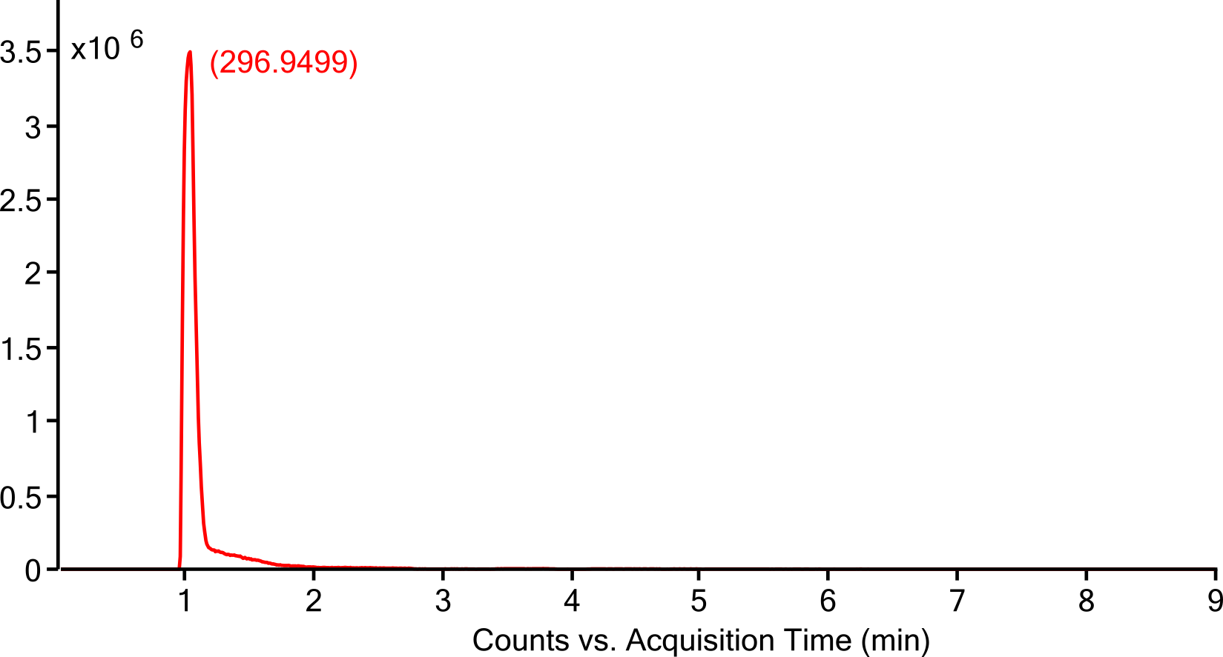
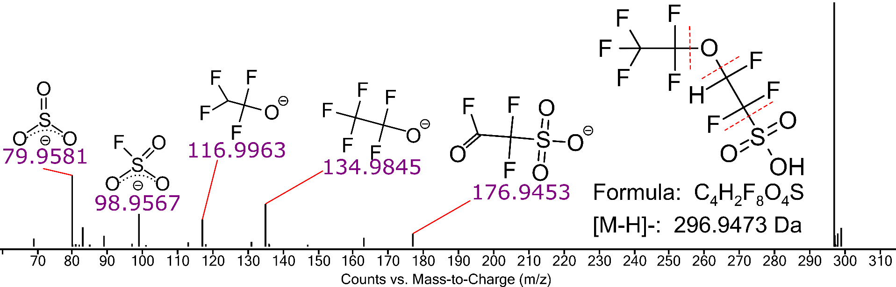
Novel Sulfonated Fluoroethers
Incompatible Fragments?
Mixed Isomer?
MS/MS

Slide 40
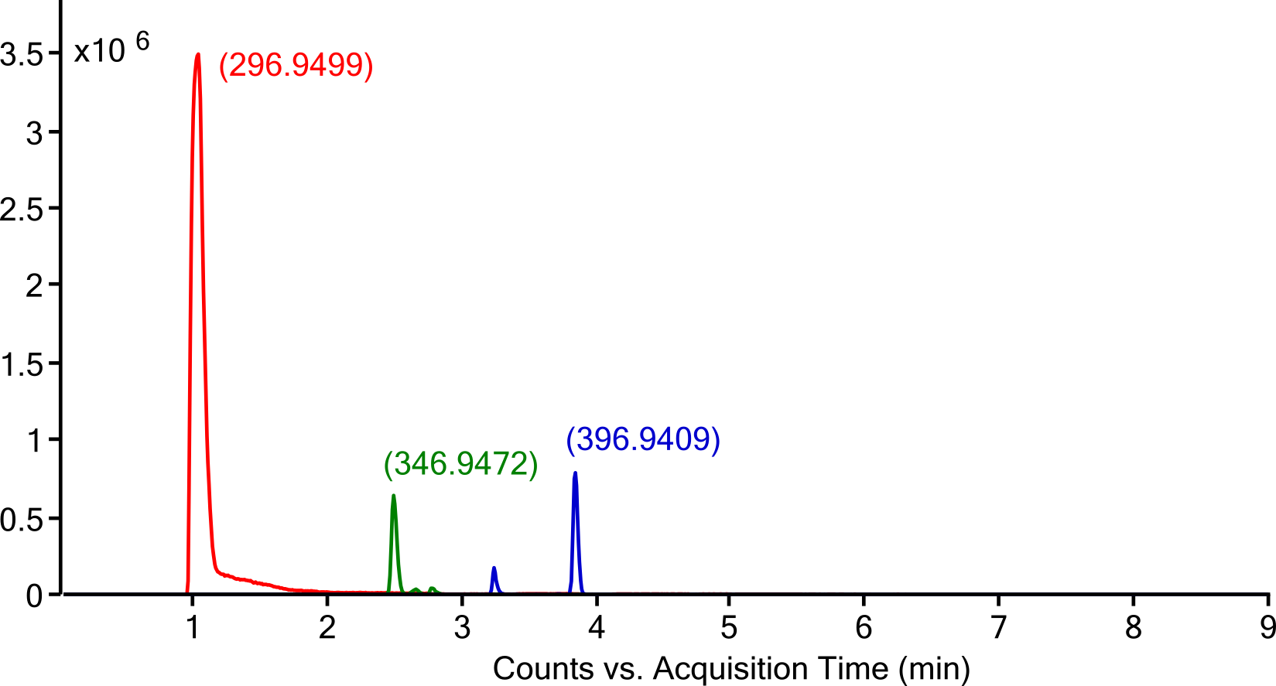
Homologous Series Improves Confirmation
+CF2
+CF2
Two Isomers
Three Isomers

Slide 41
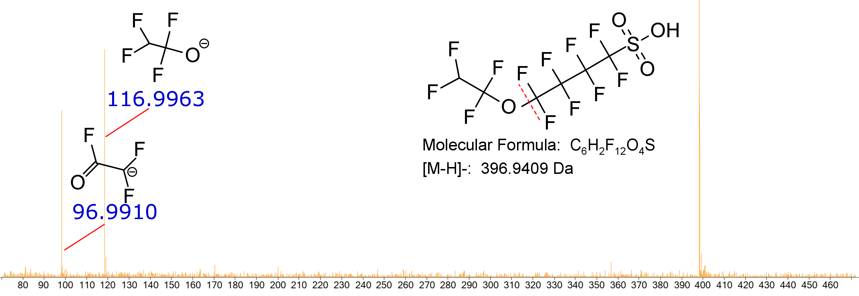
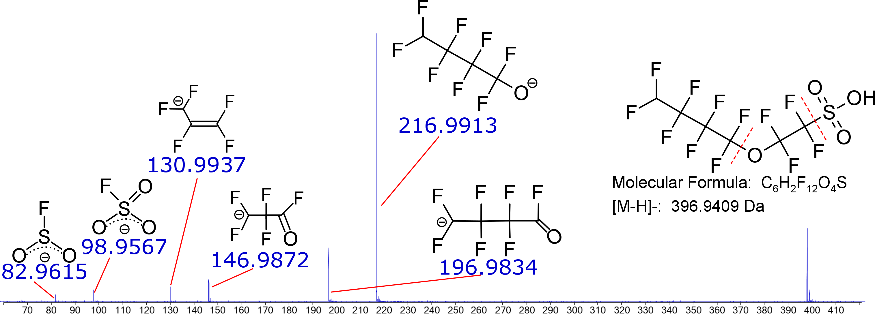
Unique MS/MS Fingerprints
Two Isomers

Slide 42
Additional Polyfluoro Ether Carboxylic Acids

Slide 43
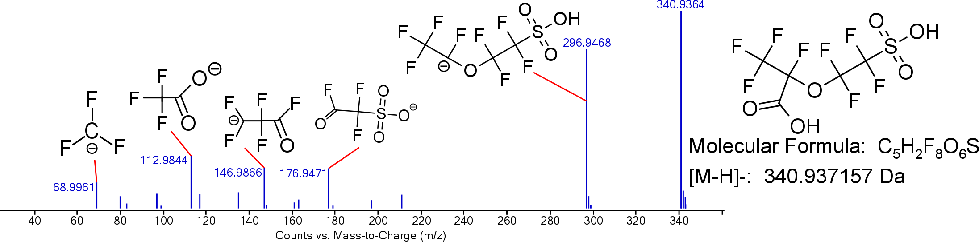
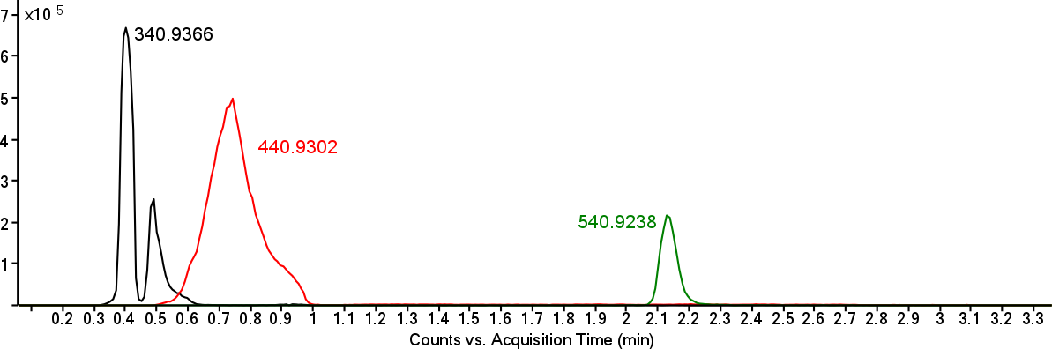
Double Headed Fluoropolymer Intermediates
Incompatible Fragments?
Mixed Isomer?
+C2F4
+C2F4

Slide 44
Double Headed Fluoropolymer Intermediates
Incompatible Fragments?
Mixed Isomer?
+C2F4
Nafion Monomer Precursor
CAS 4089-58-1
+C2F4

Slide 45
Retrospective Analysis
Year | Date | 296.9473 | 346.9472 | 396.9409 | 406.9594 | 426.9657 | 340.9372 | 440.9302 | 540.9238
2011 | 11-4-11 | ✓ | ✓ | ✓ | ✓ | ✓ | ✗ | ✗ | ✗
 | 1-26-12 | ✓ | ✗ | ✗ | ✓ | ✓ | ✗ | ✗ | ✗
2012 | 2-1-12 | ✓ | ✗ | ✗ | ✓ | ✓ | ✗ | ✓ | ✗
 | 2-9-12 | ✓ | ✓ | ✓ | ✓ | ✓ | ✓ | ✗ | ✗
 | 5-4-12 | ✓ | ✗ | ✗ | ✓ | ✗ | ✗ | ✗ | ✗
 | 5-4-12 | ✓ | ✗ | ✗ | ✗ | ✓ | ✗ | ✗ | ✗
2014 | 11-24-14 | ✓ | ✗ | ✗ | ✓ | ✗ | ✗ | ✗ | ✗
2015 | 5-12-15 | ✓ | ✓ | ✓ | ✓ | ✓ | ✓ | ✓ | ✓
 | 5-12-15 | ✓ | ✓ | ✓ | ✗ | ✓ | ✓ | ✓ | ✓
 | 8-6-15 | ✓ | ✓ | ✓ | ✗ | ✓ | ✓ | ✓ | ✓
2017 | 5-12-17 | ✓ | ✗ | ✓ | ✗ | ✓ | ✓ | ✓ | ✓
 | 6-20-17 | ✓ | ✓ | ✓ | ✓ | ✓ | ✗ | ✓ | ✓
 | 6-27-17 | ✓ | ✓ | ✓ | ✓ | ✓ | ✗ | ✗ | ✗
 | 7-4-17 | ✓ | ✓ | ✓ | ✓ | ✓ | ✗ | ✗ | ✗
 | 7-11-17 | ✓ | ✓ | ✓ | ✓ | ✓ | ✗ | ✗ | ✗
 | 7-18-17 | ✓ | ✓ | ✓ | ✓ | ✓ | ✗ | ✗ | ✗
 | 7-25-17 | ✓ | ✓ | ✓ | ✓ | ✓ | ✗ | ✗ | ✗
 | 8-3-17 | ✓ | ✓ | ✓ | ✓ | ✓ | ✗ | ✗ | ✗

Slide 46
Retrospective Analysis
Year | Date | 296.9473 | 346.9472 | 396.9409 | 406.9594 | 426.9657 | 340.9372 | 440.9302 | 540.9238
2011 | 11-4-11 | ✓ | ✓ | ✓ | ✓ | ✓ | ✗ | ✗ | ✗
 | 1-26-12 | ✓ | ✗ | ✗ | ✓ | ✓ | ✗ | ✗ | ✗
2012 | 2-1-12 | ✓ | ✗ | ✗ | ✓ | ✓ | ✗ | ✓ | ✗
 | 2-9-12 | ✓ | ✓ | ✓ | ✓ | ✓ | ✓ | ✗ | ✗
 | 5-4-12 | ✓ | ✗ | ✗ | ✓ | ✗ | ✗ | ✗ | ✗
 | 5-4-12 | ✓ | ✗ | ✗ | ✗ | ✓ | ✗ | ✗ | ✗
2014 | 11-24-14 | ✓ | ✗ | ✗ | ✓ | ✗ | ✗ | ✗ | ✗
2015 | 5-12-15 | ✓ | ✓ | ✓ | ✓ | ✓ | ✓ | ✓ | ✓
 | 5-12-15 | ✓ | ✓ | ✓ | ✗ | ✓ | ✓ | ✓ | ✓
 | 8-6-15 | ✓ | ✓ | ✓ | ✗ | ✓ | ✓ | ✓ | ✓
2017 | 5-12-17 | ✓ | ✗ | ✓ | ✗ | ✓ | ✓ | ✓ | ✓
 | 6-20-17 | ✓ | ✓ | ✓ | ✓ | ✓ | ✗ | ✓ | ✓
 | 6-27-17 | ✓ | ✓ | ✓ | ✓ | ✓ | ✗ | ✗ | ✗
 | 7-4-17 | ✓ | ✓ | ✓ | ✓ | ✓ | ✗ | ✗ | ✗
 | 7-11-17 | ✓ | ✓ | ✓ | ✓ | ✓ | ✗ | ✗ | ✗
 | 7-18-17 | ✓ | ✓ | ✓ | ✓ | ✓ | ✗ | ✗ | ✗
 | 7-25-17 | ✓ | ✓ | ✓ | ✓ | ✓ | ✗ | ✗ | ✗
 | 8-3-17 | ✓ | ✓ | ✓ | ✓ | ✓ | ✗ | ✗ | ✗

Slide 47
Retrospective Analysis
Year | Date | 296.9473 | 346.9472 | 396.9409 | 406.9594 | 426.9657 | 340.9372 | 440.9302 | 540.9238
2011 | 11-4-11 | ✓ | ✓ | ✓ | ✓ | ✓ | ✗ | ✗ | ✗
 | 1-26-12 | ✓ | ✗ | ✗ | ✓ | ✓ | ✗ | ✗ | ✗
2012 | 2-1-12 | ✓ | ✗ | ✗ | ✓ | ✓ | ✗ | ✓ | ✗
 | 2-9-12 | ✓ | ✓ | ✓ | ✓ | ✓ | ✓ | ✗ | ✗
 | 5-4-12 | ✓ | ✗ | ✗ | ✓ | ✗ | ✗ | ✗ | ✗
 | 5-4-12 | ✓ | ✗ | ✗ | ✗ | ✓ | ✗ | ✗ | ✗
2014 | 11-24-14 | ✓ | ✗ | ✗ | ✓ | ✗ | ✗ | ✗ | ✗
2015 | 5-12-15 | ✓ | ✓ | ✓ | ✓ | ✓ | ✓ | ✓ | ✓
 | 5-12-15 | ✓ | ✓ | ✓ | ✗ | ✓ | ✓ | ✓ | ✓
 | 8-6-15 | ✓ | ✓ | ✓ | ✗ | ✓ | ✓ | ✓ | ✓
2017 | 5-12-17 | ✓ | ✗ | ✓ | ✗ | ✓ | ✓ | ✓ | ✓
 | 6-20-17 | ✓ | ✓ | ✓ | ✓ | ✓ | ✗ | ✓ | ✓
 | 6-27-17 | ✓ | ✓ | ✓ | ✓ | ✓ | ✗ | ✗ | ✗
 | 7-4-17 | ✓ | ✓ | ✓ | ✓ | ✓ | ✗ | ✗ | ✗
 | 7-11-17 | ✓ | ✓ | ✓ | ✓ | ✓ | ✗ | ✗ | ✗
 | 7-18-17 | ✓ | ✓ | ✓ | ✓ | ✓ | ✗ | ✗ | ✗
 | 7-25-17 | ✓ | ✓ | ✓ | ✓ | ✓ | ✗ | ✗ | ✗
 | 8-3-17 | ✓ | ✓ | ✓ | ✓ | ✓ | ✗ | ✗ | ✗

Slide 48
Questions?
Contact Information
strynar.mark@epa.gov
The views expressed in this presentation are those of the author(s) and do not necessarily represent the views or policies of the U.S. Environmental Protection Agency.

