Slide 1
Department of Environmental Quality
High Rock Lake
Nutrient Management
Agriculture Technical
Advisory Group
December 13, 2022

Slide 2
HRL Informal Stakeholder Process
All Stakeholders
Steering Committee
Technical Advisory Groups
Final Report
September 2022 – December 2023
Six Steering Committee (SC) meetings (more if necessary)
Four All Stakeholder meetings
Five to six Technical Advisory Group (TAG) meetings (more if necessary)
SC submits final report to DWR
DWR considers final report in drafting rules
SC, TAGs, and stakeholders review draft rules and provide feedback
DWR finalizes draft rules considering feedback

Slide 3
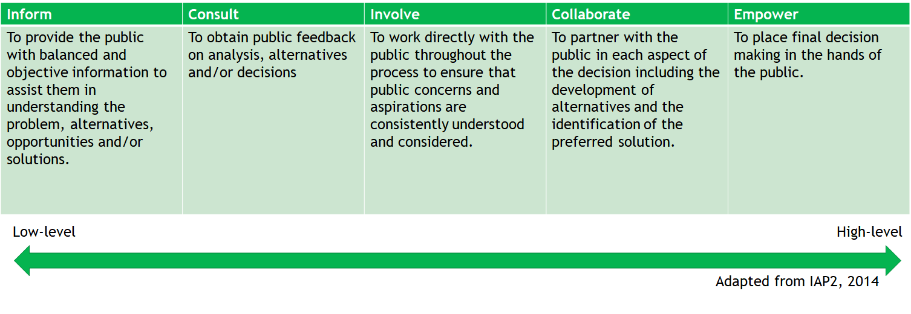
Public Participation

Slide 4
TAG Charge
What specific management improvements has your sector already implemented for nutrient control since 2006?
What further nutrient reduction management steps can you take that would make sense? Consider both examples of more easily attainable and effective opportunities, as well as more long-term or challenging opportunities for your sector.
What initiation and full implementation timeframes would be needed for each type of management step, roughly speaking?
Are there trends or changes on the horizon in your sector that could affect these timeframes?
Barriers/challenges and possible responses:
What are barriers or challenges to these steps? Consider legal barriers, financial barriers, social barriers, equity barriers.
What could be done to address these challenges and increase buy-in and support for these steps?
Do you think forming partnerships with other groups/sectors could lead to implementation opportunities and positive changes? If so, what opportunities can you envision?
Would nitrogen and/or phosphorus be most cost-effective for your sector to manage, reduce, monitor, and report? Why, and what are the limitations of each? Can you give rough proportions and scales for the kinds of reductions you think could be achieved?

Slide 5
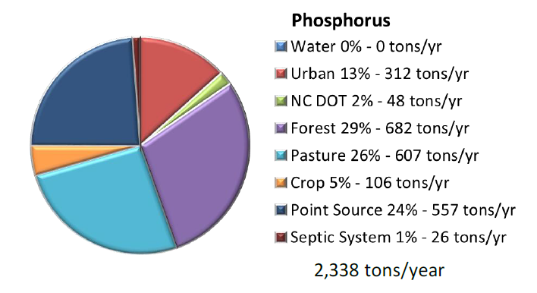
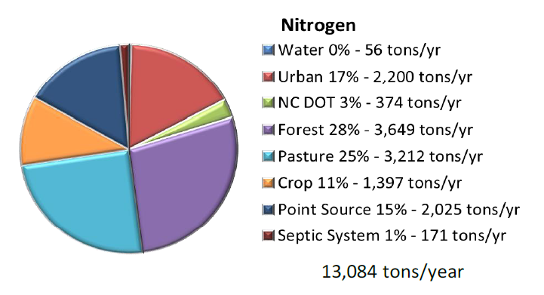
Annual Nutrient Loading
Source: Tetra Tech 2012
Department of Environmental Quality

Slide 6
Nutrient Load “Reductions”
Source: Tetra Tech 2012
Department of Environmental Quality

Slide 7
Nutrient Sources
Wastewater
POTW, WWTP
Industrial discharge
On-site wastewater (septic systems)
Development
Household fertilizers, pet waste
Construction site sediment
Post-construction impervious surfaces
Roadways
Agriculture
Animal waste
Applied fertilizers
Streambanks
Forests
Atmosphere
Lake sediments
“Point Sources”
Controllable
“Nonpoint Sources”
Uncontrollable
Department of Environmental Quality

Slide 8
Osmond 2015 Survey Findings
Soybeans are likely over-fertilized
Everything else is likely under-fertilized
Very few cover crops
Counties have at least 48% of ag fields buffered, several are much higher
Animal waste is likely an issue on corn and soybeans
Phosphorus is being added to 40% of all fields, 57% of all fields don’t need it
50% of farmers are primary income
89% of producers have no nutrient management plan

Slide 9
Crop/Pasture Notes from SWCD Outreach
Increased uptake of cover crops and no-till
Increased exclusion of livestock
Pasture management needed, overgrazing is common
Not much cropland conversion to trees

Slide 10
Animal notes from SWCD Outreach
Copper is being used as a growth hormone
More copper is being applied to fields than before
Litter has higher nutrient content than in the past
More frequent cleanouts, better litter management, more sampling
Better mortality management
Litter is in high demand
3rd party manure hauler agreements are generally good
Shift from secondary to primary income for poultry, which leads to more/better distribution
Dry stacks are not required at new facilities, integrator telling producer to wait 3-yr and then ask for SWCD or NRCS money
Poultry growth high in some places, tapered off in others

Slide 11
Capacity Issues
1-person District offices limit conservation delivery
Shortage of certified nutrient management specialists
Insufficient $$ for poultry systems, livestock exclusion, litter spreaders

Slide 12
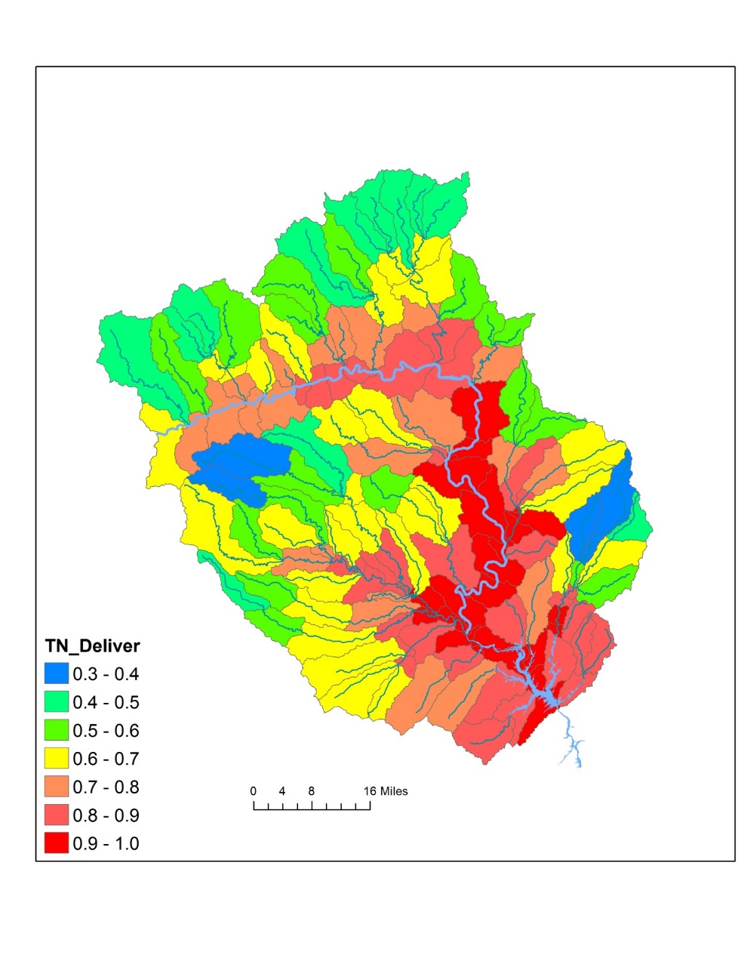
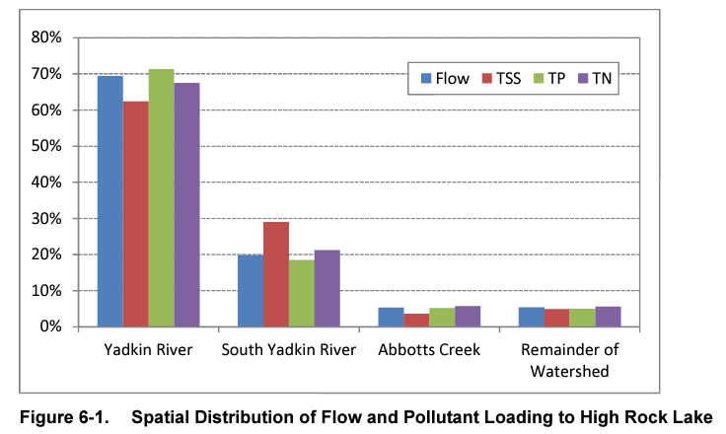
Spatial Dynamics in Nutrient Loading

Slide 13
TAG Charge
What specific management improvements has your sector already implemented for nutrient control since 2006?
What further nutrient reduction management steps can you take that would make sense? Consider both examples of more easily attainable and effective opportunities, as well as more long-term or challenging opportunities for your sector.
What initiation and full implementation timeframes would be needed for each type of management step, roughly speaking?
Are there trends or changes on the horizon in your sector that could affect these timeframes?
Barriers/challenges and possible responses:
What are barriers or challenges to these steps? Consider legal barriers, financial barriers, social barriers, equity barriers.
What could be done to address these challenges and increase buy-in and support for these steps?
Do you think forming partnerships with other groups/sectors could lead to implementation opportunities and positive changes? If so, what opportunities can you envision?
Would nitrogen and/or phosphorus be most cost-effective for your sector to manage, reduce, monitor, and report? Why, and what are the limitations of each? Can you give rough proportions and scales for the kinds of reductions you think could be achieved?

Slide 14
TAG Charge
Feb 15th Deadline
What specific management improvements has your sector already implemented for nutrient control since 2006?
What further nutrient reduction management steps can you take that would make sense? Consider both examples of more easily attainable and effective opportunities, as well as more long-term or challenging opportunities for your sector.
What initiation and full implementation timeframes would be needed for each type of management step, roughly speaking?
Are there trends or changes on the horizon in your sector that could affect these timeframes?
Barriers/challenges and possible responses:
What are barriers or challenges to these steps? Consider legal barriers, financial barriers, social barriers, equity barriers.
What could be done to address these challenges and increase buy-in and support for these steps?
Do you think forming partnerships with other groups/sectors could lead to implementation opportunities and positive changes? If so, what opportunities can you envision?
Would nitrogen and/or phosphorus be most cost-effective for your sector to manage, reduce, monitor, and report? Why, and what are the limitations of each? Can you give rough proportions and scales for the kinds of reductions you think could be achieved?

Slide 15
TAG Charge
What specific management improvements has your sector already implemented for nutrient control since 2006?
What further nutrient reduction management steps can you take that would make sense? Consider both examples of more easily attainable and effective opportunities, as well as more long-term or challenging opportunities for your sector.
What initiation and full implementation timeframes would be needed for each type of management step, roughly speaking?
Are there trends or changes on the horizon in your sector that could affect these timeframes?
Barriers/challenges and possible responses:
What are barriers or challenges to these steps? Consider legal barriers, financial barriers, social barriers, equity barriers.
What could be done to address these challenges and increase buy-in and support for these steps?
Do you think forming partnerships with other groups/sectors could lead to implementation opportunities and positive changes? If so, what opportunities can you envision?
Would nitrogen and/or phosphorus be most cost-effective for your sector to manage, reduce, monitor, and report? Why, and what are the limitations of each? Can you give rough proportions and scales for the kinds of reductions you think could be achieved?
April 15th Deadline

Slide 16
TAG Charge
What specific management improvements has your sector already implemented for nutrient control since 2006?
What further nutrient reduction management steps can you take that would make sense? Consider both examples of more easily attainable and effective opportunities, as well as more long-term or challenging opportunities for your sector.
What initiation and full implementation timeframes would be needed for each type of management step, roughly speaking?
Are there trends or changes on the horizon in your sector that could affect these timeframes?
Barriers/challenges and possible responses:
What are barriers or challenges to these steps? Consider legal barriers, financial barriers, social barriers, equity barriers.
What could be done to address these challenges and increase buy-in and support for these steps?
Do you think forming partnerships with other groups/sectors could lead to implementation opportunities and positive changes? If so, what opportunities can you envision?
Would nitrogen and/or phosphorus be most cost-effective for your sector to manage, reduce, monitor, and report? Why, and what are the limitations of each? Can you give rough proportions and scales for the kinds of reductions you think could be achieved?
May 15th Deadline

Slide 17
TAG Charge
Today’s Discussion
What specific management improvements has your sector already implemented for nutrient control since 2006?
What further nutrient reduction management steps can you take that would make sense? Consider both examples of more easily attainable and effective opportunities, as well as more long-term or challenging opportunities for your sector.
[If possible] What initiation and full implementation timeframes would be needed for each type of management step, roughly speaking?
Are there trends or changes on the horizon in your sector that could affect these timeframes?

Slide 18
Goal Setting Q&A
Joey Hester
Joey.hester@ncdenr.gov
O: 919-707-3675
C: 919-418-5712
Department of Environmental Quality

