Slide 1
Department of Environmental Quality
High Rock Lake
Nutrient Management
Steering Committee
November 17, 2022

Slide 2
HRL Informal Stakeholder Process
All Stakeholders
Steering Committee
Technical Advisory Groups
Final Report
September 2022 – December 2023
Six Steering Committee (SC) meetings (more if necessary)
Four All Stakeholder meetings
Five to six Technical Advisory Group (TAG) meetings (more if necessary)
SC submits final report to DWR
DWR considers final report in drafting rules
SC, TAGs, and stakeholders review draft rules and provide feedback
DWR finalizes draft rules considering feedback

Slide 3
Formal Rulemaking 101
US or NC grants regulatory authority
Stakeholder Reports
DEQ develops rule language & RIA
EMC WQC approves rule draft
EMC approves rule draft
Public Comment Period
Hearing Officer Deliberations
EMC approves final rules
RRC approves final rules
Effective Date
Stakeholders
SC
DWR
Substantial Revisions
Objects
Public Hearings
10 Letters
of Objection
SC
NCGA
Revisions
Fiscal Analysis
You
Implementation
Revisions

Slide 4
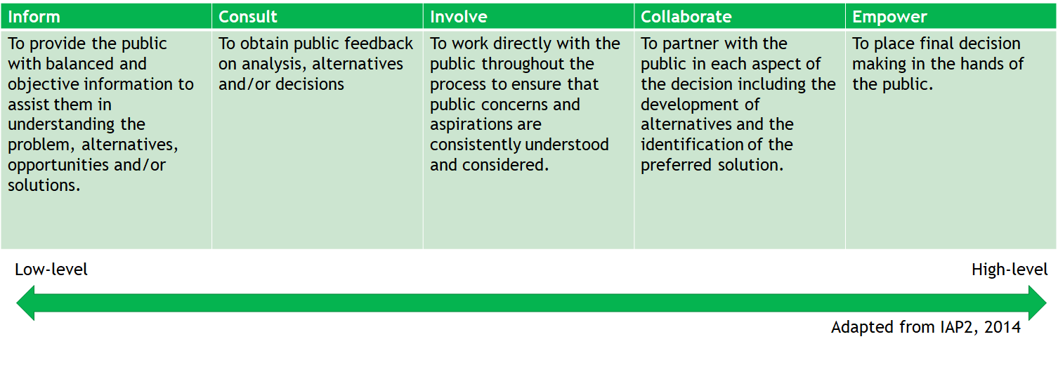
Public Participation

Slide 5
Important Points
DWR will communicate our expectations, requirements, and limitations
High Rock Lake will come off the 303(d) list when rules go into effect
  303(d) list is for Category 5 waters that require a TMDL
  HRL w/ a NMS will move to Cat 4b
Nutrient Management Strategy is designed to achieve WQ standard
  When chlorophyll-a sampling shows compliance with the standard, the rules go into maintenance mode
  If WQ standards are not achieved, adaptive management and evaluation will continue

Slide 6
Clean Water Act
40 CFR § 130.7
(1) Each State shall establish TMDLs for the water quality limited segments identified in paragraph (b)(1) of this section, and in accordance with the priority ranking. For pollutants other than heat, TMDLs shall be established at levels necessary to attain and maintain the applicable narrative and numerical WQS with seasonal variations and a margin of safety which takes into account any lack of knowledge concerning the relationship between effluent limitations and water quality. Determinations of TMDLs shall take into account critical conditions for stream flow, loading, and water quality parameters.
(ii) TMDLs shall be established for all pollutants preventing or expected to prevent attainment of water quality standards as identified pursuant to paragraph (b)(1) of this section. Calculations to establish TMDLs shall be subject to public review as defined in the State CPP.

Slide 7
TMDL Alternatives
EPA Guidance
An alternative restoration approach is a near-term plan, or description of actions, with a schedule and milestones, that is more immediately beneficial or practicable to achieving WQS. Impaired waters for which a State pursues an alternative restoration approach to achieve water quality standards would remain on the CWA 303(d) list and still require TMDLs until water quality standards are attained. States should periodically evaluate alternative restoration plans to determine if such approaches are still expected to be more immediately beneficial or practicable in achieving WQS than pursuing a TMDL approach in the near-term. If not, States should re-evaluate whether a higher priority for TMDL development should be assigned.
EPA does not take action to approve or disapprove a State’s alternative restoration plan (ARP) under CWA 303(d); however, EPA does take into account a State’s description of its alternative restoration plan to determine whether it is appropriate to include such approaches under the CWA 303(d) performance measures.
Source: https://www.epa.gov/tmdl/alternative-restoration-plans

Slide 8
TMDL Alternatives
EPA Guidance
EPA recognizes that there are restoration approaches that may be more immediately beneficial than TMDLs in achieving water quality standards. An alternative restoration approach is a plan and/or a set of actions pursued in near-term (other than a TMDL) that in their totality are designed to attain water quality standards. While appropriateness of alternative approaches is case-specific, examples could include approaches such as CWA 319 plans, “5r” restoration actions, “straight to implementation”, source water protection plans, category 4b activities, or other approaches as appropriate. In all cases (with the exception of the longstanding tool under category 4b), impaired waters remain on the CWA 303(d) list, but are assigned lower priority for TMDL development while alternative restoration approaches are pursued until water quality standards are achieved.
Source: https://www.epa.gov/sites/default/files/2015-07/documents/acwa_qa.pdf

Slide 9
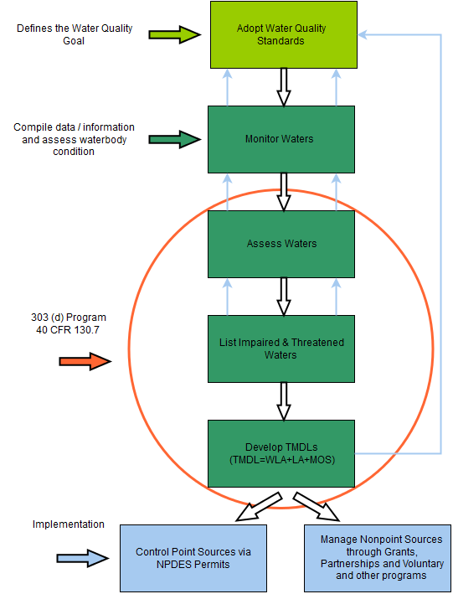
Clean Water Act
Process Requirements
Manage Nonpoint Sources via State programs
Alternative Restoration Plan
(Nutrient Management Strategy)
Manage Nonpoint Sources via State programs

Slide 10
§ 143-215.8B
Basinwide water resources management plans.
(b) Each basinwide water quality management plan shall:
(1) Provide that all point sources and nonpoint sources of pollutants jointly share the responsibility of reducing the pollutants in the State's waters in a fair, reasonable, and proportionate manner, using computer modeling and the best science and technology reasonably available and considering future anticipated population growth and economic development.
(2) If any of the waters located within the river basin are designated as nutrient sensitive waters, then the basinwide water quality management plan shall establish a goal to reduce the average annual mass load of nutrients that are delivered to surface waters within the river basin from point and nonpoint sources. The Commission shall establish a nutrient reduction goal for the nutrient or nutrients of concern that will result in improvements to water quality such that the designated uses of the water, as provided in the classification of the water under G.S. 143-214.1(d), are not impaired. The plan shall require that incremental progress toward achieving the goal. In developing the plan, the Commission shall determine and allow appropriate credit toward achieving the goal for reductions of water pollution by point and nonpoint sources through voluntary measures.

Slide 11
§ 143B-282
Environmental Management Commission - creation; powers and duties.
(c) The Environmental Management Commission shall implement the provisions of subsections (d) and (e) of 33 U.S.C. § 1313 by identifying and prioritizing impaired waters and by developing appropriate total maximum daily loads of pollutants for those impaired waters. The Commission shall incorporate those total maximum daily loads approved by the United States Environmental Protection Agency into its continuing basinwide water quality planning process.
(d) The Environmental Management Commission may adopt rules setting out strategies necessary for assuring that water quality standards are met by any point or nonpoint source or by any category of point or nonpoint sources that is determined by the Commission to be contributing to the water quality impairment. These strategies may include, but are not limited to, additional monitoring, effluent limitations, supplemental standards or classifications, best management practices, protective buffers, schedules of compliance, and the establishment of and delegations to intergovernmental basinwide groups.

Slide 12
NC Chlorophyll-a Criterion
15A NCAC 02B .0211
Chlorophyll a (corrected): except as specified in Sub-Item (a) of this Item, not greater than 40 ug/l for lakes, reservoirs, and other waters subject to growths of macroscopic or microscopic vegetation not designated as trout waters, and not greater than 15 ug/l for lakes, reservoirs, and other waters subject to growths of macroscopic or microscopic vegetation designated as trout waters (not applicable to lakes or reservoirs less than 10 acres in surface area). The Commission or its designee may prohibit or limit any discharge of waste into surface waters if the surface waters experience or the discharge would result in growths of microscopic or macroscopic vegetation such that the standards established pursuant to this Rule would be violated or the intended best usage of the waters would be impaired;

Slide 13
High Rock Lake
Chlorophyll-a Criterion
Site-specific High Rock Lake Reservoir [Index Numbers 12-(108.5), 12-(114), 12-117-(1), 26 12-117-(3), 12-118.5, and the uppermost portion of 12-(124.5) to the dam of High Rock Lake] Chlorophyll a (corrected): not greater than one exceedance of a growing season geometric mean of 35 ug/L in the photic zone within a three-year period. For the purpose of this Sub-Item:
(i) The growing season is April 1 through October 31;
(ii) Samples shall be collected in a minimum of five different months within each growing season with a minimum of two growing season geometric means collected in a three-year period;
(Pending EPA approval, stay tuned for more discussion)

Slide 14

Regulatory Authority Q&A
Joey Hester
Joey.hester@ncdenr.gov
O: 919-707-3675
C: 919-418-5712
Department of Environmental Quality

Slide 15
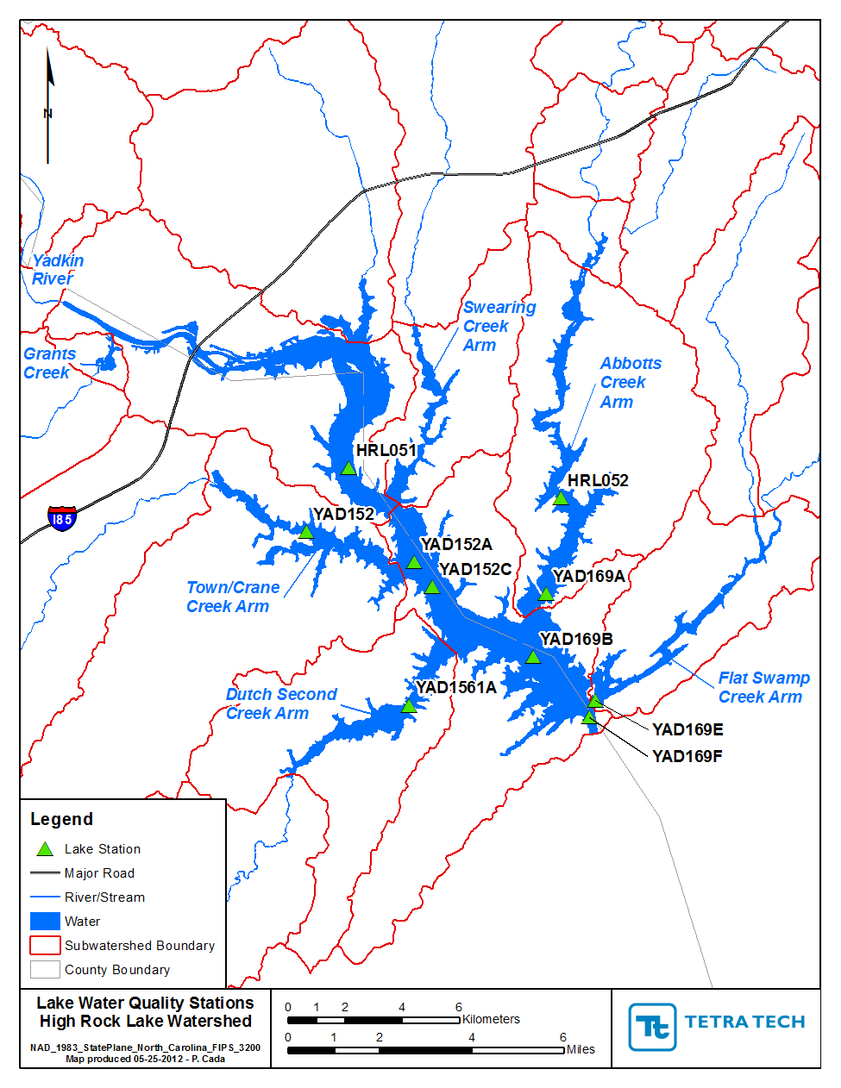
Lake Nutrient Response Model
Curve outputs
Thirty-six model scenario runs
Results output 4 times/day, evenly distributed
YAD152A and YAD152C generally have higher geometric mean model outputs
YAD152C generally has higher chlorophyll-a in reality
2006 generally had the highest geometric mean model output
Recent year geometric mean output is generally as high as or higher than 2006
Model outputs are generally not quite as high as real-world measurements, which are only taken during the day
YAD152C was selected as representing a critical area of HRL (“compliance point”)

Slide 16
Lake Nutrient Response Model
2006 generally had the highest geometric mean model output at YAD152C
Recent year observations (e.g. 2011 and 2016) are generally as high as or higher than 2006
Model outputs are generally not quite as high as real-world measurements, which are only taken during the day when chl-a values are peaking (model estimate is conservative)
YAD152C was selected as representing a critical area of HRL (“compliance point”)
Curve is still in DRAFT form

Slide 17
Reduction Curve
37% P/50% N reduction equates to a 35ug/L geomean output
42% P/48.5% N reduction equates to 40ug/L at 10% exceedance (statewide standard)
The model cannot predict results accurately from exclusive focus on ONE nutrient and not the other
Therefore, modelers suggest a combination N/P reduction may be preferable for HRL
Standard must be approved by EPA and DWR must make final internal decision about how to proceed based on EPA response
DRAFT
35ug/L seasonal geomean chl-a standard
YAD152C

Slide 18
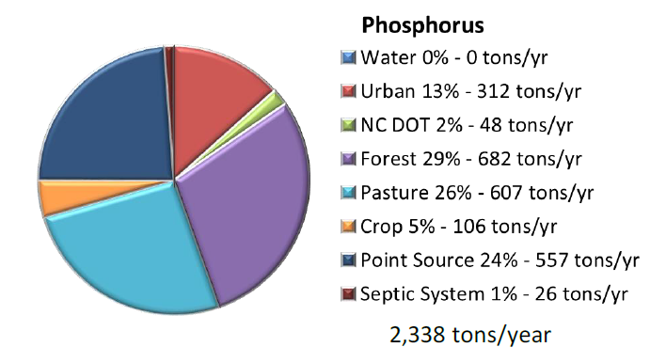
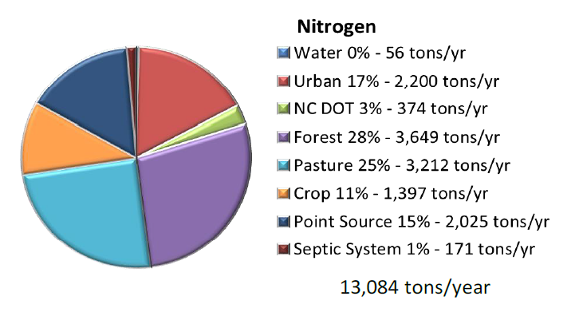
Annual Nutrient Loading
Source: Tetra Tech 2012
Department of Environmental Quality

Slide 19
Nutrient Load “Reductions”
Source: Tetra Tech 2012
Department of Environmental Quality

Slide 20
Nutrient Sources
  Wastewater
    POTW, WWTP
    Industrial discharge
    On-site wastewater (septic systems)
  Development
    Household fertilizers, pet waste
    Construction site sediment
    Post-construction impervious surfaces
    Roadways
  Agriculture
    Animal waste
    Applied fertilizers
  Streambanks
  Forests
  Atmosphere
  Lake sediments
“Point Sources”
Controllable
“Nonpoint Sources”
Uncontrollable
Department of Environmental Quality

Slide 21
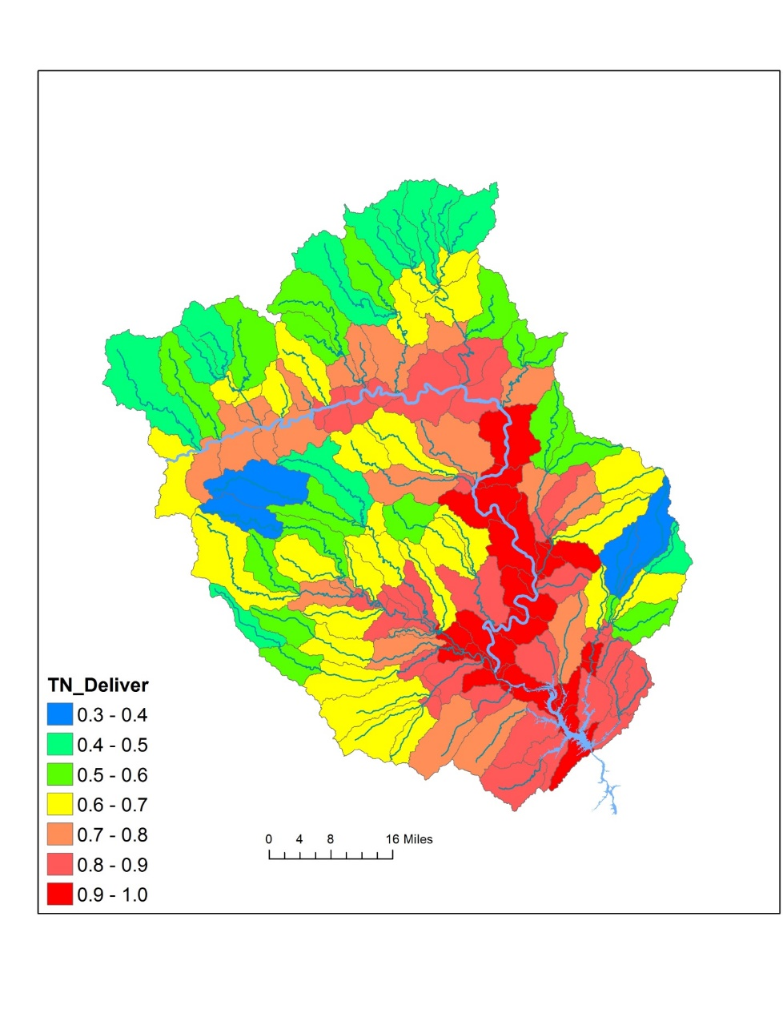
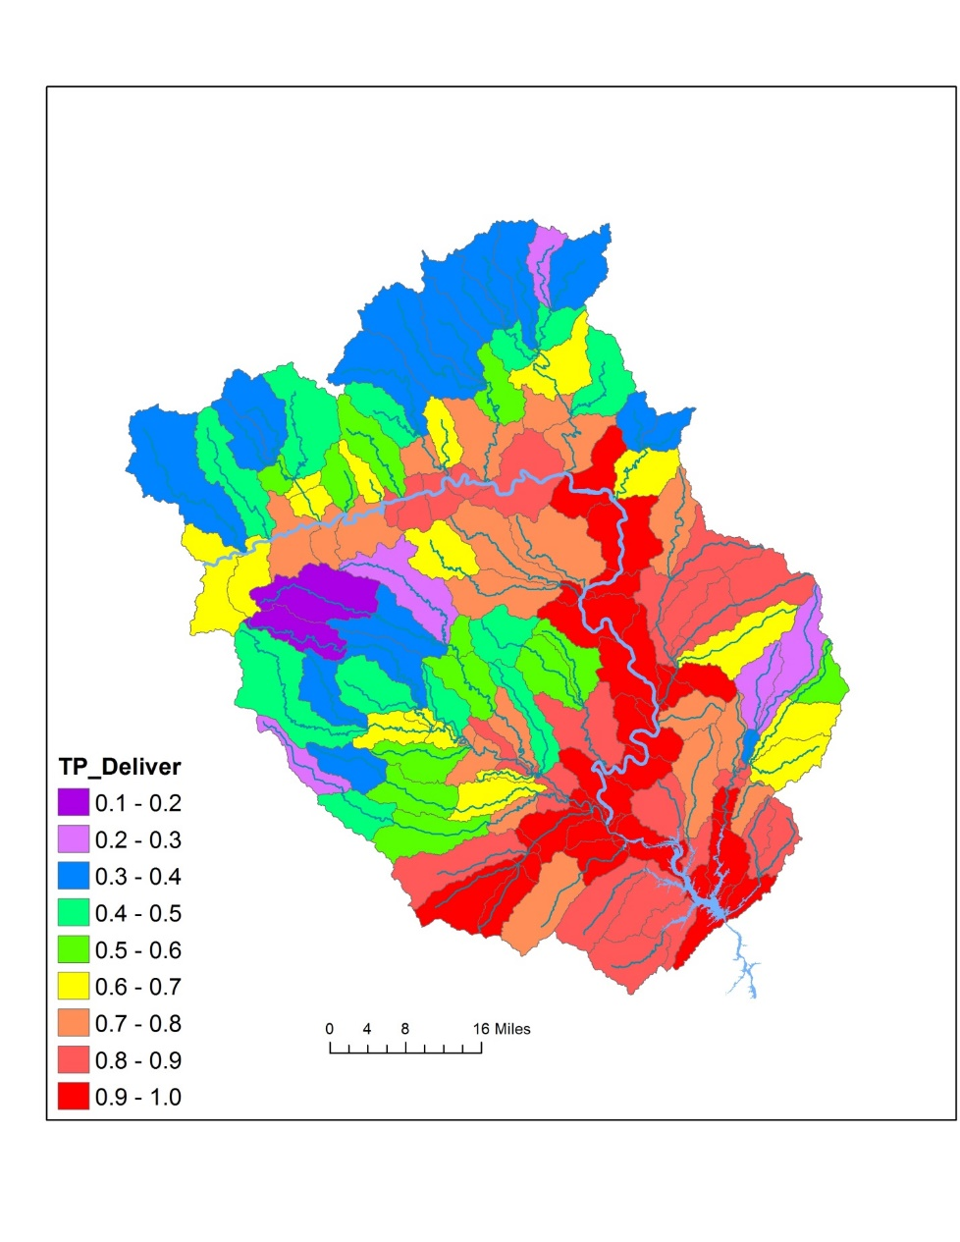
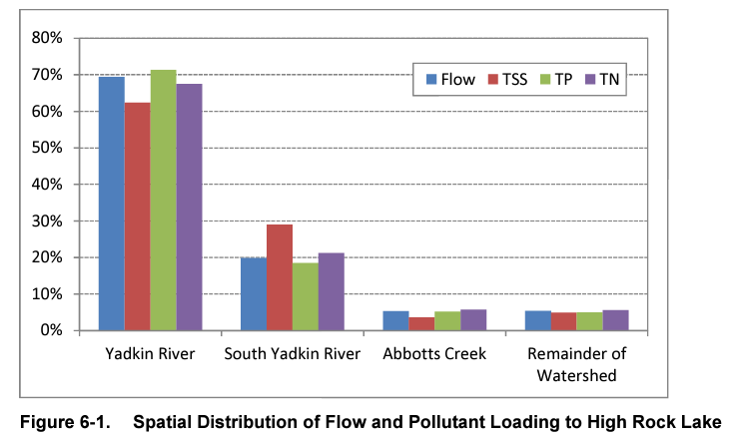
Spatial Dynamics in Nutrient Loading

Slide 22
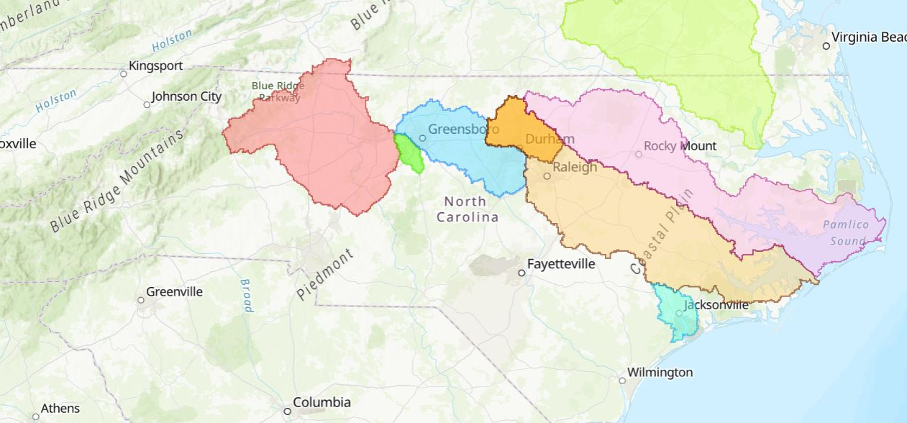
Nutrient Management Strategies
In North Carolina
Chowan River (1985)
High Rock Lake (TBD)
Falls
Lake (2011)
Jordan
Lake (2009)
Tar-Pamlico River (2000)
Neuse River (1997)
Randleman Lake (1999)
New River (1991)

Slide 23
Neuse River Basin NMS
15A NCAC 02B .0710
(a) PURPOSE. The purpose of this Rule and Rules .0711 through .0715 of this Section is to attain the designated uses of the Neuse River estuary with respect to meeting nutrient-related water quality standards pursuant to the Environmental Management Commission's authority under the Clean Water Responsibility and Environmentally Sound Policy Act, S.L. 1997-458. All waters of the Neuse River Basin are supplementally classified as Nutrient Sensitive Waters (NSW) pursuant to 15A NCAC 02B .0223. The rules enumerated in Paragraph (d) of this Rule together constitute the Neuse nutrient strategy, and shall be implemented in accordance with 15A NCAC 02B .0223.
(c) GOAL. To achieve the purpose of the Neuse nutrient strategy, the Commission established in the initial Neuse nutrient strategy rules, enacted in August 1998, the goal of reducing the average annual load of nitrogen delivered to the Neuse estuary from point and nonpoint sources by a minimum of 30 percent below the average annual load for the period 1991 through 1995 and thereafter maintaining it at or below that level. This amended strategy continues that goal.

Slide 24
Tar-Pamlico River Basin NMS
15A NCAC 02B .0710
PURPOSE. The purpose of this Rule and Rules 15A NCAC 02B .0731 through .0736 of this Section is to attain the designated uses of the Pamlico River estuary with respect to meeting nutrient-related water quality standards pursuant to the Environmental Management Commission's authority under the Clean Water Responsibility and Environmentally Sound Policy Act, S.L. 1997-458. The estuary and waters of the Tar-Pamlico River Basin are classified as Nutrient Sensitive Waters (NSW) pursuant to Rule 15A NCAC 02B .0223 of this Subchapter. The rules enumerated in Item (3) of this Rule together constitute the Tar-Pamlico nutrient strategy, and shall be implemented in accordance with Rule .0223 of the Subchapter.
(2) GOALS. To achieve the purpose of the Tar-Pamlico nutrient strategy, the Commission established in the initial Tar-Pamlico nutrient rules, enacted in 2000 and 2001, goals of reducing the average annual load of nitrogen delivered to the Pamlico River Estuary from nutrient sources to a level 30 percent below a 1991 baseline, and thereafter maintaining it at or below that level, and of reducing average annual phosphorus load to 1991 baseline level and thereafter maintaining it at or below that level. This Tar-Pamlico nutrient strategy continues these goals.

Slide 25
Jordan Lake Watershed NMS
15A NCAC 02B .0262
PURPOSE. The purpose of this Rule, 15A NCAC 02B .0263 through .0273 and .0311(p) shall be to restore and maintain nutrient-related water quality standards in B. Everett Jordan Reservoir; protect its classified uses as set out in 15A NCAC 02B .0216, including use as a source of water supply for drinking water, culinary and food processing purposes; and maintain or enhance protections currently implemented by local governments in existing water supply watersheds. These Rules, as further enumerated in Item (3) of this Rule, together shall constitute the Jordan water supply nutrient strategy, or Jordan nutrient strategy. Additional provisions of this Rule include establishing the geographic and regulatory scope of the Jordan nutrient strategy, defining its relationship to existing water quality regulations, setting specific nutrient mass load goals for Jordan Reservoir, providing for the use of adaptive management to restore Jordan Reservoir, and citing general enforcement authorities. The following provisions further establish the framework of the Jordan water supply nutrient strategy:
(2) STRATEGY GOAL. Pursuant to G.S. 143-215.1(c5), 143-215.8B, and 143B-282(c) and (d) of the Clean Water Responsibility Act of 1997, the Environmental Management Commission establishes the goal of reducing the average annual loads of nitrogen and phosphorus delivered to Jordan Reservoir from all point and nonpoint sources of these nutrients located within its watershed, as specified in Item (5) of this Rule, and provides for adaptive management of the strategy and goal, as specified in Item (8) of this Rule.
Paraphrased:
Upper New Hope Arm: 35% N reduction, 5% P reduction
Lower New Hope Arm: No net increase N, No net increase P
Haw Arm: 8% N reduction, 5% P reduction
Allocations can change based on transfer between point and nonpoint sources
One year for P compliance, six to nine years for N compliance for all rules except existing development (open ended)

Slide 26
Falls Lake Watershed NMS
15A NCAC 02B .0275
GOAL AND OBJECTIVES. To achieve the purpose of the Falls nutrient strategy, the Commission establishes the goal of attaining and maintaining nutrient-related water quality standards identified in 15A NCAC 02B .0211 throughout Falls Reservoir pursuant to G.S. 143-215.8B and 143B-282(c) and (d) of the Clean Water Responsibility Act of 1997. The Commission establishes a staged and adaptive implementation plan, outlined hereafter, to achieve the following objectives. The objective of Stage I is to, at minimum, achieve and maintain nutrient-related water quality standards in the Lower Falls Reservoir as soon as possible but no later than January 15, 2021 and to improve water quality in the Upper Falls Reservoir. The objective of Stage II is to achieve and maintain nutrient-related water quality standards throughout Falls Reservoir. This is estimated to require a reduction of 40 and 77 percent in average annual mass loads of nitrogen and phosphorus respectively, delivered from the sources named in Item (6) in the Upper Falls Watershed from a baseline of 2006. The resulting Stage II allowable loads to Falls Reservoir from the watersheds of Ellerbe Creek, Eno River, Little River, Flat River, and Knap of Reeds Creek shall be 658,000 pounds of nitrogen per year and 35,000 pounds of phosphorus per year.
(4) STAGED IMPLEMENTATION. The Commission shall employ the staged implementation plan set forth below to achieve the goal of the Falls nutrient strategy:
(a) STAGE I. Stage I requires intermediate or currently achievable controls throughout the Falls watershed with the objective of reducing nitrogen and phosphorus loading, and attaining nutrient-related water quality standards in the Lower Falls Reservoir as soon as possible but no later than January 15, 2021, while also improving water quality in the Upper Falls Reservoir as described in this Item. Implementation timeframes are described in individual rules, with full implementation occurring no later than January 15, 2021;
(b) STAGE II. Stage II requires implementation of additional controls in the Upper Falls Watershed beginning no later than January 15, 2021 to achieve nutrient-related water quality standards throughout Falls Reservoir by 2041 to the maximum extent technically and economically feasible, with progress toward this overall objective as described in Sub-Item (5)(a); and

Slide 27
Nutrients and Algae
Anthropogenic nutrient overenrichment, coupled with rising temperatures, and an increasing frequency of extreme hydrologic events (storms and droughts) are accelerating eutrophication and promoting the expansion of harmful algal blooms (HABs) across the freshwater-to-marine continuum. All HABs-with a focus here on cyanobacterial blooms-pose serious consequences for water supplies, fisheries, recreational uses, tourism, and property values. As nutrient loads grow in watersheds, they begin to compound the effects of legacy stores. This has led to a paradigm shift in our understanding of how nutrients control eutrophication and blooms. Phosphorus (P) reductions have been traditionally prescribed exclusively for freshwater systems, while nitrogen (N) reductions were mainly stressed for brackish and coastal waters. However, because most systems are hydrologically interconnected, single nutrient (e.g., P only) reductions upstream may not necessarily reduce HAB impacts downstream. Reducing both N and P inputs is the only viable nutrient management solution for long-term control of HABs along the continuum.
Source: Paerl HW, Otten TG, Kudela R. Mitigating the Expansion of Harmful Algal Blooms Across the Freshwater-to-Marine Continuum. Environ Sci Technol. 2018 May 15;52(10):5519-5529. doi: 10.1021/acs.est.7b05950. Epub 2018 Apr 25. PMID: 29656639.

Slide 28
Nutrients and Algae
In the past, considerable attention was focused on improving the water quality of freshwater bodies and estuaries by reducing inputs of phosphorus alone. However, new research suggests that strategies controlling the two main nutrients, phosphorus and nitrogen, are more effective in the management of eutrophication. There is no specific solution to solving phosphorus pollution of water resources; however, sustainable management of phosphorus requires an integrated approach combining at least a reduction in consumption levels, source management, more specific regime-based nutrient criteria, routine soil fertility evaluation and recommendations, transport management, as well as the development of extensive phosphorus recovery and recycling programs.
Source: Haque SE. How Effective Are Existing Phosphorus Management Strategies in Mitigating Surface Water Quality Problems in the U.S.? Sustainability. 2021; 13(12):6565. https://doi.org/10.3390/su13126565

Slide 29
Other States/Regions
Gulf Hypoxia Task Force: 45% P load reduction to Mississippi Basin
Lake Erie: 40% P load reduction
Lake Winnipeg: 10% P load reduction, 13% N load reduction
Chesapeake Bay: 24% P load reduction, 25% N load reduction
Puget Sound: targets expected in 2023
Long Island Sound: 60% N load reduction
Lake Champlain: 34% P load reduction
Tampa Bay: voluntary “caps” of N load at 2003-2007 levels + TMDL

Slide 30
Goal Setting Q&A
Joey Hester
Joey.hester@ncdenr.gov
O: 919-707-3675
C: 919-418-5712
Department of Environmental Quality

