Slide 1
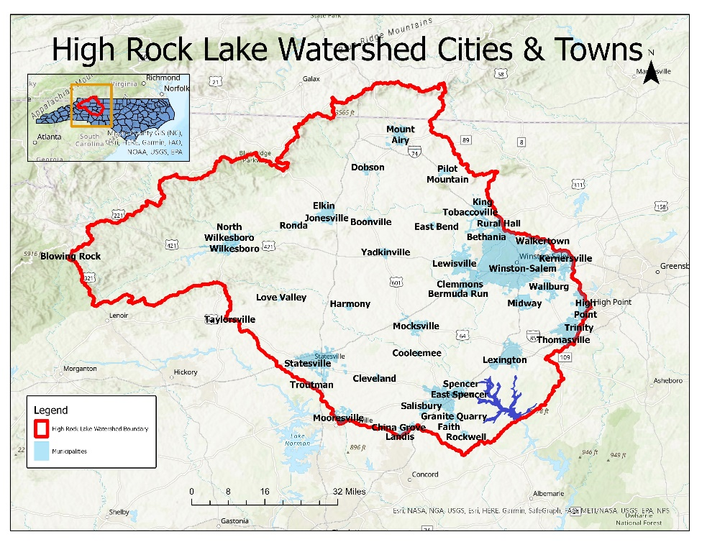
Welcome to the High Rock Lake Nutrient Management Strategy Rulemaking Kickoff

Slide 2
Department of Environmental Quality
High Rock Lake
Nutrient Management
Strategy Development
June 25, 2018

Slide 3
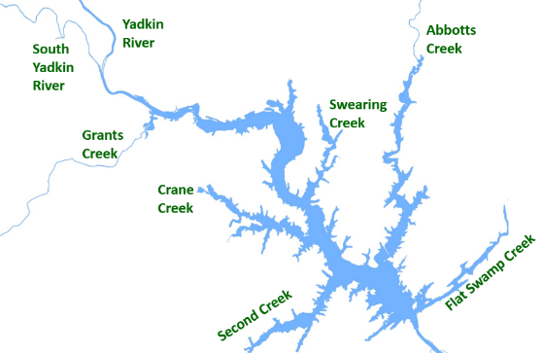
NSW Rulemaking
Goals and Purpose
Engage stakeholders in watershed planning
Draft rule language to reduce nutrient loading to High Rock Lake
Prioritize and enable creative and innovative solutions that meet the needs of residents
Reduce nutrient loading in a fair, reasonable, and proportionate manner
Ensure that High Rock Lake continues to be fishable and swimmable
Protect drinking water supplies along the Yadkin River
Department of Environmental Quality

Slide 4
Department of Environmental Quality
High Rock Lake
Water Quality Status
June 25, 2018

Slide 5
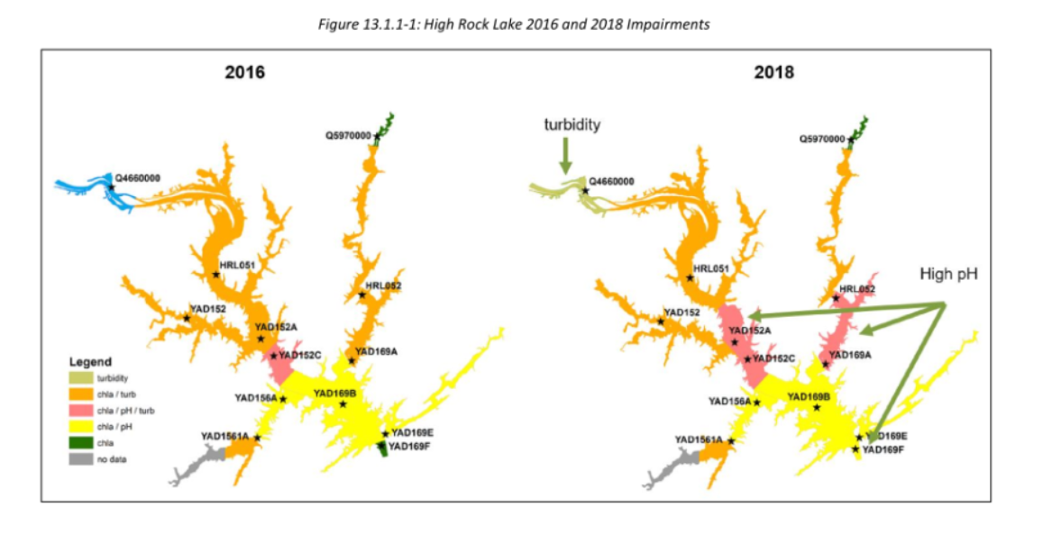
High Rock Lake
Eutrophic since at least the 1970s
First impaired for chlorophyll-a in 2004
Currently impaired for chlorophyll-a, pH, and turbidity
Summer phosphate limits are in place for 3 WWTPs in Abbotts Creek
Persistent algae blooms in every season except winter
Department of Environmental Quality

Slide 6
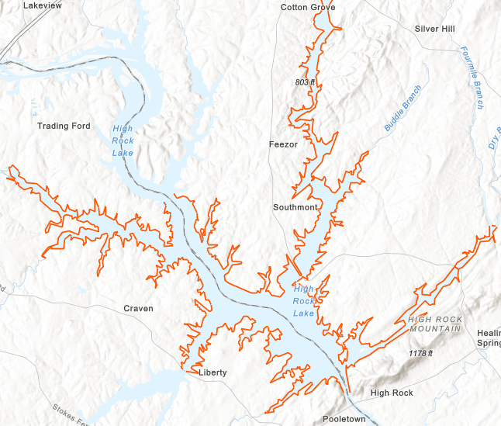
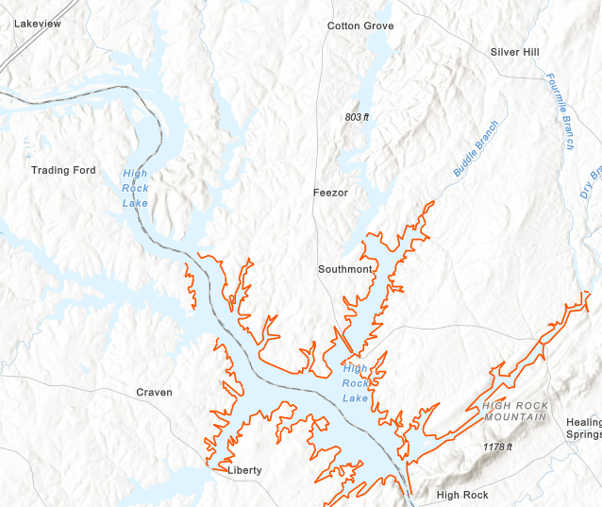
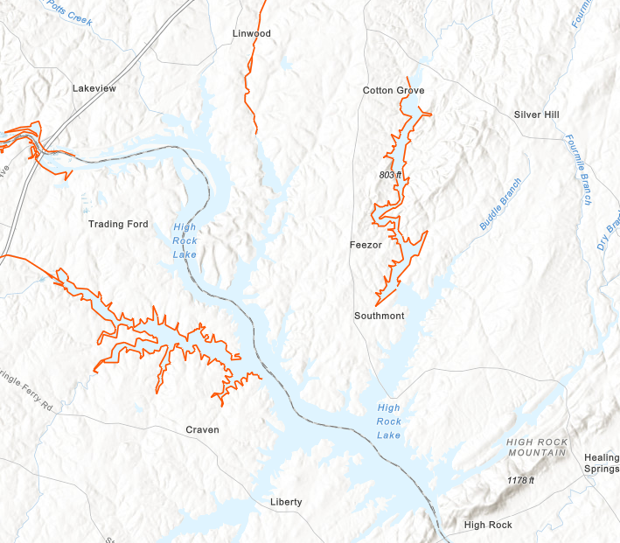
2020 HRL Impairments
Chlorophyll-a pH Turbidity

Slide 7
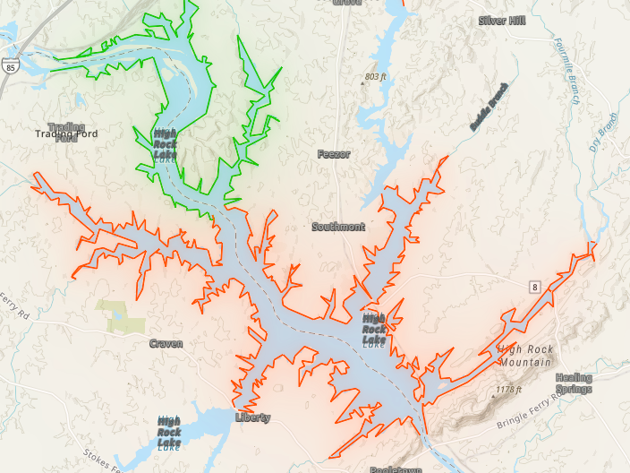
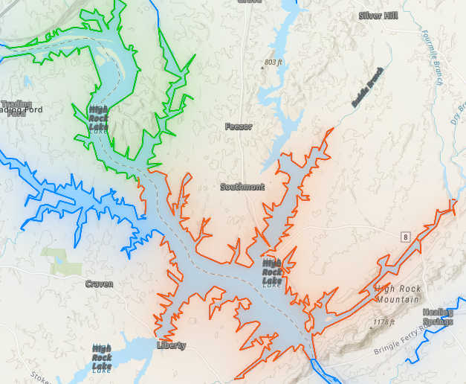
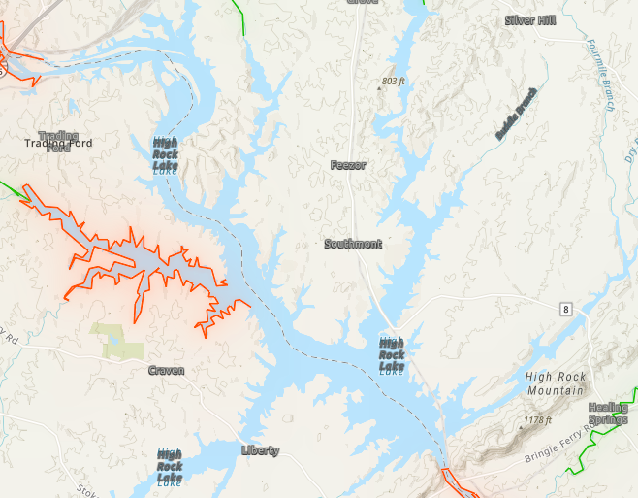
2022 HRL Impairments
Chlorophyll-a pH Turbidity

Slide 8
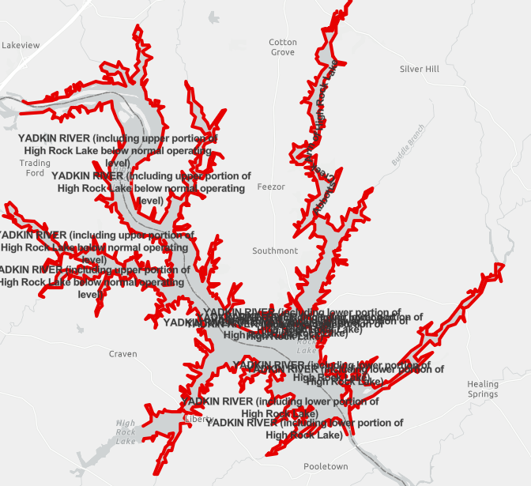
HRL Chlorophyll-a Impairments
2018 2020 2022

Slide 9
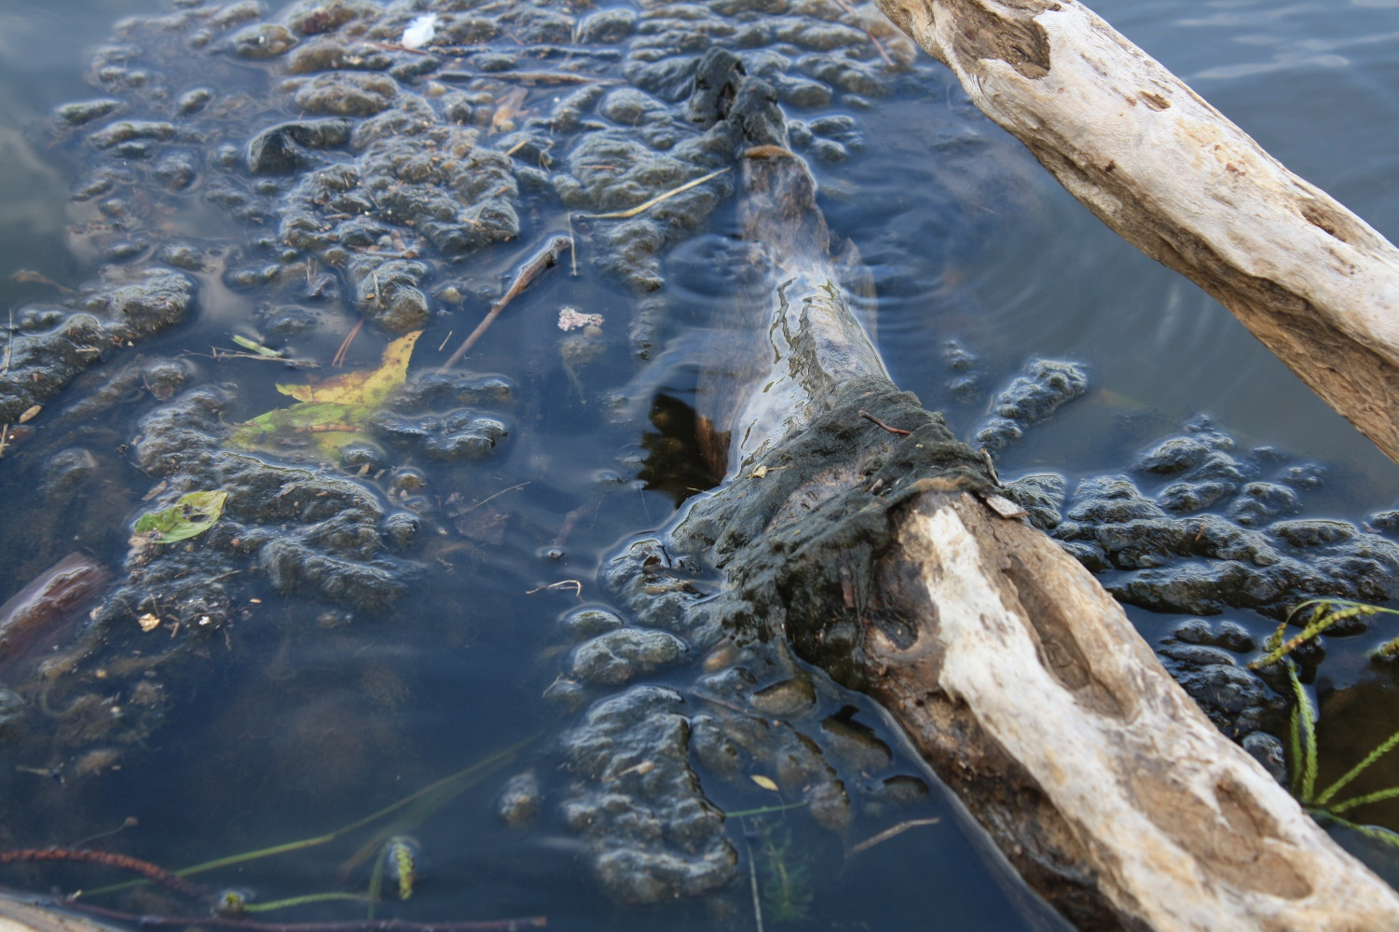
Lyngbya wollei
Blue green algae (cyanobacteria)
Unpleasant, musty smell
Reduces oxygen exchange
Can produce toxins
  Cylindrospermopsin (causes liver damage)
  Saxotoxin (neurotoxin that can cause gastrointestinal damage)
Ingestion of or contact with nearby water can cause health effects
No documented illnesses caused by Lyngbya wollei
Can augment high pH which eliminates competition
Least preferred food source of carp
Department of Environmental Quality

Slide 10
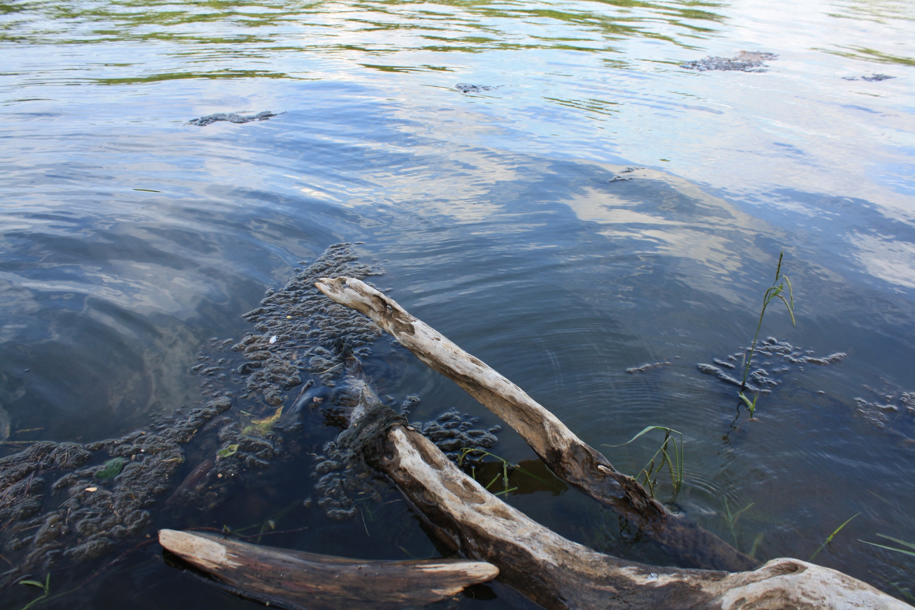
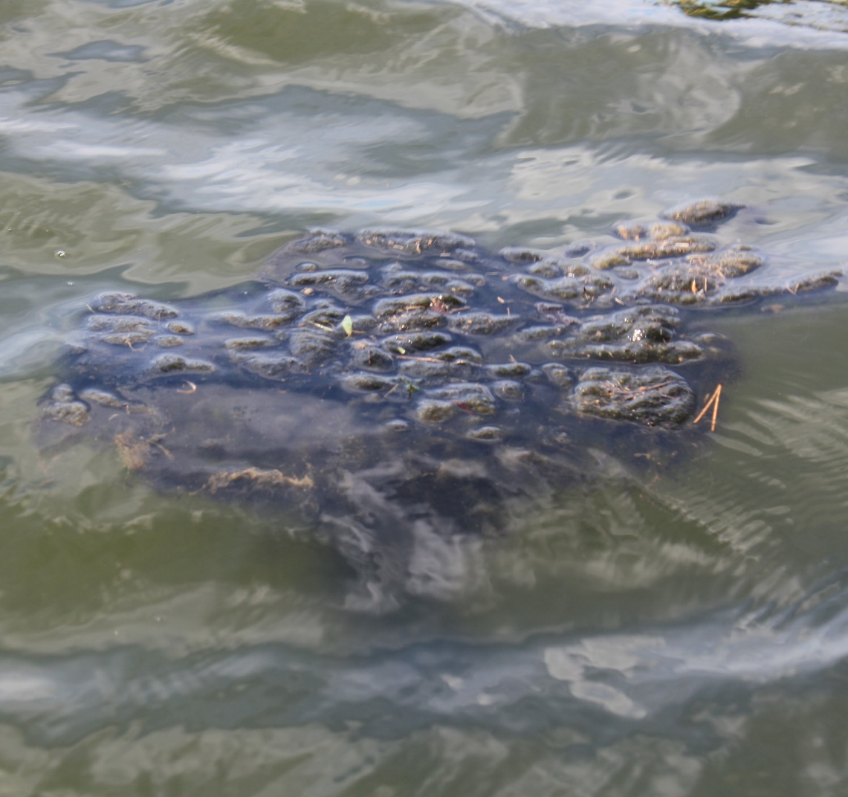
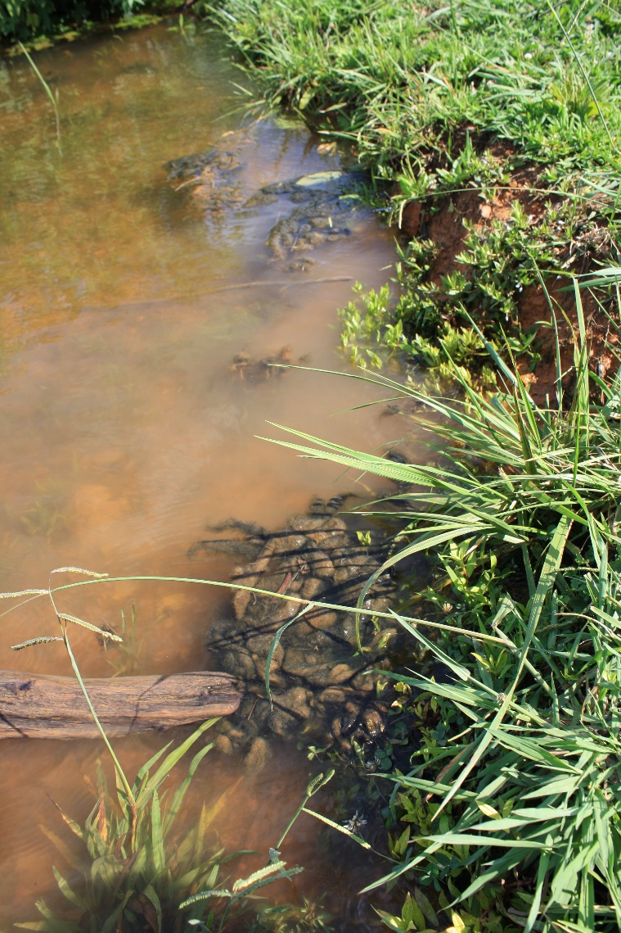
Lyngbya wollei
Local photos
High Rock Lake
High Rock Lake
Department of Environmental Quality

Slide 11
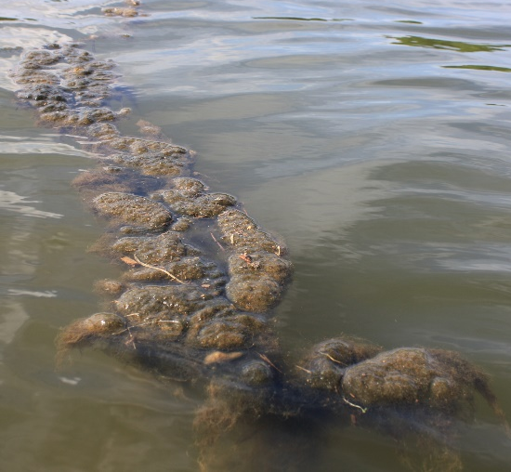
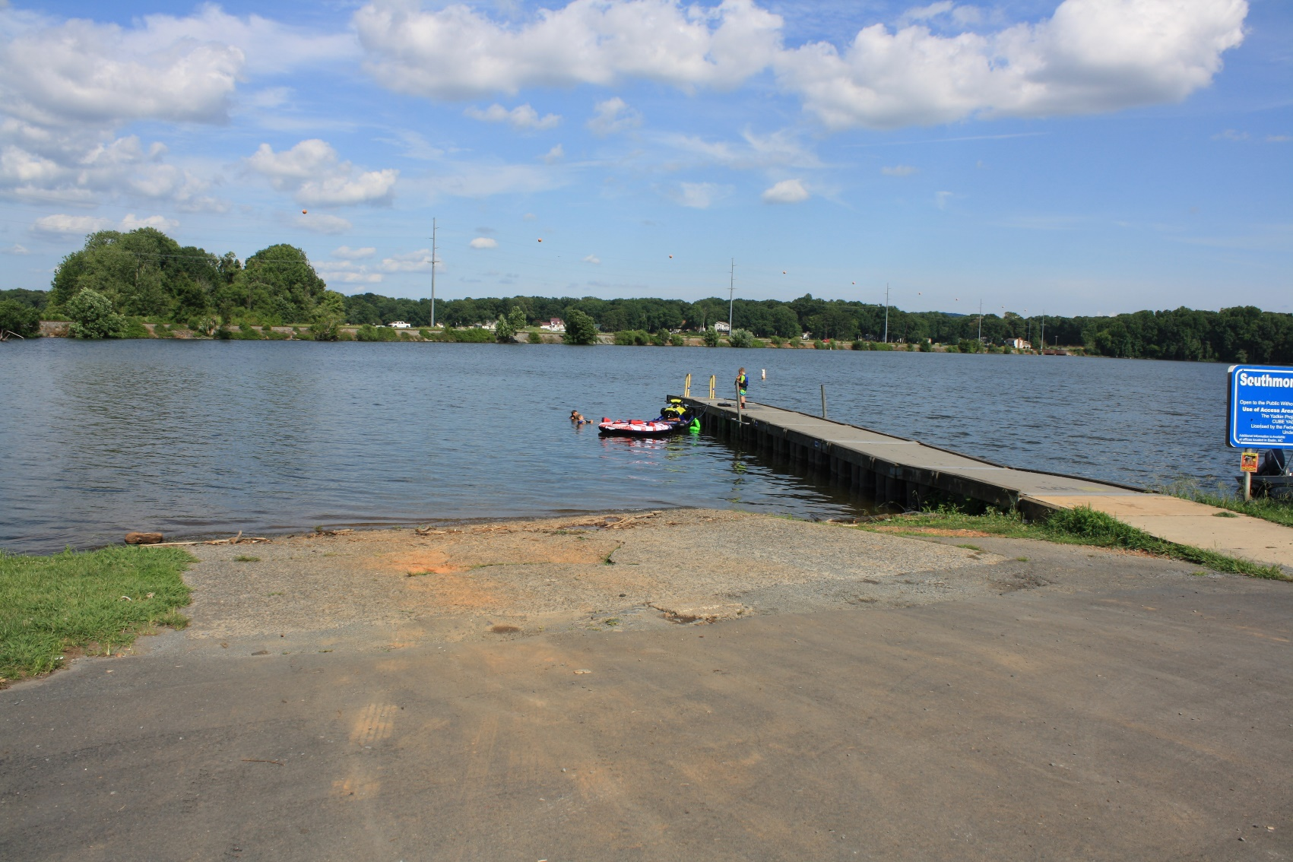
Lyngbya wollei
July 12, 2022
Department of Environmental Quality

Slide 12
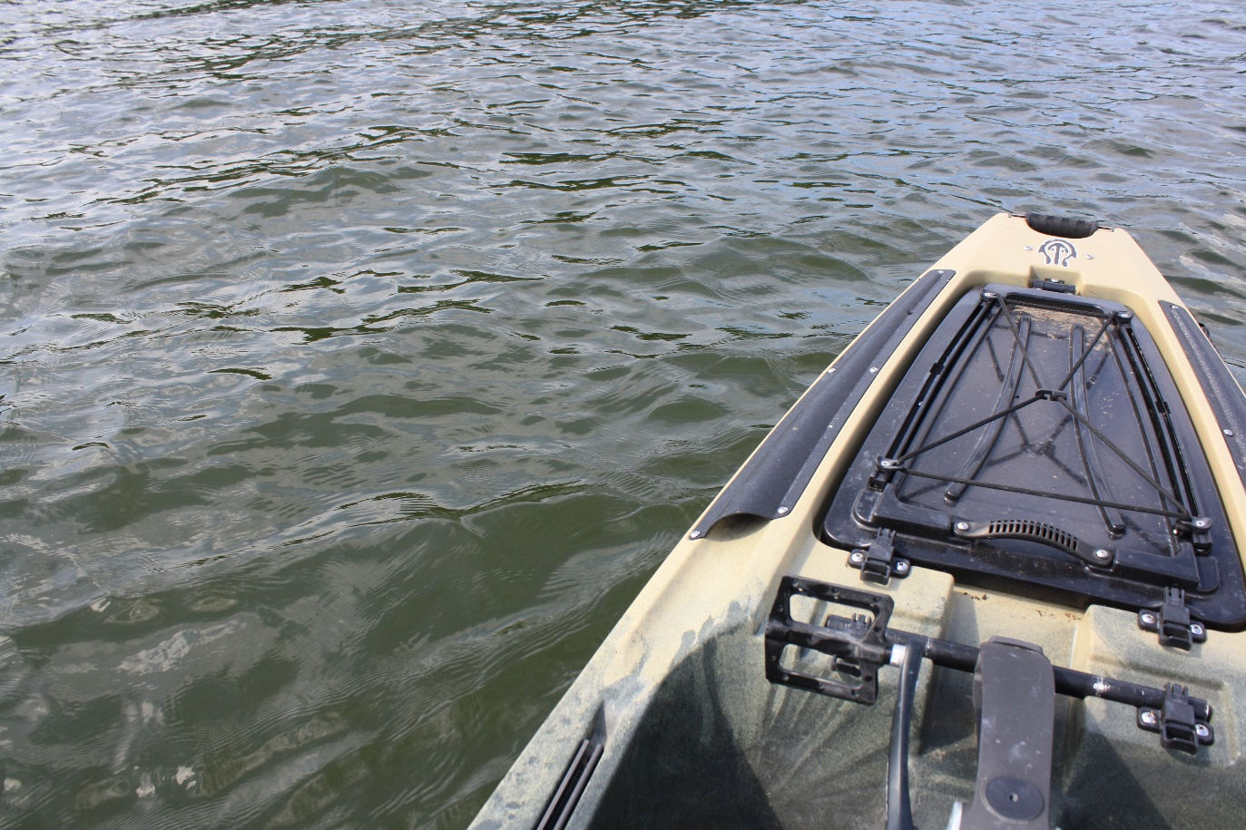
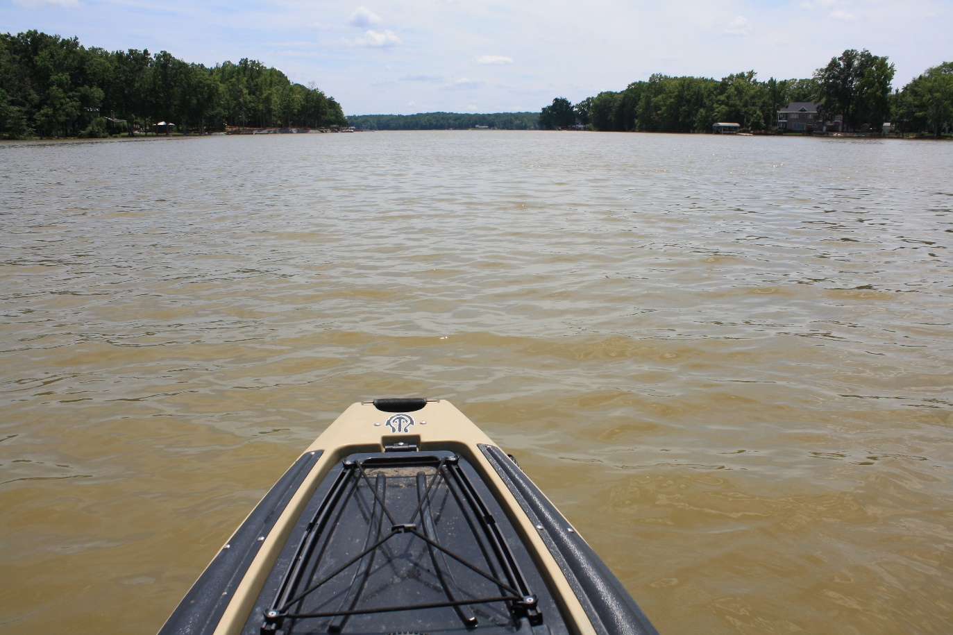
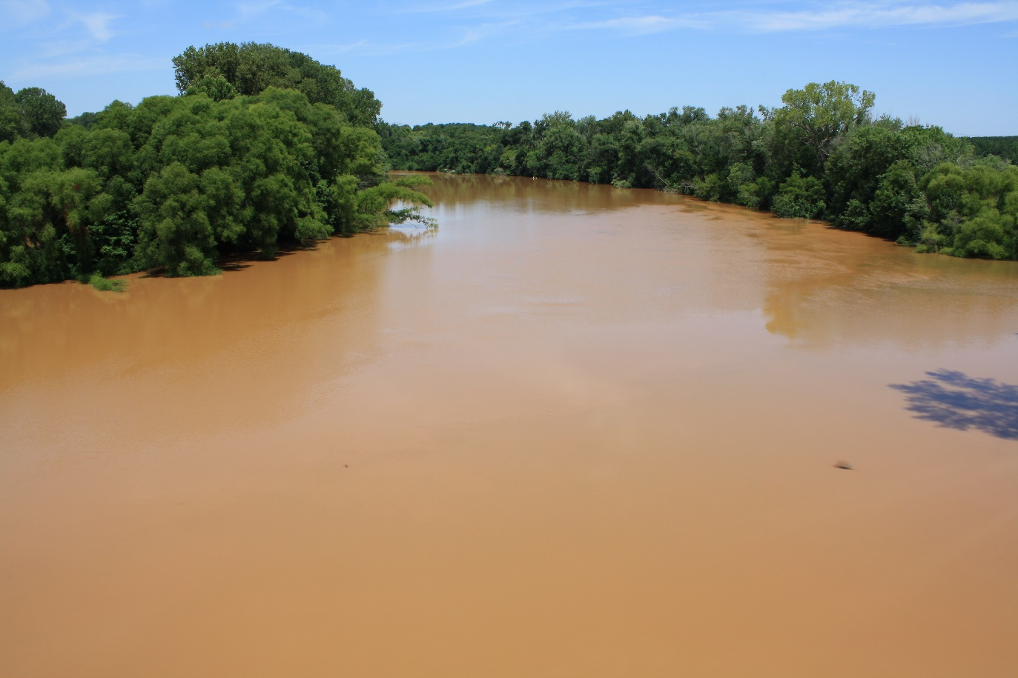
Sedimentation
July 12, 2022
Lower Lake
(Southmont Boat Ramp)
Mid Lake
(between Swearing and Crane Creeks)
Yadkin River
(York Hill River Access)
Department of Environmental Quality

Slide 13
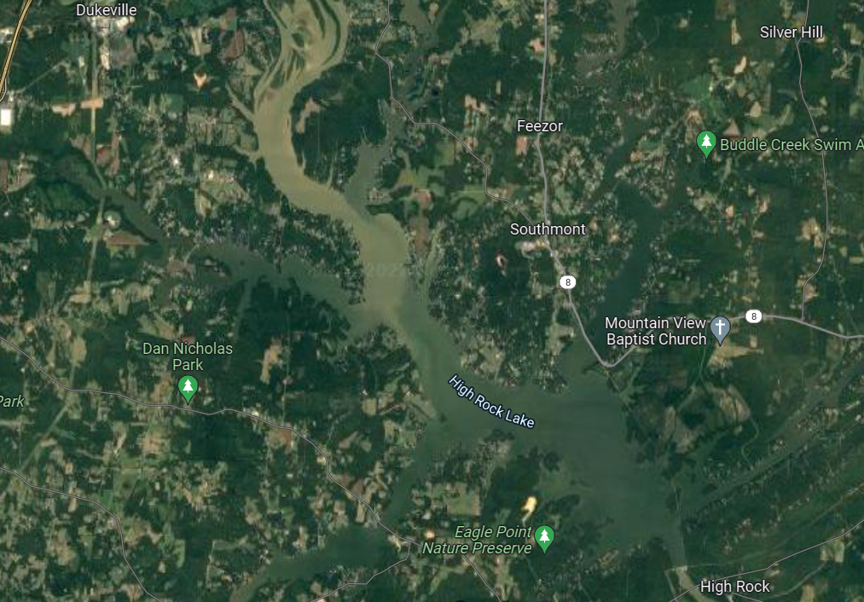
Sedimentation
Aerial View
Department of Environmental Quality

Slide 14
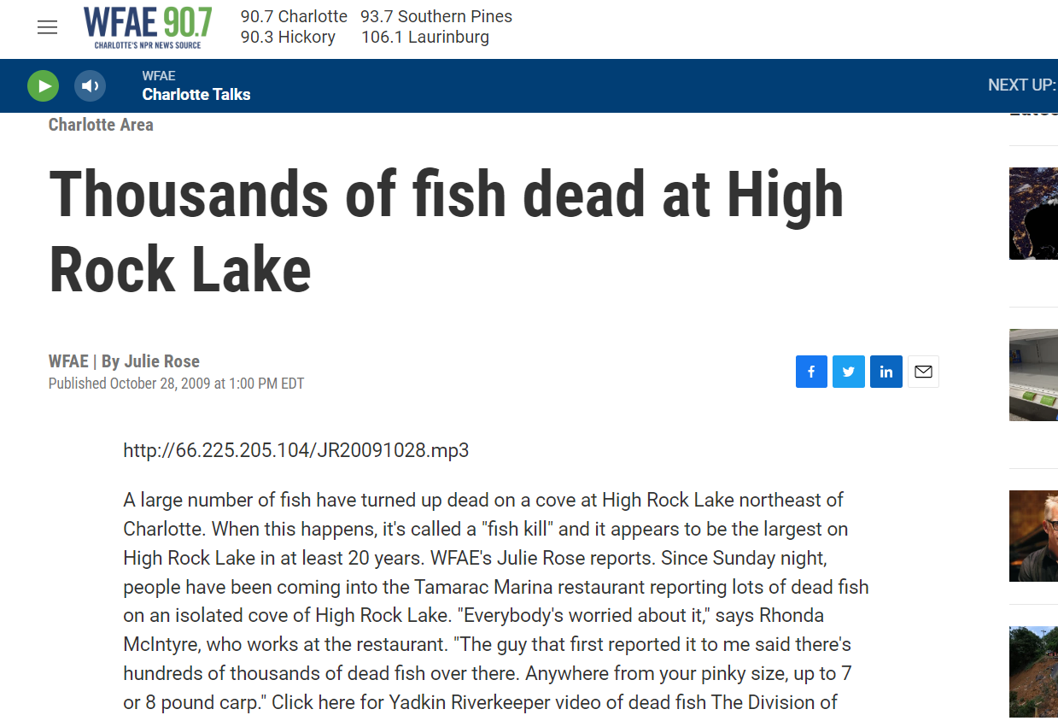
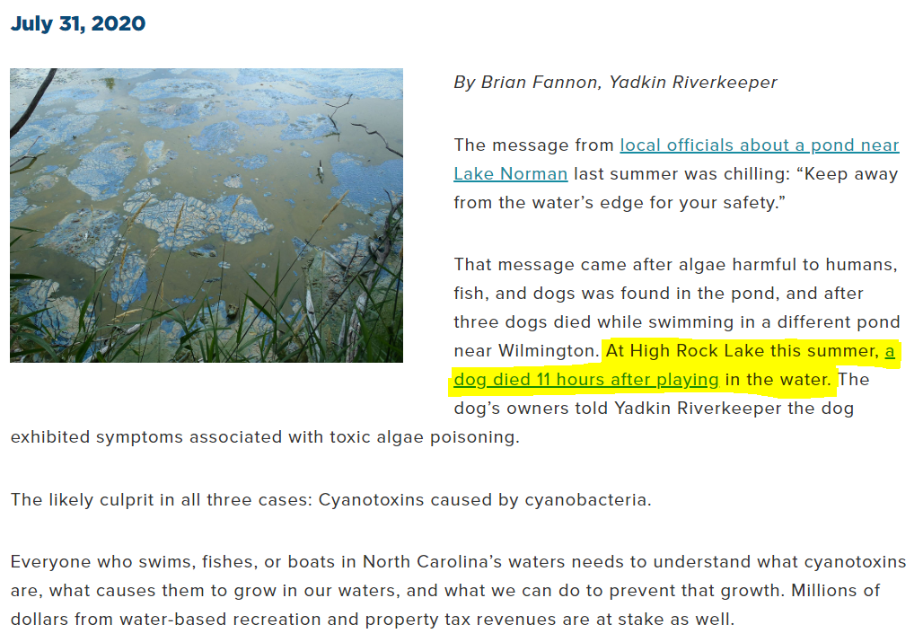
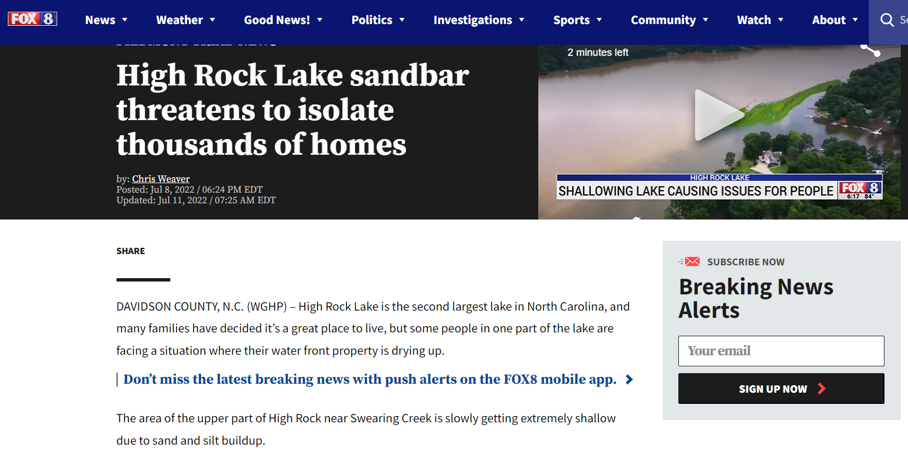
Public & Environmental Health
Recent News

Slide 15
Nutrients and Algae
Algae need:
  Sunlight
  Water
  Carbon dioxide
  Nitrogen
  Phosphorus
  Potassium
  Other trace elements (Calcium, Magnesium, Sulphur, etc.)
Excessive inputs of N & P stimulate production
Nitrogen and Phosphorus are delivered to rivers/lakes via:
  Stormwater runoff
  Wastewater
  Animal waste deposition
  Decomposition
  Erosion
  Precipitation
  Groundwater

Slide 16
Water Quality Status
Chlorophyll-a concentrations routinely exceed 50 ug/L. However, there is no clear long-term trend. (SAC 2020)
Fecal coliform levels appear to have increased in recent years since 2014, particularly from Swearing Creek, Town Creek, Grants Creek, and the mainstem Yadkin and since 2018 in the South Yadkin River which merges with the Yadkin mainstem approximately 5 miles above the lake. (Yadkin-Pee Dee Basin Plan 2022)
In-situ phytotoxin tracking indicated microcystin, anatoxin, and cylindrospermopsin were present much of the summer. Bulk water analysis indicated toxin concentrations were below action limits or health advisory concentrations. (SAC 2020)
Dissolved oxygen concentrations are relatively high. (SAC 2020)
Surface water pH is consistently high during the summer and correlates with high chlorophyll-a levels. (SAC 2020)
Sources closer to the lake below the upper Yadkin mainstem station (South Yadkin River and Grant Creek watersheds) have increased nitrogen contributions to HRL in recent years. (Yadkin-Pee Dee Basin Plan 2022)
There is no clear long-term trend in phosphorus contribution to HRL.
W. Kerr Scott Reservoir is also seeing elevated levels of chlorophyll-a. (Yadkin-Pee Dee Basin Plan 2022)

Slide 17
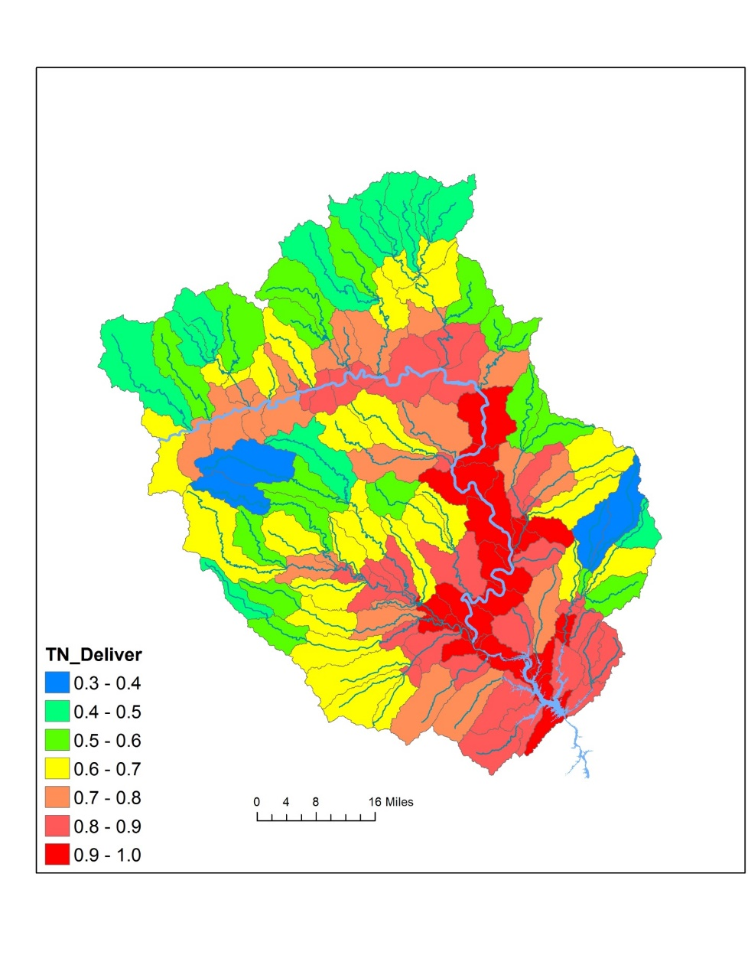
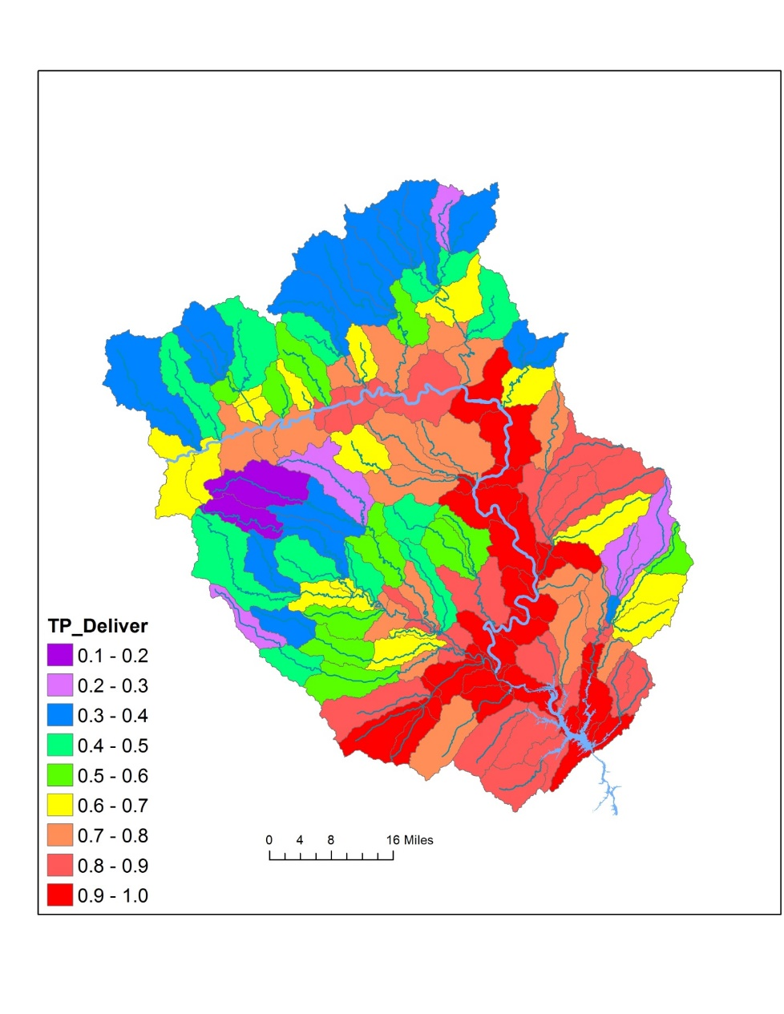
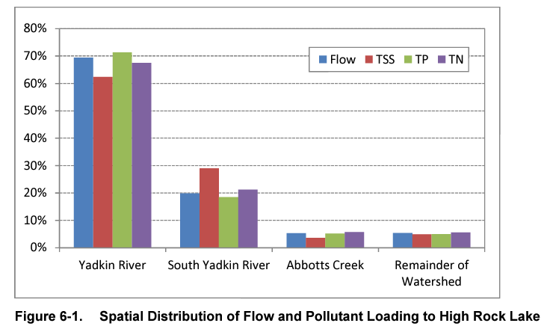
Spatial Dynamics in Nutrient Loading

Slide 18
Big Picture Status
The Value of High Rock Lake
High Rock Lake continues to support a healthy fishery for crappie, catfish, white perch, and largemouth bass
The dam provides hydroelectric power for surrounding communities
Annual recreational use of High Rock Lake is estimated at over 1.4 million recreational days
High Rock Lake has 365 miles of shoreline, which is roughly the distance from Yadkinville to New Jersey
As a fishing and swimming resource it’s important that we carefully manage pollution inputs to the lake to ensure these uses continue
There are 9 drinking water intakes on the Yadkin and South Yadkin Rivers

Slide 19
Department of Environmental Quality
Nutrient Sources and
Management Needs
June 25, 2018

Slide 20
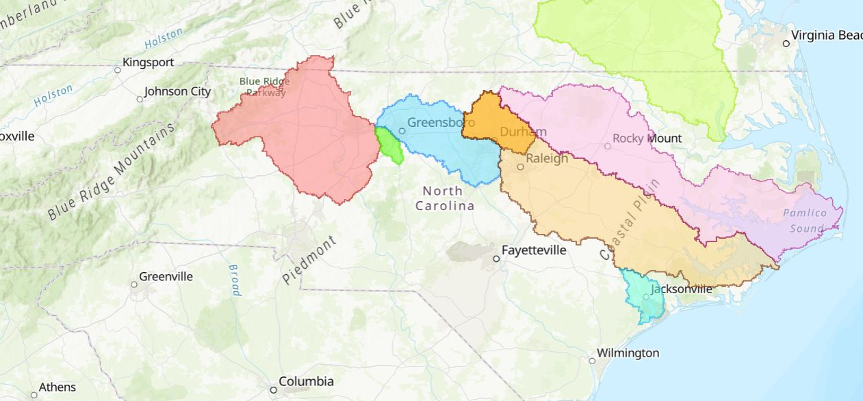
Nutrient Management Strategies
In North Carolina
Chowan River (1985)
High Rock Lake (TBD)
Falls
Lake (2011)
Jordan
Lake (2009)
Tar-Pamlico River (2000)
Neuse River (1997)
Randleman Lake (1999)
New River (1991)

Slide 21
Clean Water Act
Requirements for States
Set water quality parameter standards to protect “uses” (recreation, drinking water, fishing, etc.)
When WQ parameters are exceeded, designate a water body “impaired”
Develop a restoration/remediation plan to reduce inputs to comply with WQ standards
Monitor implementation until WQ standards are met
“De-list” the impaired water body → This is the goal.

Slide 22
North Carolina Authorities
1978 – Chlorophyll-a criterion: 40ug/L (10/90)
  2022 – High Rock Lake site-specific criterion: 35ug/L seasonal geomean (1 year in 3) (pending EPA approval)
1997 - Clean Water Responsibility and Environmentally Sound Policy Act – EMC shall:
  Set reduction goals for nutrient-impaired waters
  Establish plans with “fair, reasonable, and proportionate” reductions from point and nonpoint sources
  Adopt rules for above, and to implement TMDLs
2010-2016 – modeling to set point/nonpoint source goals for N, P and guide wasteload allocations for dischargers

Slide 23
Lake & Watershed Models
Development and Outputs
Lake & Watershed Models developed starting in 2010 after intensive WQ monitoring
  Watershed: Simulates nutrient sources and delivery to surface waters
  Lake: Simulates chlorophyll-a concentrations from variable nutrient inputs
Lake model produces a “curve” that isolates reduction thresholds

Slide 24
Reduction Curves
38% Phosphorus Reduction
37% Nitrogen Reduction
DRAFT
35ug/L seasonal geomean
chl-a standard
YAD152C

Slide 25
Reduction Curves
DRAFT
35ug/L seasonal geomean
chl-a standard
28% Phosphorus Reduction
50% Nitrogen Reduction
YAD152C

Slide 26
Reduction Curves
DRAFT
35ug/L seasonal geomean
chl-a standard
YAD152C

Slide 27
Lake & Watershed Models
Development and Outputs
Lake & Watershed Models developed starting in 2010 after intensive WQ monitoring
  Watershed: Simulates nutrient sources and delivery to surface waters
  Lake: Simulates chlorophyll-a concentrations from variable nutrient inputs
Lake model produces a “curve” that isolates reduction thresholds
Our goal is to reduce chlorophyll-a production so that it falls below the WQ standard
  Current proposal is no more than 35ug/L geometric mean over full growing season 1 in 3 years (approved by EMC, pending EPA approval)
Steering Committee will determine nutrient reduction goals and Technical Advisory Groups will identify implementation needs to achieve those reductions

Slide 28
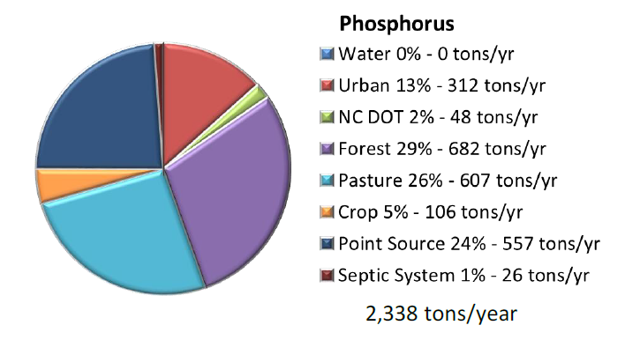
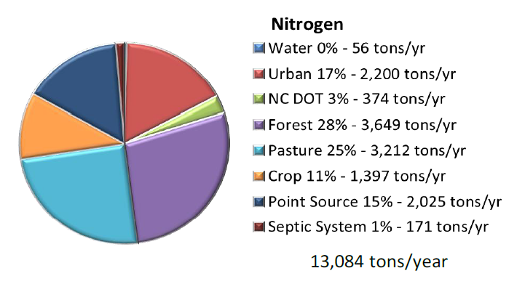
Annual Nutrient Loading
Source: Tetra Tech 2012
Department of Environmental Quality

Slide 29
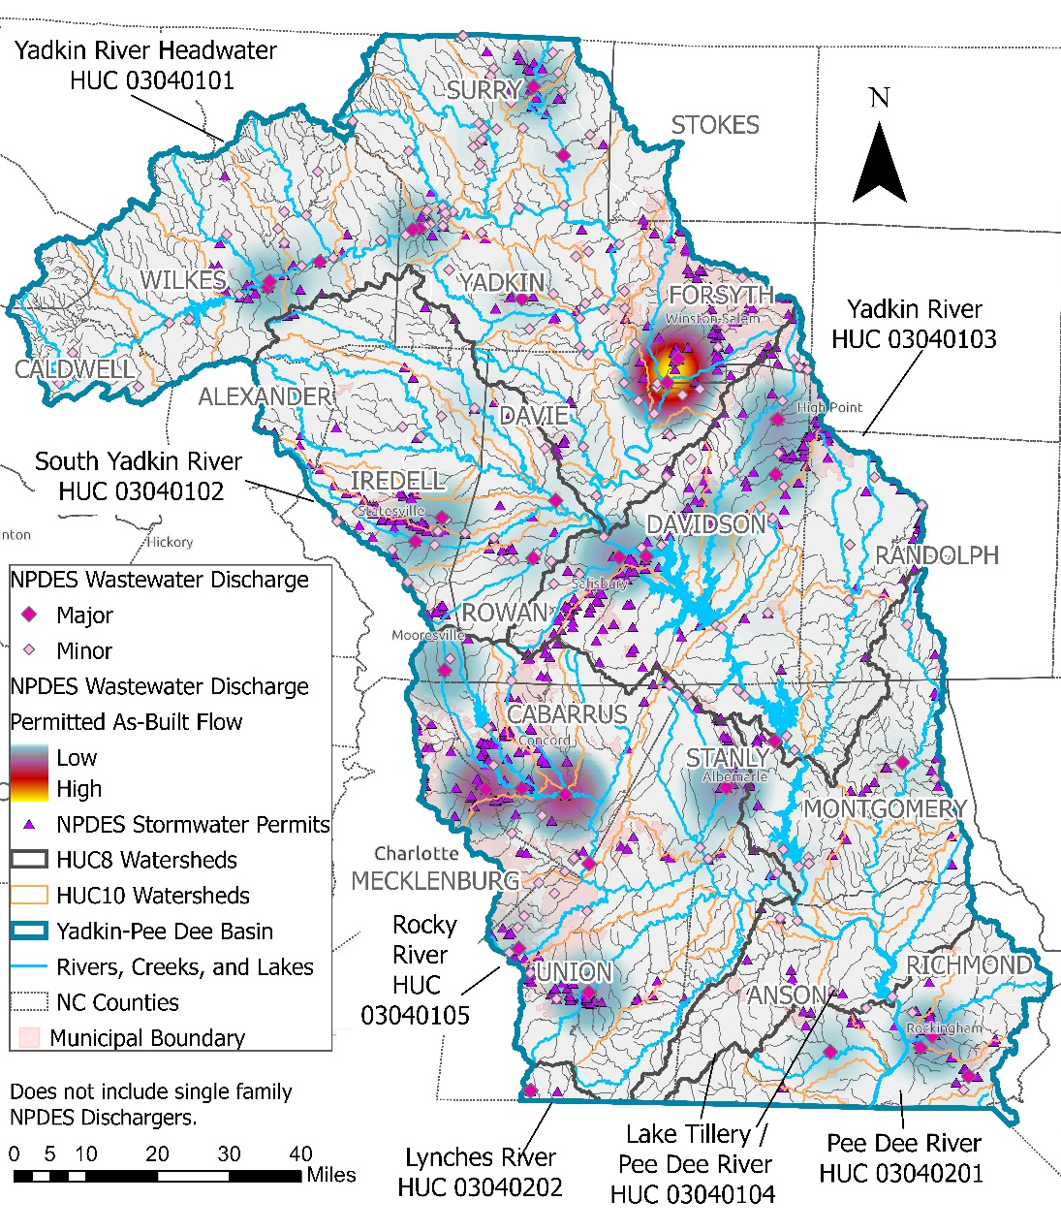
Permitted Point and Nonpoint Sources of Pollution
Yadkin-Pee Dee Permitted Facilities (2018)
Permit Type | No. | Permit Information
NPDES Major Discharger | 32 | Permitted As-built 218.5188 GD
NPDES Minor Discharger | 145
NPDES Stormwater | 631 | 22 NPDES MS4 permits
Non-Discharge | 49 | 244 fields
Residual Management | 31 | 796 fields
Animal Feeding Operations³ | 108 | Permitted Allowable Weight 80.75 million lb
¹The 2018 permit numbers include Active and Expired Permits ²NPDES Minor Dischargers do not include Single Family Domestic Waste Treatment Systems ³Animial Feeding Operations do not include Deemed Permitted

Slide 30
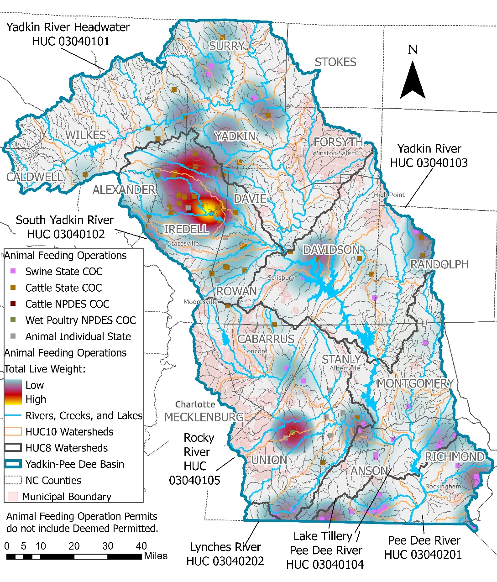
Permitted Animal Feeding Operations (AFOs)
Yadkin-Pee Dee Permitted AFOS (2018)
Permit Type | Permit Number | Permitted Allowable Weight (lb) | Percent of Permitted Liveweight
Animal Individual State | 7 | 612,000 | 0.8%
Cattle State | 62 | 51,163,500 | 63.4%
Cattle NPDES | 1 | 1,015,000 | 1.3%
Swine State | 37 | 22,359,376 | 27.7%
Wet Poultry NPDES | 1 | 5,600,000 | 6.9%

Slide 31
USDA National Agricultural Statistic - Poultry
2017
Inventory
2017
Contracts
20172017
Inventory
Inventory

Slide 32
Nutrient Sources
  Wastewater
    POTW, WWTP
    Industrial discharge
    On-site wastewater (septic systems)
  Development
    Household fertilizers, pet waste
    Construction site sediment
    Post-construction impervious surfaces
    Roadways
  Agriculture
    Animal waste
    Applied fertilizers
  Streambanks
  Forests
  Bottom sediments
  Atmosphere
“Point Sources”
Controllable
“Nonpoint Sources”
Uncontrollable
Department of Environmental Quality

Slide 33
Watershed Source Status Changes
2000 through 2022
Population growth is occurring primarily in the Winston-Salem, Salisbury, and Statesville areas.
Fourteen local governments are currently required to comply with federal stormwater permitting requirements.
Poultry houses are being built at a rapid pace, but many older houses are also being decommissioned. Poultry numbers are generally falling in the overall HRL watershed but increasing in Alexander and Yadkin Counties. Poultry numbers remain highest in Wilkes County.
Dairy and pastured cattle numbers are falling across the watershed. Most dairy production occurs in Iredell County.
A small but significant decline in agricultural (-1.7%) land cover is compared to a small but significant increase in developed (+2.5%) land cover.
There is no p-index cutoff for land application of residual biosolids.

Slide 34
HRL Management Actions
To Date
2004 | High Rock Lake designated as “impaired” for chlorophyll-a
2005-2010 | Intensive WQ monitoring for nutrient source documentation
2010-2016 | Watershed model development Lake nutrient response model development
2016-2020 | Nutrient Criteria Development Process (WQ standard reassessment)
2021 | Rule planning
2022 - 2023 | Informal stakeholder outreach (ongoing) Facilitated Engagement Rule language drafting
2023 – 2026 | Rule proposals, feedback, submission, public comments, approval

Slide 35
Rulemaking Timeline

Slide 36
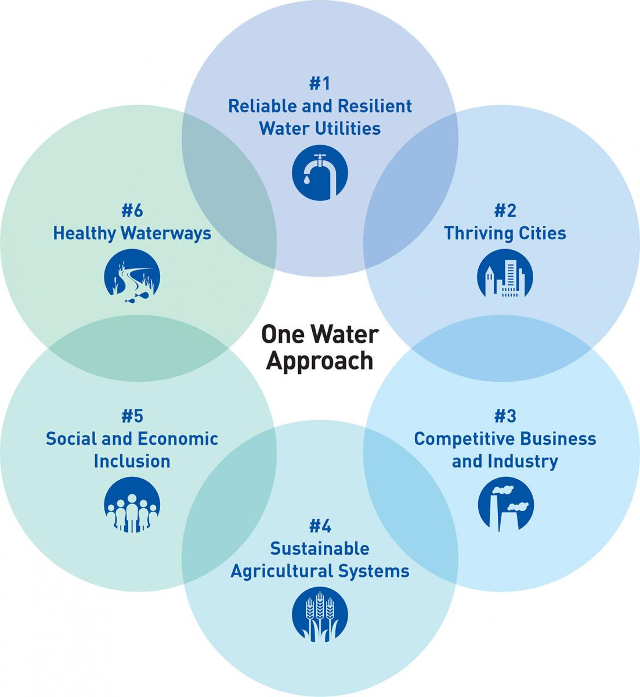
Integrated Watershed Management
One Water

Slide 37
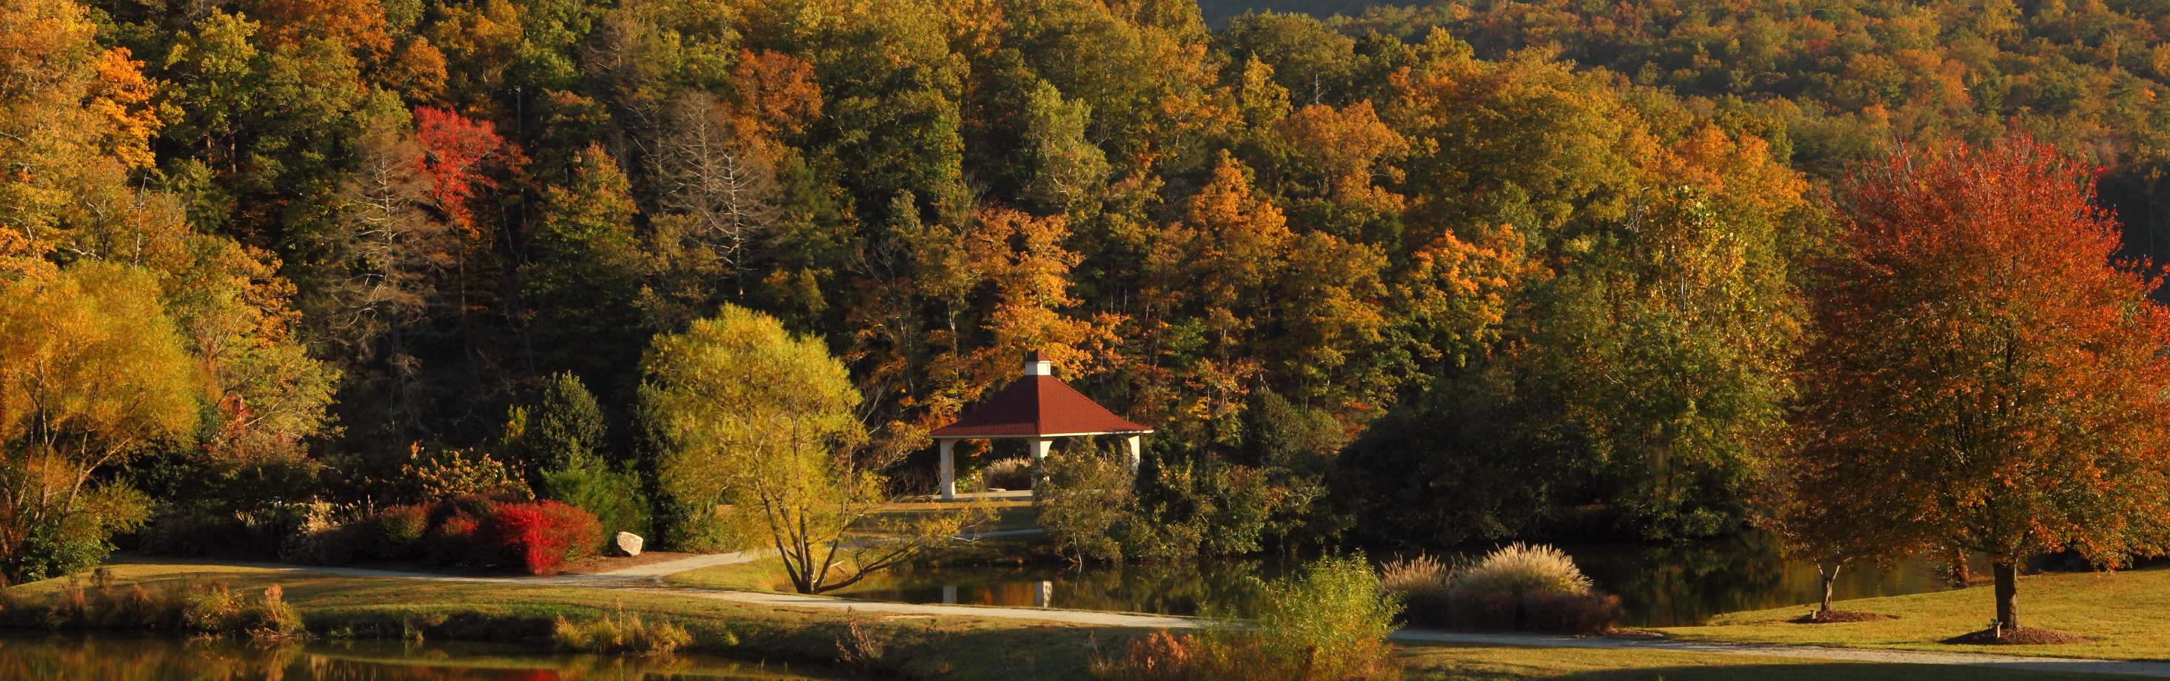
Questions?
Joey Hester
Joey.hester@ncdenr.gov
O: 919-707-3675
C: 919-418-5712
Department of Environmental Quality

