Slide 1
Steering Committee Actions
Set overall reduction targets for each source
Address and redistribute uncontrollable source reductions
Agree on which sources will be regulated – Use TAG Charge to inform
Agree on recommended actions for non-regulated sources
Establish implementation timeframes – Use TAG Charge to inform
Decide whether to include the watershed above W. Kerr Scott
Identify ways to plan and allow for adaptive management
Begin gathering data to inform fiscal analysis

Slide 2
High Rock Lake Steering Committee Meeting #2
Modeling Q/A
12/1/2022

Slide 3
High Rock Lake Model Basics
Developed by Tetra Tech 2012
Comment Period September 27 to November 28, 2012
Model revised by EPA
Comment Period May 5 to November 30, 2015
Model Revised by EPA
Model Report Updated and Finalized by DWR 2016

Slide 4
High Rock Lake Model Basics
Watershed model – HSPF
Lake model
  Hydrodynamic model – EFDC
  Eutrophication model – WASP
Horizontal 538 grid cells and vertical hybrid z-grid
Lake model simulation period: 2005-2010

Slide 5
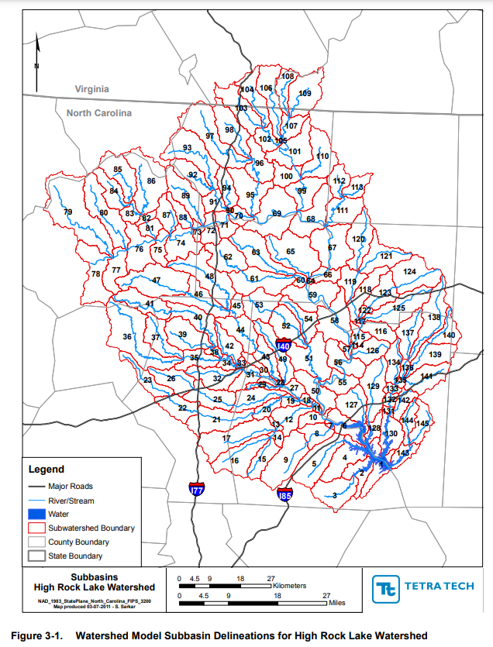
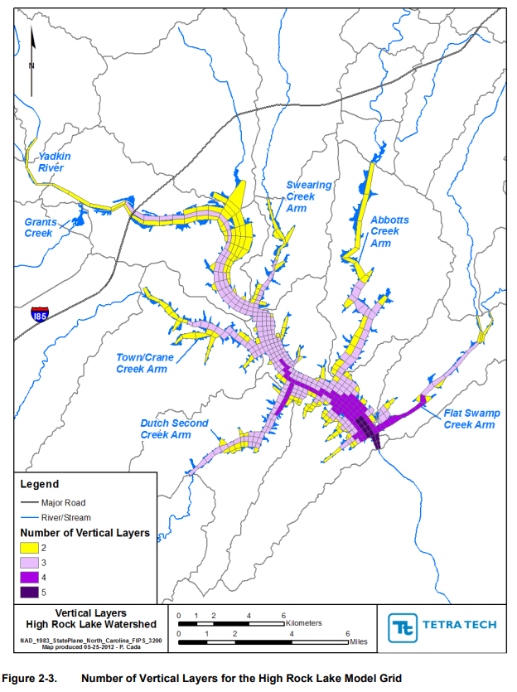
HSPF Model
EFDC & WASP Model

Slide 6
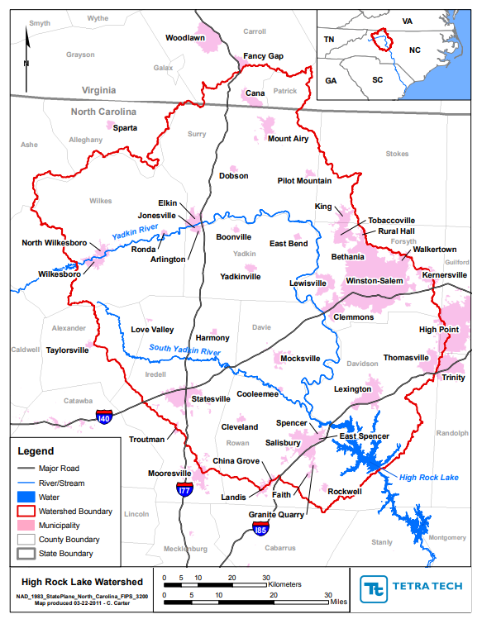
“Because much of the mass of sediment and nutrients originating upstream of that dam is trapped or temporarily retained in the Kerr Scott reservoir, the outflow from W. Kerr Scott Dam is treated as a boundary condition for the High Rock Lake watershed model and not explicitly simulated.”
Nutrient load from the reservoir is represented in the model
The load is estimated (not simulated) based on field data

Slide 7
Model Scenario Runs
Models were calibrated and validated based on historical data (watershed model: 1999-2010; lake model: 2005-2010)
Model scenario runs were made with reduced nutrient loads:
N00 P00% | N10% P00% | N20% P00% | N30% P00% | N40% P00% | N50% P00%
N00 P10% | N10% P10% | N20% P10% | N30% P10% | N40% P10% | N50% P10%
N00 P20% | N10% P20% | N20% P20% | N30% P20% | N40% P20% | N50% P20%
N00 P30% | N10% P30% | N20% P30% | N30% P30% | N40% P30% | N50% P30%
N00 P40% | N10% P40% | N20% P40% | N30% P40% | N40% P40% | N50% P40%
N00 P50% | N10% P50% | N20% P50% | N30% P50% | N40% P50% | N50% P50%

Slide 8
The Curve
Baseline year: 2006
Compliance Point: YAD152C

Slide 9
Model Limitation
Model calibration uncertainty
  Model input – data uncertainty; error propagation
  Model parameterization
  Model grid
Model scenario run limitation
  Based on historical time period
  Reduced nutrient load may change NP ratio

Slide 10
Q: What can/can’t the model predict when we focus reductions exclusively on one nutrient and ignore the other completely?
Confidence of model
  EPA approved and widely used model
  Well calibrated using historical field data
Uncertainty of the curve – much diversions from historical settings represented in the model
  different NP ratio may lead to different dominant algal species
  Benthic nutrient flux may respond to nutrient loading reductions, which is not represented in the model
  Climate change

Slide 11
Modeler Questions
What can/can’t the model predict when we focus reductions exclusively on one nutrient and ignore the other completely?
What lake behaviors would we expect from exclusive focus on one nutrient?
Is it feasible to assign a nitrogen reduction target to one source category and a phosphorus reduction target to another?
Would the Division entertain further revisions to the model?
The reduction totals described to not line up with the curve itself. Can you explain the narrative statement that specifies reduction requirements?
Why was the watershed model not run for the area above W. Kerr Scott Reservoir?

