Slide 1
Welcome!
Please take a seat anywhere and we will get started soon.
Thank you!

Slide 2
High Rock Lake Stakeholder Meeting
September 29, 2022
Yadkinville, NC

Slide 3
Meeting Goals
Inform stakeholders about ongoing nutrient issues that impact the water quality and ecological health of High Rock Lake and limit the lake’s use by the surrounding population and residents of the state.
Solicit input from anyone who will potentially be impacted by regulations to control nutrient sources such as stormwater runoff and wastewater.
Describe statutory obligations to address the water quality impairment and outline the plan for developing a reasonable and effective regulatory strategy that will help achieve long-term water quality improvement in High Rock Lake for all users.
Offer sign-ups for technical workgroups and steering committee.

Slide 4
Today’s Agenda
1st hour
Purpose of the Process Joey Hester & Rich Gannon, Division of Water Resources
Working together today Maggie Chotas, Facilitation Team
Who’s in the room? Will Dudenhausen, Facilitation Team
Table Talk #1
Diving deeper into the lake’s condition Joey Hester & Rich Gannon
Table Talk #2 Monica Veno, Facilitation Team
Mandate, action status, lake needs Joey Hester & Rich Gannon
About this process Maggie Chotas
How you can engage Laura Swartz, Facilitation Team
Next Steps & Survey
2nd hour

Slide 5
Purpose of the Process
Joey Hester & Rich Gannon
NC Division of Water Resources

Slide 6
Working together today
Begin & Adjourn on time
One speaker at a time
Listen for understanding
Say what you need to say & make room for others to say what they need to say
Embrace a learning mindset
Be mindful of assumptions & ask questions
It’s okay to disagree … please do so respectfully
Share your own perspective & respect the perspectives of others

Slide 7
Who’s in the room?

Slide 8
Table talk #1 At your table, you’ll have 10 minutes to introduce yourself and share --What brought you to this session -- One hope you have for High Rock Lake & its watershed
Have a notetaker record responses on the paper provided
& post in the room.

Slide 9
Table Talk #2
At your table, you’ll have 10 minutes to reflect on the presentation and share with your table group -- 1-2 immediate reactions to the information shared -- 1-2 questions this presentation raised for you -- 1-2 topics you would like to learn more about
Have a notetaker record responses on the template provided
to be collected for the notes.

Slide 10
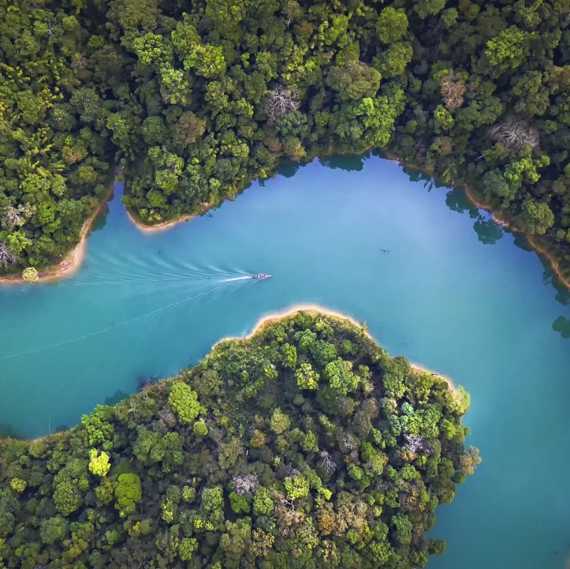
Diving deeper into the lake’s condition
Joey Hester &
Rich Gannon
NC Division of Water Resources

Slide 11
Mandate, action status, lake needs
Joey Hester &
Rich Gannon
NC Division of Water Resources

Slide 12
About this process

Slide 13
High Rock Lake Stakeholder Rules Purpose: to identify the most mutually satisfactory set of draft regulations that will achieve the objective of reducing nutrient inputs to High Rock Lake over time. 15-18 month process
In this process, YOU as stakeholders have the opportunity…
1. To gain deeper understanding of the water quality need; the state’s legal mandate to take action; and the components of a strategy considered necessary to improve water quality.
2. To work together & with DWR to develop draft proposals for fair, reasonable and proportionate strategies to reduce phosphorus and nitrogen inputs into the High Rock Lake watershed, & to provide a report with proposals to DWR for recommended rulemaking.

Slide 15
All Stakeholders
WHO
Anyone interested, INCLUDING those who will take a more hands-on role in one of the working teams.
WHAT
Learn about nutrient-driven water quality issues in High Rock Lake & associated need for watershed management actions
Raise issues & ideas for the working teams to consider
Comment on the potential impacts of draft working team recommendations
WHEN
Meeting 3-4 times, roughly every 4-5 months.

Slide 16
Technical Advisory Groups (TAGs)
ROLE: To generate recommendations to the state on regulations & other actions to improve the water quality of HRL, with guidance from the Steering Committee & the Division + input from stakeholders.
WHO: All perspectives, with weight toward stakeholders who have most knowledge &/or investment in rule outcomes. Consistent participation requested.
WHAT: Four teams: Agriculture; Wastewater; Stormwater; Riparian Buffers.
WHEN: 4-8 virtual meetings, 2 hours each over 6-8 months. Beginning late October.

Slide 17
Steering Committee
ROLES
Draft nutrient management strategy goals
Guide & oversee the TAGs
Provide initial recommendations to the TAGs at the outset & again after reviewing draft TAG proposals & considering feedback from All Stakeholders
Develop a report to the Division that recaps meeting process & outlines conceptual rule proposals & other action recommendations
WHO: Maximum 15 individuals, selected from sign-up list by DWR with input from DSC to balance interests & perspectives.
WHAT: In-person & virtual meetings. Initial 3-4 hour in-person meeting, then 2-hour meetings.
WHEN: 5-8 meetings; grouped at start, midpoint & end of TAGs processes, otherwise ad hoc as needed.

Slide 18
Division of Water Resources
ROLES
Listen to stakeholders
Assist with recommendation development
Provide policy & technical guidance
Advise stakeholders where proposals appear fundamentally problematic from a staff standpoint
Offer potential alternatives for consideration
WHO: Joey Hester, Rich Gannon, others as necessary
WHAT: At the end of the 15-18 month informal stakeholder process, draft rules content, possibly including options, for further consideration by the Steering Committee & stakeholders.
At the end of the informal process, present the stakeholders’ report to the NC Environmental Management Commission.

Slide 19
Subject Matter Experts (SMEs)
ROLES
Provide technical grounding & insights from a content standpoint
May or may not weigh in on policy recommendations, depending on their expertise, but don’t typically participate in decision-making actions
WHO: Invited from:
Agricultural agencies
University researchers
State on-site wastewater staff
State stormwater agency staff
DWR wastewater permitting, modeling, standards, and Buffer permitting staff
Other professionals or researchers with relevant experience

Slide 20
Facilitation Team
ROLES
Neutral convener for the process
esign meetings & processes that value everyone’s time, maintain momentum & work toward process goals
Ensure equitable participation
Support teams in upholding working agreements, including implementing a consensus approach to decision-making
Document the process & administer post-meeting surveys
WHO: A team of 4 professional facilitators from DSC

Slide 21
Roles and Responsibilities of Participants
1. Make all reasonable efforts to attend all meetings that are scheduled with adequate notice.
2. In meetings, explain interests openly and fully, and look for mutually beneficial solutions.
3. Follow through on commitments, such as providing contact information on potential stakeholders for teams, gathering information, doing background reading, and reviewing draft rule language.
4. Report back to the groups they represent. Explain and support any consensus agreements reached by the team. Bring their organization’s feedback or unresolved issues to the relevant team or Production Team.
5. Steering Committee members provide constructive input on draft recommendations developed by the Technical Advisory Groups.
Members of each team or committee are encouraged to work within their realms of influence and in their organizations to contribute to successful implementation of adopted recommendations and rules even after the informal engagement process has concluded.

Slide 22
Decision-Making Process
The intent for this process Steering Committee and the Technical Advisory Groups will strive to make decisions by consensus whenever possible.
Part of DSC’s role will be to facilitate the implementation of this approach. Consensus requires the active participation of everyone in the group and an atmosphere where disagreements are respected.
When someone disagrees, the goal of the group shall be to discover the reason for the objection and to find a way to work toward meeting that need in a revised agreement. Consensus is being defined as at a minimum, “I can live with and support the decision.”

Slide 23
Process Flow

Slide 24
Phase 1: September 2022- June 2023ish
September 2022-January 2023
All Stakeholders meet TODAY
Steering Committee meets
TAGs meet 3 times
Later May 2023-June 2023
Steering Committee meets
All Stakeholders meet – May 2023
Steering Committee meets
February 2023-Early May 2023
Steering Committee meets
All Stakeholders meet – March 2023
Steering Committee meets
TAGs meet 2 times

Slide 25
June-December 2023ish: Hand off + Phase 2
November 2023
DWR shares rules based on recommendations with Steering Committee.
June 2023
Steering Committee sends report to DWR for feasibility and technical review, with rule development.
December 2023
All Stakeholders learn about recommendations going to EMC and timeline for formal rulemaking and public comment.

Slide 26
Next steps & Survey
Be part of this effort – cards at your table to indicate interest
QR codes – for website + Survey

Slide 27
Thank You!
Thank you for being here!
Complete survey
Please be sure to share your feedback on the survey. We use this information to improve the next meeting and the process!
Stay around
If you have questions or want to chat, stay around after the meeting.

