Slide 1
Nutrient Management Strategies
Division of Water Resources
Patrick Beggs
2021
Notes:
NC has a set of watershed specific Nutrient Management Strategies.
And Buffers can be a part of these strategies.
I’d like to:
give you an overview of where we have Nutrient Management Strategies,
explain a bit about what they entail, and
share which of them include buffers.
In addition, a survey this past year identified a couple items that I can clarify for you at the end.

Slide 2
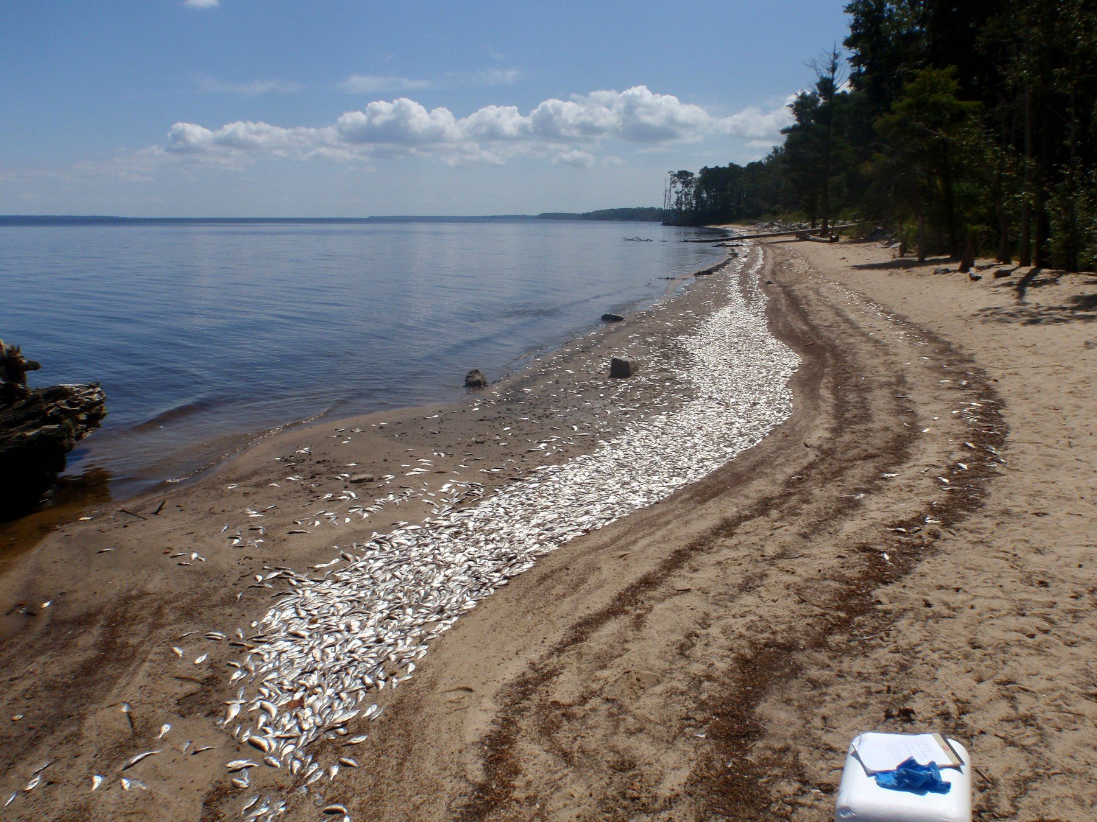
Why do we have Nutrient Management Strategies?
Notes:
First, why do we have nutrient management strategies.
The earliest ones go back to the 80s. The impacts of excess nutrients on our waters required us to develop them. The impacts of excessive nutrients include fish kills, over production of algae, and generally reduced ecosystem benefits downstream, whether that is a lake, a river or an estuary.
Problems in our estuaries is what initially prompted nutrient management strategies.
Another problem related to algae production is its impact on drinking water and the need for water treatment plants to remove it. It can produce toxins that that are harmful to breathe and also affect fishing, swimming, and general bodily contact, including contacts for pets.
All of these impacts I just mentioned have Environmental, Social, and Economic components.

Slide 3
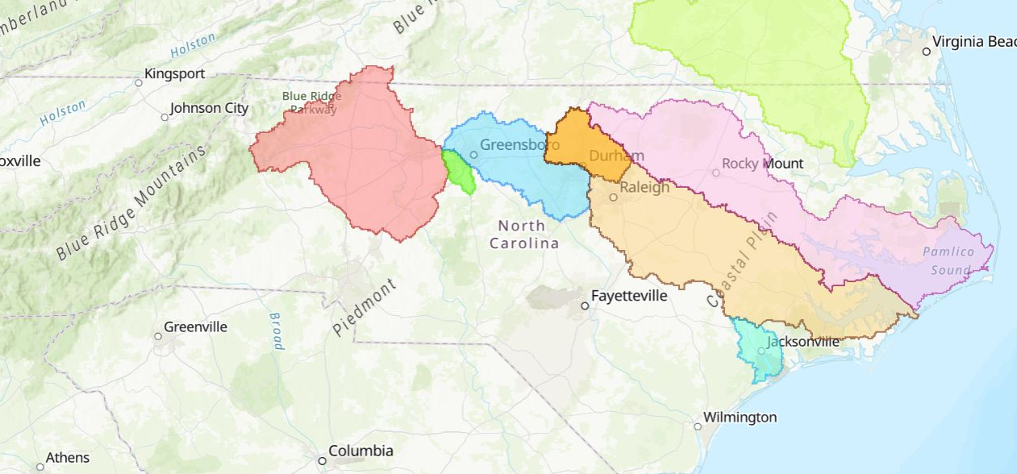
NC Nutrient Management Strategies
Chowan
High Rock
Falls
Jordan
Neuse
Tar-Pamlico
Randleman
New River
Notes:
I mentioned these strategies are watershed specific. That might be an entire riverbasin like Neuse and Tar-Pamlico, or a specific smaller river like the New River, in the White Oak Riverbasin, or a lake watershed, like the rest here – Falls, Jordan, Randleman, and High Rock.
I want to specifically point out - High Rock Lake does not yet have a Nutrient Management Strategy but we are planning for one.
The goal of the strategies is to control nutrients at their sources. And this is authorized under the federal Clean Water Act, and by state statute. Trying to remove nutrients once they reach their destination is largely ineffective and is contrary to these laws. An example of this is the Jordan Lake Solarbees from a few years ago. They didn’t work and they go against these laws.
One more thing to note about this map. I mentioned that buffers can be a part of these strategies, but buffers can also be present without these strategies. Goose Creek and Catawba River are examples of buffer programs that do not have Nutrient Management Strategies, so they are not on this map. The reverse is also true - Chowan and New River, the earliest strategies - do not have buffer rules.
--------------------------------------------------------------------
In the Chowan strategy only the NC section is subject to our strategy, but we do have agreements with Virginia including through the Albemarle Pamlico National Estuary Program or APNEP.
Chowan riverbasin – leads to Albemarle Sound
New River – part of the White Oak riverbasin that drains to the Back, Core and Bogue sounds
Tar Pamlico riverbasin leads to the Pamlico Sound
Neuse – also leads to the Pamlico Sound
Falls Lake watershed is the upper part of the Neuse riverbasin and has its own Nutrient management strategy
Jordan Lake watershed drains the Haw River and New Hope Creek. Initially New Hope creek drained into the Haw River but now flows directly into Jordan Lake. Below the Jordan Lake dam, the Haw River meets join the Deep River and becomes the Cape Fear River which becomes the Cape Fear Estuary at the coast.
Randleman Lake watershed drains the upper Deep River.
Finally, the High Rock Lake watershed on the Yadkin River will have a nutrient management strategy developed for it.

Slide 4
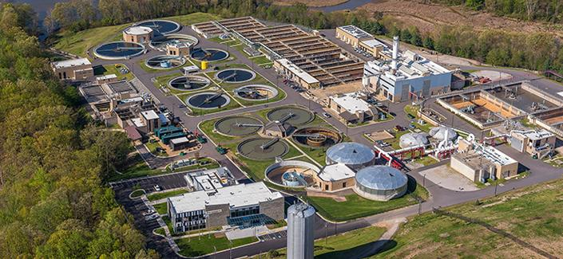
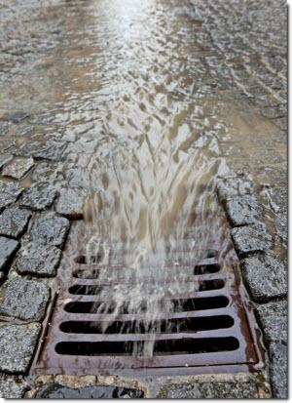
Potential Elements of Nutrient Management Strategies
Wastewater permits
Agriculture runoff
Riparian Buffers
Stormwater management
New Development
Existing Development
Offsets / Trading
Notes:
Potential elements of Nutrient strategies include:
Wastewater discharge
Agriculture runoff
Buffer rules
New Development stormwater – from changes in land use and runoff due to development
Existing Development Stormwater – concerned with stormwater that we never really dealt with in the past
Offset trading rules which allow for an option of doing work in a different area of the watershed where it is easier and more cost-effective to implement.
Quote by Ralph Waldo Emerson:
“The voyage of the best ship is a zigzag line of a hundred tacks. See the line from a sufficient distance, and it straightens itself to the average tendency.”
That’s what I think the best science and the best decision making and the best adaptive management can do.
----------------------------------------------------------------------------------------
Something to note, which you’ve heard today, buffer rules are unlike the source control rules, in that:
They apply across all land uses.
They’re not designed to achieve new nutrient reductions; instead, they help “buffer” against increases of nutrient loading.
They include a requirement that when there is a change in land use, e.g., development, a buffer must be established.
Once established, the buffer is permanent.

Slide 5
NC Nutrient Management Strategies - Chowan & New
Chowan
Chowan Riverbasin & New River Watershed
No buffer rules
No nonpoint source rules
Could seek voluntary measures.
Data collection continues
Struggling with excess algal production again, especially Chowan.
Need revisiting and adaptation.
High Rock
Falls
Jordan
Neuse
Tar-Pamlico
Randleman
New River
Notes:
Chowan and New River are our earliest strategies, and they don’t have all the potential elements I just mentioned.
----------------------------------------------------------------------------------
The Chowan River basin and New River watershed are both have Nutrient Management Strategies.
These are our earliest strategies.
They don’t have all the potential elements I just mentioned.
They include point sources, Ag Cost Share Programs, phosphate detergent bans, nutrient reduction goals, and discharger limits, but they do not include regulatory mandates on nonpoint sources, nor do they have buffer rules.
Both strategies were successful for years. However, now both waterbodies are again struggling with excess algal production, especially the Chowan.
Both strategies need revisiting and adaptation. Probably with more focus on nonpoint sources.
This could mean developing rules for the nonpoint sources but there is no current plan to do that, and it would be years off.
In the meantime, we may seek voluntary measures.
Data collection is continuing, and estuarine nutrient criteria are being revisited.

Slide 6
NC Nutrient Management Strategies – Tar Pamlico & Neuse
Chowan
High Rock
Falls
Jordan
Neuse
Tar-Pamlico
Randleman
Tar Pamlico & Neuse Riverbasins
NMS rules readopted Spring 2020
Buffer rules readopted earlier.
New River
Notes:
These strategies include regulations for point and nonpoint sources of nutrients
----------------------------------------------------------------------
The Tar-Pamlico and Neuse River basins both have Nutrient Management Strategies.
We consider these our modern nutrient strategies.
Both sets of rules were readopted in Spring 2020, except the buffer rules which were readopted earlier. Effective June 2020.
Very little new content was added besides some stormwater changes, including adding some local governments to the rule.
We consider these 2 and the next 2, Falls and Jordan, to be our modern Nutrient Management Strategies
The buffer rules for both of these are implemented by DWR, with an option for Local Governments to be delegated responsible.

Slide 7
NC Nutrient Management Strategies – Falls Lake
Chowan
High Rock
Falls
Jordan
Neuse
Tar-Pamlico
Randleman
Falls Lake Watershed
Has its own NMS separate from Neuse
NMS rules readoption begins 2023
Subject to the Neuse Buffer Rules
New River
Notes:
Falls Lake watershed has its own Nutrient Management Strategy, separate from the Neuse watershed Nutrient Management Strategy, but it doesn’t have its own buffer rules.
Falls Lake Rules are scheduled to begin readoption in 2024 after the NC Policy Collaboratory finishes its current 3-year study.

Slide 8
NC Nutrient Management Strategies – Jordan Lake
Chowan
High Rock
Falls
Jordan
Neuse
Tar-Pamlico
Jordan Lake Watershed
NMS includes buffer rules
NMS rules readoption began 2020
Includes buffer rule readoption
Collaboratory study completed
Further modeling in 2020-21
Stormwater rules delayed
Randleman
New River
Notes:
Jordan Lake watershed has a Nutrient Management Strategy.
It is currently undergoing a stakeholder process prior to rule readoption, expected to take another 3 years.
Jordan buffer rules will also be readopted
It already went through a 3-year Collaboratory study, like Falls is going through right now.
Basically, the Jordan nutrient rules related to stormwater were delayed and still are, while the remainder of the Jordan rules are in affect. ( which is agriculture, wastewater, and buffers)
-----------------------------------------------
Jordan buffer rules are implemented by the local governments except a few exceptions
See map for Jordan buffer contacts: https://ncdenr.maps.arcgis.com/apps/webappviewer/index.html?id=13a3a215e56343bca5389fc9913b98fe

Slide 9
NC Nutrient Management Strategies – Randleman Lake
Chowan
High Rock
Falls
Jordan
Neuse
Tar-Pamlico
Randleman
Randleman Lake Watershed
NMS includes buffer rules
Readoption effective June 2020
New River
Notes:
Randleman Lake watershed has a Nutrient Management Strategy which includes buffers.
Its rule readoption became effective June 2020 including its buffer rules and little to no changes were made.
Like Jordan, buffer rules are implemented by the local governments.

Slide 10
NC Nutrient Management Strategies – High Rock Lake - planned
Chowan
High Rock
Falls
Jordan
Neuse
Tar-Pamlico
Randleman
High Rock Lake Watershed - planned
Used as a template for nutrient-related water quality criteria
Anticipate NMS rulemaking
Not yet sure if it will include buffers
New River
Notes:
High Rock Lake watershed is planned to receive an NMS.
It’s has had a lot of studies performed in anticipation of a strategy.
Modeling has been done., both watershed nutrient delivery and lake nutrient response.
The next step is nutrient criteria rulemaking. We have an initial rule drafted and expect it to go the EMC this Spring so that nutrient management strategy rulemaking can start, which may take a year or two.
The nutrient management strategy will likely involve rulemaking, which would take another 2 or 3 years.

Slide 11
Clarification: NMS and NSW
NMS: Nutrient Management Strategy
NSW: nutrient sensitive waters
A supplemental surface water classification intended for waters needing additional nutrient management due to their being subject to excessive growth of microscopic or macroscopic vegetation.
NSW Classification is not required to develop a Nutrient Management Strategy.
Neither Randleman nor High Rock Lake are classified NSW
Notes:
I mentioned a survey that went out. One of the issues mentioned by respondents was the confusion between NSW and NMS.
A nutrient management strategy is a program approved by the EMC, the Environmental Management Commission, to help alleviate excess nutrient inputs.
NSW is Nutrient Sensitive Waters water classification: The definition is a supplemental surface water classification intended for waters needing additional nutrient management due to their being subject to excessive growth of microscopic or macroscopic vegetation.
NSW classification is viewed as an unnecessary procedural step since the EMC has been given explicit legislative authority to develop restoration strategies to address impaired waters.

Slide 12
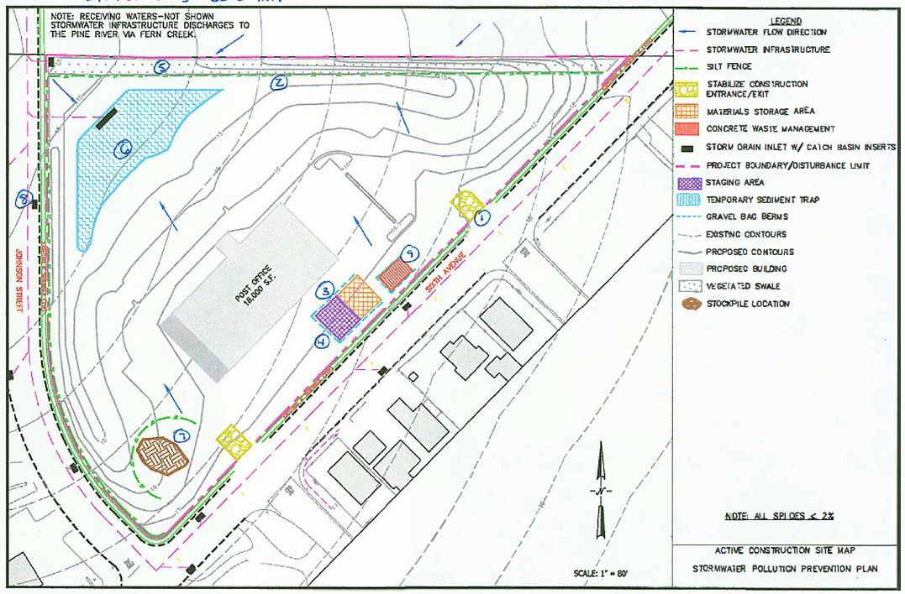
Clarification: Stormwater Nutrient and Phosphorous Tool
SNAP is a project-scale tool for estimating:
nitrogen and phosphorus in stormwater runoff from development sites and
nutrient reductions provided by stormwater treatment.
NOT used for buffers
Notes:
Another item mentioned by respondents in the survey that went out was the SNAP tool.
SNAP is a project-scale tool for estimating:
nitrogen and phosphorus in stormwater runoff from development sites and
nutrient reductions provided by stormwater treatment.
The SNAP Tool only applies to the New Development and Existing Development stormwater rules.
It is not used for nutrient accounting with buffers.
-------------------------------------------------
It estimates nutrient load reduction benefits of stormwater SCMs (BMPs), whether retrofits or on New Development sites.
Other rules, such as Agriculture and Wastewater, use their own load accounting methods.
Buffer rules operate on a habitat acreage bases with respect to impacts and mitigation.
The SNAP Tool can be found here:
https://deq.nc.gov/about/divisions/water-resources/planning/nonpoint-source-management/nutrient-offset-information

Slide 13
NC Nutrient Management Strategies
Result in Environmental, Social, & Economic Benefits
Notes:
The goals of Nutrient Management Strategies is to reduce nutrient inputs to our waters, resulting in Environmental, Social, & Economic Benefits

