Slide 1
Updates to NCDEQ’s Stormwater Nitrogen and Phosphorus Tool (SNAP)
SNAP 4.2 Demo and Call for Testers
Department of Environmental Quality
Trish D’Arconte
Nutrient Scientific Advisory Board | September 2021

Slide 2
What is the Stormwater Nitrogen and Phosphorus (SNAP) Tool?
Spreadsheet calculates nutrient runoff export from a development site
Models nutrient reductions by Stormwater Control Measures
Determines compliance relative to watershed nutrient export targets
Implements Falls and Jordan Rules, updated for Neuse and Tar-Pamlico Rules
Based on Jordan-Falls Tool v2
Designed for usability across the State
Department of Environmental Quality

Slide 3
How Does the Tool Work?
Site-scale annual runoff volume calculated with Simple Method
Annual runoff volume * landcover-specific nutrient concentrations →
Aggregated into annual load N and P (lb/yr)
SCM nutrient treatment
Inflow partitioned through SCM to hydrologic fates
Effluent - fixed concentrations, SCM-specific
Department of Environmental Quality

Slide 4
What Does SNAP Calculate For You?
Annual nutrient export from project
Nutrient reduction provided by SCMs
Screens projects by input data for development type, development landuse type, disturbance area, development location, owner type
Applies watershed-specific Rule targets
Project nutrient load balance (credits/debits)
Document projects for annual reporting
Track site nutrient export even where reductions not required
Easy data collection platform for project info
Department of Environmental Quality

Slide 5
What Does SNAP Calculate For You? SPECIFICALLY
N and P leaving site
Before and after project
With and without SCM
Total load and loading rate (lb/yr and lb/ac/yr)
Target load and loading rates, scaled to project area
Total Reduction needed (relative to load without SCM)
Buy-Down threshold
Treatment Balance relative to Reduction needed
Department of Environmental Quality

Slide 6
Comparing SNAP to Tar-Pamlico Tool
Similarities:
Site-scale annual runoff volume calculated with Simple Method
Annual runoff volume * landcover-specific nutrient concentrations
Differences:
Different landcover TN and TP EMCs
SNAP SCM treatment first determines volume reduction (hydrologic fates), then applies a set EMC to effluent
Tar-Pam SCM treatment uses percent reduction
SNAP can apply watershed-specific Rules (e.g. for buydown calculation)
SNAP can do SCM under/oversizing
Department of Environmental Quality

Slide 7
Tool Assumptions
Simple Method for runoff volume calculation
N & P export increases linearly with runoff
Runoff, nutrient exports, SCM hydrologic partitioning are average annual
SCM effluent conc’s cluster around set value
Infiltrated P immobilized in soil
Infiltrated N denitrifies prior to reaching waterbody
SCMs designed / maintained to State requirements
Department of Environmental Quality

Slide 8
Tool Limitations
Drainage area maximum 1 square mile
Does not model agriculture
Does not model subsurface or instream transport / transformation
Does not model onsite wastewater
Cannot estimate error or variability
Custom SCMs must use hydrologic partitioning and effluent concentration with central tendency
Department of Environmental Quality

Slide 9
What’s New? (relative to older tools)
All SCMs that have Minimum Design Criteria
Use SCM design variants and HyPerTool outputs
Custom SCMs and land covers
Reports under/over-treatment vs. loading rate targets
Determines, reports watershed-specific compliance
Automated Nutrient Offset reporting form
Online GIS map to find your watershed, delivery zone
Export data to other spreadsheet or database
Simpler set of land cover types with clear definitions
All background calculations visible to user

Slide 10
What’s Improved? (relative to older tools)
Refined science on land cover export values
Refined SCM inflow partitioning, effluent concentrations
Correct calculation of SCM under- and oversizing
Explicit retrofit credit calculation
Applicable across entire state
Easier to use, simpler layouts, better print formats
Better error checking and user feedback
Extensive testing and bug fixes
Greatly expanded, revised User Manual
Clearer SCM and catchment routing

Slide 11
Nutrient SCMs in Tool
Previously available:
Bioretention w/ or w/o IWS
Permeable Pavement
Wet pond
Stormwater wetland
Sand Filter
Rainwater Harvesting
Green Roof
Level Spreader – Filter Strip
Grassed Swale
Dry Pond
New in SNAP:
Bioretention variants
Permeable Pavement variants
Pollutant Removal Swale variants
Sand Filter variants
Infiltration Systems
Disconnected Impervious Surface
Floating Wetlands for Wet Ponds
LS-FS with Virophos ®
Silva Cell ® w/ or w/o IWS
Custom SCMs
Department of Environmental Quality

Slide 12
Existing Tool Flexibility and Capabilities
Model custom SCM designs
Uses output from NCSU design Tools:
Bioretention HyPerTool
PermPave HyPerMod
Rainwater Harvester
Use custom land cover types (e.g. dog parks)
Model multiple SCM sizes (from 50% to 200% of “design volume”)
Use multiple combinations of SCMs in series and parallel
Department of Environmental Quality

Slide 13
Goals of Tool Update / Needs of Tool Performance
Incorporate Neuse and Tar-Pamlico Stormwater Rules
Work well with LG plan review process
Work well with LGs that have stormwater regs different from State “default”
Easy for novices to enter necessary data and resolve errors
Incorporate new SCMs / SCM data
Reduce “black box” – make it easy as possible for user to trace/view calculations
Actually help with stormwater nutrient management
No “cat-helping”
Department of Environmental Quality

Slide 14
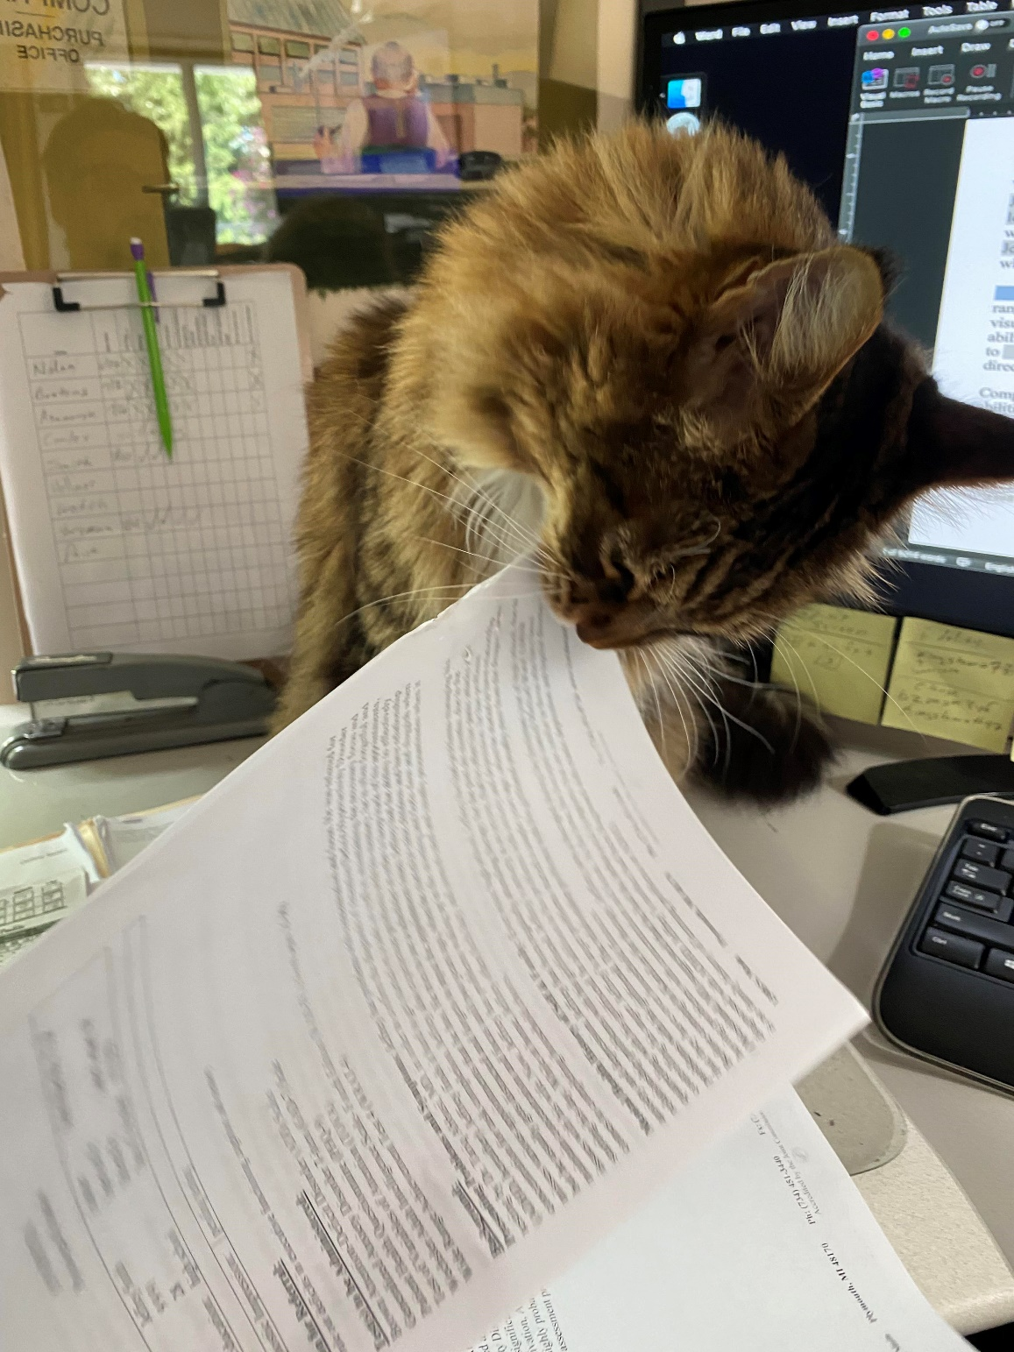
Cat-Helping

Slide 15
SNAP Tool User Groups
Permit- or Grant-seekers
Need to understand enough of tool and their site conditions to accurately enter data, unless SCMs are involved
Designers
Require assurance that tool calculates correctly
Need easy evaluation of alternative designs
Trust but verify – no black boxes
Reviewers
Applying state or local stormwater regs, or grant admins
Need cues to important characteristics that help determine applicability of regs
Need cues to likely data entry errors
Department of Environmental Quality

Slide 16
General Modifications for SNAP 4.2
Explicit tracking of offsite run-on and existing BUA → enables “onsite offset”
More explicit data entry error checking with guides for resolution
Structured visual formatting of site characteristics needed to apply state and local stormwater requirements
Runoff volume match (using Simple Method)
Changed load results to tenths of a pound (from hundredths)
B&W non-color scheme
(I hope!) Addressed intermittent fatal crashing
New SCM performance data!
Department of Environmental Quality

Slide 17
Requested Mods Not in This Update
Curve number method
Ability to have SCMs in pre-project land cover
Ability to determine SCM retrofit uplift from running tool once rather than running tool twice (i.e. if you are modifying an existing SCM)
Lot size → avg land cover converter
Dwelling unit/ac → avg land cover converter
Department of Environmental Quality

Slide 18
Schedule for Completion / Release
September NSAB – demo, and start testing
October – reconvene SCM Credit Team to discuss NEST process & document
November NSAB – Tool modifications, NEST document
January – present preliminary revised SCM EMCs
Also January – Last call for more SCM data
March – Tool Release
Ongoing, throughout – Tool debugging, testing, revision
Department of Environmental Quality

Slide 19
Testers & Reviewers Needed!
First version available shortly (early next week) via email
Does not include new SCM performance data
Expect multiple (3 or 4) versions over the next 2 months in response to error reports and major modifications
Would prefer error reports as you find them, longer reviews by November NSAB meeting
Please volunteer via chat box (live meeting) or email to Trish
Department of Environmental Quality

Slide 20
Needed Feedback from Testers & Reviewers
Errors, bugs
Ease of use, intuitive for the average user?
Does this get a better balance between Calculating Everything (Black Box) vs Flexible (but Requires Work to Use)?
Full set of detailed questions in Change Log
LGs with stormwater regs different from default NMS – how does it work for you?
LGs that commonly deal with offsite run-on or existing BUA
Department of Environmental Quality

Slide 21
SNAP 4.2 Demonstration
Department of Environmental Quality

Slide 22
Questions?
Department of Environmental Quality
Notes:
Functions to Review in Live Demo:
Terms of Use
Navigation Buttons
Where Do I Start?
Online Help
GIS and other maps
Printing sheets (incl. to file)
Clearing sheets
Hover for Help
Beige cells, Yellow cells, Green cells
Pull-down menus
Adding/removing catchments
Export/Import CSV
Background calculation sheets

