Slide 1
Department of Environmental Quality
High Rock Lake
Nutrient Management
Strategy: Agriculture
May 8, 2023

Slide 2
Agriculture Rule Proposal
Overall NMS percentage reduction goals will be applied
Agriculture representatives will submit an annual report that gauges progress toward achieving the overall goals
The report will track production and implementation metrics that have been determined through consultation from the Steering Committee and other stakeholders
No nutrient loss/loading model (i.e. NLEW) will be required to demonstrate collective compliance with the overall NMS reduction goals
The need for local agricultural committees to assist data collection will be determined by the TAG

Slide 3
Steering Committee Feedback
More interest in livestock stream access management and phosphorus application via waste than in numerical nitrogen loss/load modeling
Need good ambient data to align progress reports with evidence of improvement
No need for local committees if they’re not improving adoption of conservation practices
Some kind of watershed oversight committee may be necessary for tracking progress
Department of Environmental Quality

Slide 4
Reporting Metrics/Frequency
Alternating reports every 2, 3, 2, 3, 2, 3, etc. years
Implementation Report
  2 years of data
  BMP implementation
    Practices chosen by centralized oversight committee
    Steering Committee can offer a non-binding recommendation to oversight committee
  Soil test phosphorus results
  Cost share expenditures
Strategic Planning Report
  3 years of data
  Overlaps w/ Census of Agriculture publication
  2-year report trends over time
  Easement program enrollment
  USDA Census of Agriculture
    Animal numbers
    Pasture acres
    Crop Acres
  Planning/Implementation recommendations
What’s missing?

Slide 5
Local Committees
“Local Advisory Committee” in Neuse, Tar-Pamlico, and Falls Lake
  Members include DSWC, SWCD, CEC, NCDACS Regional Agronomist, 2 Farmers
  Meets annually
  Review crop acres, fertilization, BMP implementation
  Usually held adjacent to SWCD Board meeting
Benefits
  Input obtained directly from producers
  Can assist SWCD in prioritization and strategy planning
Drawbacks
  All volunteer
  Not part of existing committee/group (extra workload)
  Members lose interest over time
  As implementation wanes, data collection loses value
  Time consuming
Are local committees
necessary?

Slide 6
Oversight Committee
Watershed/Basin Oversight Committee in Neuse, Tar-Pamlico, Falls Lake, and Jordan Lake
  Members include DSWC, DWR, NRCS, SWCD, CES, NCFB, Enviros, Academics
  Meets annually
  Reviews and approves annual reports
Benefits
  Stakeholder involvement in review/approval
  Can assist in strategy planning
  Can provide more dynamic year-to-year change observation and oversight recommendations
  Serves as a point of contact and deliberation for input from outside parties
Note
  All data compilation and report writing falls to DSWC with or without an oversight committee
Is an oversight
committee needed?

Slide 7
Existing Regulations: Livestock
DWR currently inspects livestock operations for WQ violations
  Samples for turbidity, fecal coliform, sediment deposition, etc.
  Issues ~4-5 warning letters per year (most often for turbidity/sediment)
  Most producers voluntarily correct the problem (takes time)
  Rotational grazing can be part of the solution
  Enforcement is occasionally necessary

Slide 8
Questions for TAG Members
Can a new rule accelerate the process of exclusion or encourage reluctant producers to act?
  How does that differ for operations that are secondary sources of income?
  Thoughts on an operation size threshold?
    Only pastures with more than a certain number of livestock head
    Only pastures that generate a certain amount of income
  If no rule is recommended, what is needed to meaningfully increase the pace of exclusion?
Are achievement targets necessary?
  i.e. certain percentage of operations excluded by XXXX date, increasing over time?
Can a separate BMP be implemented to lure them away from the stream?
  Cost share tree plantings w/ protection through establishment
  Cost share waterers
  O&M lasts until canopy expands to provide shade
  Grants 10-year grace period before fencing is required (i.e. if “luring” BMP is implemented, no DWR enforcement actions will be taken)
  If producer can demonstrate exclusion, no fencing is necessary
Can tax incentives or funding eligibility be tied to exclusion?

Slide 9
Case Studies
Maryland
  Exclusion required for producers who earn > $2,500 annually from farm sales or have 8 cows (or equivalent)
  Minimum 10ft setback
  Fencing not explicitly required, only controlled access
Virginia
  Exclusion only required for operations with > 300 beef cattle or dairies
  No exclusion required for pastured animals
  Complaint-driven process for activities that impact nutrient, sediment, toxin delivery to streams
  When complaint is filed and investigated, the producer may correct voluntarily or be fined

Slide 10
Consensus Questions
How has the Steering Committee’s feedback changed your proposal?
Should local committees be charged with data collection and analysis?
Are you comfortable incorporating a livestock exclusion provision into rule?

Slide 11
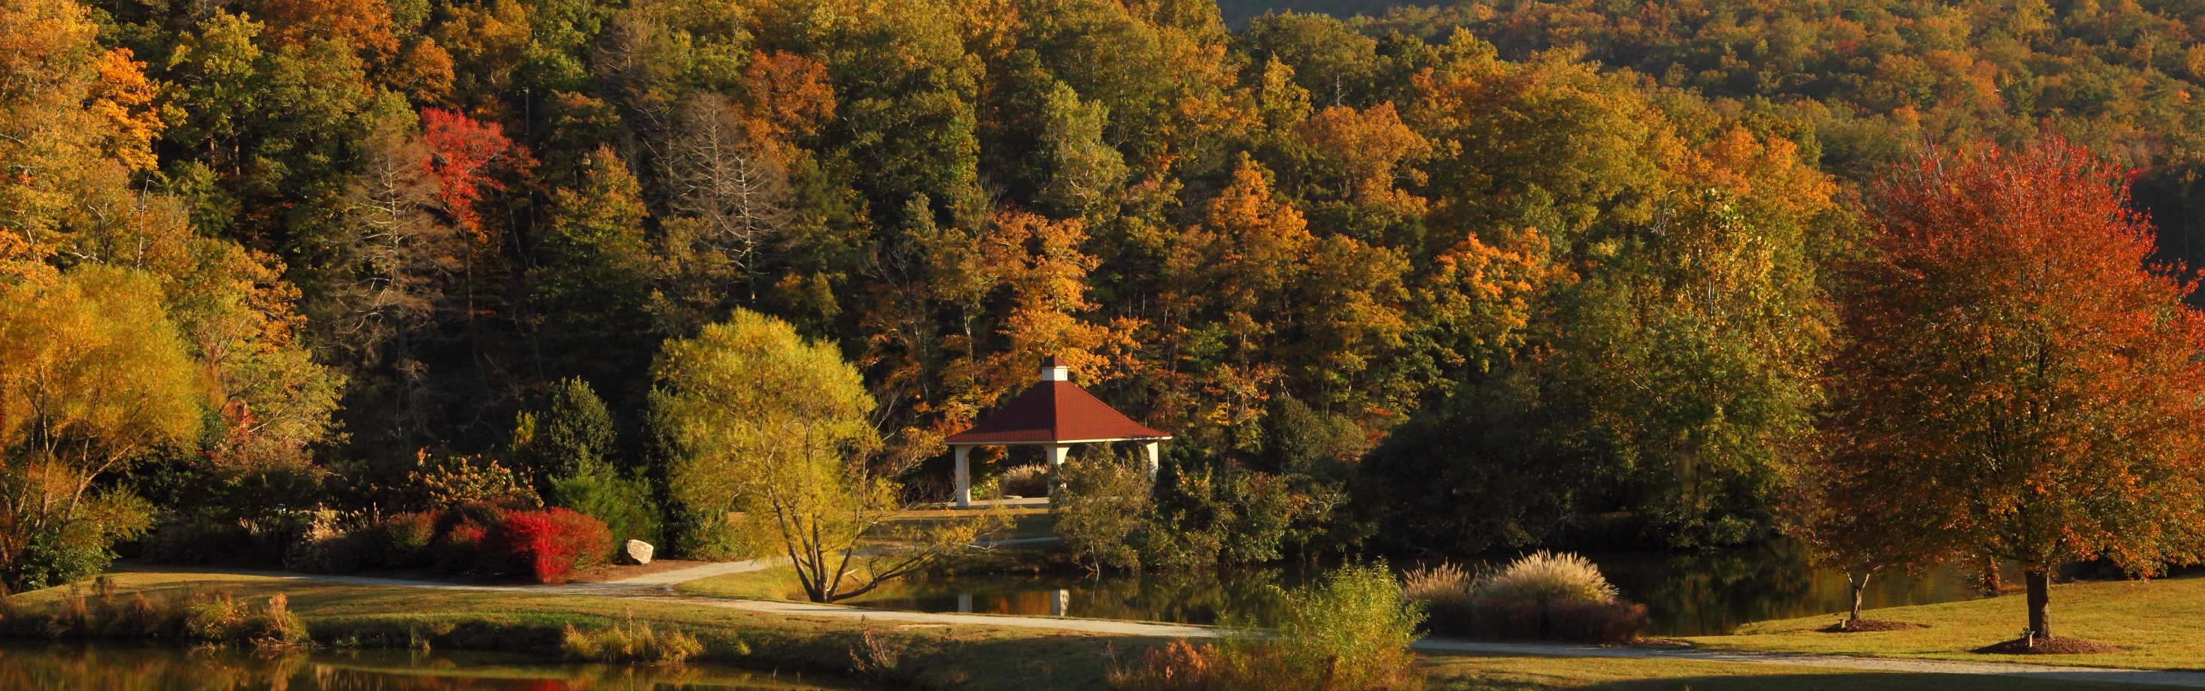
Questions?
Joey Hester
Joey.hester@ncdenr.gov
O: 919-707-3675
C: 919-418-5712
Department of Environmental Quality

