Slide 1
High Rock Lake Nutrient Rules Engagement Process All Stakeholders Meeting #2
March 29, 2023
Virtual

Slide 2
Welcome!
Please introduce yourself in the chat…
Share your name, location and connection to High Rock Lake and its watershed

Slide 3
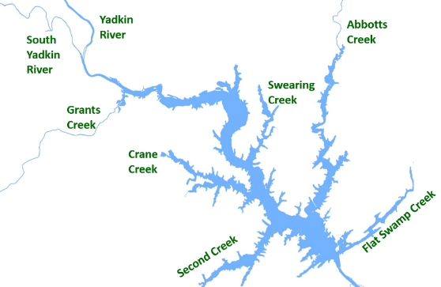
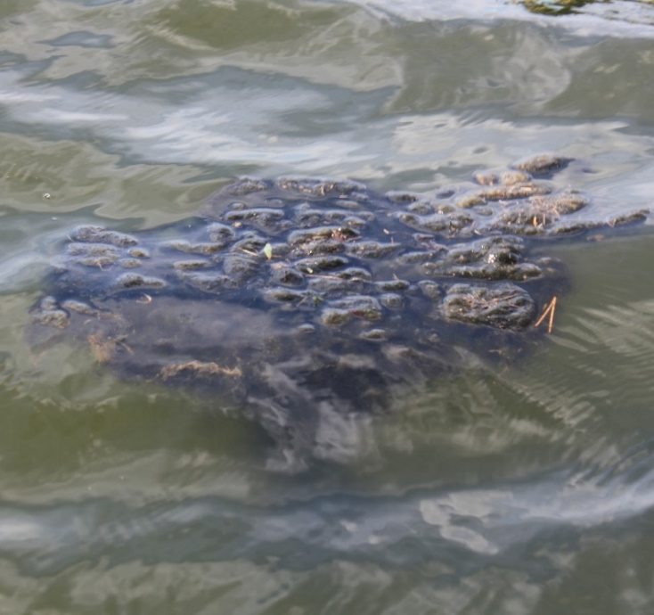
High Rock Lake Nutrient Management Strategy Rulemaking
Excessive algal production
Elevated risk to human health from algal toxins
Seeking stakeholder input on means of reducing nitrogen and phosphorus, which feed algae
Drafting regulations (called “rules”) to reduce loading of N and P to HRL
Department of Environmental Quality

Slide 4
Meeting goals for todayGoals
For anyone interested in High Rock Lake and its watershed to…
Hear process updates, including updates from Technical Advisory Groups and the Steering Committee
Collect questions from the stakeholders.
Get input about next steps in the process.

Slide 5
Agenda, 4- 5:30 pm
Welcome & purpose of the meeting
Agenda, ground rules review & who’s in the room
Process Update
Hearing from Steering Committee & TAGs
Small groups
Next steps & survey
Closing

Slide 6
WORKING TOGETHER: GROUND RULES
GROUND RULES
Stick to the tasks and topics on the agenda and keep discussion focused; one subject at a time.
Discuss all relevant information and issues, even difficult ones.
Keep discussion open and balanced.
Participate, show up, share your thinking as much as you can.
Strive to make decisions by consensus.
Look beyond positions to interests.
Disagree openly and respectfully.
Put personal differences aside in the interests of a successful team.
Jointly design ways of testing disagreements and look for mutually beneficial solutions.
Follow through on commitments.
Share information discussed in team meetings with your organization, and reflect its position back to the team.
While participants are free to discuss the process outside of official meetings, decisions will be made during meetings themselves.

Slide 8
Progress Since September
Wastewater treatment facilities
Permitted nutrient limits
Septic systems
Residuals/Biosolids
Stormwater
Wastewater
Agriculture
Riparian Buffers
Animal feeding operations
Manure/waste distribution
Fertilization management
Livestock stream exclusion systems
Conservation planning
Cost share funding
Construction sites
Urban, residential, commercial development
Roadway/highway runoff
Local government ordinances
Flood management
Vegetation protection
Erosion control
Nutrient management

Slide 9
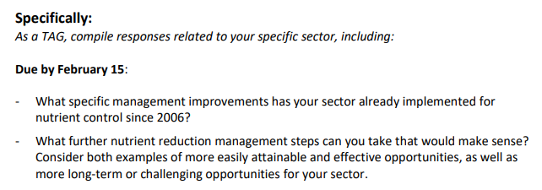
Steering Committee
Stormwater
Riparian Buffers
Wastewater
Agriculture

Slide 10
Membership Representation (so far…)
NC Department of Environmental Quality
Yadkin-Pee Dee River Basin Association
NC Farm Bureau
Yadkin Riverkeeper
NC Conservation Network
NC Homebuilders Association
Soil & Water Conservation Districts
NC Cooperative Extension
NC Forest Service
Blue Ridge Trout Unlimited
Triad Real Estate and Building Industry Coalition
NC Department of Agriculture
Natural Resources Conservation Service
High Rock Lake Association
NC Department of Transportation
City Governments
County Governments
FEI Engineering
Stimmel Associates, P.A.
Tyson Farms
Wild Ones Central NC Chapter
Piedmont Triad Regional Council
North Carolina Septic Tank Association
Crop Risk Services

Slide 11
Meetings Held
Stormwater
Riparian Buffers
Wastewater
December 12
Agriculture
December 13
January 25
Steering Committee
February 28
December 1
November 17
January 26
February 8
February 27
March 1
March 15
March 10

Slide 12
Rulemaking Timeline

Slide 13
High Rock Lake Chlorophyll-a Standard

Slide 14
Steering Committee Update
Grace Messinger, Piedmont Triad Regional Council
Role | Member | Alternate | Organization
Voting | Ann Marie Clark |  | High Rock Lake Association
Voting | Dr. Bill Davis | Rob Baldwin | Wilkes SWCD
Voting | Allie Dinwiddie | Julie Henshaw | NC Division of Soil & Water Conservation
Voting | Rich Gannon |  | NC Division of Water Resources
Voting | Joey Hester |  | NC Division of Water Resources
Voting | Keith Huff | Andy Allen | City of Winston-Salem
Voting | Bill Kreutzberger |  | Independent Consultant
Voting | Keith Larick |  | NC Farm Bureau
Voting | Grady McCallie |  | NC Conservation Network
Voting | Andy McDaniel |  | NC Department of Transportation
Voting | Grace Messinger | Danica Heflin | Piedmont Triad Regional Council
Voting | Edgar Miller | Grace Fuchs | Yadkin Riverkeeper
Voting | Chris Millis |  | NC Homebuilders Association
Voting | David Saunders |  | Yadkin Pee Dee River Basin Association
Voting | Justin Somers |  | Perdue Farms, Yadkin SWCD
Voting | Judy Stalder | Jon Lowder | Triad Real Estate and Building Industry Coalition
Voting | Jonathan Williams |  | Town of Spencer
Non Voting | Helen Simonson |  | Downstream Interests

Slide 15
Technical Advisory Group Updates
Agriculture TAG – Keith Larick, NC Farm Bureau
Stormwater TAG – Scott Leonard, Davidson County
Wastewater TAG – Bill Brewer, Winston-Salem/Forsyth County Utilities
Riparian Buffer TAG – Robby Abou-Rizk, Blue Ridge Trout Unlimited

Slide 16
Breakout Session Q&A
Joey Hester
Joey.hester@ncdenr.gov
O: 919-707-3675
C: 919-418-5712
Department of Environmental Quality

Slide 17
Closing & Thank you!
MARK YOUR CALENDARS - This group will gather again in person at the Salisbury Civic Center from 2 – 5 pm on May 31!
Questions? Want to get more involved? Email Joey!
Please complete the anonymous survey (link in chat)
THANK YOU for joining us today!

