Slide 1
Department of Environmental Quality
High Rock Lake
Nutrient Management
Buffer Technical
Advisory Group
April 17, 2023

Slide 2
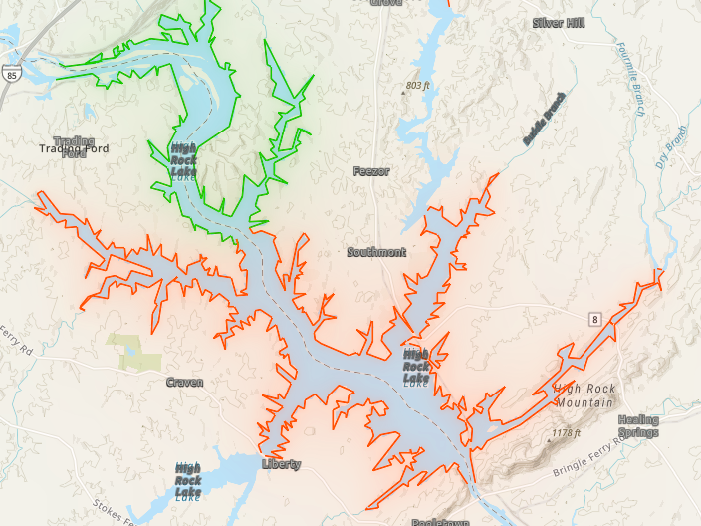
Regulatory Charge
High Rock Lake is violating NC’s chlorophyll-a WQ standard
Nutrient Management Strategy rules designed to reduce nutrient loading
Modeling indicates that 40-50% reductions in N/P loading are necessary
Riparian buffer protection improves nutrient cycling and stabilizes streambanks
Buffers have co-benefits, but the rule cannot be designed to address them
NFWS/WRC is in charge of endangered species management

Slide 3
State-level Buffer Reviews
Environmental Review Commission, 2016:
“The buffer rules were adopted specifically to address nutrient, sediment and pollutant loading as part of the larger management strategies that also require reductions from municipal and industrial dischargers and agriculture (as required in G.S. 143‐215.8B). Scientific literature demonstrates that 50‐foot riparian buffers on intermittent and perennial streams perform many functions that protect water quality, including nutrient, sediment and pollutant removal, stream bank stabilization, and temperature control. ”
DEQ Literature Review, 2012:
“If buffer protections were removed from existing residential development in the Neuse and Tar-Pamlico River Basins, Nitrogen load would increase by approximately 20% and 13% in Neuse and Tar-Pamlico respectively compared to total N load to streams from all sources, both point and nonpoint, in each basin.”
“If buffer protections were removed from all developed and agricultural lands in the Neuse and Tar-Pamlico River Basins, Nitrogen load would increase by approximately 130%, or more than double, compared to total N load to streams from all sources, both point and nonpoint, in both basins.”

Slide 4
State-level Buffer Reviews (cont’d)
NC Conservation Network 2016
Fifty foot, naturally vegetated buffers should remain in place along perennial and intermittent streams, rivers, lakes, and estuaries in watersheds that are impaired by or sensitive to nutrient or sediment pollution.
Burchell 2016 report to Environmental Management Commission:
Overall, research indicates most buffer functions approach a maximum at or above 100 feet and start to diminish at different rates as buffers widths get more narrow.
Reduction in the 50 ft width requirement could significantly reduce the effectiveness in N removal (less treatment area) and sediment removal (particularly on lands with higher slopes).
50 ft width optimizes cost efficiency, beyond which the cost-per-benefit increases considerably

Slide 5
Buffer Width Research
Dillaha et al. 1988 found that even a fairly narrow buffer of 15 feet removed 76-87% of sediment while wider buffers of 30 feet were more effective and removed from 88-95% of sediment.
Wenger 1999 reviewed four published studies and found that a 30-foot wide riparian buffer removed 46-79% of the total phosphorus
Meta Analysis: Mayer et al. 2007 examined the results of 89 buffers from 45 published studies and concluded that riparian buffers were very effective in removing nitrogen from water flowing through the riparian zone. Specifically, they found that a 50-foot wide riparian buffer removed about 70% of the total nitrogen entering the buffer through stormwater.

Slide 6
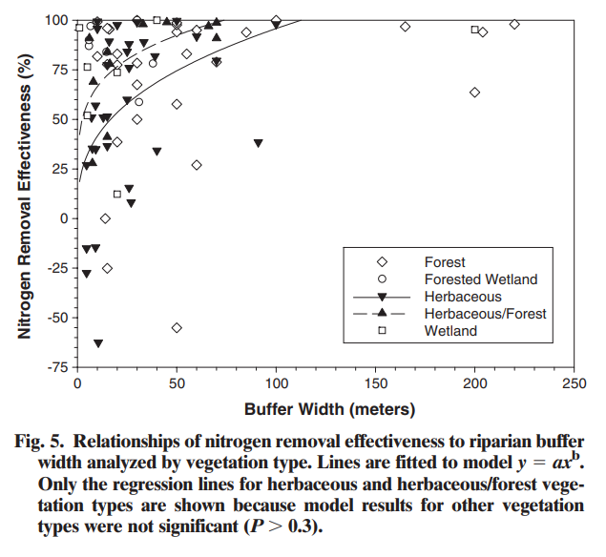
Meyer 2007 Meta Analysis

Slide 7
Buffer Width Research (continued)
Jontos 2004
Water quality protection width = 20-100 feet
Stream stabilization width = 30-60 feet
Flood attenuation width = 60-500 feet
Dodd 2015
“Conservation Practices which act by trapping P within the landscape, such as buffers, wetlands and grassed waterways can accumulate P over time and become enriched with labile forms of P compared to adjacent field soils. This may result in these P sinks transitioning into P sources.”
Gay 2023
“Fixed width 50ft and 100ft riparian buffer treatments that we tested did not substantially mitigate [the effects of land cover conversion and climate change] at the watershed level; however, we found evidence that these buffers could reduce the frequency of local flooding in some developed subbasins and increase flow rates during low flow periods in the highest developed subbasins.”

Slide 8
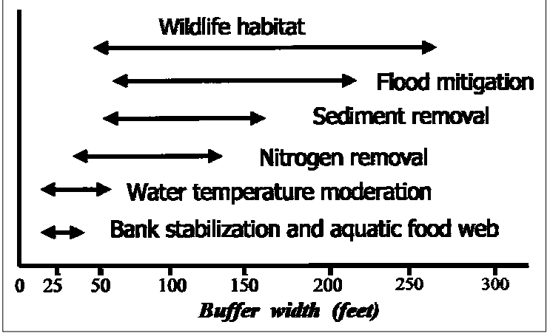
Minimum Buffer Widths for Specific Objectives
Notes:
Because buffers provide so many different functions, there are many different minimum buffer widths recommended depending on the specific objective. Diagram from Chesapeake Bay Riparian Handbook (1998)
All of the functions in the blue box relate to nutrients.
This is also why it’s a challenge to compare NC to other states. It’s not just simply a number for how wide the buffer is, it’s also what is the purpose of the buffer.

Slide 9
Buffer Performance Research
King 2016
“Vegetation alone, including the control, had no effect on NO3 –N removal or DOC concentrations, although trends suggested that trees provided the greatest NO3 –N removal and that the control provided the least. Due to the complex relationships and interactions between site characteristics (water table depth, soil type, low incoming N, and low DOC), it is not surprising that only width and time have thus far emerged as important factors affecting NO3 removal at this site.”
Beeson and Doyle 1995
Wooded buffers have significant effect on stabilizing streambanks and preventing erosion which can impact downstream waters. A study of over 700 stream bends found that 67% of bends without vegetation eroded during a storm, while only 14% of bends with vegetation showed erosion.
Riparian buffers slow down stormwater runoff, allowing water to infiltrate the soil and recharge the groundwater supply. This helps control flooding and maintain stream flow during dryer times of the year (Connecticut River Joint Commissions 1998). It also replenishes the water supply during periods of lower rainfall (Virginia Department of Forestry 2011).

Slide 10
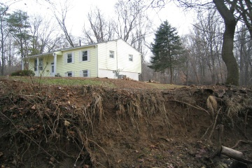
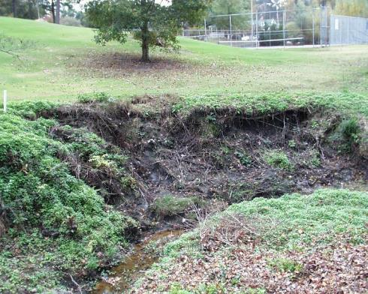
Why we require forest and grass
Montgomery Co., MD
Notes:
Grass does not stabilize streams.

Slide 11
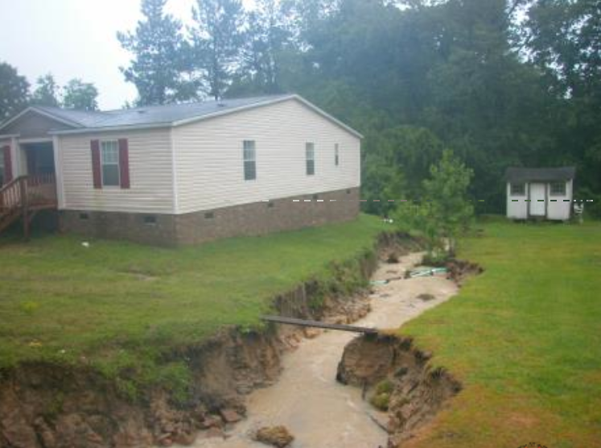
Grass Doesn’t Cut It
Notes:
Prevent erosion, Stabilize streambanks, Protect property
Wooded buffers have significant effect on stabilizing streambanks and preventing erosion which can impact downstream waters and result in property loss.
A study of over 700 stream bends found that 67% of bends without vegetation eroded during a storm, while only 14% of bends with vegetation showed erosion (Beeson and Doyle 1995).
Over 75% of sediment comes from stream banks (Deanna Osmond, NCSU)

Slide 12
Reduction of Nutrient Loads
Buffer Type | Nitrogen | Phosphorus | Sediment
Forested | 48-74% | 36-70% | 70-90%
Vegetated Filter Strips | 4-70% | 24-85% | 53-97%
Forested and Vegetated Filter Strips | 75-95% | 73-79% | 92-96%
Notes:
Generally, the grass filter strip works best for sediment removal, while the forested buffer is better for nitrate removal from subsurface flows¹³. Grasses have a shallower and denser root mat that is more effective in slowing runoff and trapping sediments from the surface flow. Trees have a deeper root system that can trap and uptake nutrients from the groundwater, stabilize banks, and regulate the flow of water to the stream. (Hawes and Smith 2005)

Slide 13
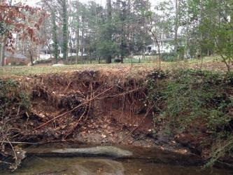
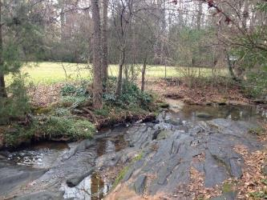
Sediment Removal and Bank Stabilization
Displace sediment-producing activities away from waterbodies
Trap sediments in stormwater runoff
Reduce water velocity to allow sediment to settle (both stormwater and floodwater)
Stabilize streambanks, preventing channel erosion
Moderate stream flow during floods
Contribute large woody debris, which traps sediment
Notes:
Studies have a range of recommendations for buffer width needed to reduce stream sediment. Buffers as narrow as 15 ft can be effective in the short term, but in general the recommendation is 100-foot buffers. Grass buffers are good at removing sediment in stormwater runoff, but not effective at all in streambank stabilization.

Slide 14
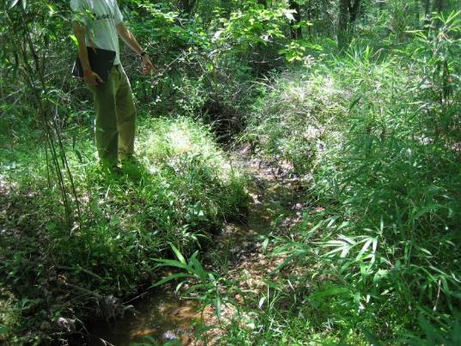
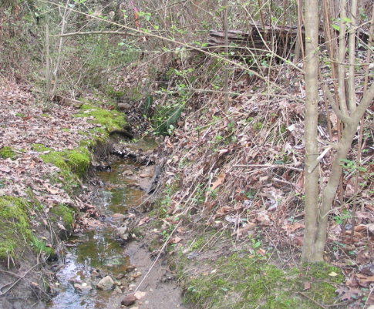
Why buffers on small streams are critical

Slide 15
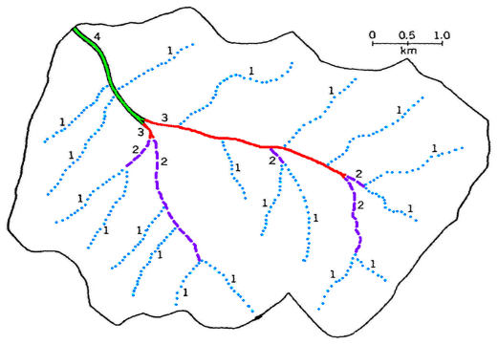
Headwater Streams – Key to Success
Headwater streams (intermittent and small perennial streams) comprise 75-90% of total stream miles
Buffers have the greatest potential for control over water quality when adjacent to headwater streams
Notes:
Even the best buffer strips along larger rivers and streams cannot significantly improve water that has been degraded by improper buffer practices higher in the watershed

Slide 16
Different Stream Types
Ephemeral Stream
Intermittent Stream
Perennial Stream
Seasonal High Water Table
Seasonal Low Water Table
Bedrock
Notes:
Ephemeral:
Stormwater is the primary source of water
Lacks biological, hydrological and physical features associated with continuous or intermittent conveyance of water
Intermittent:
Well-defined channel that contains water for part of year
Flow may be heavily supplemented with stormwater
Often lacks biological, hydrological and physical features associated with continuous conveyance of water
Perennial:
Well-defined channel that contains water year round (during year of normal rainfall)
Groundwater is primary source of water
Exhibits biological, hydrological and physical features associated with continuous conveyance of water

Slide 17
Intermittent Streams
Typically considered Waters of the U.S.
Drain 55-85% of the land area
50% of the food flowing through streams originates from headwater streams
Have 50-70% of the aquatic life found in perennial streams
USFS study found that it would be nearly impossible to successfully implement pollution control strategies without regulating intermittent streams
Department of Environmental Quality
Notes:
The small size of the stream ensures a large amount of water-sediment contact, which removes nitrogen from runoff via nitrification and denitrification by bacteria in the sediments (Mulholland et al 2001, Peterson et al 2001).
This increased contact also allows a higher rate of adsorption of phosphorus to soil particles in the headwater stream bed than in larger streams (James Gregory, personal comm.).
Wallace (USFWS 2000) has also found that these headwater streams are a major source of organic carbon (food) to aquatic ecosystems.
Up to half of the organic carbon flowing through aquatic ecosystems originates as leaf litter in headwater streams that has been broken down and converted to more usable forms of carbon by the bacteria, fungi and invertebrates in these headwater streams.
Sweeny (USFWS 2000) has calculated that if the nutrient reduction functions of these headwater streams were removed (e.g. by culverting the stream), it would be nearly impossible to successfully implement a nutrient reduction strategy in a watershed.

Slide 18
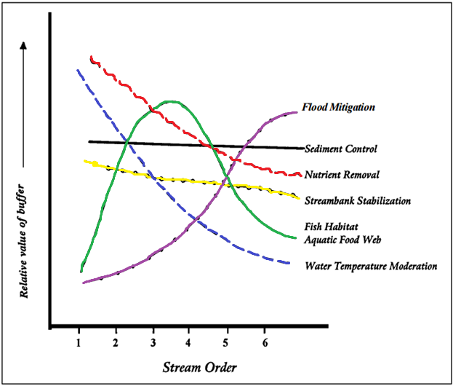
Highest Nutrient Removal in Small Streams

Slide 19
Discussion Questions
Why 50ft if 100ft is more effective?
Should we expand buffers in areas with high nutrient loading?
What percentage of HRL watershed is undeveloped? Doesn’t this equate to most land being exempt from buffer protection?
How much nutrient loading will buffers help achieve?
What benefits are being achieved by newly established buffers in the Neuse and Tar-Pamlico River Basins?
Are the other nutrient management strategies achieving their desired effects?

Slide 20
HRL Riparian Buffer Recommendation
Follow existing buffer rule format:
50ft riparian buffer protection
Zone 1: Inner 30ft
Zone 2: Outer 20ft
Applies equally to all surface waters in watershed
Perennial
Intermittent
Hydrologically connected ponds
Lakes and Reservoirs
Existing and ongoing uses protected as of rule effective date (same footprint)
Forest harvest allowable in zone 2 w/ ground cover reestablishment, select harvest allowable in zone 1
SCM stormwater conveyances allowed

Slide 21
Mark your calendars!
All Stakeholder gathering, May 31 from 2 – 5 pm in person in Salisbury

