Slide 1
Department of Environmental Quality
High Rock Lake
Nutrient Management
Buffer Technical
Advisory Group
February 27, 2023

Slide 2
HRL Informal Stakeholder Process
All Stakeholders
Steering Committee
Technical Advisory Groups
Final Report
September 2022 – December 2023
Six Steering Committee (SC) meetings (more if necessary)
Four All Stakeholder meetings
Five to six Technical Advisory Group (TAG) meetings (more if necessary)
SC submits final report to DWR
DWR considers final report in drafting rules
SC, TAGs, and stakeholders review draft rules and provide feedback
DWR finalizes draft rules considering feedback

Slide 3
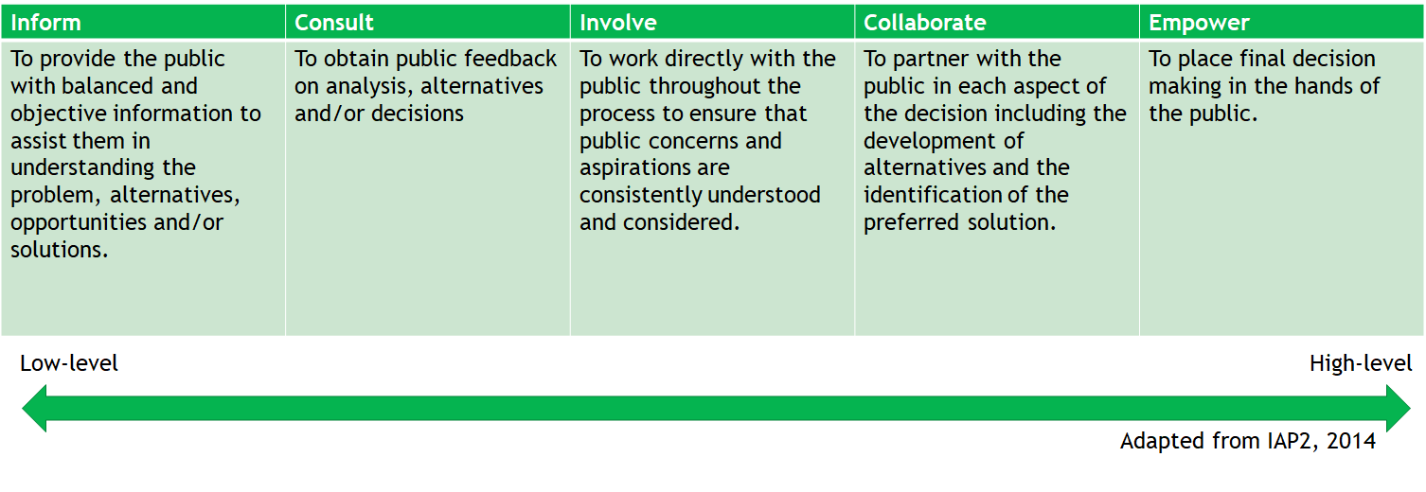
Public Participation

Slide 4
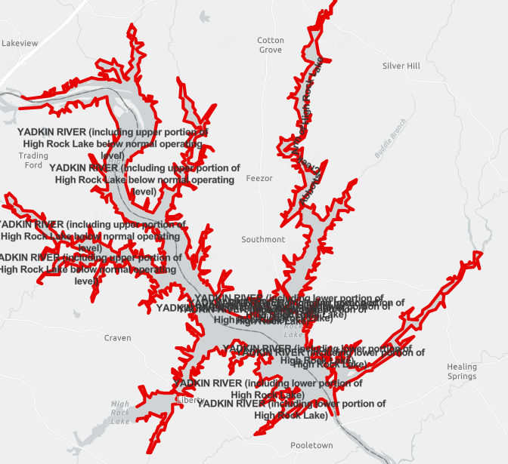
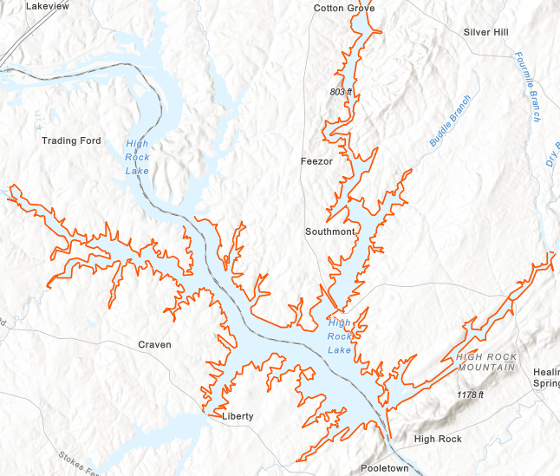
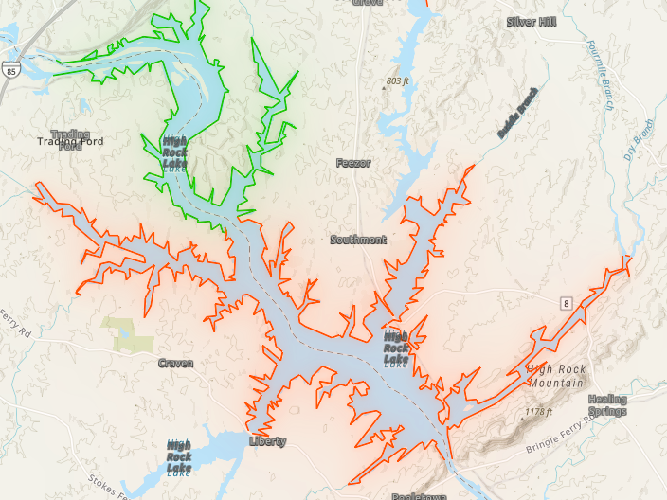
HRL Chlorophyll-a Impairments
2018 2020 2022

Slide 5
Rulemaking Timeline

Slide 6
TAG Charge
What specific management improvements has your sector already implemented for nutrient control since 2006?
What further nutrient reduction management steps can you take that would make sense? Consider both examples of more easily attainable and effective opportunities, as well as more long-term or challenging opportunities for your sector.
What initiation and full implementation timeframes would be needed for each type of management step, roughly speaking?
Are there trends or changes on the horizon in your sector that could affect these timeframes?
Barriers/challenges and possible responses:
What are barriers or challenges to these steps? Consider legal barriers, financial barriers, social barriers, equity barriers.
What could be done to address these challenges and increase buy-in and support for these steps?
Do you think forming partnerships with other groups/sectors could lead to implementation opportunities and positive changes? If so, what opportunities can you envision?
Would nitrogen and/or phosphorus be most cost-effective for your sector to manage, reduce, monitor, and report? Why, and what are the limitations of each? Can you give rough proportions and scales for the kinds of reductions you think could be achieved?

Slide 7
Buffer Rule Overview
Sue Homewood

Slide 8
Nutrient Sources
Wastewater
POTW, WWTP
Industrial discharge
On-site wastewater (septic systems)
Development
Household fertilizers, pet waste
Construction site sediment
Post-construction impervious surfaces
Roadways
Agriculture
Animal waste
Applied fertilizers
Streambanks
Forests
Atmosphere
Lake sediments
Department of Environmental Quality

Slide 9
HRL Riparian Buffer Recommendation
Follow existing buffer rule format:
50ft riparian buffer protection
Zone 1: Inner 30ft
Zone 2: Outer 20ft
Applies to all surface waters in watershed
Perennial
Intermittent
Hydrologically connected ponds
Lakes and Reservoirs
Existing and ongoing uses protected as of rule effective date (same footprint)
Forest harvest allowable in zone 2 w/ ground cover reestablishment, select harvest allowable in zone 1
SCM stormwater conveyances allowed

Slide 10
Clarifications
Buffers are our most valuable tool to keep nutrient load from increasing
Change in use triggers
Conversion of land use
Addition of livestock to non-livestock agricultural operation
Expansion of buildings, dwellings, decks, patios, driveways, etc.
Expansion of existing use footprint
Grass can be maintained/mowed if existing as of rule effective date
Forest harvest rules apply if already in woody vegetation (i.e. Zone 1 cannot return to grass)
Fertilization only allowable for replanting

Slide 11
Alternatives
Can consider changes to allowable uses (e.g. flash grazing, fencing, mowing, etc.)
Catawba lake/main stem only
Goose Creek 200ft inside of100yr floodplain, 100ft outside of 100yr floodplain
Mountains v. piedmont considerations

Slide 12
Q&A
Joey Hester
Joey.hester@ncdenr.gov
O: 919-707-3675
C: 919-418-5712
Department of Environmental Quality

