Slide 1
Department of Environmental Quality
High Rock Lake
Nutrient Management
Steering Committee
February 28, 2023

Slide 2
Updates
Process Road Map
EPA approval of site-specific chl-a standard
Curve memo update schedule
Steering Committee Charge revision

Slide 3
Steering Committee Charge
Current version
DWR asks the Steering Committee to provide written recommendations on the following:
Lake N and P % reduction goals – an overall pair and potentially tailored by source
Redistribute “uncontrollable” loads, increase controllable reduction %’s accordingly
Agree on sources the state should regulate, and any useful non-regulatory actions on other sources or additionally on regulated ones
Coarse implementation timeframes by source, including phasing or adaptive action
Whether to include the subwatershed above W. Kerr Scott Reservoir in management mandates, and any appropriate modifications to regulatory mandates for that subwatershed

Slide 4
Steering Committee Charge
Proposed changes
DWR asks the Steering Committee to provide written recommendations on the following:
Task A: Propose lake N and P % reduction goals – an overall pair and potentially tailored by source, redistribute “uncontrollable” loads and increase controllable reduction %’s accordingly
Task B: Agree on sources the state should regulate, and any useful non-regulatory actions on other sources or additionally on regulated ones
Task C: Propose coarse implementation timeframes by sources identified in Task B, including phasing or adaptive action
Task D: Determine whether to include the subwatershed above W. Kerr Scott Reservoir in management mandates, and any appropriate modifications to regulatory mandates for that subwatershed
Task E: Propose rule concepts to guide compliance and implementation for the major source categories identified in Task B

Slide 5
Recent Watershed Changes

Slide 6
Department of Environmental Quality

Slide 7
Animal Feeding Operations
Permitted
HUC8 | Permit Type | Permits | Allowable Count | Allowable Live Weight
03040101: Yadkin River Headwaters | Animal Individual State | 1 | 420 | 231,000
03040101: Yadkin River Headwaters | Cattle State COC | 13 | 7211 | 8481650
03040101: Yadkin River Headwaters | Swine State COC | 4 | 26370 | 3468750
03040102: South Yadkin River | Animal Individual State | 3 | 345 | 381000
03040102: South Yadkin River | Cattle NPDES COC | 1 | 800 | 1015000
03040102: South Yadkin River | Cattle State COC | 35 | 28,444 | 33952100
03040103: Yadkin River* | Cattle State COC | 9 | 5321 | 6276550
03040103: Yadkin River* | Swine State COC | 3 | 4265 | 1186461
* HUC 03040103 extends beyond the High Rock Lake Dam

Slide 8
HRL Ag TAG Report
Highlights
Many farmers are already using precision nutrient management
Smaller producers generally cannot afford the time/resources/energy required
Poultry industry has undergone significant changes
Slight overall increase in production (trend in point-in-time inventory unclear)
Litter being applied across the watershed
Local conservation staffing capacity is an ongoing limitation
TAG members highlight need for better education, outreach, and training

Slide 9
HRL Wastewater TAG Report
Daily phosphorus loading has fallen considerably since baseline
Daily nitrogen loading has remained stable since baseline
Annual loading trends are facility specific
Cub Creek WWTP (Wilkesboro) is undergoing a major capacity and treatment upgrade
Almost no upgrades planned
Significant declines in industrial flow have been realized across the watershed

Slide 10
Stormwater Updates
MS4 Program History
MS4s in Upper Yadkin River Basin
Permittee Name | Permit Number | Initial Permit Year
Winston Salem | NCS000247 | 12/30/1994
Kernersville | NCS000483 | 9/9/2005
Lewisville | NCS000494 | 11/21/2005
Clemmons | NCS000410 | 7/15/2005
Statesville | NCS000587 | 11/1/2016
Salisbury | NCS000484 | 11/1/2005
Lexington | NCS000584 | 11/1/2016
Thomasville | NCS000436 | 10/1/2005
High Point | NCS000421 | 7/1/2005
Municipalities not designated as MS4s that implement WSW Protection Programs
Tobaccoville
King
Walkertown

Slide 11
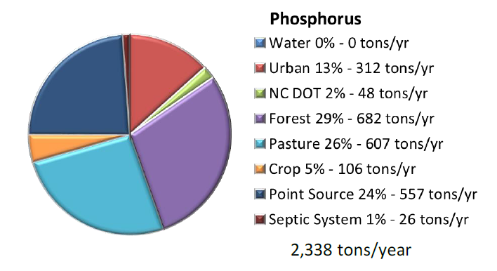
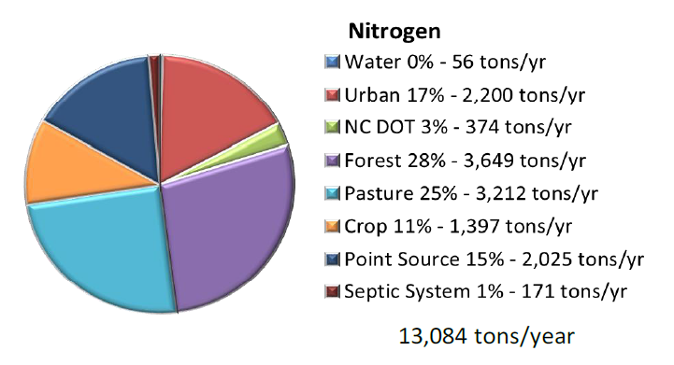
Source Categories
Point Source
POTW
Industrial
Septic Systems
Urban
New Development
Redevelopment
Existing Development
Residential
Commercial
Transportation
State and Federal Entities
Pasture
Crop
Animal Feeding Operations
Forest
Managed
Unmanaged
NC DOT
Buffer Protection

Slide 12
Existing Development
Think “existing uses”
Buffer rule triggered on change of use
New Development triggered on change of use
Ag rule existing uses
Retrofits significantly more expensive than initially planned SCMs
Space constraints, utilities make some areas impossible to treat
Regulatory authority can be challenging
Existing uses are the only possible nonpoint source load reductions

Slide 13
HRL Riparian Buffer Proposal
50ft riparian buffer protection
Zone 1: Inner 30ft
Zone 2: Outer 20ft
Applies to all surface waters in watershed
Perennial
Intermittent
Hydrologically connected ponds
Lakes and Reservoirs
Existing and ongoing uses protected as of rule effective date (same footprint)
Forest harvest allowable in zone 2 w/ ground cover reestablishment, select harvest allowable in zone 1
SCM stormwater conveyances allowed

Slide 14
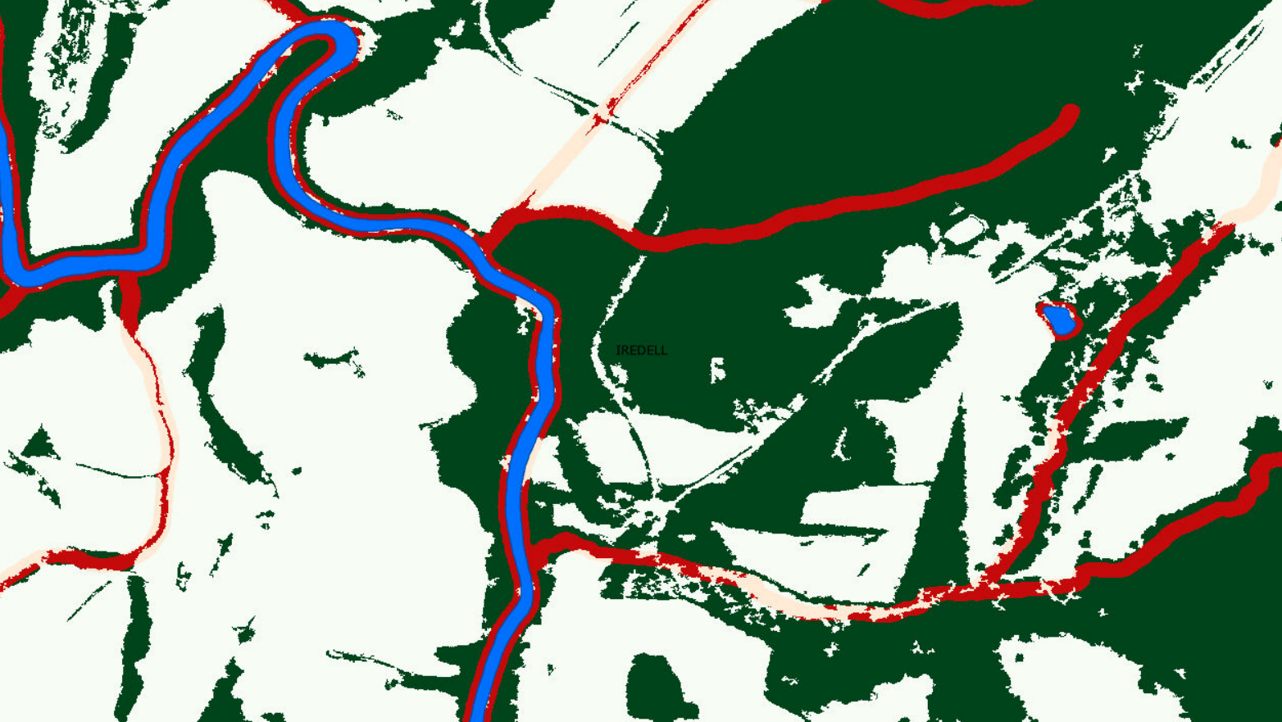
Department of Environmental Quality

Slide 15
Goal Setting Q&A
Joey Hester
Joey.hester@ncdenr.gov
O: 919-707-3675
C: 919-418-5712
Department of Environmental Quality

