Slide 1
Review of DEQ Water Quality Data (N & P Trends in Watershed)
Department of Environmental Quality

Slide 2
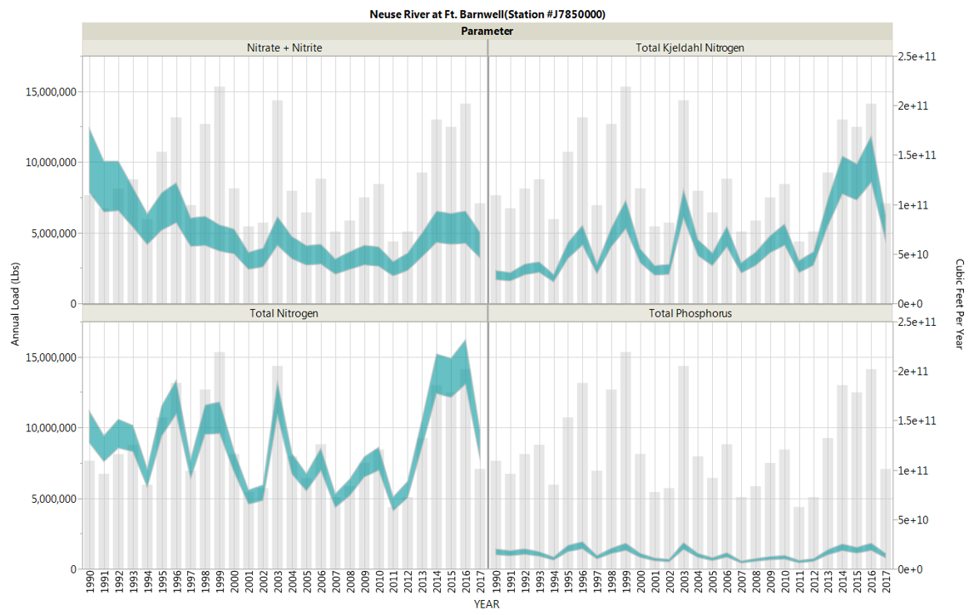
Annual Loads and Discharge, Neuse River at Fort Barnwell, 1990-2017
Nitrate + Nitrite
Total Kjeldahl Nitrogen
Total Nitrogen
Total Phosphorus
Notes:
Note some high-discharge years: 1998, 1999, 2003, 2014-2016
Do we need anything about load estimation methods? (I.e. verbal, not on slides?)

Slide 3
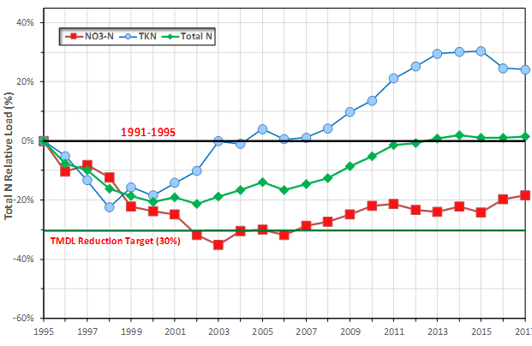
Nitrogen Reduction for Average Flow Condition Neuse River at Fort Barnwell (1995 – 2021)
Notes:
Explain graphic:
- Ft Barnwell – close as can above top of estuary where still get flow.
- All these values normalized to baseline years, 91-95 (heavy black line)
- Baseline = black bar at 0%. TMDL 30% reduction = green line below.
- 3 param’s – total N (green), then split into NO3 (red), TKN (blue).
What it shows:
Initial redux first 5 yrs,
Then ~2000, upswing TKN starts. This is before Rules went into effect, but after WW dischargers were already reducing loads
Such that TN returns to baseline ~2013.

Slide 4
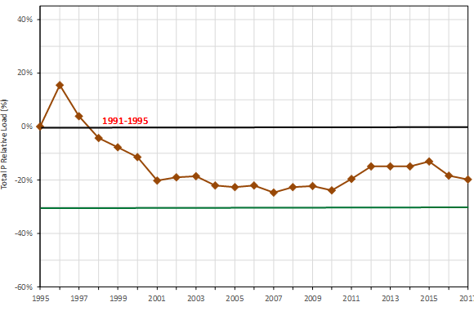
Phosphorus Reduction for Average Flow Condition Neuse River at Fort Barnwell (1995 – 2021)
Notes:
Phosphorus reduction not required for Neuse, but looking good nonetheless

Slide 5
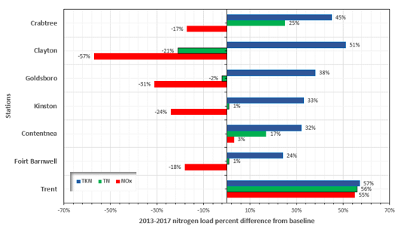
Review of Upstream to Downstream % Change in N Load - Neuse
Notes:
This slide compares N species Loads at major sites, baseline period to late 20-teens
NOx reductions for the 2013-2017 period relative to baseline track urban areas and discharge points, peaking at 57% reduction near Clayton downstream of Raleigh (top circle) and satellite communities’ discharges. Proceeding downstream, NOx reduction percentage wanes to 18% by Ft. Barnwell (bottom circle). This pattern is highly likely to be driven by wastewater discharges.
HOWEVER, TKN showed the largest percentage increases in the upper, more urban Neuse basin, decreasing its proportion traveling downstream.
Watershed modeling conducted by Strickling and Obenour (2018) found for the period of 1994-2012 that point source N load decreased in the Neuse by 61%.

Slide 6
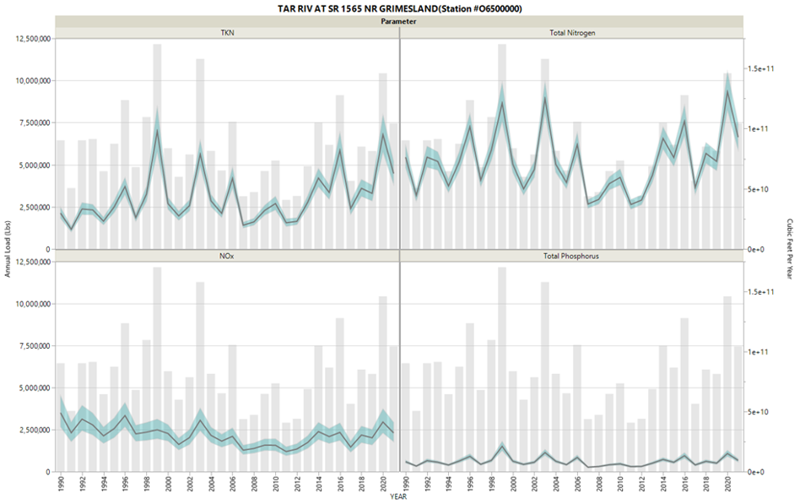
Annual Loads and Discharge, Tar River near Grimesland, 1990-2021
Total Kjeldahl Nitrogen
Total Nitrogen
Nitrate + Nitrite
Total Phosphorus
Notes:
Note some high-discharge years: 1996, 1999, 2006, 2014-2016, 2020
(also note order of parameters is different from other slide)

Slide 7
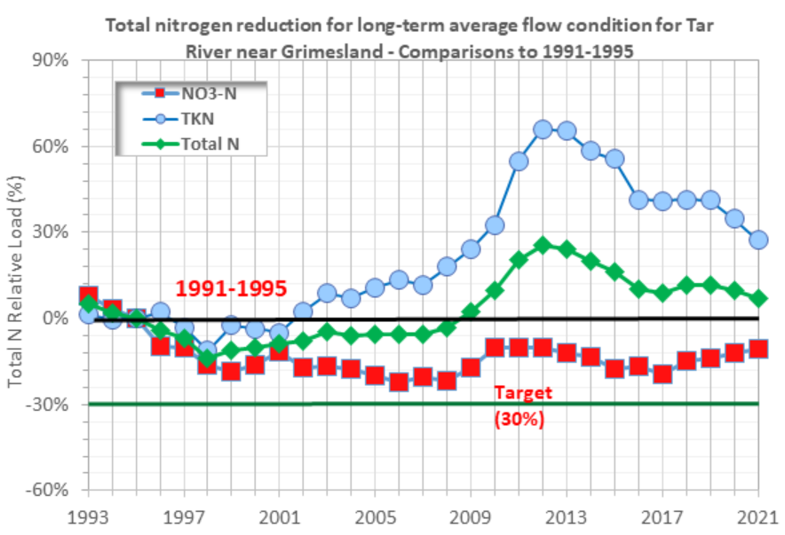
Nitrogen Reduction for Average Flow Condition – Tar River near Grimesland (1993-2021)
Notes:
Explain graphic:
- Grimesland – close as can above top of estuary where still get flow.
- All these values normalized to baseline years, 91-95 (heavy black line)
- Baseline = black bar at 0%. TMDL 30% reduction = green line below.
- 3 param’s – total N (green), then split into NO3 (red), TKN (blue).
Same general pattern as Neuse.
Overall redux ’95 – ’00,
Then TKN separates, starts climbing.
Pulls TN up to exceeded baseline ~2009.

Slide 8
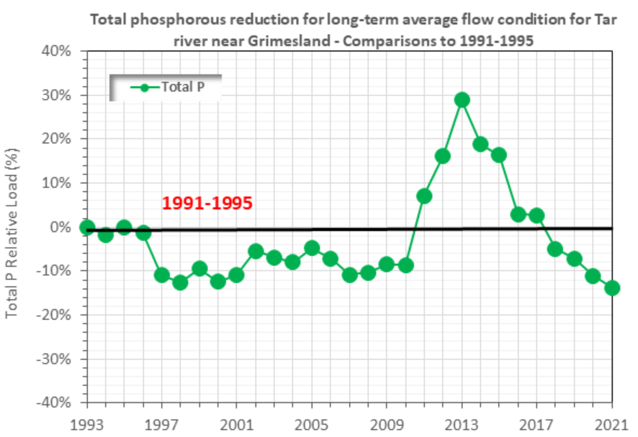
Phosphorus Reduction for Average Flow Condition – Tar River near Grimesland (1993-2021)
Notes:
Rules require 0% increase/decrease in TP. Looks good until 2011, but came back down by 2017. What happened?

Slide 9
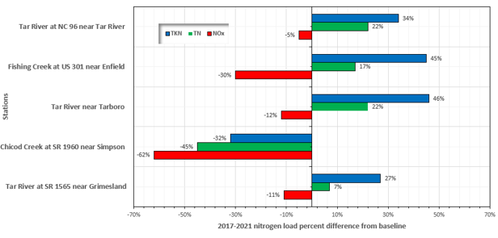
Review of Upstream to Downstream % Change in N Load – Tar-Pamlico
Notes:
This slide compares N species Loads at major sites, baseline period to late 20-teens
Tar-Pam dischargers were already achieving reductions during baseline period, so you don’t see big NOx reduction. HOWEVER, TKN showed the largest percentage increases in the upper, more urban Neuse basin, decreasing its proportion traveling downstream. A similar, weaker trend appears in the Tar TKN trends.
Watershed modeling conducted by Strickling and Obenour (2018) found for the period of 1994-2012 that point source N load decreased in the Neuse by 61%, while it showed essentially no change in the Tar-Pamlico basin, where dischargers had already largely achieved much of their reductions by 1994.
Note that Chicod Cr (bottom circle) – huge reductions across the board – had its own TMDL and AFO regs come into effect after baseline, and as you can see this was a huge success
Note Fishing Cr (top circle) – looks boring and unremarkable – it is ORW, means “outstanding Resource water”, a sort of “reference watershed”, undeveloped, may have some ag, lots of regs to protect from development, results may be significant as an indicator of larger-scale drivers such as atmos N decrease and increasing rainfall-driven TKN

Slide 10
Nitrogen Reduction for Average Flow Condition – for Nottoway River, VA (Relative to 1981-1985)

Slide 11
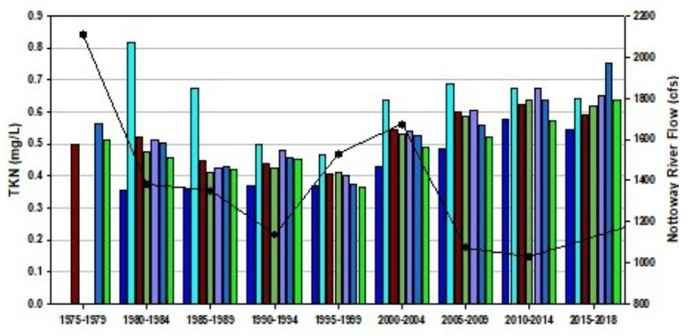
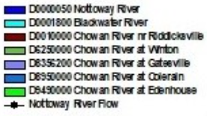
Chowan R and Tributary Stations 5yr Average TKN Concentrations, 1975 to 2018
Notes:
Showing increasing TKN in nearby watershed

Slide 12
Review of Supporting Research
Department of Environmental Quality

Slide 13
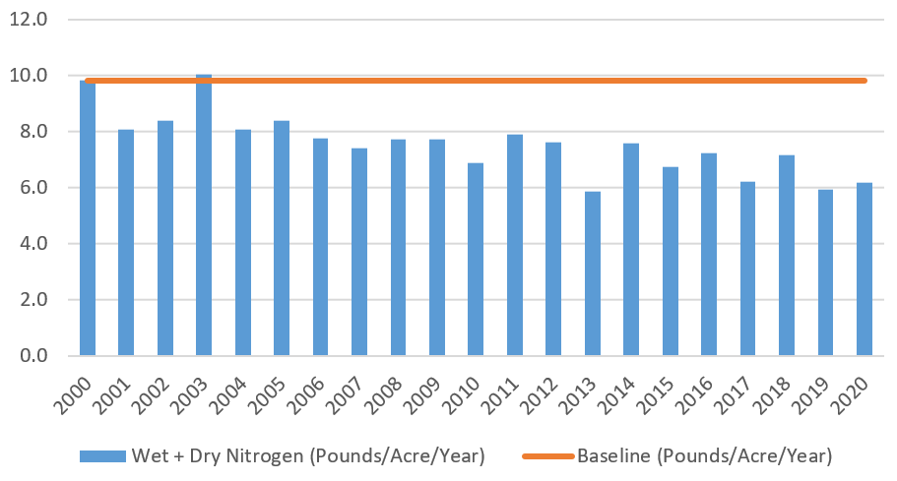
Atmospheric Inorganic Nitrogen Deposition, Beaufort CASTNET Station #142, 2000 to 2020
Notes:
This is all inorganic (nitrate, nitrite, ammonia) – going down by 20 to 30%. This does include ammonia, which we’ve seen from some references may be increasing in contribution from animal ag sources. In contrast, NOX has significant decrease from AQ regulations. Will need to tease apart nitrogen species to see what’s going on.
Do we need to redistribute loading going to uncontrollable land/water covers to other land covers? Or maybe not because AQ regs are reducing atmospheric deposition.

Slide 14
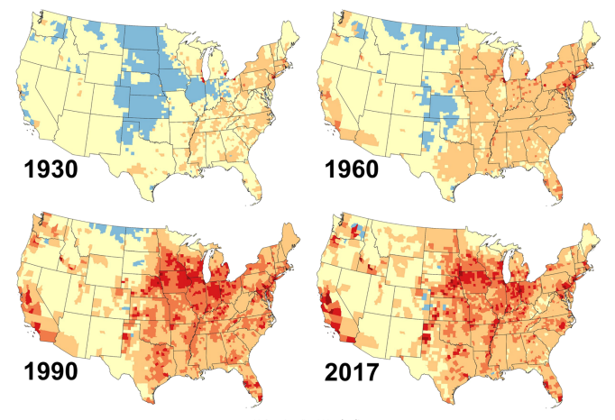
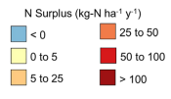
County-Scale Long-Term (1930-2017) Nitrogen “Surplus”
(From Byrnes et al, 2020, Global Biogeochemical Cycles)
Notes:
Long-term N dynamics - County-scale N-surplus: difference between N inputs (atmospheric, fertilizer, manure, bio N fixation, human waste) and productive N outputs (crop and pastureland uptake). Important to note this has been going on over decades, may be “re-entering” watershed & estuary from groundwater, which will take some years to “unwind” after reducing N sources.
In particular for NE/Central-Eastern NC: moderate long-term contributions from fertilizer, atmospheric deposition, light contributions from human and animal waste, moderate-but-increasing biological N fixation, but increasing crop productivity.
Decades of “surplus N” doesn’t just exit the watershed, other studies suggest considerable contributions of N from GW, but this is something we need to understand in more detail and more quantitatively. In any case, N “stored” in GW acts as a lag on actions we do on the surface to reduce N
From: (Byrnes et al, 2020) Byrnes, DK, Van Meter, KJ, Basu, NB. 2020. Long‐Term Shifts in U.S. Nitrogen Sources and Sinks Revealed by the New TREND‐Nitrogen Data Set (1930–2017). Global Biogeochemical Cycles.

Slide 15
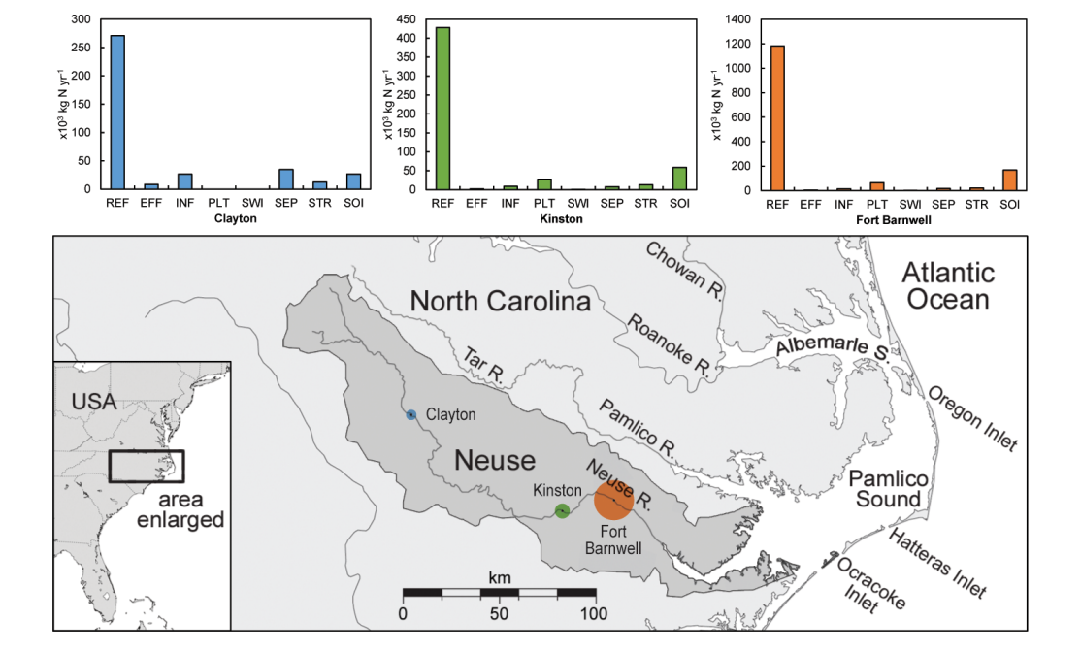
Annual Mass Flux of DON in Neuse Basin
Notes:
We’ve seen that TKN (or Organic N) is an increasing problem in the watershed, but where is it coming from?
Osburn and others created an approach (“FluorMod”) for fingerprinting DON from various source types and used that to examine stream samples taken from around the Neuse basin to quantify sources. This analysis was applied to a snapshot of stream samples taken from across the basin of a “snapshot” from Aug 2011 through May 2013. Source types characterized included: a Reference stream, Soil leachate, WWTP influent, WWTP effluent, Street runoff, Septic outflow, Swine lagoons, and Poultry leachate.
This graphic shows the overall breakdown of the source types going from top to bottom in the basin: At all points, the “Reference” source type (background forest) generally dominates all other source types in total annual mass flux. Urban sources are stronger higher in the basin and shift to ag sources further down in the basin. By the time you get to the estuary, 70% of DON is background/reference, 30% is NPS, most urban is diluted out and the larger NPS signal is poultry and soil. Practically no swine contribution notable at the estuary.
Graphic from: Christopher L. Osburn,*,† Lauren T. Handsel,†,§ Benjamin L. Peierls,‡ and Hans W. Paerl. 2016. Predicting Sources of Dissolved Organic Nitrogen to an Estuary from an Agro-Urban Coastal Watershed. Environmental Science and Technology 50, 8473-8484.

Slide 16
Comparison of DON sources
Contentnea Creek
Crabtree Creek
Large influence of wetland, soil
Large influence of street runoff, effluent
Notes:
From Osburne draft presentation for NCWRA

Slide 17
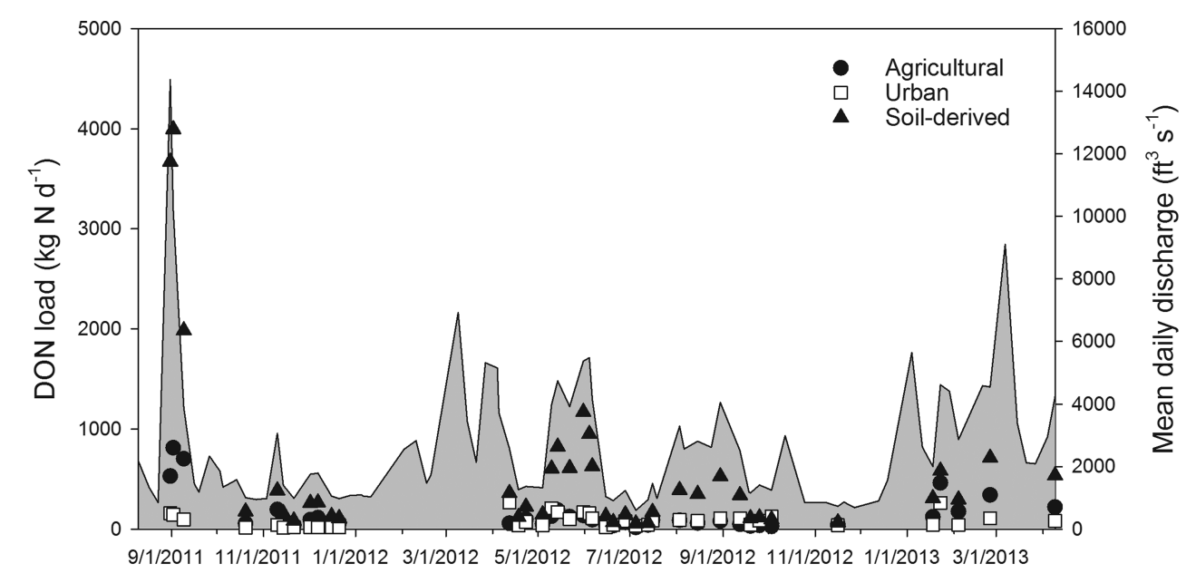
Rainfall Variability in DON Source Loads
Notes:
(From Osburn et al, 2016)
This graphic shows the analysis done comparing discharge against grouped sources. Swine & poultry. Septic, Influent, Effluent, and Street washoff.
Here you can see natural sources dominate during highest flows, followed by agricultural sources. Urban sources stick to a narrow, low range indicating little response to discharge. This supports other studies showing that N may be mobilized more during high precip events.
Re: Soil
o Authors note that humification reaction “quenches protein and microbial fluorescence signals specific to the animal waste sources” and could transform swine or poultry signal into soil. Needs further research.
o Soil is “potentially an anthropogenically influenced source important for increasing N at estuary”. Possible urban, agricultural and forestry sources hypothesized.
§ Good place to make the observation that in DWR trends, TKN increased greatly %wise from baseline from (urban in Neuse) top of the basin down
- Significant qualifiers (from author)
o Higher temporal resolution needed; monthly/bimonthly samples likely missing a lot
o Wetland DOM fluxes from extreme events & land use change possible important DON source

Slide 18
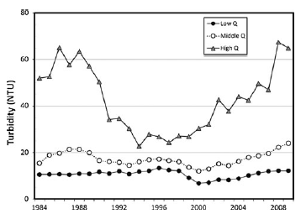
Turbidity, Neuse R at Clayton – Low, Medium, High Discharge
Notes:
Lebo et al, 2012
Other ideas of where the TKN is coming from, potentially associated with turbidity:
Decreases of NOx highest just below Triangle, Nitrate has reduced: low flows 43%, medium flows 25%, high flows 8%
But increases of TKN below triangle esp high flows, concurrent w/ increased tropical storm activity, TKN increases for middle flows, high flows
TKN went up below clayton, same for Trent R
Turbidity may explain TKN, as particle-bound N, found increases in turbidity roughly correlated w/TKN increase at high flows below Raleigh
Found 50% flow-adjusted decrease from PS below Raleigh
TSS/turb increase, likely cause of TKN increase
High flow events may also lead to increased nitrate from particle-bound N

Slide 19
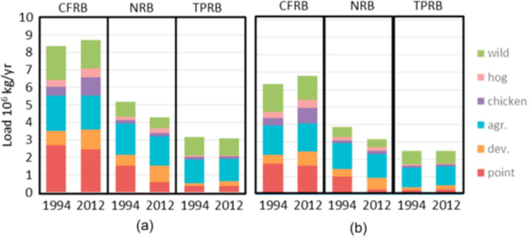
Source-Specific Loads for Cape Fear, Neuse, and Tar-Pamlico Basins, 1994 vs 2012
(at source)
(bottom of basin)
Notes:
(From Strickling and Obenour)
Model “hybrid” formulation similar to USGS SPARROW, but considering inter-annual variability related to precipitation and land-use change. It also used Bayesian inference for rate estimation and uncertainty quantification.
From rest of study – restates what we’re seeing elsewhere:
Generally PS loads decrease over time
no appreciable change to stream N loading from agriculture landuses between 1994 and 2012 in either basin (no change in crop area, but this is in contrast to all the nutrient BMPs going on), greater unit-area loading rates from the mostly agricultural lower-basin watersheds
why do these results differ from required Ag reporting?
edge-of-field N loss calcs differ from stream loading and watershed loading estimates possibly due to SW-GW link, most ag applied N is either taken up by plants or lost to shallow GW, changes in fert application may take some time to show up in SW due to GW lag
increases in those loading rates in lower basin watersheds over the study period, perhaps due at least in part to a greater impact from increased precipitation in the coastal part of the basins
precipitation may have greater influence on unit-area N export rates for agricultural than for developed lands
Ag sources dominate during high precip years, in 95th percentile year for precip, ag TN export is 2.1 and 2.3 x wildland and dev (respectively)
Urban landuse dominates during low precip years, 5th percentile year for precip, ag approx. equal to wild, dev is 1.8 x ag/wild
Urban areas may export most N during small events
- analyzed loading from hog and chicken waste separately, and for the same time period estimated a 35% increase in hog N export in the Neuse (from 9% to 12% of total N loading) compared to a 14% decrease in the Tar-Pamlico, with no meaningful change in chicken N export in either basin

Slide 20
History of Tropical Cyclones in North Atlantic Ocean derived from National Hurricane Center, Miami FL
(from Paerl et al, 2020, Biogeochemistry)
Notes:
So what might be driving increased TKN?
Appears we’ve “entered new climatic regime
characterized by more frequent extreme precipitation events,
with major ramifications for hydrology, cycling of C, N and P, water quality and habitat conditions in estuarine and coastal waters”.

Slide 21
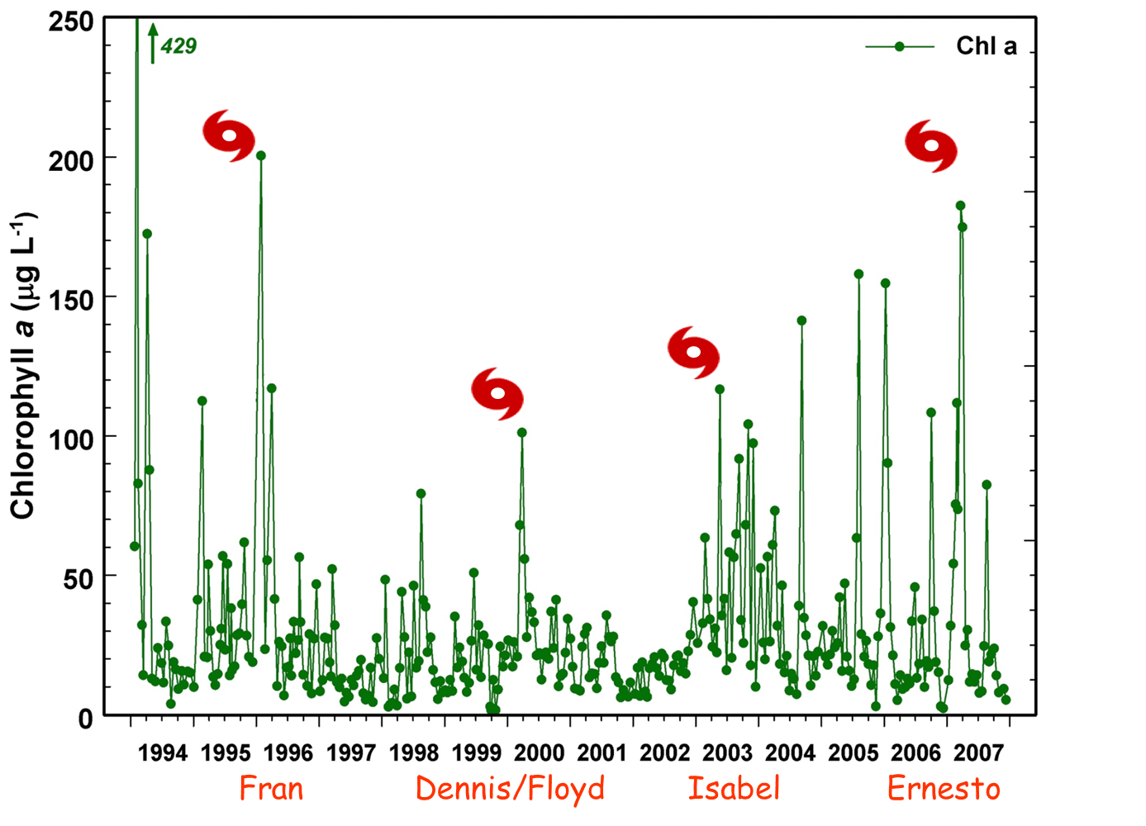
Major tropical cyclones and large rainfall events: impacts on phytoplankton biomass (Chl a) responses in the Neuse R. Estuary, NC
Notes:
Increased storm activity may be driving algal bloom events:
NC - 36 tropical cyclones last 2 decades
- 6 of 7 wettest storms in last 120 years
- Unprecedented high precipitation events
- 3 floods of historical significance
Account for > 50% annual loads of C, N and P
- Estuary either “processor” or “pipeline”, depending on conditions
- During storms, C sources enhanced by wetlands release
- Event-scale discharge plays important or predominant role in loadings
***Riparian wetlands are a major source of OM in response to storm-related flooding
Latest research we’ve found: Norway study, in wake of reduced NOx and SO4 via rain, watersheds are exporting more DOC, even more DON, somewhat more TP, receiving waters changing from TN:TP limited to TN-limited, which favors cyanobacteria, on top of greater precip and warmer temps is driving algal blooms

Slide 22
Implications and Strategy Adaptations
Department of Environmental Quality

Slide 23
Review of Key Findings
Estuaries remain impaired
50% increase in Neuse pop’n, 5% in Tar-Pam, comparable increase in developed area
Neuse WW dischargers reduced TN by 65%; Tar-Pam 30-40%
Cropland agriculture maintains 45-55% N-loss reduction, decrease in cropland area
Little change in animal agriculture #s
Decrease in NOx, increase in TKN, TN balance in long term slightly increased from baseline
Department of Environmental Quality
Notes:
Status of estuaries still impaired, finding of increased DON, differences between Neuse & Tar-Pam yet similar implementation

Slide 24
Key Research Findings (con’t)
Increasing frequency of tropical storms over time
Storms significant driver of TKN increases
Watershed sources:
Developed lands – Nitrogen doubled 1994-2012
Cropland – no meaningful decrease 1994-2012
Wet years Ag loading 2x urban; reversed dry years
Point Sources – initial estuary load decrease
Strong poultry source signal low in basin, weak swine signal
Reduction in acid rain + increased precip may be driving biogeochem changes
Department of Environmental Quality
Notes:
Status of estuaries still impaired, finding of increased DON, differences between Neuse & Tar-Pam yet similar implementation
Estuary (Paerl et al.)
Post 90’s shift more frequent, wetter storms & tropical cyclones
Driving increased DOC from wetlands
Driving DON + other nutrients from watershed to & through estuaries
Storms significant driver of TKN increases
Estuary processor vs pipeline = Estuary blooms vs Sound Blooms
Organic Nitrogen (Osburn et al.)
Single time period (2011-2013)
DON tracks land use – upper basin urban; lower basin poultry
Virtually no swine signal, cattle not tested
Poultry DON at Fort Barnwell
Organic Nitrogen (cont…)
DWR Analysis: significant TKN % increase vs baseline
Higher increase in developed watersheds; Less increase in rural areas
Most basin areas appear to contribute to TKN Increase
Paerl et al finding: Bigger storms flushing nutrients from basin
Strickling & Obenour: Ag more vulnerable to wet yr loading increases
Poultry appears to make sizeable TKN contribution in lower basin

Slide 25
Potential Adaptive Management Actions
Reassess estuary needs
Reallocate load reduction responsibilities
Include more sources & sectors
Expand set of management tools
Department of Environmental Quality
Notes:
Reassess Estuary Needs
- Estuary response modeling now 20-30 years old
- Climatic shifts affecting estuary dynamics
- Chl-a and possible future clarity standard
- better understanding of algal community dynamics relative to abiotic factors, comm interactions
- Substantial time and resources would be needed
- Counter argument: remodel after reductions goals achieved
Reallocate Load Reduction Responsibilities
- Fuller allocation of load reduction needs
- determine groundwater contribution
- Forest, existing developed lands, atmospheric deposition loads distributed to other sectors
- wetlands as potentially especially large DON sources
breaks fair, proportionate, standard
Rainfall pattern changes may make it hard to stay ahead
Include more sources & sectors in Rules
- post-construction stormwater below current applicability thresholds
- better construction stormwater
- streambed stability (hydrologic impacts)
- retrofit existing development
- smaller WW dischargers
- onsite wastewater
- small farms, hobby farms, horse farms
- animal agriculture
Expand set of management tools
- track ag changes related to subwatershed, not just county (need better data)
- N/P credit, $ support for more types of ag BMPs
- buyout programs
- application of animal manure, phos agronomic rates
- more data on types of new development activity, SCMs commonly used, SCM limitations
- Tiered intensity of stormwater practices for different project densities
- SCM-based nutrient banks (urban retrofits w/a market driver)
- credit for restoration focused “nature based” management actions
- Allow practices w/ WQ benefit even if credit not quantified

Slide 26
Further Investigation Needed
Whence increased TKN (or is it DON?)
TN sources for high flows vs low flows, management ideas
GW contributions and how it modifies recovery timeline
Changes in atmospheric N deposition and/or rainfall patterns → regional changes in watershed biogeochem?

Slide 27
Neuse and Tar-Pamlico NMS Retrospective Report
Out of public comment now through June 16th
Submit comments to john.huisman@deq.nc.gov
Final Report will be posted to DWR website
Distributed to watershed stakeholders later this summer
Department of Environmental Quality
Notes:
Status of estuaries still impaired, finding of increased DON, differences between Neuse & Tar-Pam yet similar implementation

Slide 28
Special Thanks
Research Community
Division of Soil & Water Conservation
Division of Mitigation Services
Division of Air Quality
DHHS Onsite Wastewater Protection Branch
Division of Water Resources:
Modeling & Assessment Branch
Basin Planning Branch
Water Sciences Section
Department of Environmental Quality
Notes:
Status of estuaries still impaired, finding of increased DON, differences between Neuse & Tar-Pam yet similar implementation

Slide 29
Questions?
Department of Environmental Quality

Slide 30
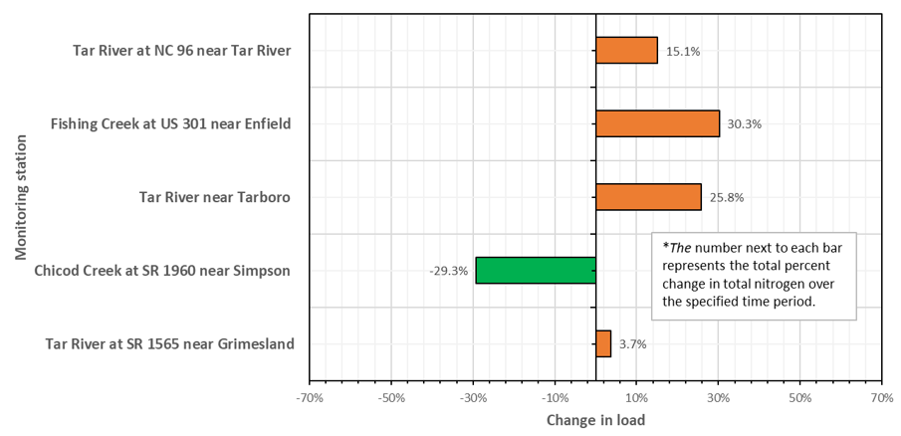
Tar-Pamlico Basin – Change in Total Nitrogen Loads, Comparing 1991-1995 to 2017-2021
Notes:
This compares TN Baseline period to late 20-teens at 5 stations (upstream – top, downstream – bottom)
Generally all but Chicod Cr. increase TN relative to baseline. Chicod Cr. is tributary near bottom of basin.

Slide 31
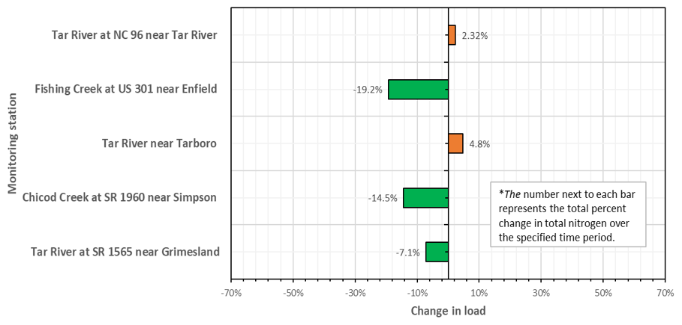
Tar-Pamlico Basin – Change in Total Phosphorus Loads, Comparing 1991-1995 to 2017-2021
Notes:
This compares TN Baseline period to late 20-teens at 5 stations (upstream – top, downstream – bottom)
Most show reduction in TP compared to baseline, does not reflect weird mid-decade increase in TP

