Slide 1
Neuse and Tar-Pamlico Nutrient Management Strategy 20-Year Retrospective
Implementation, Estuarine Response, and Adaptive Issues
Department of Environmental Quality
John Huisman and Trish D’Arconte, QEP
Nutrient Scientific Advisory Board | June 2023
Notes:
Outline & Organization of Presentation today for NSAB
Brief Intro
Estuary Status
Rule Implementation and Watershed Changes
Review of DEQ WQ Data
Review of Supporting Research
Implications and Strategy Adaptations

Slide 2
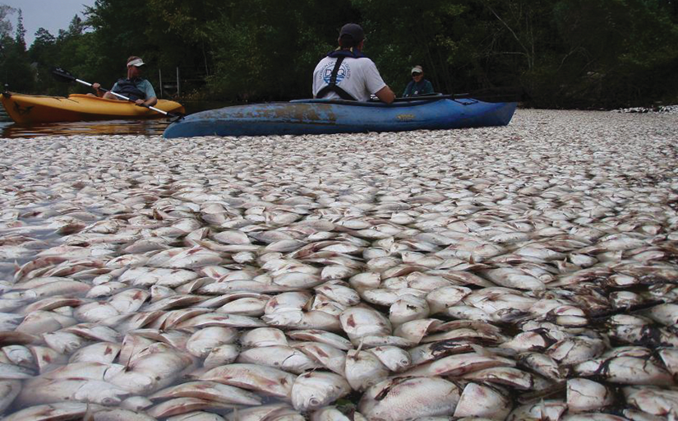
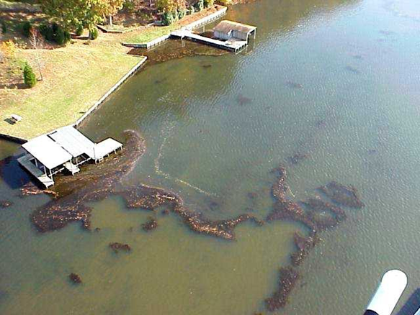
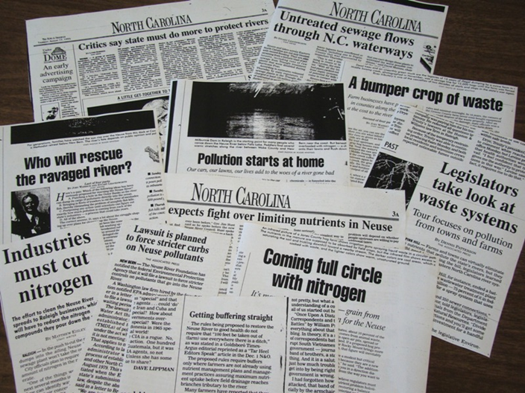
Neuse & Tar-Pamlico Estuarine History and Context
Department of Environmental Quality

Slide 3
Neuse and Tar-Pamlico Estuary Status
Department of Environmental Quality

Slide 4
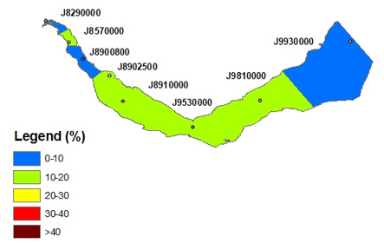
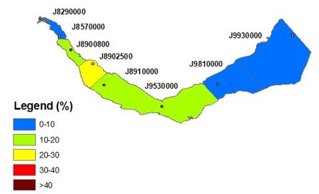
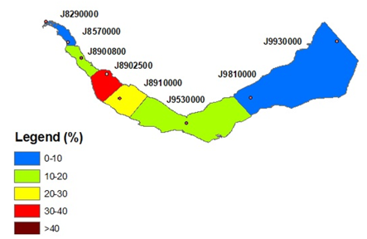
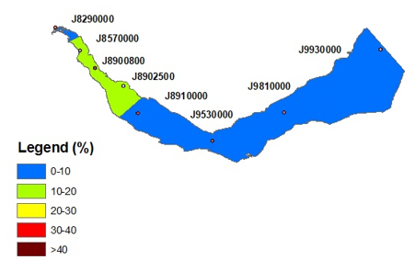
Neuse Estuarine Chlorophyll a Percent of Samples Exceeding Standard (40µg/L)
2001 to 2005
2010 to 2015
2005 to 2010
2015 to 2020

Slide 5
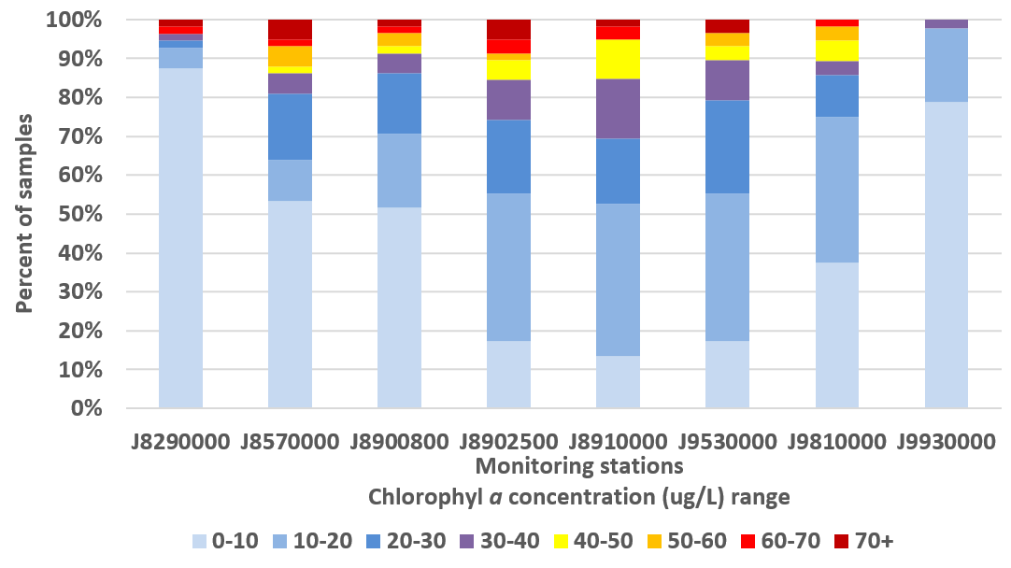
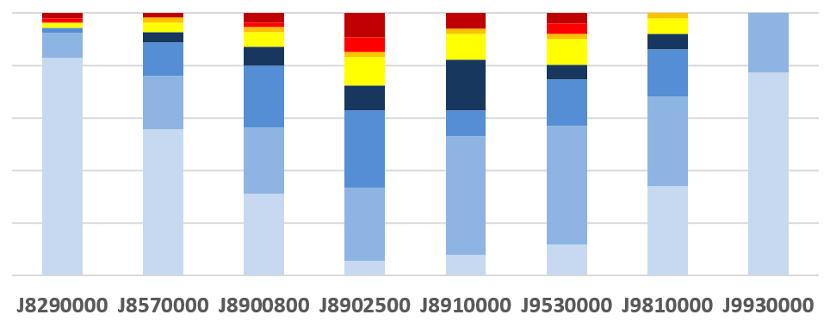
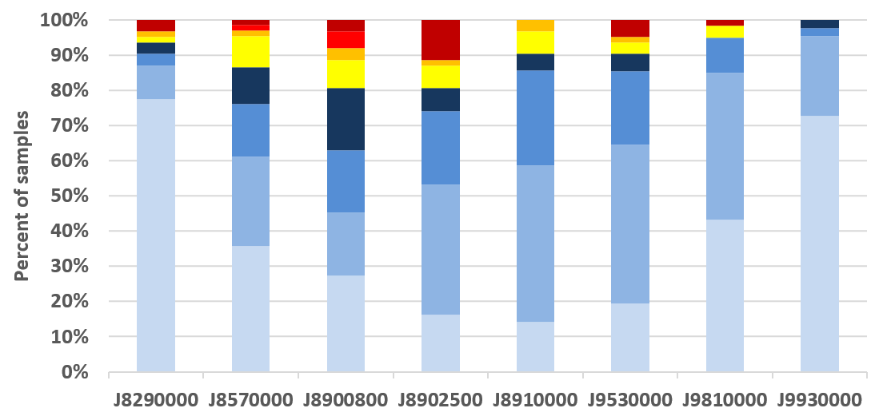
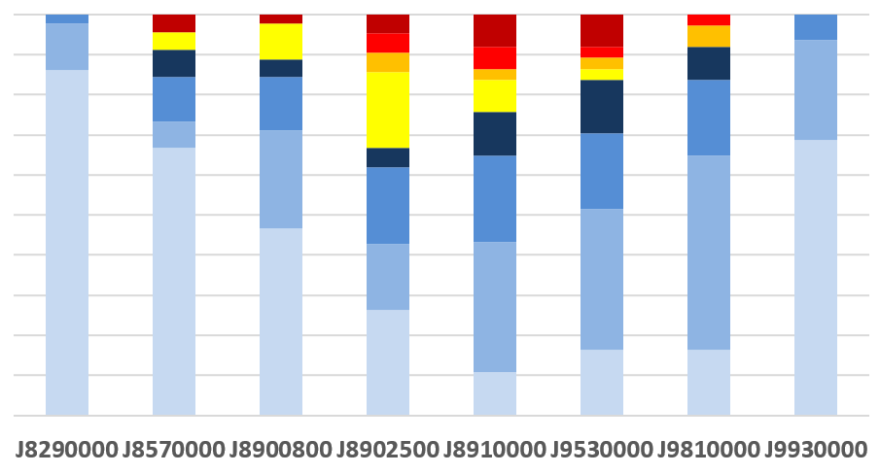
Neuse Estuarine Chlorophyll a Concentration Ranges
2001- 2005
2010- 2015
2005- 2010
2015- 2020

Slide 6
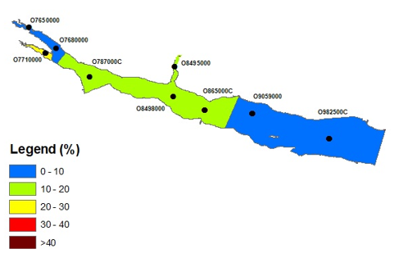
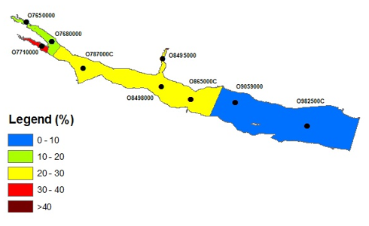
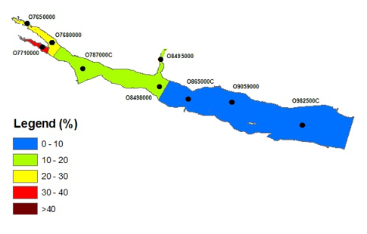
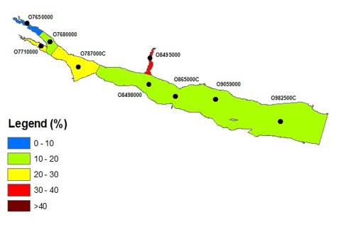
Tar-Pamlico Estuarine Chlorophyll a Percent of Samples Exceeding Standard (40µg/L)
2001 to 2005
2010 to 2015
2005 to 2010
2015 to 2020

Slide 7
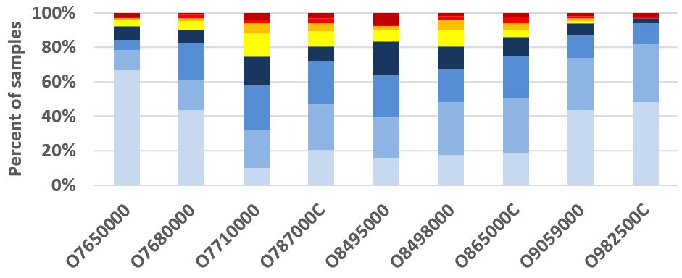
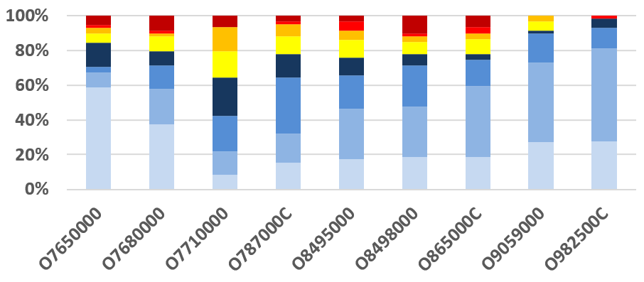
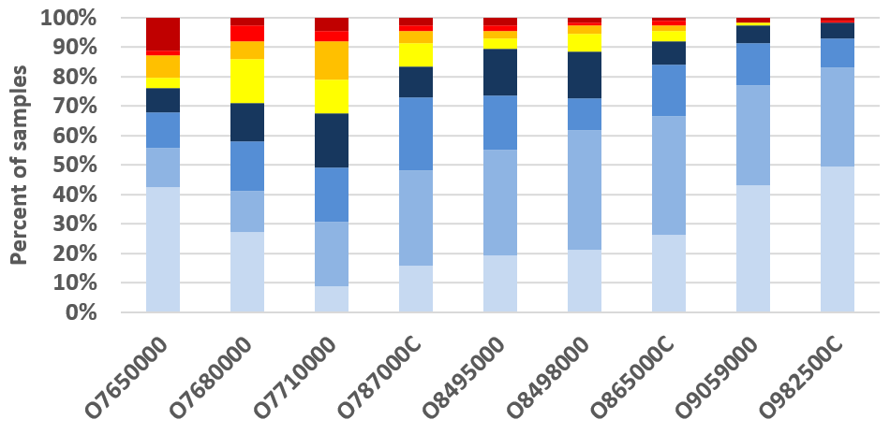
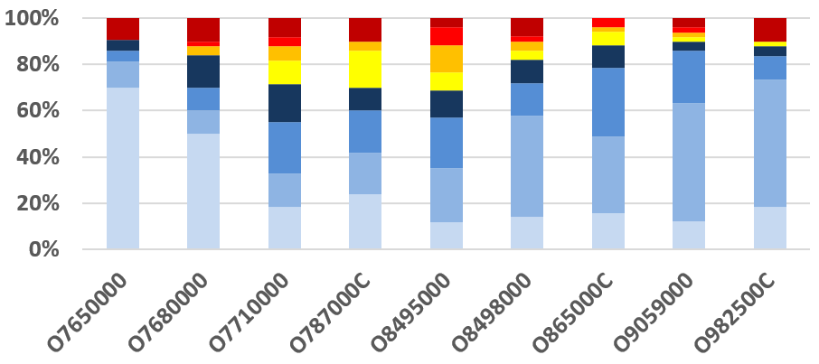
Tar-Pamlico Estuarine Chlorophyll a Concentration Ranges
2010- 2015
2001- 2005
2015- 2020
2005- 2010

Slide 8
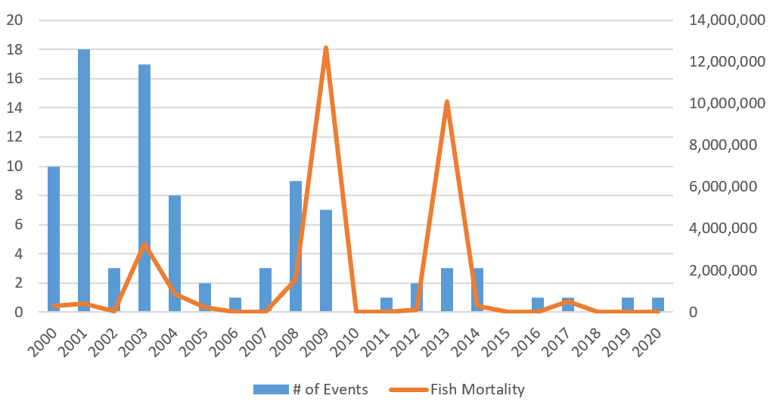
Neuse Estuary Fish Kill Events & Total Mortality

Slide 9
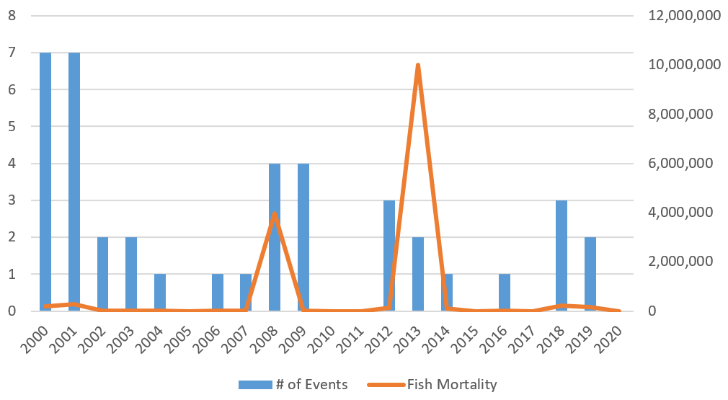
Tar-Pamlico Estuary Fish Kill Events & Total Mortality

Slide 10
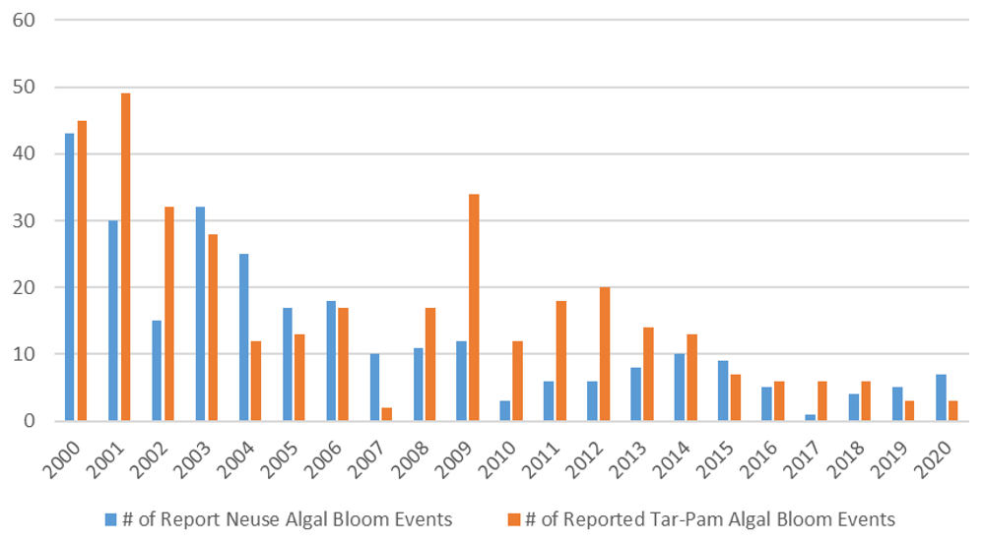
Neuse & Tar-Pamlico Estuaries - Algal Bloom Events

Slide 11
Rule Implementation and Watershed Changes
Department of Environmental Quality

Slide 12
Neuse & Tar-Pamlico Nutrient Management Strategies
Strategy Goals
Reduce nutrient loading; address chl-a impairment
30% TN Load Reduction (Neuse & Tar-Pamlico)
No Increase in TP Load (Tar-Pamlico)
Rules adopted 1998 (Neuse), 2001 (Tar-Pamlico)
Reductions from Point & Nonpoint Sources
Wastewater Discharges
Crop Agriculture
New Development Stormwater
Riparian Buffer Protection
Nutrient Credit Offsets
Department of Environmental Quality

Slide 13
New Development Stormwater
Stormwater plans required; developers meet export rate targets
15 LGs in Neuse / 11 LGs in Tar-Pam (currently)
Added 15 Neuse LG and 1 Tar-Pam LG in 2020 rule readoption
24% BUA or greater = implement SCM onsite
Nutrient offset credit option; ensure riparian buffers protected
Department of Environmental Quality

Slide 14
Population in 2000, 2010, 2020

Slide 15
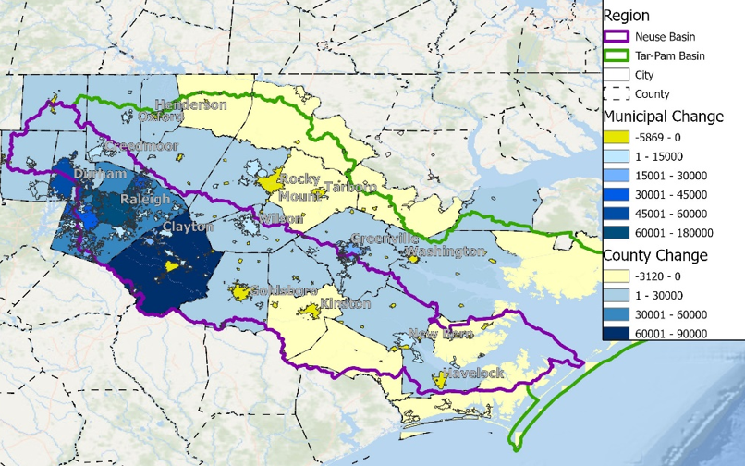
Population Change 2000 to 2020

Slide 16
Neuse Basin – Changes in Land Covers 2001 to 2019

Slide 17
Tar-Pamlico Basin – Changes in Land Covers 2001 to 2019

Slide 18
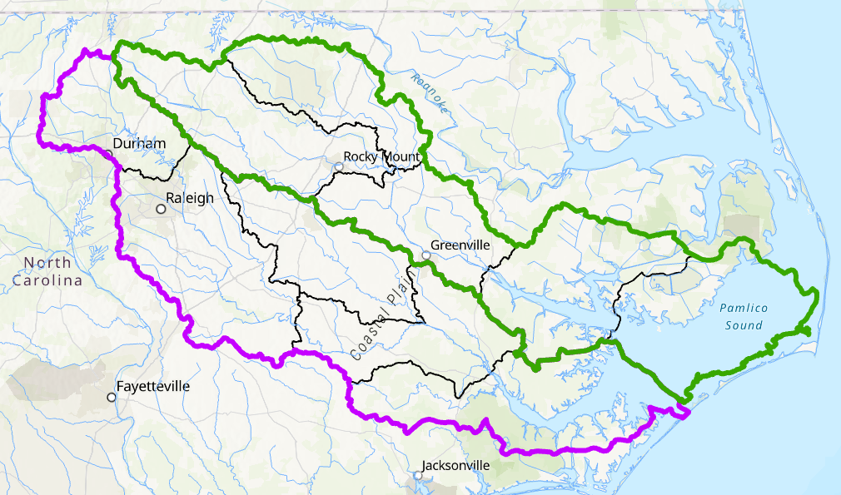
Nutrient Offsets Sold by Subwatershed (2001-2022)
825 lbs N
91 lbs P
118,235 lbs N
19,971 lbs P
68,168 lbs N
5,718 lbs P
123,557 lbs N
9,642 lbs P
6,194 lbs N
349 lbs P
2,513,450 lbs N
195,607 lbs N
808,833 lbs N
63,706 lbs N

Slide 19
Riparian Buffer Protection Rules
50ft protected zone along perennial, intermittent streams & waterbodies
Zone 1, 30ft forested
Zone 2, 20ft any vegetation
Buffers included in LG stormwater plan review
Buffer use table includes allowable activities
Allowable, Allowable w/ mitigation, variances

Slide 20
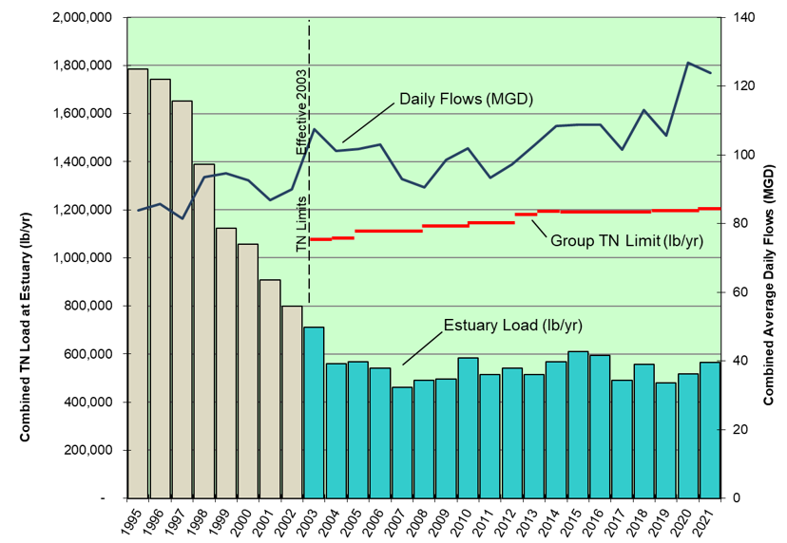
Neuse Compliance Assoc. Annual Nitrogen Loads 1995 - 2021

Slide 21
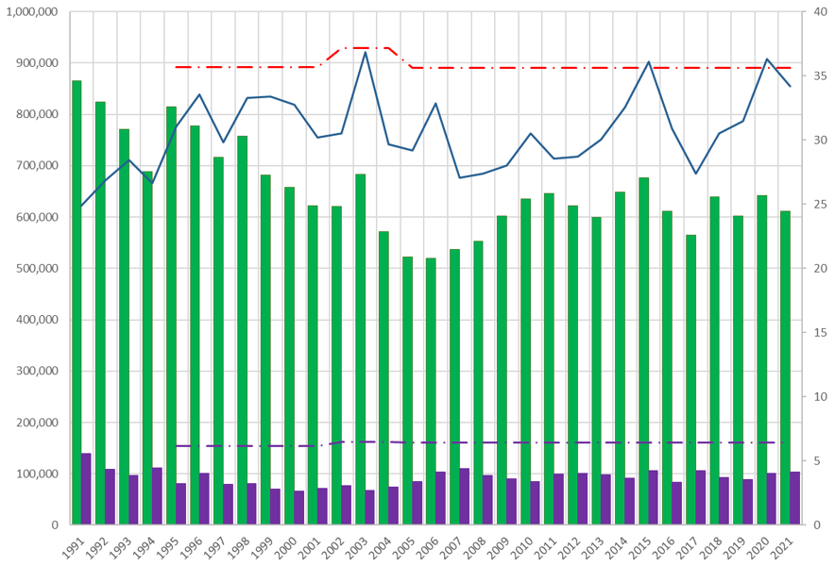
Tar-Pamlico Basin Assoc. Annual Nitrogen and Phosphorus Loads (1991-2021)

Slide 22
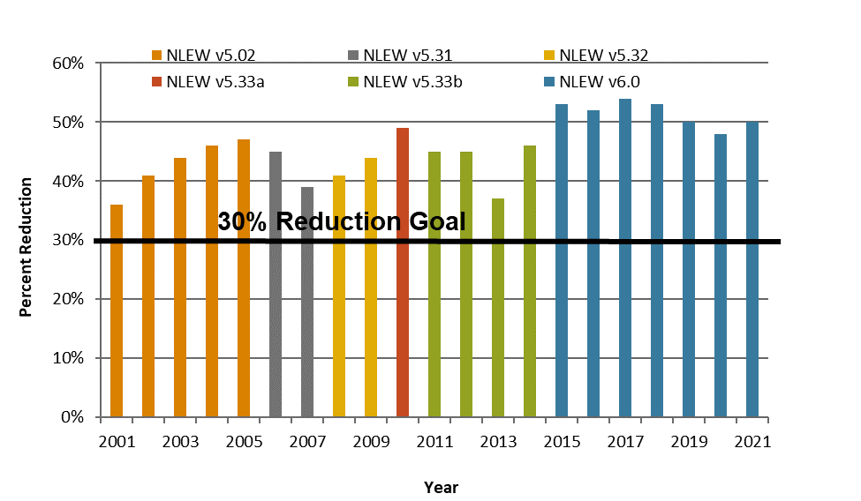
Estimated Nitrogen Loss Reduction from Cropland Agriculture, Neuse Basin (2001-2021)

Slide 23
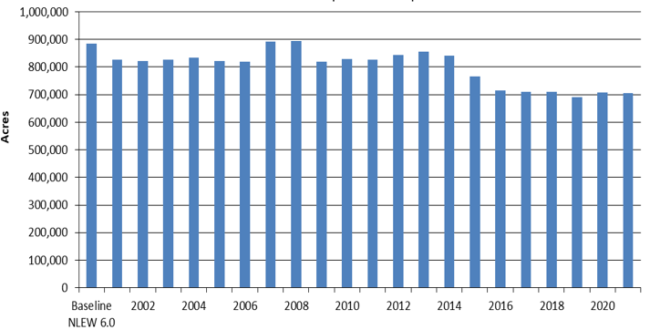
Total Reportable Cropland Acres – Neuse Basin, Baseline and 2001 to 2021
20% crop acres reduction

Slide 24
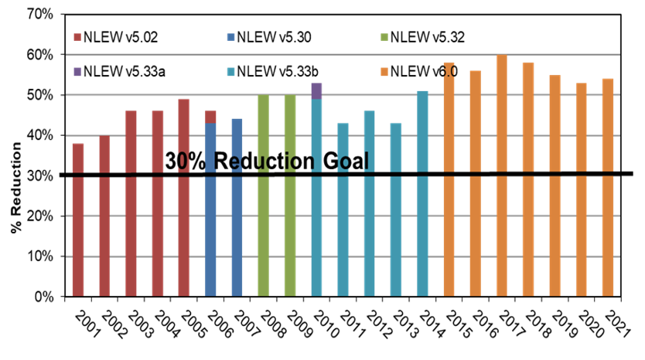
Estimated Nitrogen Loss Reduction from Cropland Agriculture, Tar-Pamlico Basin (2001-2021)

Slide 25
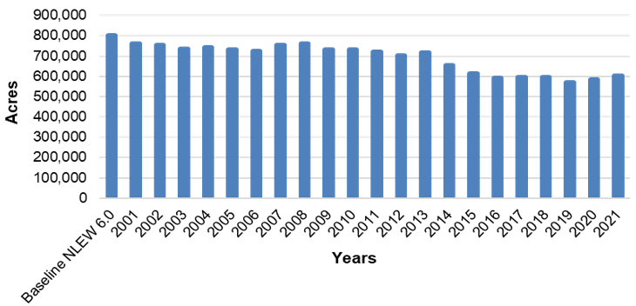
Total Reportable Crop Acres in Tar-Pamlico Basin, Baseline and 2001 to 2021
25% crop acres reduction

Slide 26
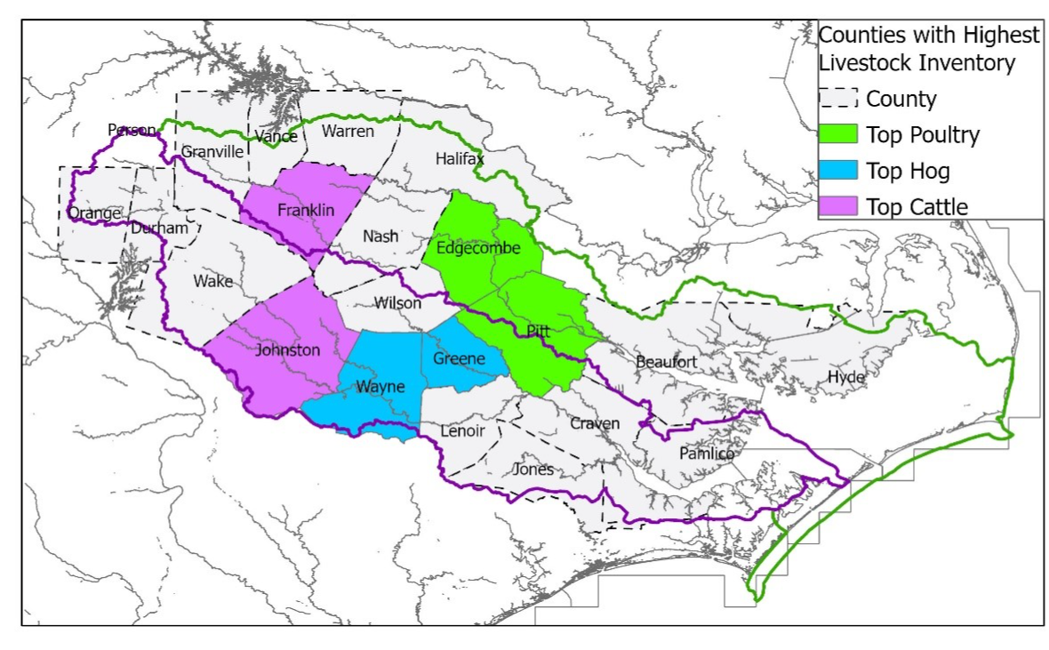
Top Animal Inventories (2017) by County, Neuse and Tar-Pamlico Basins

Slide 27
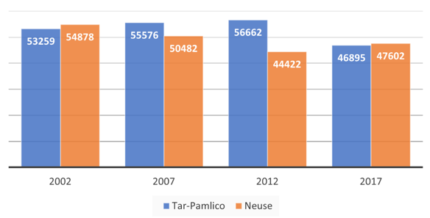
Cattle Inventory, 2002, 2007, 2012, 2017

Slide 28
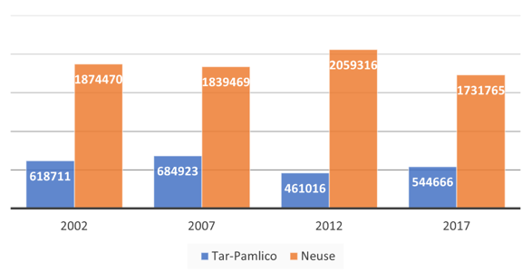
Hog Inventory, 2002, 2007, 2012, 2017

Slide 29
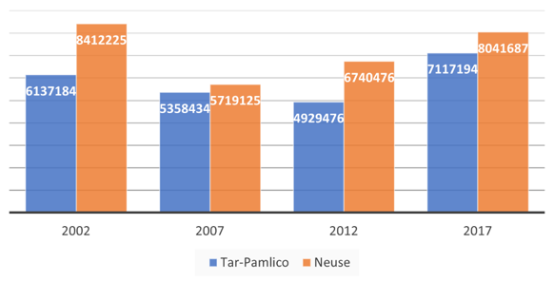
Poultry Layer + Broiler Inventory, 2002, 2007, 2012, 2017

Slide 30
Questions?
Department of Environmental Quality

