Slide 1
IBT Program Overview
Public Meetings for
Proposed Fuquay-Varina IBT
Oct. 14, 20 & 21, 2020
Harold Brady, Division of Water Resources

Slide 2
Outline
I. Interbasin Transfer (IBT) Definition
Statutory Requirements
IBT Process
EMC Decision Considerations

Slide 3
IBT Definition & Purpose
The withdrawal of surface water from one river basin and discharge of all or any part of the water in a river basin different from the origin.
The purpose of the Interbasin Transfer Law is to ensure it is good public policy to move water from one river basin into another.

Slide 4
Statutory Thresholds
§ 143-215.22L Regulation of surface water transfers.
(a) Certificate Required. - No person, without first obtaining a certificate from the Commission, may:
Initiate a transfer of 2,000,000 gallons of water or more per day, calculated as a daily average of a calendar month and not to exceed 3,000,000 gallons per day in any one day, from one river basin to another.
Increase the amount of an existing transfer of water from one river basin to another by twenty-five percent (25%) or more above the average daily amount transferred during the year ending 1 July 1993 if the total transfer including the increase is 2,000,000 gallons or more per day.
Increase an existing transfer of water from one river basin to another above the amount approved by the Commission in a certificate issued under G.S. 162A-7 prior to 1 July 1993.

Slide 5
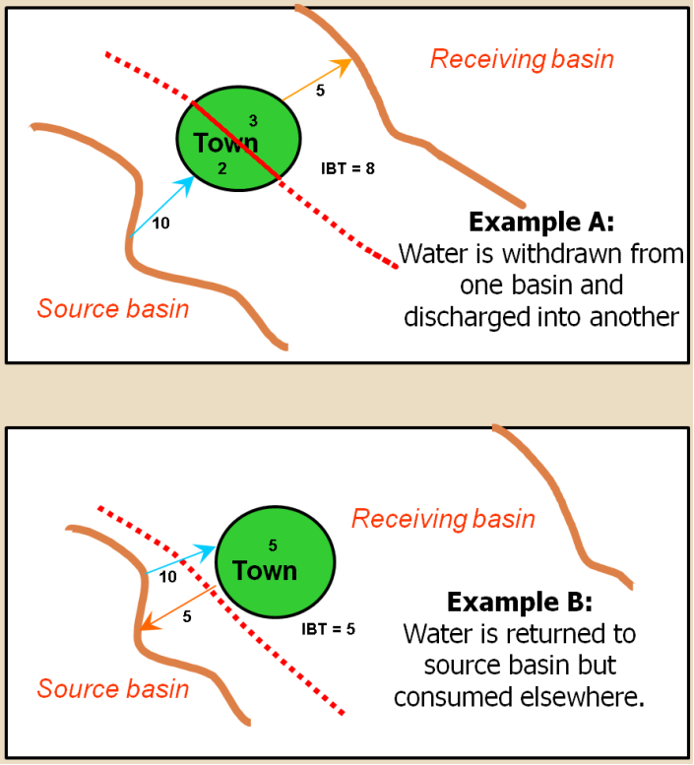
What is an Interbasin Transfer?
Transfer = Withdrawal – Return
Net Transfer, Not Gross
The amount of a transfer is determined by the amount of water moved from the source basin to the receiving basin, less the amount of water returned to the source basin and consumptive use in the source basin.
Notes:
Definition by default makes an issue of consumption (consumption different in IBT than system operators use) Losses like lawn watering, septic tanks, etc.

Slide 6
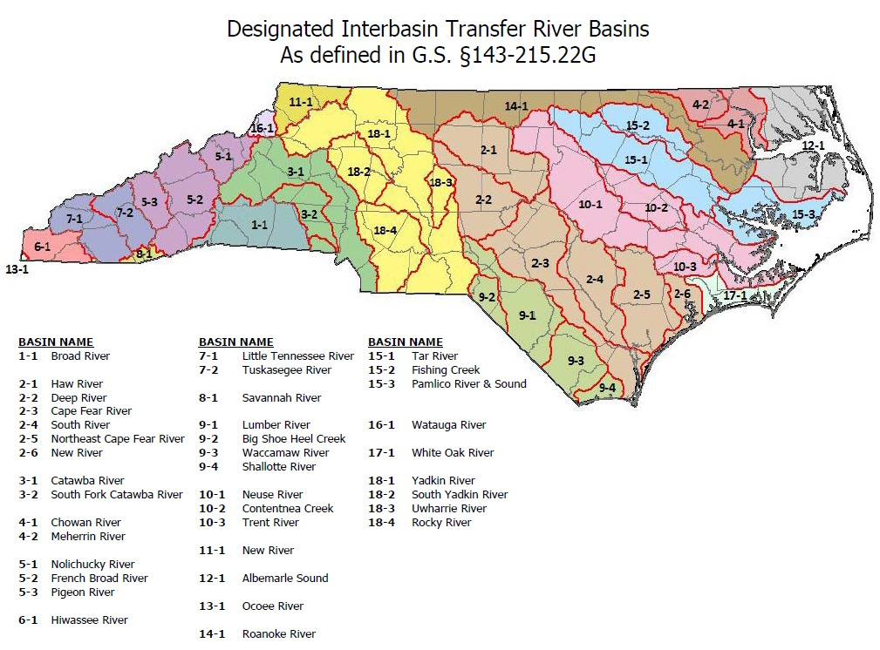

Slide 7
Water Transfers in North Carolina
Over 130 public water systems with surface water transfers
80% are under 1 MGD
Nine IBT Certificates have been issued
Grandfathered allowance for systems that were transferring over 2 MGD prior to July 1993
Handful of water systems transferring between 1-2 MGD

Slide 8
Transfers Regulated by IBT Certificate
 | System/Certificate Holder(s) | Year | Amount | Source Basin(s) | Receiving Basin(s)
1. | Piedmont Triad Regional Water Authority | 1991 | 30.5 MGD | Deep River | Haw River, Yadkin River
2. | Charlotte Water | 2002 | 33 MGD | Catawba | Rocky River
3. | Cities of Concord and Kannapolis | 2007 | 10 MGD/ 10 MGD | Catawba/ Yadkin | Rocky River
4. | Greenville Utilities Commission, the Towns of Farmville and Winterville, and Greene Co. | 2010 | 8.3 MGD/ 4.0 MGD | Tar River | Contentnea Creek/ Neuse River
5. | Brunswick County | 2013 | 17 MGD | Cape Fear | Shallotte and Waccamaw
6. | Towns of Cary and Apex | 2015 | 31.0 MGD/ 2.0 MGD | Haw River | Neuse River/ Cape Fear River
7. | Kerr Lake Regional Water System | 2015 | 10.7 MGD/ 1.7 MGD/ 1.8 MGD | Roanoke | Tar River/ Fishing Creek/ Neuse River
8. | Union County and Town of Wingate | 2017 | 23.0 MGD | Yadkin River | Rocky River
9. | Pender County Utilities and Towns of Burgaw, Topsail Beach, Surf City and Wallace and Utilities, Inc. | 2018 | 14.5 MGD | Cape Fear | South River, New River, Northeast Cape Fear

Slide 9
IBT Process § 143-215.22L
I. Applicant submits Notice of Intent to file a petition.
30 days notice of public meetings
3+ public meetings held
within 90 days of filing NOI
Comments accepted for 30 days after meetings
II. Applicant submits draft environmental document (EIS or EA)
30 days notice of public hearing
Public hearing
Comments accepted for 30 days after hearing
Written response to comments prepared
Adequacy of environmental document determined (DEQ issues ROD)
III. Applicant submits petition to EMC
Comments accepted for 30 days after last hearing;
Written response to comments prepared
Settlement discussions, if requested
EMC issues Draft Determination within 90 days of receiving petition and adequacy of doc determined
Public notice of draft determination and 30-day notice of hearings
2+ public hearings held within 60 days of issuing draft determination
EMC issues final determination

Slide 10
EMC Decision Considerations
The EMC may grant a Petition in whole or in part, or deny it, and may require mitigation measures to minimize detrimental effects.
In making this determination, the EMC is required to specifically consider:

Slide 11
Findings of Fact - §143-215.22L
The EMC shall specifically consider:
The necessity, reasonableness, and proposed uses of water transferred.
Present and reasonably foreseeable detrimental effects on the source basin.
Cumulative effects on the source major river basin of any water transfer or consumptive water use currently authorized or projected in a Local Water Supply Plan.
Present and reasonably foreseeable beneficial and detrimental effects on the receiving basin.
The availability of reasonable alternatives to the proposed transfer.
Use of impoundment storage capacity, if applicable.
Purposes and water storage allocations in a US Army Corps of Engineers multipurpose reservoir.
Whether the service area of the applicant is within both the source and receiving basin.
Any other facts or circumstances reasonably necessary.

Slide 12
Conditions/Limitations on IBT Certificate
Specific conditions required by statute:
Submittal for Division approval
Water Conservation Plan
Drought Management Plan
Compliance and Monitoring Plan
Quarterly Monitoring Reports
Ability to reopen, amend, and modify, if necessary
No selling of transferred water to water systems that are not co-applicants on the Certificate
EMC may impose additional conditions as necessary

Slide 13
Contact Information
Harold Brady
Division of Water Resources
919-707-9005
harold.m.brady@ncdenr.gov
DWR IBT website: https://www.ncwater.org/?page=297

