Slide 1
Department of Environmental Quality
High Rock Lake
Nutrient Management
Wastewater Technical
Advisory Group
December 12, 2022

Slide 2
HRL Informal Stakeholder Process
All Stakeholders
Steering Committee
Technical Advisory Groups
Final Report
September 2022 – December 2023
Six Steering Committee (SC) meetings (more if necessary)
Four All Stakeholder meetings
Five to six Technical Advisory Group (TAG) meetings (more if necessary)
SC submits final report to DWR
DWR considers final report in drafting rules
SC, TAGs, and stakeholders review draft rules and provide feedback
DWR finalizes draft rules considering feedback

Slide 3
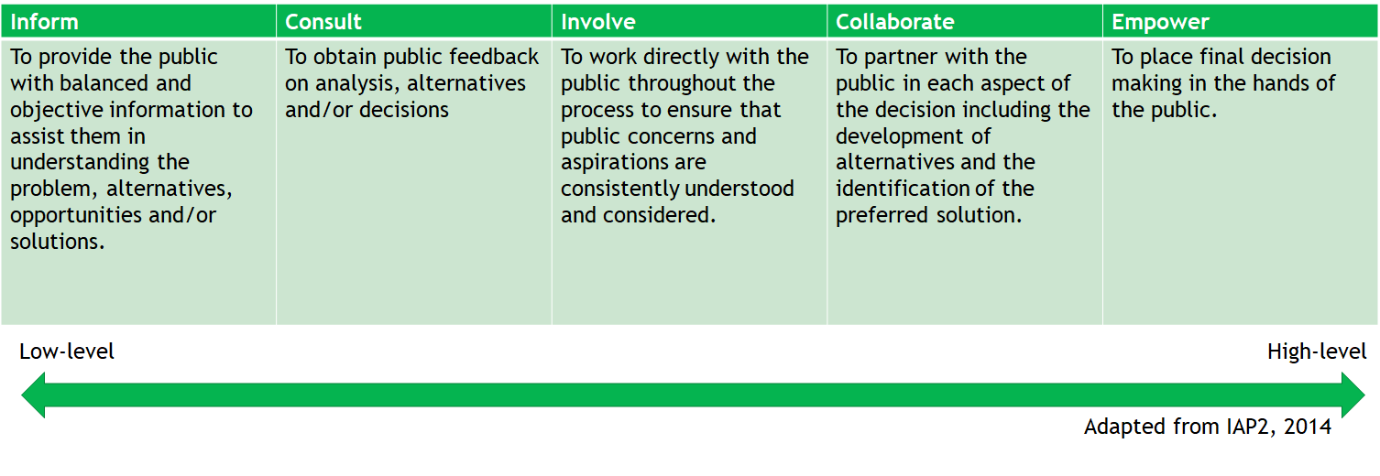
Public Participation

Slide 4
TAG Charge
What specific management improvements has your sector already implemented for nutrient control since 2006?
What further nutrient reduction management steps can you take that would make sense? Consider both examples of more easily attainable and effective opportunities, as well as more long-term or challenging opportunities for your sector.
What initiation and full implementation timeframes would be needed for each type of management step, roughly speaking?
Are there trends or changes on the horizon in your sector that could affect these timeframes?
Barriers/challenges and possible responses:
What are barriers or challenges to these steps? Consider legal barriers, financial barriers, social barriers, equity barriers.
What could be done to address these challenges and increase buy-in and support for these steps?
Do you think forming partnerships with other groups/sectors could lead to implementation opportunities and positive changes? If so, what opportunities can you envision?
Would nitrogen and/or phosphorus be most cost-effective for your sector to manage, reduce, monitor, and report? Why, and what are the limitations of each? Can you give rough proportions and scales for the kinds of reductions you think could be achieved?

Slide 5
Load Reduction Needs
35ug/L seasonal geomean (1 year in 3 allowable exceedance)
37% phosphorus reduction if nitrogen is held at baseline
50% nitrogen reduction if phosphorus is held at baseline
EPA approved HRL site-specific chlorophyll-a standard on 12/7/2022
Modelers have proposed 2006 as baseline
A combination of N and P may allow lower % reductions
% reductions are for delivered loads
Permit limits are on discharged loads

Slide 6
Derivation of Nutrient Allocations
Borrowed from Mike Templeton, August 2020
Limits are key part of strategy and are based on allocations
The entire WLA is divided among the existing discharges – no reserve for growth
Goal is “fair and equitable” distribution – like limits for like facilities, i.e., based on same equivalent concentrations at EOP
Equivalent concentrations can vary by facility type and size: e.g., POTWs, Industrial WWTPs, 100% Domestic WWTPs
All nutrient-bearing discharges are assigned allocations; only those above X MGD receive limits
Threshold has ranged from 0.1 to 0.5 MGD

Slide 7
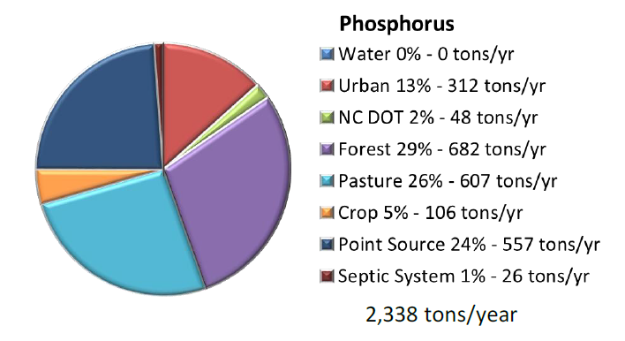
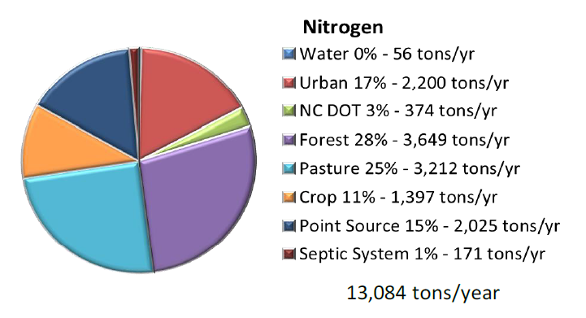
Annual Nutrient Loading
Source: Tetra Tech 2012
Department of Environmental Quality

Slide 8
Nutrient Load “Reductions”
Source: Tetra Tech 2012
Department of Environmental Quality

Slide 9
Nutrient Sources
Wastewater
POTW, WWTP
Industrial discharge
On-site wastewater (septic systems)
Development
Household fertilizers, pet waste
Construction site sediment
Post-construction impervious surfaces
Roadways
Agriculture
Animal waste
Applied fertilizers
Streambanks
Forests
Atmosphere
Lake sediments
“Point Sources”
Controllable
“Nonpoint Sources”
Uncontrollable
Department of Environmental Quality

Slide 10
Discharge by Facility
2019-2022

Slide 11
Annual P Loading by Facility

Slide 12
Additional Industrial Discharges
Average Annual Flow in MGD
Facility Name | 1994 | 2006 Baseline | 2019
Buck Steam Station | 71.9 | 270.9 | 0.60
PPG Industries Fiber Glass Products Inc. | 0.37 | 0.34 | 0.45
Linwood Yard | 0.08 | 0.11 | 0.22
Patterson Mill | 0.05 | 0.14 | 0.21
Tyson Farms Inc. | 0.22 | 0.15 | 0.17
Edge Water Treating LLC | 1.05 | 0.59 | 0.13

Slide 13
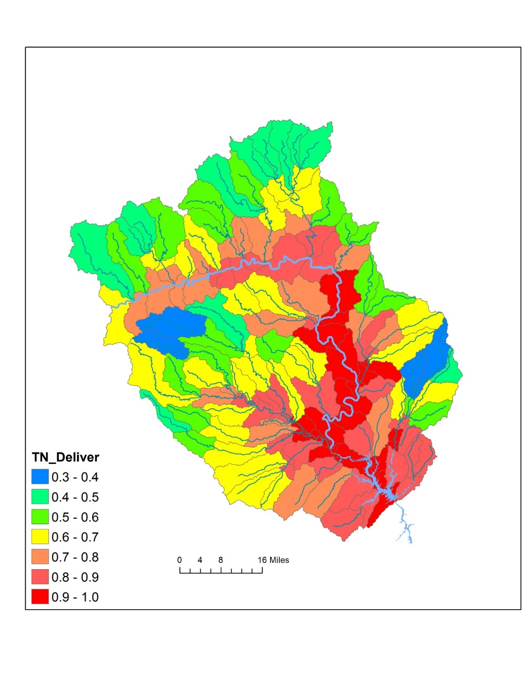
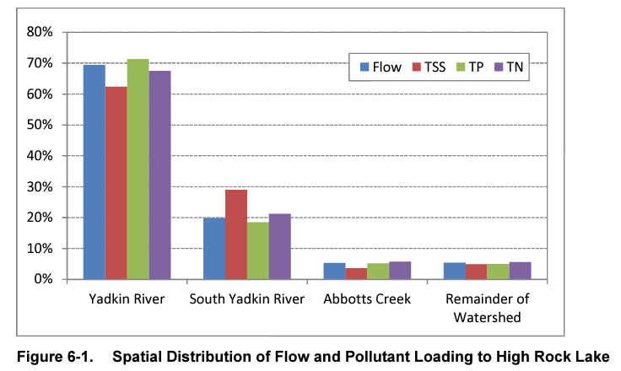
Spatial Dynamics in Nutrient Loading

Slide 14
TAG Charge
What specific management improvements has your sector already implemented for nutrient control since 2006?
What further nutrient reduction management steps can you take that would make sense? Consider both examples of more easily attainable and effective opportunities, as well as more long-term or challenging opportunities for your sector.
What initiation and full implementation timeframes would be needed for each type of management step, roughly speaking?
Are there trends or changes on the horizon in your sector that could affect these timeframes?
Barriers/challenges and possible responses:
What are barriers or challenges to these steps? Consider legal barriers, financial barriers, social barriers, equity barriers.
What could be done to address these challenges and increase buy-in and support for these steps?
Do you think forming partnerships with other groups/sectors could lead to implementation opportunities and positive changes? If so, what opportunities can you envision?
Would nitrogen and/or phosphorus be most cost-effective for your sector to manage, reduce, monitor, and report? Why, and what are the limitations of each? Can you give rough proportions and scales for the kinds of reductions you think could be achieved?

Slide 15
TAG Charge
Feb 15th Deadline
What specific management improvements has your sector already implemented for nutrient control since 2006?
What further nutrient reduction management steps can you take that would make sense? Consider both examples of more easily attainable and effective opportunities, as well as more long-term or challenging opportunities for your sector.
What initiation and full implementation timeframes would be needed for each type of management step, roughly speaking?
Are there trends or changes on the horizon in your sector that could affect these timeframes?
Barriers/challenges and possible responses:
What are barriers or challenges to these steps? Consider legal barriers, financial barriers, social barriers, equity barriers.
What could be done to address these challenges and increase buy-in and support for these steps?
Do you think forming partnerships with other groups/sectors could lead to implementation opportunities and positive changes? If so, what opportunities can you envision?
Would nitrogen and/or phosphorus be most cost-effective for your sector to manage, reduce, monitor, and report? Why, and what are the limitations of each? Can you give rough proportions and scales for the kinds of reductions you think could be achieved?

Slide 16
TAG Charge
What specific management improvements has your sector already implemented for nutrient control since 2006?
What further nutrient reduction management steps can you take that would make sense? Consider both examples of more easily attainable and effective opportunities, as well as more long-term or challenging opportunities for your sector.
What initiation and full implementation timeframes would be needed for each type of management step, roughly speaking?
Are there trends or changes on the horizon in your sector that could affect these timeframes?
Barriers/challenges and possible responses:
What are barriers or challenges to these steps? Consider legal barriers, financial barriers, social barriers, equity barriers.
What could be done to address these challenges and increase buy-in and support for these steps?
Do you think forming partnerships with other groups/sectors could lead to implementation opportunities and positive changes? If so, what opportunities can you envision?
Would nitrogen and/or phosphorus be most cost-effective for your sector to manage, reduce, monitor, and report? Why, and what are the limitations of each? Can you give rough proportions and scales for the kinds of reductions you think could be achieved?
April 15th Deadline

Slide 17
TAG Charge
What specific management improvements has your sector already implemented for nutrient control since 2006?
What further nutrient reduction management steps can you take that would make sense? Consider both examples of more easily attainable and effective opportunities, as well as more long-term or challenging opportunities for your sector.
What initiation and full implementation timeframes would be needed for each type of management step, roughly speaking?
Are there trends or changes on the horizon in your sector that could affect these timeframes?
Barriers/challenges and possible responses:
What are barriers or challenges to these steps? Consider legal barriers, financial barriers, social barriers, equity barriers.
What could be done to address these challenges and increase buy-in and support for these steps?
Do you think forming partnerships with other groups/sectors could lead to implementation opportunities and positive changes? If so, what opportunities can you envision?
Would nitrogen and/or phosphorus be most cost-effective for your sector to manage, reduce, monitor, and report? Why, and what are the limitations of each? Can you give rough proportions and scales for the kinds of reductions you think could be achieved?
May 15th Deadline

Slide 18
TAG Charge
Today’s Discussion
What specific management improvements has your sector already implemented for nutrient control since 2006?
What further nutrient reduction management steps can you take that would make sense? Consider both examples of more easily attainable and effective opportunities, as well as more long-term or challenging opportunities for your sector.
[If possible] What initiation and full implementation timeframes would be needed for each type of management step, roughly speaking?
Are there trends or changes on the horizon in your sector that could affect these timeframes?

Slide 19
Discussion
Joey Hester
Joey.hester@ncdenr.gov
O: 919-707-3675
C: 919-418-5712
Department of Environmental Quality

